Slide 1
Machine Learning Approaches in Programming Language Type Inference
Presentation: Jiancheng Qian

Slide 2
Overview
Code Naturalness and Type Inference
Related Work
Deep Learning Type Inference (Hellendorn, FSE 2018)
Typilus: Neural Type Hints (Allamanis, PLDI 2020)
LambdaNet: probabilistic type inference using graph neural networks (Jiayi Wei, ICLR 2020)
Limitation, Challenges and My Own Opinions

Slide 3
Code Naturalness and Type Inference
Code Naturalness:
The naturalness hypothesis: Programming languages, in theory, are complex, flexible and powerful, but, “natural” programs, the ones that real people actually write, are mostly simple and rather repetitive; thus they have usefully predictable statistical properties that can be captured in statistical language models and leveraged for software engineering tasks.
– A. Hindle, On the Naturalness of Software, 2018
Machine learning ‘Language’ models:
Code generating models
Representational models
Pattern mining models

Slide 4
Code Naturalness and Type Inference
Applications of code naturalness:
Recommender systems
Code completion
Finding defects
Code to natural language/natural language to code
Pattern mining
Code translation
Name/type inference
Traceability
…

Slide 5
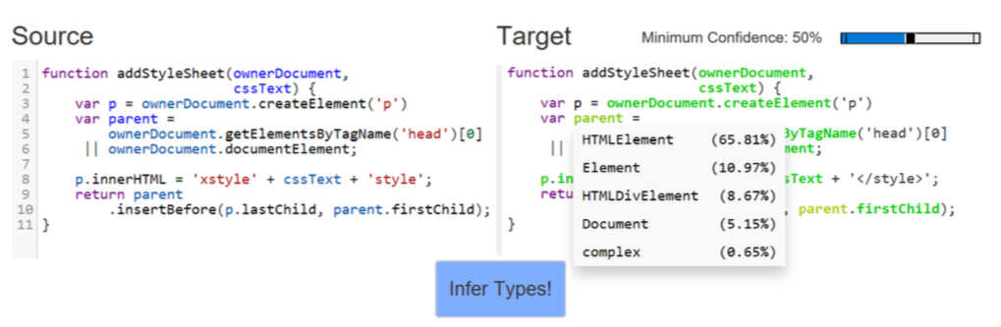
Code Naturalness and Type Inference
Type Inference
Figure: Deep Learning Type Inference (Hellendorn, FSE 2018)

Slide 6
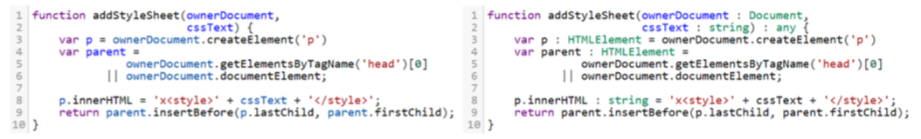
Code Naturalness and Type Inference
Why we need type inference:
Dynamic languages like Python/JavaScript
Enhance maintainability and readability
Avoid 15% of the bugs, lower fault occurrence
Automation in code maintenance and testing
Traditional methods:
Type annotation (e.g. mypy and pytype, TypeScript)
Figure: Deep Learning Type Inference (Hellendorn, FSE 2018)

Slide 7
Related Work
Similar to NLP
Type inference neural models:
1) Preprocessing: Embed the code/functions into tokens/graph
Word2vec
AST
Type Dependency Graph
2) Train the neural model, obtain the vector representation of identifiers/nodes
RNN
GNN
3) Prediction
Calculate the probability distribution of type for input tokens/nodes

Slide 8
Related Work
Machine learning models:
Title | Input | Machine Learning Model | Prediction
DeepTyper(2018) | Sequential tokens | 2 Bi-RNN
NL2Type(2019) | Vector representation of function | Bi-LSTM
DTLPy(2019) | Vector representation of function | 2 LSTM/GRU
Typilus(2020) | AST | GNN | KNN
Type4Py(2020) | AST + Sequential tokens | RNN | KNN
LambdaNet(2020) | Type Dependency Graph | GNN | MLP
TypeWriter(2020) | AST based extraction of code + comments | RNN | Feedback directed search
Notes:
AST-去冗余化

Slide 9
Deep Learning Type Inference (Hellendorn, FSE 2018)
DeepTyper
First work to implement neural network in type inference
Training using aligned corpus (TypeScript) and prediction on JS code
Explore the probability for open-world type suggestion tasks

Slide 10
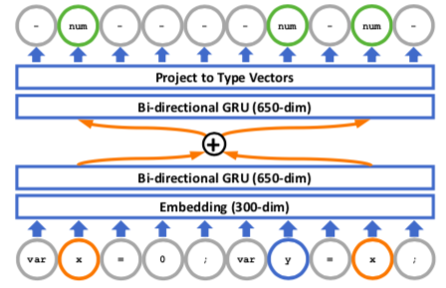


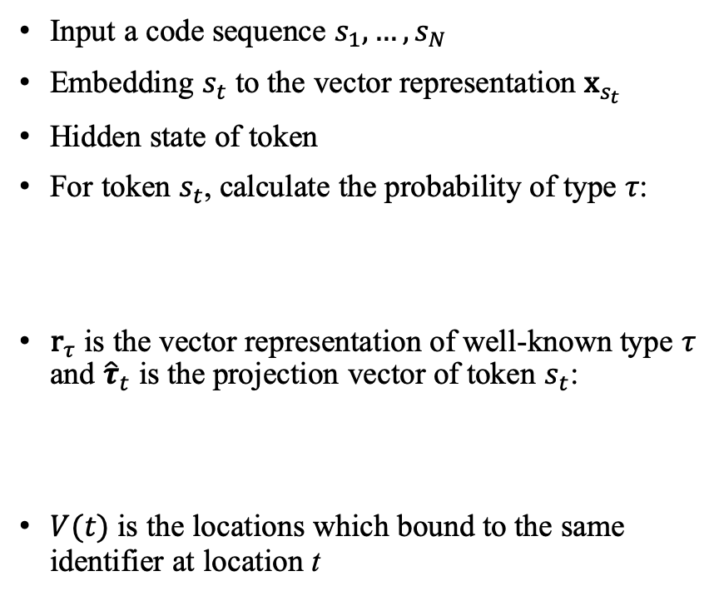
Deep Learning Type Inference (Hellendorn, FSE 2018)
Input a code sequence $s_{1},…,s_{N}$
Embedding $s_{t}$ to the vector representation ${\text{x}}_{s_{t}}$
Hidden state of token
For token $s_{t}$, calculate the probability of type $τ$:
${\text{r}}_{τ}$ is the vector representation of well-known type $τ$ and ${\hat{τ}}_{t}$ is the projection vector of token $s_{t}$:
$V(t)$ is the locations which bound to the same identifier at location t

Slide 11
Typilus: Neural Type Hints (Allamanis, PLDI 2020)
Typilus:
A graph-based deep neural network to the type prediction problem by considering source code syntax and semantics
Using GNN to catch the relations between distant identifiers
A novel training loss to evaluate the learned type features in the type space, can accurately predict types that were rare, or even unseen
Trained on Python codes with mypy/pytype corpus

Slide 12
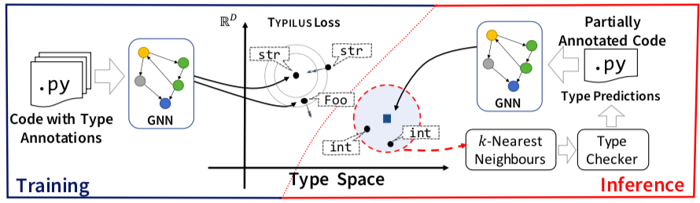
Typilus: Neural Type Hints (Allamanis, PLDI 2020)
Overview of Typilus
Figure: Allamanis, 2020

Slide 13
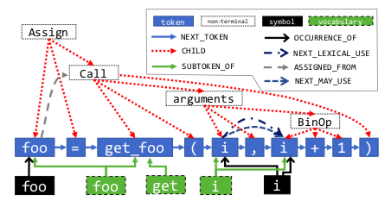
Typilus: Neural Type Hints (Allamanis, PLDI 2020)
AST(abstract syntax tree) embedding for code
A sample of foo = get_foo(i, i+1)
Figure: Allamanis, 2020

Slide 14
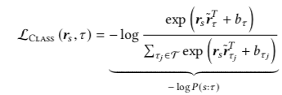


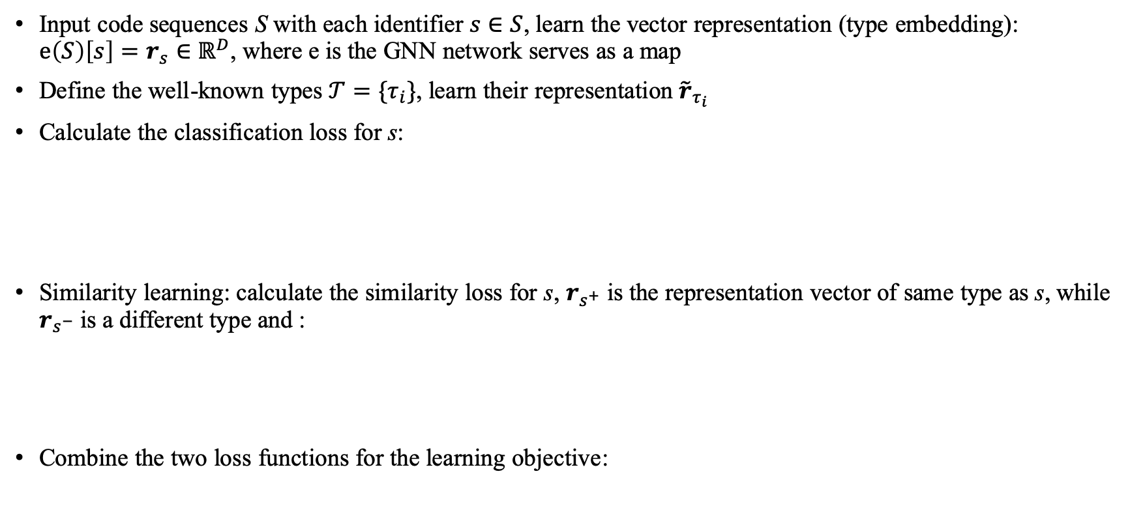
Typilus: Neural Type Hints (Allamanis, PLDI 2020)
Input code sequences S with each identifier $s∈S$, learn the vector representation (type embedding): $e\left(S\right)\left[s\right]=r_{s}∈ℝ^{D}$, where e is the GNN network serves as a map
Define the well-known types $𝒯=\{τ_{i}\}$, learn their representation ${\tilde{r}}_{τ_{i}}$
Calculate the classification loss for s:
Similarity learning: calculate the similarity loss for s, $r_{s^{+}}$ is the representation vector of same type as s, while $r_{s^{−}}$is a different type and :
Combine the two loss functions for the learning objective:

Slide 15
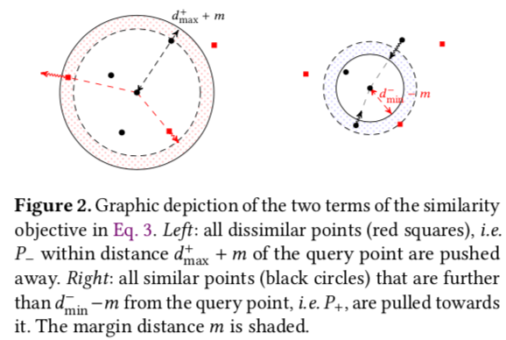
Typilus: Neural Type Hints (Allamanis, PLDI 2020)
The implementation of type space enables the model to predict unseen types without well-known annotation
Figure: Allamanis, 2020

Slide 16
LambdaNet: probabilistic type inference using graph neural networks (Jiayi Wei, ICLR 2020)
LambdaNet:
Using a novel graph representation – type dependency graph for the JavaScript code
Using GNN to learn the features of input nodes
An MLP prediction layer to compute a compatibility score with well-known types for each output vector

Slide 17
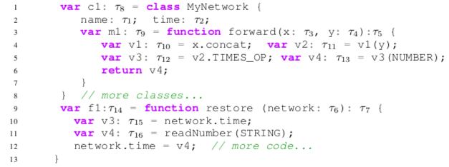
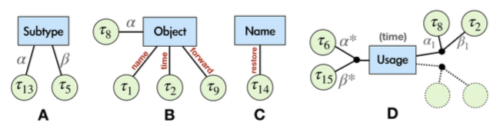
LambdaNet: probabilistic type inference using graph neural networks (Jiayi Wei, ICLR 2020)
Type dependency graph
Types of hyperedges: bool, subtype, function, call, object, name, usage,…
Figure: LambdaNet: probabilistic type inference using graph neural networks, Jiayi, 2020

Slide 18
Challenge in Type Inference
Depends on existing corpus (like mypy/pytype/TypeScript)
Predicting unknown/complicated types
Some types are user-defined and specialized in some projects
Need to know the stability among different projects/datasets
For some nested types like List[List[List[int]]], Optional[Map[str, int]] are hard to predict
Cross programming language use
E.g. Typilus performs bad on JS comparing to Python code
Need to find more universal methods since PL is developing fast
Focus on the dynamic type features for different language and build dependency graphs
The impact of network structure is still unknown

Slide 19
My Own Opinions
Recent work (since 2020) are focusing on the graph representation, while not enough research on the network structure (most are using RNN/single layer GNN)
Working on a NAS(Neural architecture search) attempting to find the network structures implications
We can using a unsupervised or self-supervised learning method to enhance the ability for training without an existing type annotation corpus

