Slide 1

GitHub

Slide 2

Version Control and Git
Version Control
Category of software tools that help a software team manage changes to source code over time
Git
Git is a version-control system for tracking changes in source code during software development

Slide 3
What is GitHub ?
GitHub is a code hosting platform for version control and collaboration
Form of Git but, it's web based graphic interface
cloud-based Git repository hosting service

Slide 4
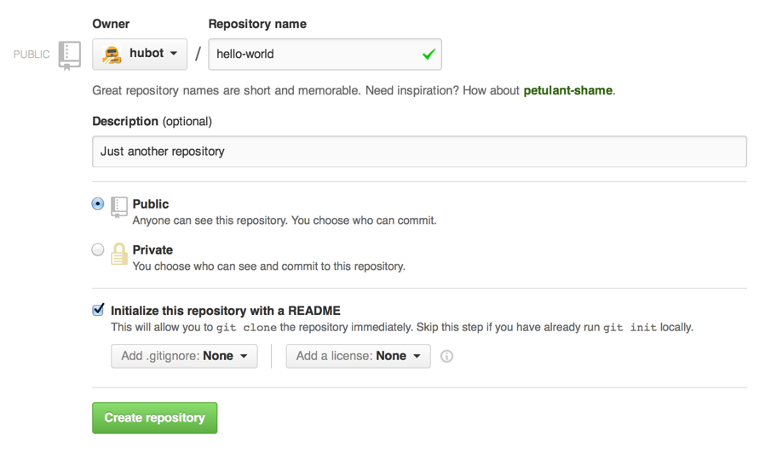
How to get working on GitHub ?
Firstly you have to create a repository for your project/program
Give your repository a name, add description along with other details
Click on create

Slide 5
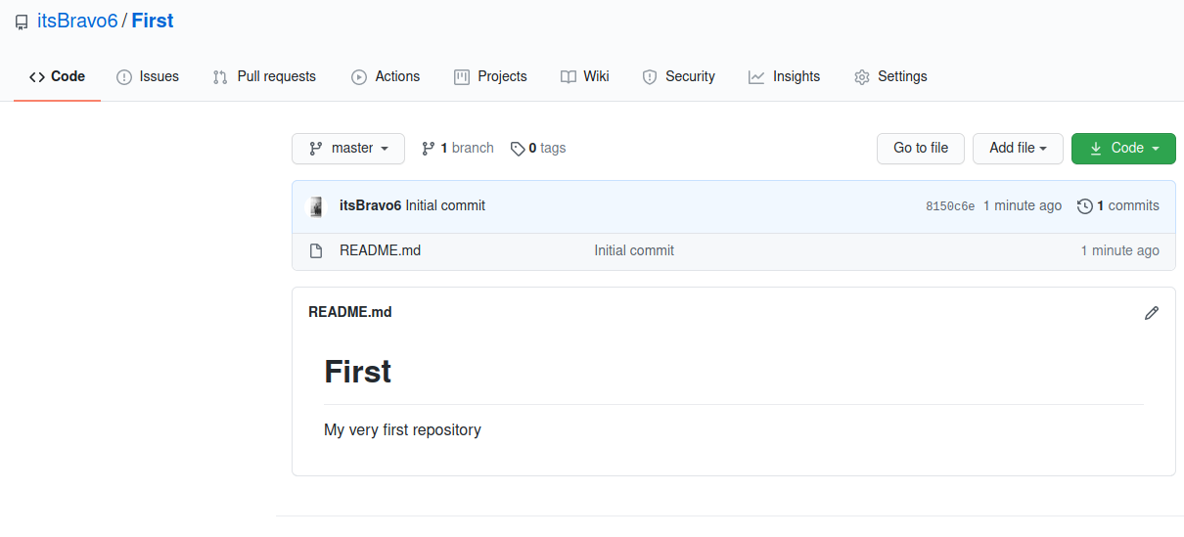
Your Repository looks something like this

Slide 6
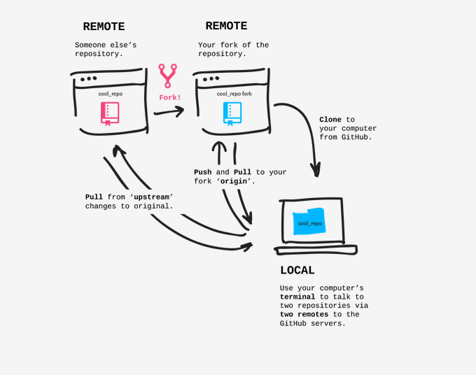
Some Terms to Remember
Fork
Clone
Push
Pull
Pull Request
Branching

Slide 7
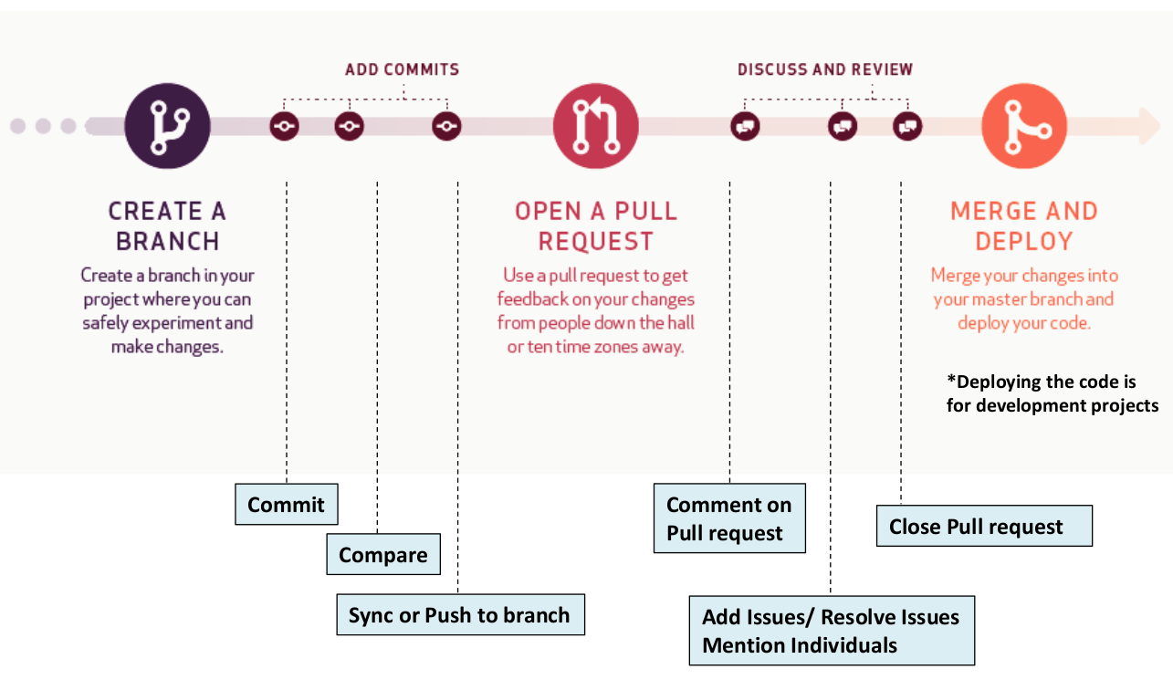
Understanding GitHub Workflow

Slide 8
Benefits of GitHub
Projects are saved with record in track
Collaboration with people all around the world
Attainment of good opportunities for being hired by someone or some company
Showcasing your work to help other people in their work

Slide 9
Any Questions ?

