Slide 1

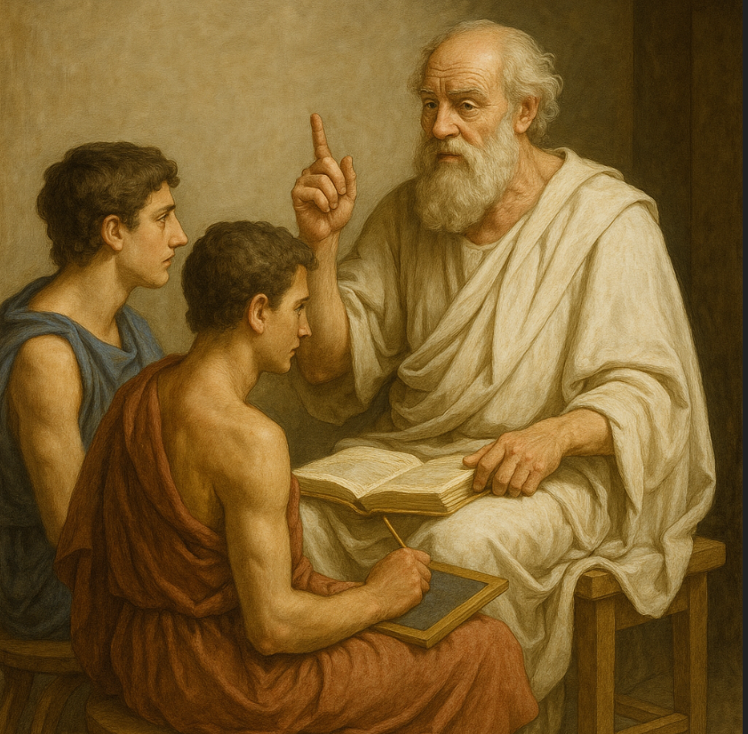
Domain Knowledge
Greece
Greek Tutor

Slide 2
Question 1: What is the Capital of Greece
- Question Type: Single Choice
- Related Skills: Geographical Knowledge
- Hint: Synonymously used as a name
- Hint: It's known as the birthplace of democracy.
- Hint: The Capital of Greece starts with „A“
- Solution: „Athen“
Answers:
1: Athens, 2: Thessaloniki, 3: Arta, 4: Patras
Solution: Athens

Slide 3
Question 2: What is the biggest island in Greece
- Question Type: Single Choice
- Related Skills: Geographical Knowledge
- Hint: The island is known for it´s olive oil
- Hint: The Capital of this islands is „Heraklion“
- Hint: The island is known for it´s mobs
- Hint: Starts with a „C“
Answers: 1: Rhodes 2: Zante 3: Corfu 4: Crete
Solution:
Crete

Slide 4
Question 3: Name as many popular traditional Greek foods as you can
- Question Type: Text Box
- Related Skills – Cultural Knowledge
Solutions: Gyros, Pitas, Olives, Tzatziki, Souvlaki, Gigantes, Taramas, Kolokithokeftedes
Hint: Pictures
Hint: Think appetizers
Hint: Think mains

Slide 5
Question 4: Name as many Greek Gods as you can
- Question Type- Multiple Choice
- Related Skills – Mythological Knowledge
- Anwers: (4 Answers are correct)
- 1: Hercules, 2: Zeus, 3: Ares, 4: Aphrodite, 5: Hades 6: Perseus, 7: Achilles, 8: Percy Jackson
- Hint: (4 Answers are correct)
- Hint: Dont confuse half gods with gods
Solutions:
2: Zeus, 3: Ares, 4: Aphrodite, 5: Hades

Slide 6
Question 5: What means „hello“ in greek
- Question Type: Single Choice
- Related Skills: Language Skills
- Anwers: 1: Bon jour 2: Geia sou 3: Malaka, 4: Salve
- Hint: Only two options are greek
- Hint: Consists of two words
Solution:
Geia sou

