Slide 1
Team Supreme
Pagliai’s Inventory Tracking Systems (P.I.T.S)

Slide 2
Presentation Overview
Introduction about the group and the project
Explain requirements and mockup clearly
Clearly explain the design
A list of concrete tasks to carry out the project
Initial schedule estimate table with actual task assignment
Current status (include code snippet or screen shot, any real GUI, any demo if available)

Slide 3
Introduction
Group Members
Our Client Pagliai’s
Why our client needs a inventory tracking system

Slide 4
Project Requirements
What the Client wants
Count her inventory faster
Allow updating prices of products fast and easily.
Find total cost of all products on hand and get figure for accountant
What we suggested
Linked scan gun to mobile application
Desktop Application
Finalize report button for final calculation
Monthly report feature

Slide 5
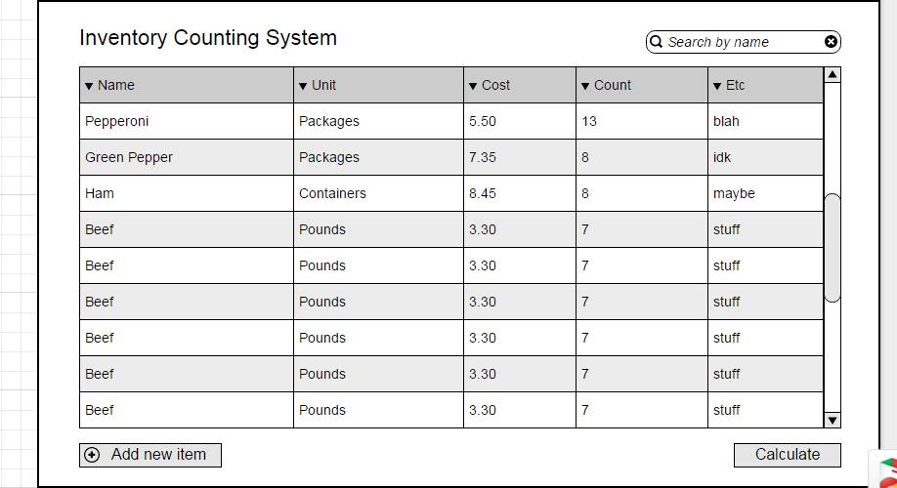
Mockups

Slide 6
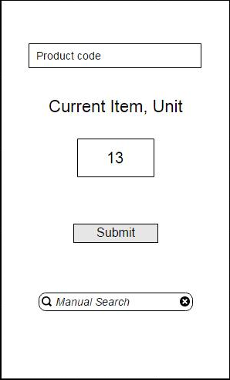
Mockups

Slide 7
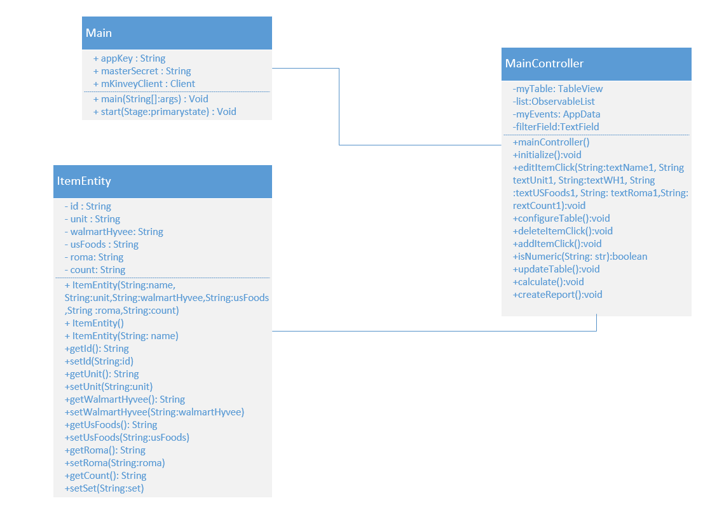
Design

Slide 8
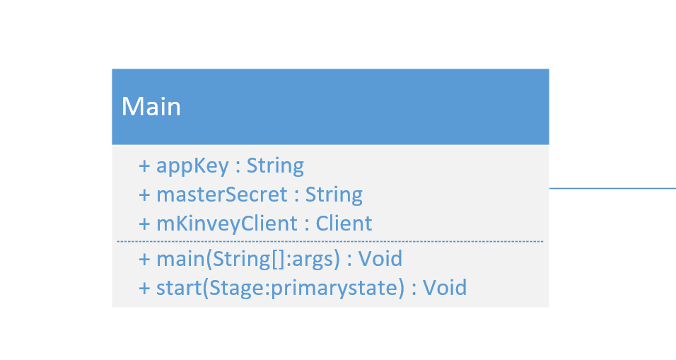
Main

Slide 9
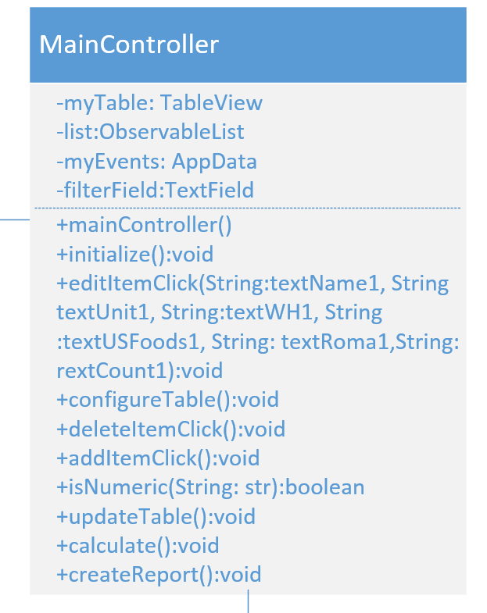
Main Controller

Slide 10
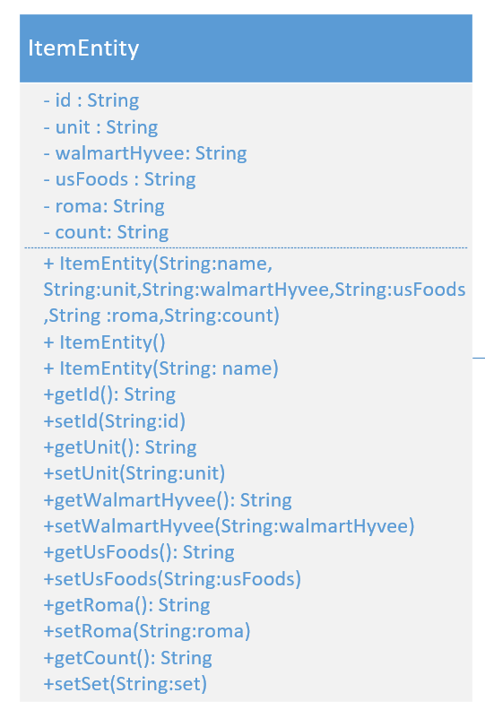
ItemEntity

Slide 11
Design

Slide 12
List of tasks
Completed
Incomplete
1. Gather Requirements (1)
2. Record Requirements (Requirement Specification Sheet (2)
3. Create Moqups for User Interfaces (3a)
4. Set up repository (3b)
5. Research Databases that can connect with iOS and desktop applications (3c)
6.Create a design for the system. (4)
7. Set up desktop application (5a)
8. Set up iOS application (5b)
9. Connect desktop application to Kinvey Database (6a)
10. Connect iOS application to Kinvey Database (6b)
11. Enter current data into database. (6c)
12. Create test cases for our requirements. (7)
13. Implement the requirements for the desktop application (8a)
14. Implement the requirements for the iOS application (8b)
15. Test our implementation (9a)
16. Create Labels for the items at Pagliai's (9b)
17. Propose working copy of system to client (10)
18. Adjust system if needed (11a)
19. Add additional features if time allows (11b)
20. Install the system on site (12)

Slide 13
Task Network
Task3a
Task6a
Task5a
Task8a
Task9a
Task11a
Task1
Task2
Task3b
Task4
Task6b
Task7
Task10
Task12
Task5b
Task8b
Task9b
Task11b
Task3c
Task6c

