Slide 1


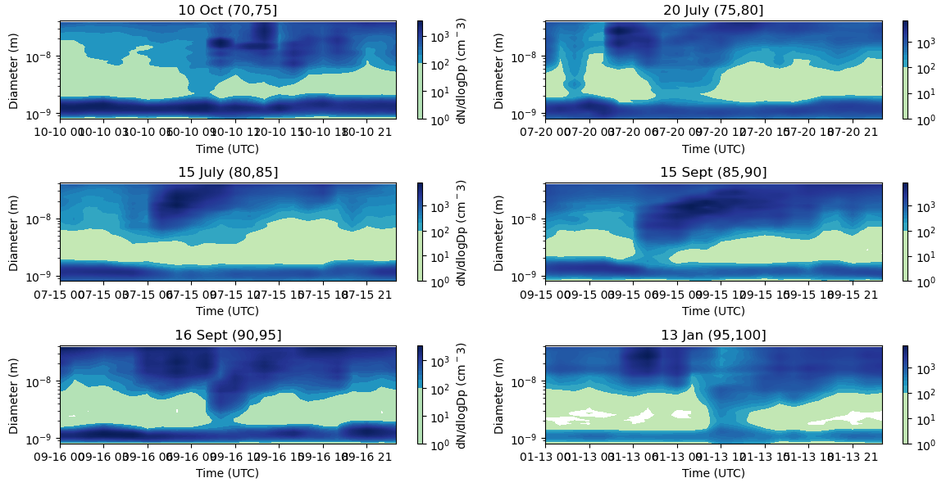
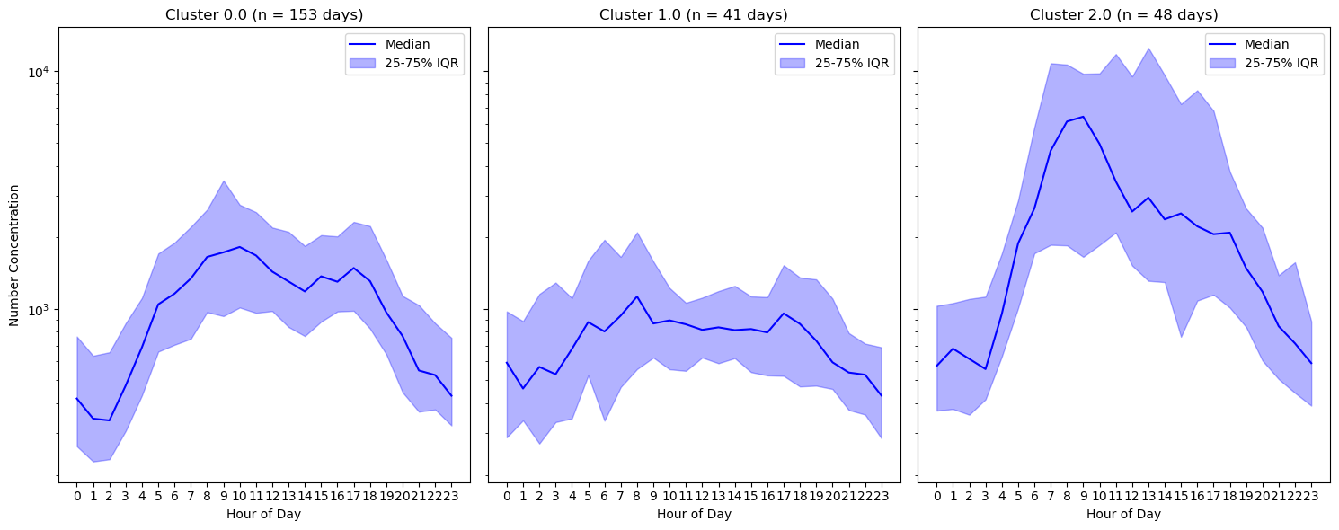
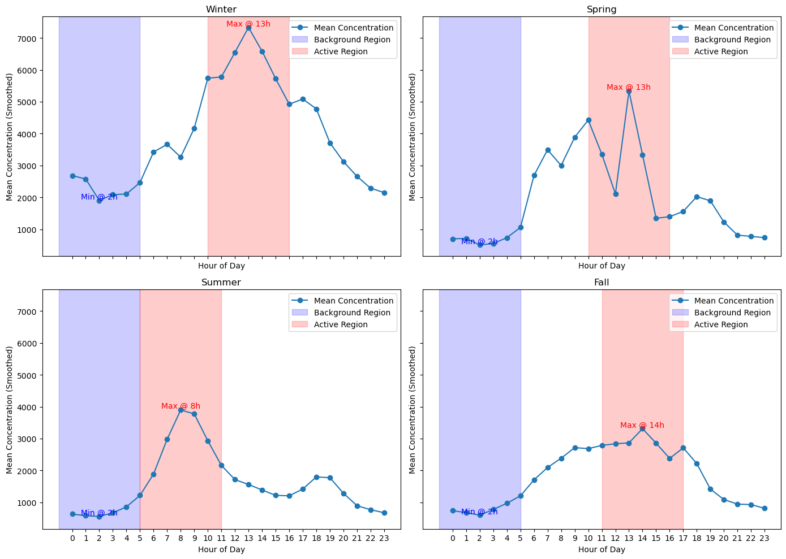
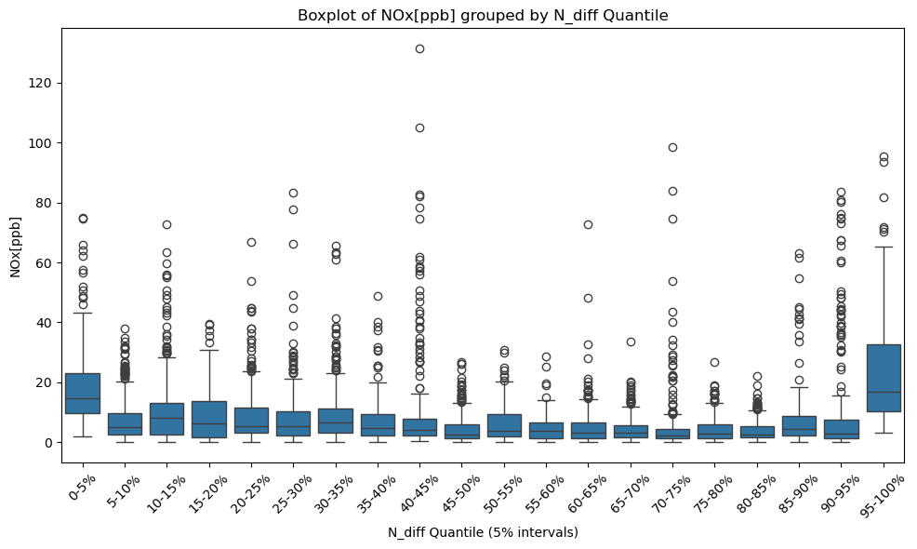
PhD SDC School
Sustainable Development and Climate Change
PhD-Day 2025
Investigating New Particle Formation Dynamics in the Urban Po Valley
Celestine Atieno OLIEWO
PhD SDC Cycle 39 – Curriculum 1
Tutor: Prof. Alessandro Bigi
INTRODUCTION
Ultrafine particles (1-100 nm diameter) have adverse heath impact as they travel far in the respiratory track, they also affect visibility and air quality, and also affect the earth’s radiative balance by absorbing and scattering light, and indirectly when they grow and act as cloud condensation nuclei.
These particles can be directly emitted into the atmosphere or by new particle formation (NPF) processes. Research has shown that NPF is a major contributor to levels of ultrafine particles.
To investigate this phenomenon, we set up the Neutral cluster and air ion spectrometer (NAIS) at CNR Bologna, an urban background environment.
METHODOLOGY
We apply the nanoparticle ranking analysis to identify the occurrence and intensity of NPF events as described by Diego Aliaga et al. (2023).
The NAIS data used for this analysis runs from May 16th 20224 to 31st January 2025 at hourly resolution.
Using the log of the number concentration difference for each day, the mode fitting of 3 Gaussian curves shows that the 48 days in cluster 2 exhibit stronger NPF event occurrence.
The ranking based on the difference in the number concentration in the background and active regions for each day, shows the probability of NPF events being recorded.
The excerpt shows the particle number size distribution as measured by the NAIS, for the higher percentiles that exhibit stronger NPF events.
CONCLUSION AND FUTURE WORK
The nanoparticle ranking method provides a good alternative to the more time consuming and rather subjective method described by Dal Maso et al for classifying NPF events.
It is however worth noting that the higher ranks might be days of higher pollution events disguised as NPF events.
The next step is to calculate the growth and formation rates and how they vary with the ranks.
We will also explore the behavior of naturally charged particles during NPF events since this is also measured by the NAIS.
Since the NAIS is known to overestimate the concentrations, we will explore ways to correct this with reference to the more accurate Scanning Mobility Particle Sizer (SMPS)
Reference
Aliaga, D. et al. Aerosol Res. (2023) doi:10.5194/ar-1-81-2023
Dal Maso, M. et al. Boreal Environ. Res. 10, 323–336 (2005)
The winter season records the highest values of number distribution in the range 2.5-5 nm. In the summer, the active region is recorded earlier in the day compared to the other seasons.
The boxplots variation suggest that stronger NPF events occur when there are less pollutants, but it is also important to note that the highest rank also records the highest median value and spread of Nox.
Author: Celestine Oliewo is with Department Enzo Ferrari: University of Modena and Reggio Emilia, Italy. Email: celestine.oliewo@iusspavia.it

