Slide 1
Economic scenarios for transformative AI
Andrea Blasco, DG JRC
Thimo De Schouwer, DG EMPL

Slide 2
Introduction
Wide ranging views on how AI will impact the labor market
  from limited effects on wages, productivity, and employment
  to a large-scale transformation
Antropic built a model that turns a few assumptions into measurable outcomes
  in particular: paths for GDP / wages / unemployment by 2030
We change their model in two ways:
  set the parameters to reflect our labor market
  adjust the assumptions on what AI can already and will be able to do
    disclaimer: scenarios to explore and not forecasts

Slide 3
Model

Slide 4
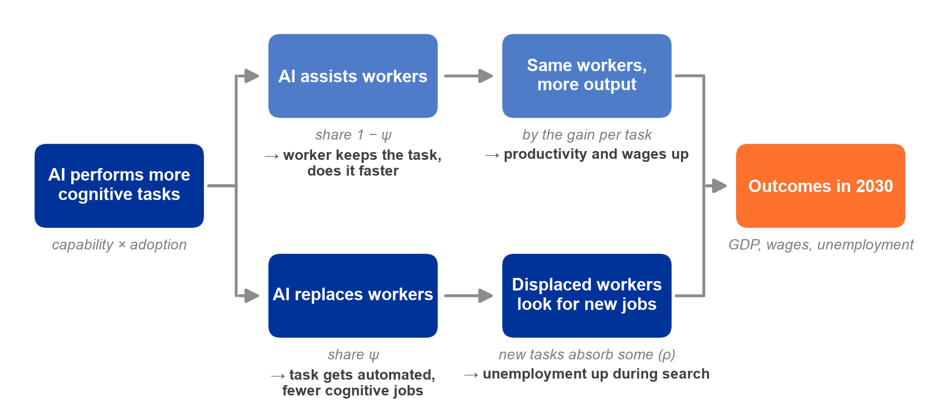
What the model does

Slide 5
Scenarios

Slide 6
What Scenarios Set for 2030
Use of AI
Capability | share of work AI can do (replacing or assisting)
Adoption | share of that actually done with AI
Effect on tasks
Automation | share where AI replaces workers
New tasks | share of displaced work returning as new tasks
Gain per task | how much faster AI does a task
Finding new jobs
Switching | how easily displaced workers get hired in other jobs
Hiring speed | how quickly firms post vacancies for the workers they want
Today | same in all scenarios
Capability | AI can do 14% of all work (EU: 12%)
Adoption | of that work, 10% is actually done with AI (EU: 6%)

Slide 7
Scenario Assumptions
 | US | EU | why
Use of AI
Capability | 20 / 30 / 50% | 18 / 28 / 48% | occupation mix
Adoption | 20 / 40 / 60% | 12 / 24 / 36% | lower start carried forward
Effect on tasks
Automation | 50 / 75 / 90% | 25 / 50 / 75% | data counts iterations as automation
New tasks | 50 / 25 / 0% | 75 / 50 / 25% | historically: more new tasks
Gain per task | 35 / 42 / 57% | same | property of the tool
Finding new jobs
Switching | 3 / 6 / 13 months | same | no differences in retraining time
Hiring speed | 7 / 2.5 / 1 months | same | no data to estimate

Slide 8
The European economy
 | US | EU
unemployment | 3.8% | 4.6%
monthly job-finding rate | 22% | 10%
annual quits | 11% | 6%
wage stickiness | 0.5 | 0.7

Slide 9
Results
Labour Market in 2030 (relative to no-AI)

Slide 10
Comparing Results
Three sets of results | Economy | Scenarios
US Economy | US | Korinek Paper
EU Economy w. US Scenarios | EU | Korinek Paper
EU Economy w. EMPL Scenarios | EU | EMPL
What if
EU Economy w. US Adoption | EU | EMPL but US adoption
Outcomes in 2030 (vs. no AI)
Overall | GDP, unemployment, labour share
Cognitive workers | wage, employment

Slide 11
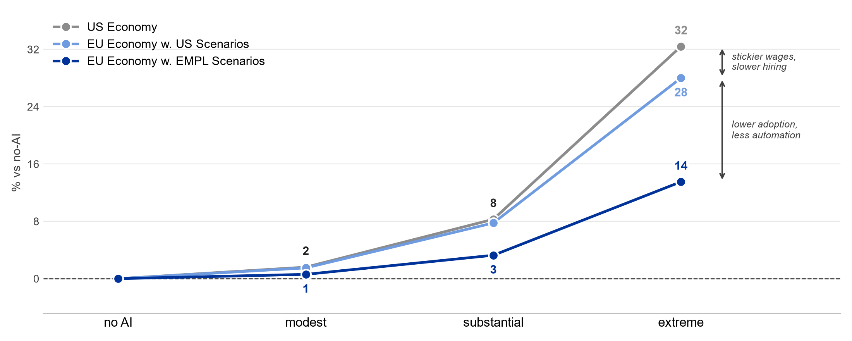
GDP

Slide 12
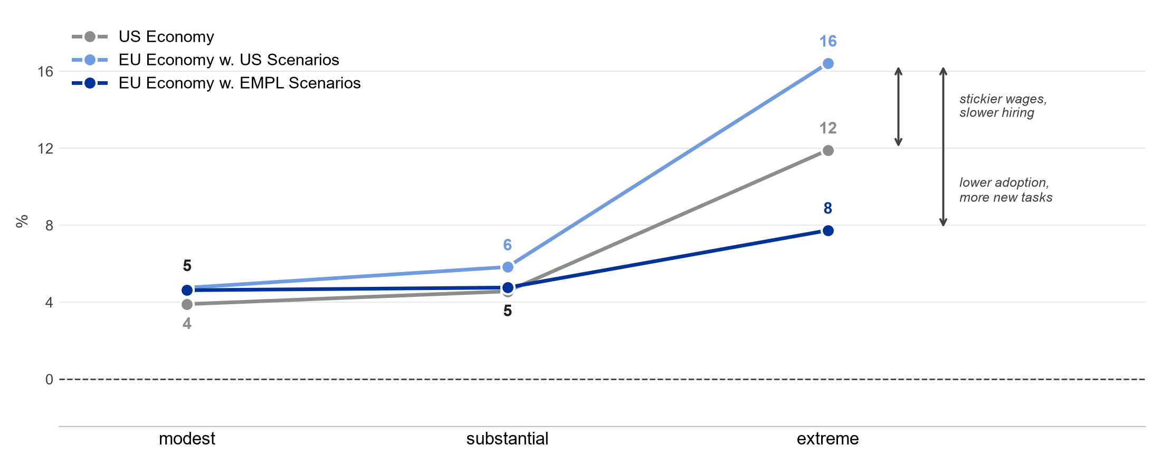
Unemployment

Slide 13
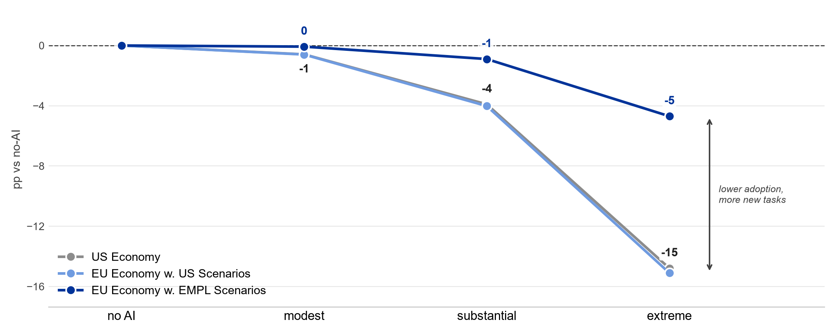
Labour share

Slide 14
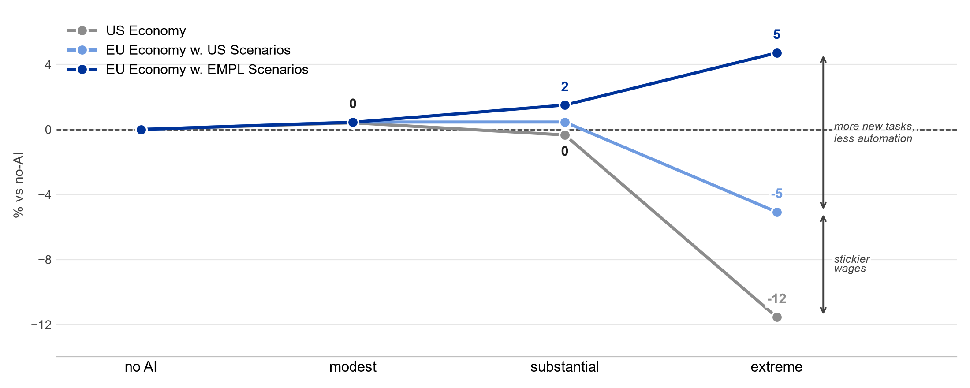
Cognitive wage

Slide 15
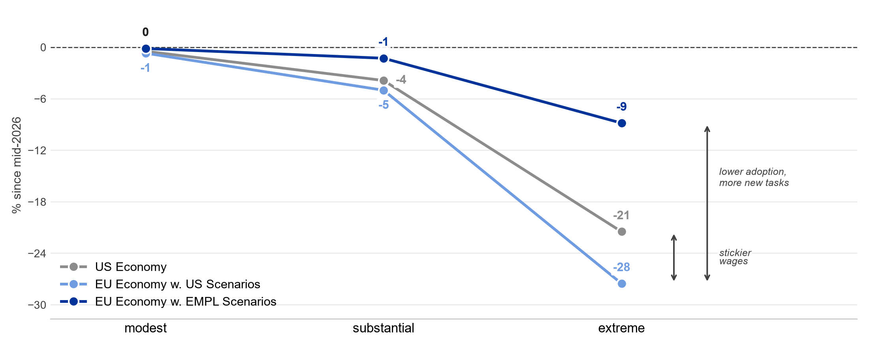
Cognitive employment

Slide 16
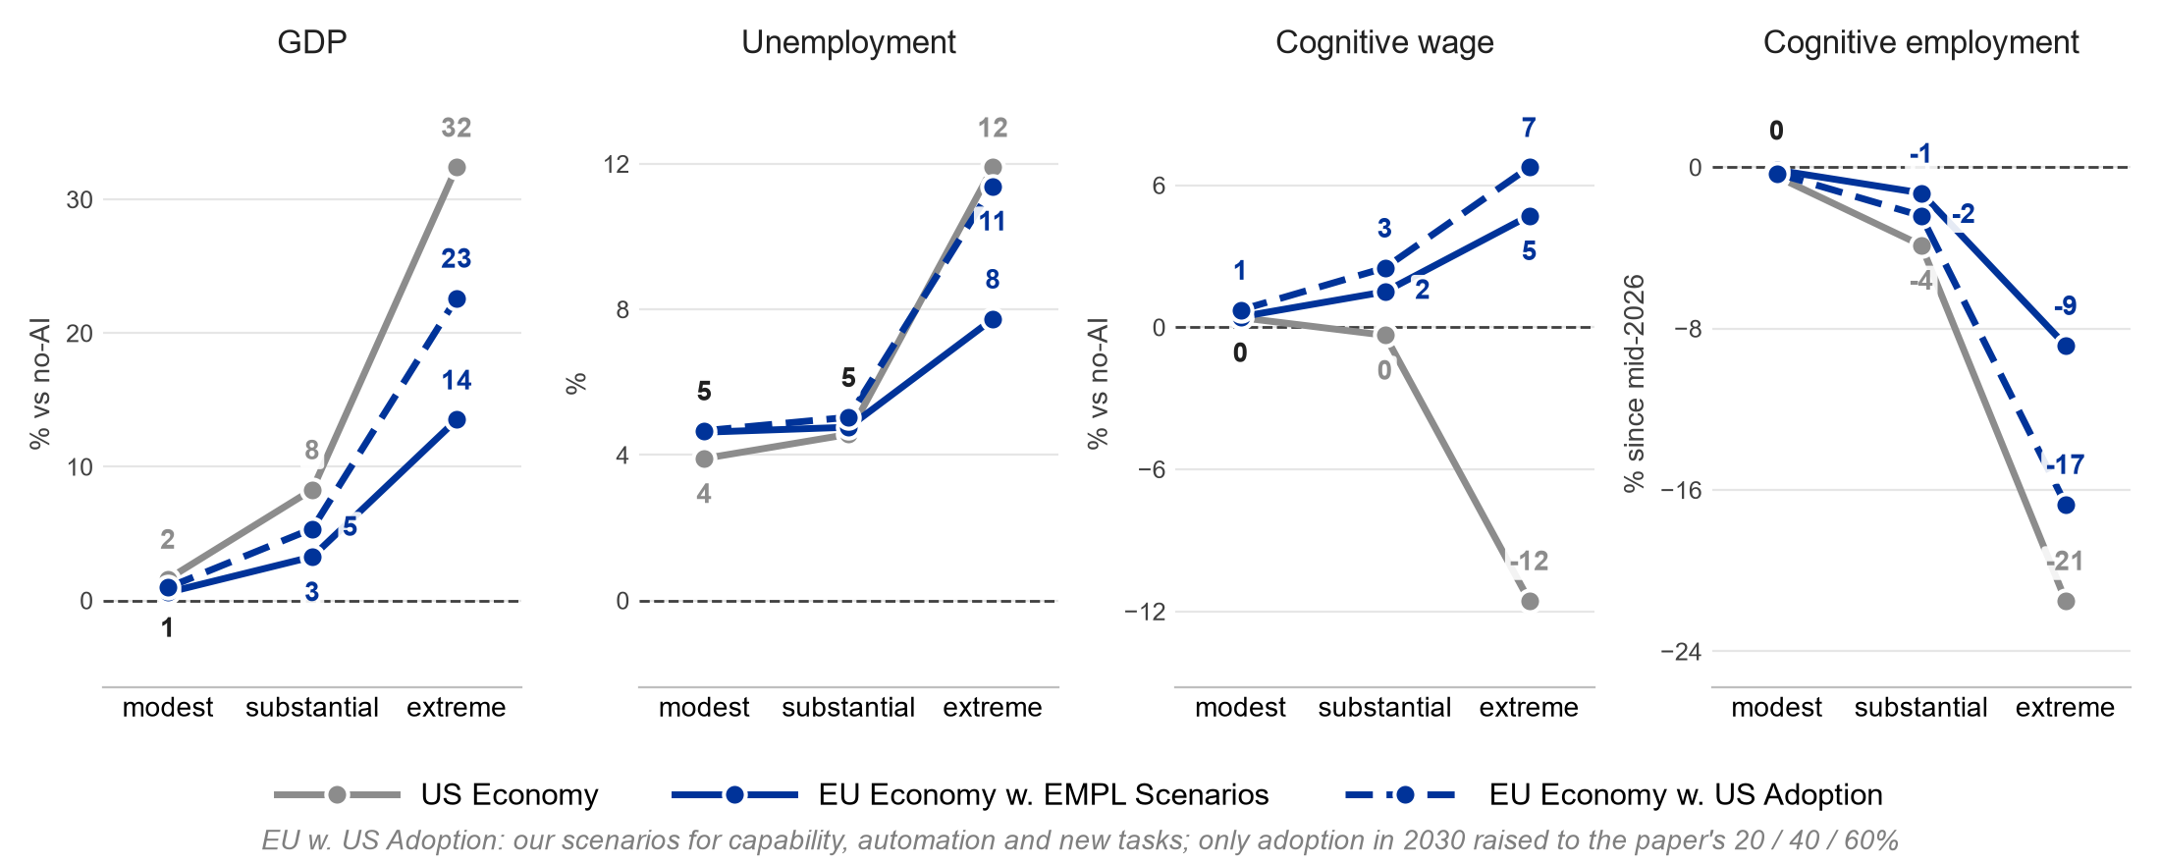
What if Europe caught up on adoption?

Slide 17
Takeaways
Each set vs the one above | GDP | Unemployment | Cognitive wages | Why
US Economy
EU Economy w. US Scenarios | similar | higher | fall less | stickier wages, slower hiring
EU Economy w. EMPL Scenarios | lower | lower | rise | lower adoption, less automation
EU Economy w. US Adoption | higher, < US | higher, ≈ US | rise more | faster adoption
ongoing work: why adoption differs

Slide 18
Comparison with the JRC’s EDGE simulation
 | Our scenarios | JRC EDGE-EUROMOD
Similar
Scenarios | modest / substantial / high impact by 2030 | low / medium / high impact by 2035
Different
Assumptions | what AI can do + how much it is used | outcomes like TFP, wages, unemployment
Results | GDP + labour market impact | distributional effects of given shock
Dynamics | better AI → more use → jobs adjust | same AI → 3.6×* use → 3.6× effects
Mechanisms | sticky wages, job search, switching / re-education | none: effects imposed, not explained
Coverage | EU aggregate, two occupation groups | DE, ES, PL, SE; age and gender
 |  | * growth to full AI use in most exposed jobs

Slide 19

Thank you
© European Union 2026
Unless otherwise noted the reuse of this presentation is authorised under the ​CC BY 4.0 license. For any use or reproduction of elements that are not owned by the EU, permission may need to be sought directly from the respective right holders.

Slide 20
Appendix

Slide 21
Why adoption starts lower in Europe
 | US | EU | EU / US
People, any purpose, 2025
monthly LLM users, millions, total (A) | 61 | 133 | 2.2
Workers, 2026
use genAI for work (B) | 43% | 30% | 0.69
share of work hours with genAI (B) | 5.2% | 1.7% | 0.33
Firms, 2025
use AI, any purpose (C) | 34% | 20% | 0.59
deploy genAI (D) | 36% | 37% | 1.03
of AI users: in more than two activities (D) | 81% | 55% | 0.68
Our model, today
share of AI-doable work done with AI (E) | 10% | 6% | 0.6
(A) Prosus/Dealroom, Europe (B) Bick et al. 2026, EU-5 (C) Eurostat; US Census (D) EIB survey (E) AIM-WORK; Korinek et al.

Slide 22
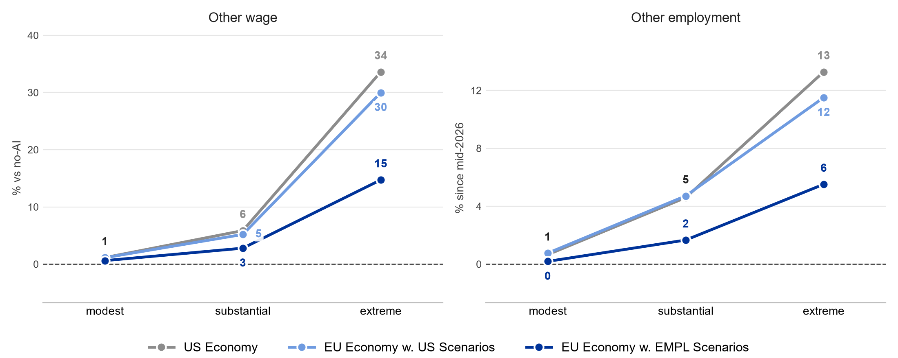
Other workers gain in every scenario

