Slide 1

Assignment 1 Specification
Fabian Sauter, Kilian Traub, Atakan Yenel
Group 5
Technische Universität München
Garching, 30.04.2018

Slide 2
Handshake
Client
Server

Slide 3
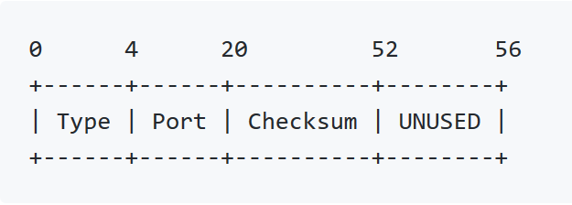
Handshake
Client
Server
[1] Client-Hello-Handshake:
[1]

Slide 4
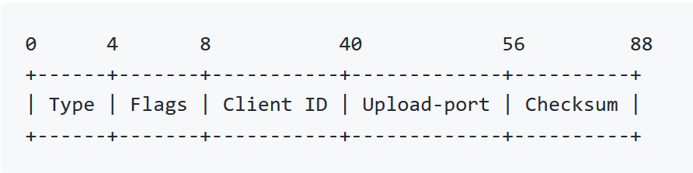
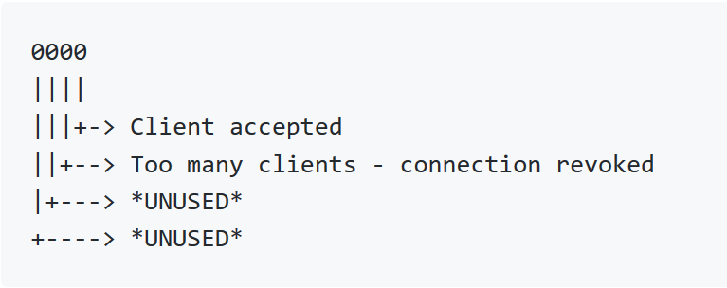
Handshake
Client
Server
[1] Client-Hello-Handshake:
[2] Server-Hello-Handshake:
[1]
[2]

Slide 5
Transfer
Client
Server
[1]
[2]

Slide 6
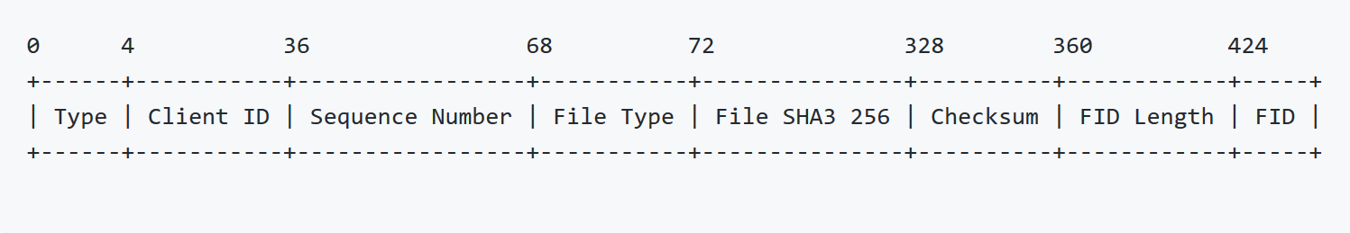
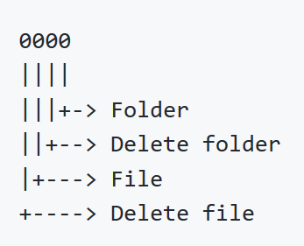
Transfer
Client
Server
[3] File-Creation:
[1]
[2]
[3]

Slide 7
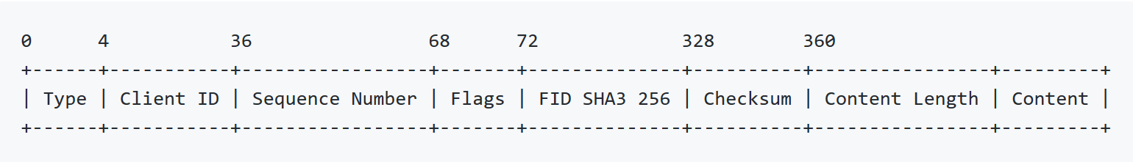
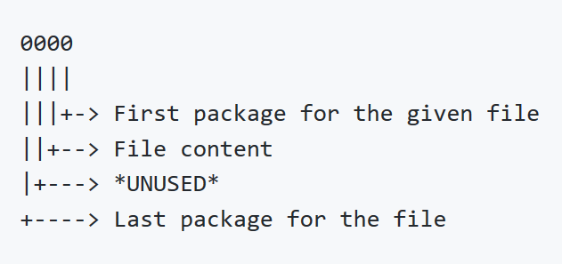
Transfer
Client
Server
[3] File-Creation:
[4] File-Transfer:
[1]
[2]
[3]
[4]

Slide 8
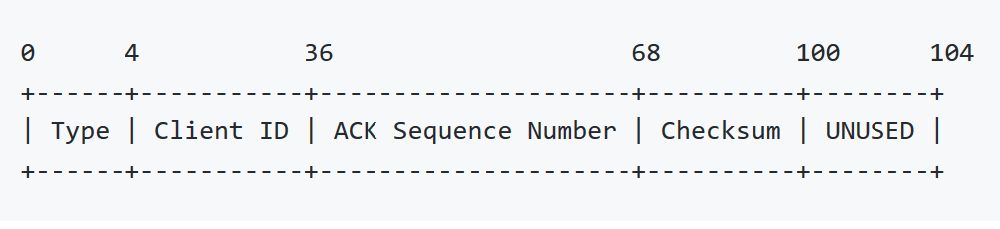
Transfer
Client
Server
[3] File-Creation:
[4] File-Transfer:
[5] ACK:
[1]
[2]
[3]
[5]
[4]
[5]

Slide 9
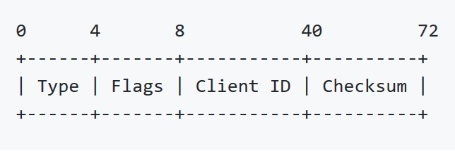
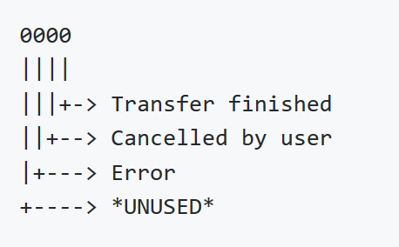
Utilities
Client
Server
[6] Transfer-Ended:
[1]
[2]
[3]
[5]
[4]
[5]
[6]

Slide 10
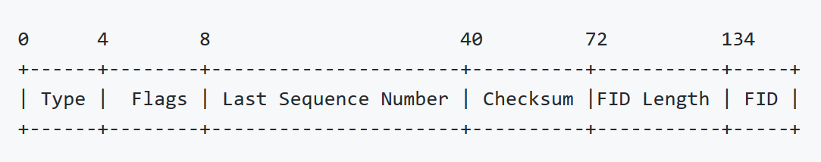
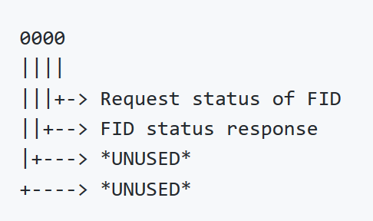
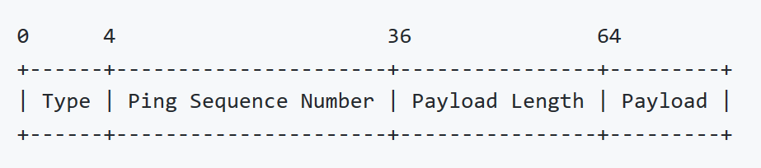
Utilities
Client
Server
[6] Transfer-Ended:
[7] File-Status:
[8] Ping:
[1]
[2]
[3]
[5]
[4]
[5]
[6]

Slide 11
Utilities
Client
Server
[6] Transfer-Ended:
[7] File-Status:
[8] Ping:
[…]
[4]
[5]

Slide 12
Utilities
Client
Server
[6] Transfer-Ended:
[7] File-Status:
[8] Ping:
[…]
[4]
[5]
[1]

Slide 13
Utilities
Client
Server
[6] Transfer-Ended:
[7] File-Status:
[8] Ping:
[…]
[4]
[5]
[1]
[2]

Slide 14
Utilities
Client
Server
[6] Transfer-Ended:
[7] File-Status:
[8] Ping:
[…]
[4]
[5]
[1]
[2]
[7]

Slide 15
Utilities
Client
Server
[6] Transfer-Ended:
[7] File-Status:
[8] Ping:
[…]
[4]
[5]
[1]
[2]
[7]
[7]
[…]

