Slide 1

Protocol Analysis
Fabian Sauter, Kilian Traub, Atakan Yenel
Group 5
Technische Universität München
Garching, 10.08.2018

Slide 2
General
C++17
Compiler: g++/clang
OS: Unix like, (Windows possible)

Slide 3
General

Slide 4
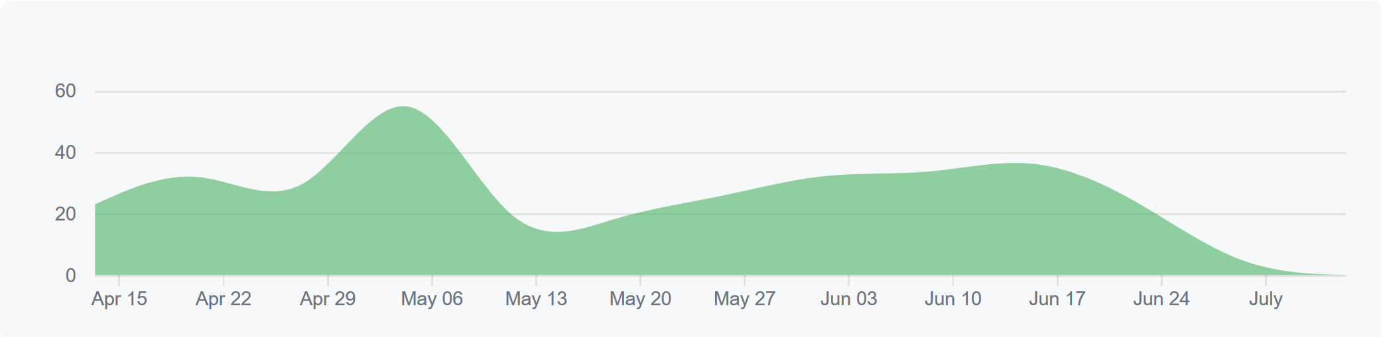
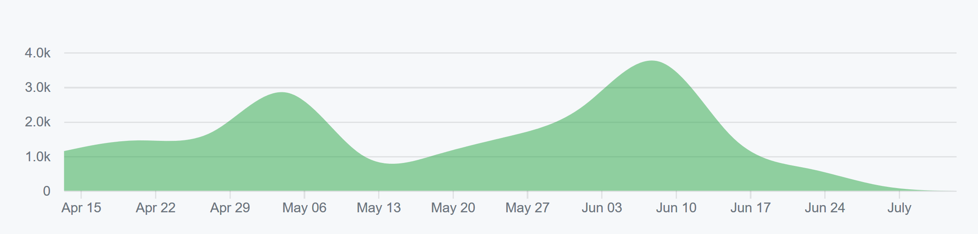
General
402 Commits
60 Files
6641 LOC

Slide 5
The process
17.04
Initial commit
20.04
Initial
protocol
26.04
First
prototype
13.05
Assignment 1
done

Slide 6
The process
29.05
Memory
management!
13.05
Assignment 1
done

Slide 7
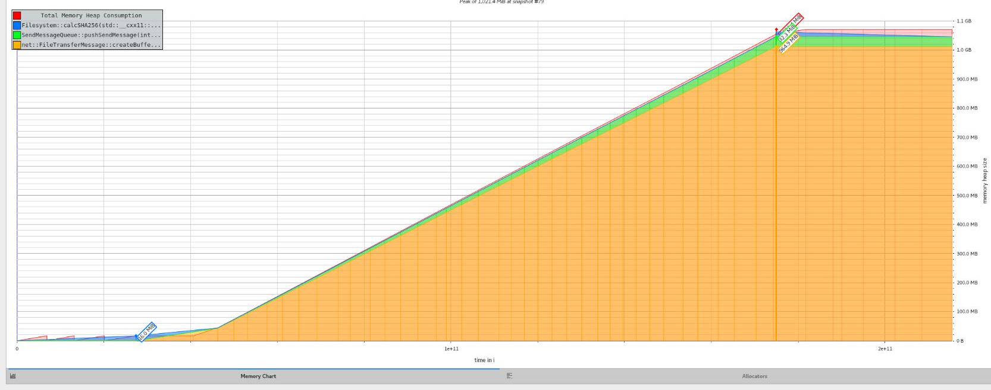
Memory management
Begin
file upload
Upload finished
~1GB RAM usage

Slide 8
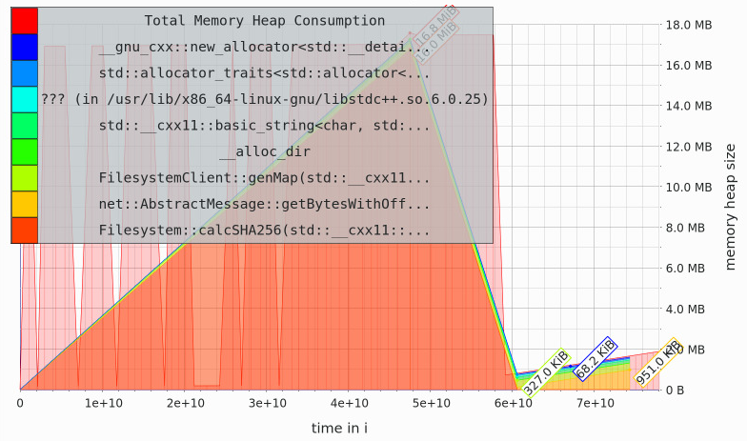
Memory management
Upload finished
~2MB RAM usage
Begin
file upload

Slide 9
The process
29.05
Memory
management!
05.06
Encryption
support
09.06
“Congestion
control”
13.05
Assignment 1
done

Slide 10
The process
29.06
Fixed typo
in README.md
02.07
Client auth
03.07
Began working on
Delta Sync
10.07
Own
timer
implementation

Slide 11
The process
15.07
More Delta less Sync
19.07
Less Delta
more Sync
20.07
DoS protection
24.07
Assignment 2
deadline

Slide 12
Performance
1Gb – 40s
→26.64MB/s

Slide 13


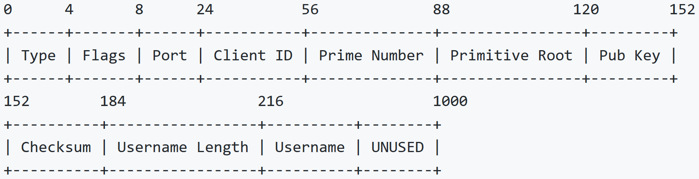


Security
User authentication
DoS protection
Multi-way handshake
Encryption
Multi-way handshake

Slide 14

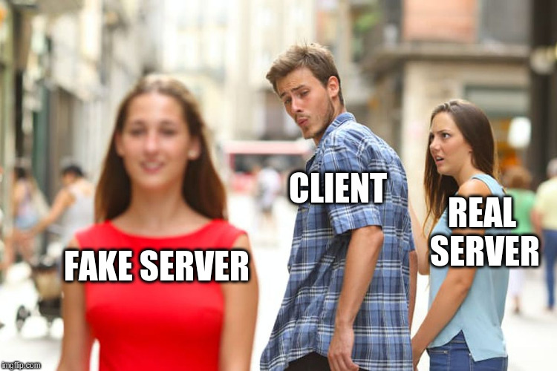
Security
Man-in-the-Middle attacks

Slide 15
What we learned
If you use new or malloc:
Use smart pointers
If not delete your shit
If it says „experimental“ it actually means experimental
Wait till C++20 for the filesystem module
Doing your own crypto suckz, use libraries
Certificate checks are no snake oil
C++ is awesome❤

