Slide 1
Acquiring and Transforming Data to Networks
Iiro Tiihonen

Slide 2
Goals of this lecture
This lecture will introduce you to practicalities of working with network data
By the end you should:
Know how nodes and edges can be represented as concrete data
Have basic knowledge about the network data sets that we are going to use during the course
In the process of creating your own Twitter data set.

Slide 3
Translating networks for computers
Humans can understand things like connections (edges) between nodes vaguely, computers can not
To represent a network so that a computer can understand it, it needs to be represented as data
The main things to turn to data are the entities to be connected (nodes) and the connections (edges)
Additionally, we might want to translate qualities of the nodes and strength of connections

Slide 4
Nodes as data, node list
In the simplest case, nodes can be represented as a list (N x 1 table) of ids, one node per row
If the analysis makes use of some properties of the nodes, then the list can have more columns (N x P table)
Example: a list of persons, one per row. At least an identifier, possibly other columns.

Slide 5
Node list example
id occupation 1 person_1 humanist 2 person_2 digital humanist 3 person_3 computer scientist 4 person_4 post humanist

Slide 6
Connections as data: adjacency matrix
If we have N nodes, there are N x N possible connections (edges) between them
All possible edges can be represented with a N x N matrix (M)
If there is connection between nodes X and Y, M_{X,Y}>0, otherwise 0

Slide 7
Connections as data: adjacency matrix, additional considerations
if the network is undirected, them M_{X,Y}=M_{Y,M}
A network might capture only whether a connections exists (cells of M take only values 1 or 0)

Slide 8
Edge list
Think of it has the Adjacency matrix writ open (edge lists and adjacency matrices are convertible)
list of pairs of nodes and (sometimes) weight
The pairs of nodes represent edges in the network (non zero cells in the adjacency matrix)
The weight is the strength of the connection

Slide 9
Edge list example
from to weight 1 person_1 person_4 1 2 person_2 person_3 2 3 person_1 person_3 1 4 person_1 person_2 1

Slide 10
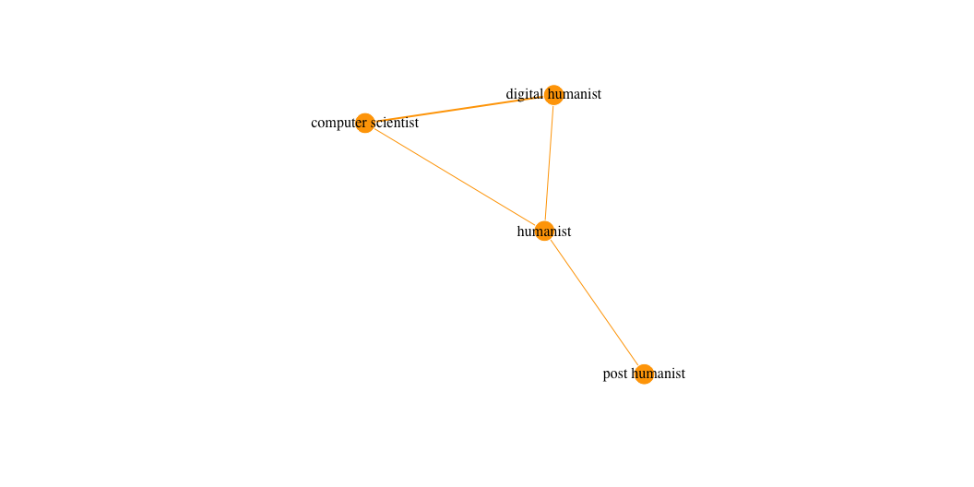
Example network

Slide 11
Summary of data representation
The things (nodes) to be connected in the network can be represented as a list
The connections (edges) between the things can be represented as an adjacency matrix or edge list
Most network softwares can understand your network data if you give them a node list and an edge list

Slide 12
Network data sets on this course
Twitter networks
Nodes: (for example) users
edges: interactions between users
used to study: spread of (dis)information
ESTC
Nodes: (for example) publishers, printers, authors
Edges: Co-operation instances
used to study: early modern book, political and intellectual history
Your data set
Nodes and edges: ?

Slide 13
Next steps
Read the instructions for homework from the corresponding course book chapter
Start working on getting data from Twitter
After the lecture: Start thinking about the data set that you would like to use for the final project.

