Slide 1
A Quantitative Approach to Book Printing in Sweden and Finland, 1640–1828
COMHIS Helsinki
HiTu 2017, Turku

Slide 2
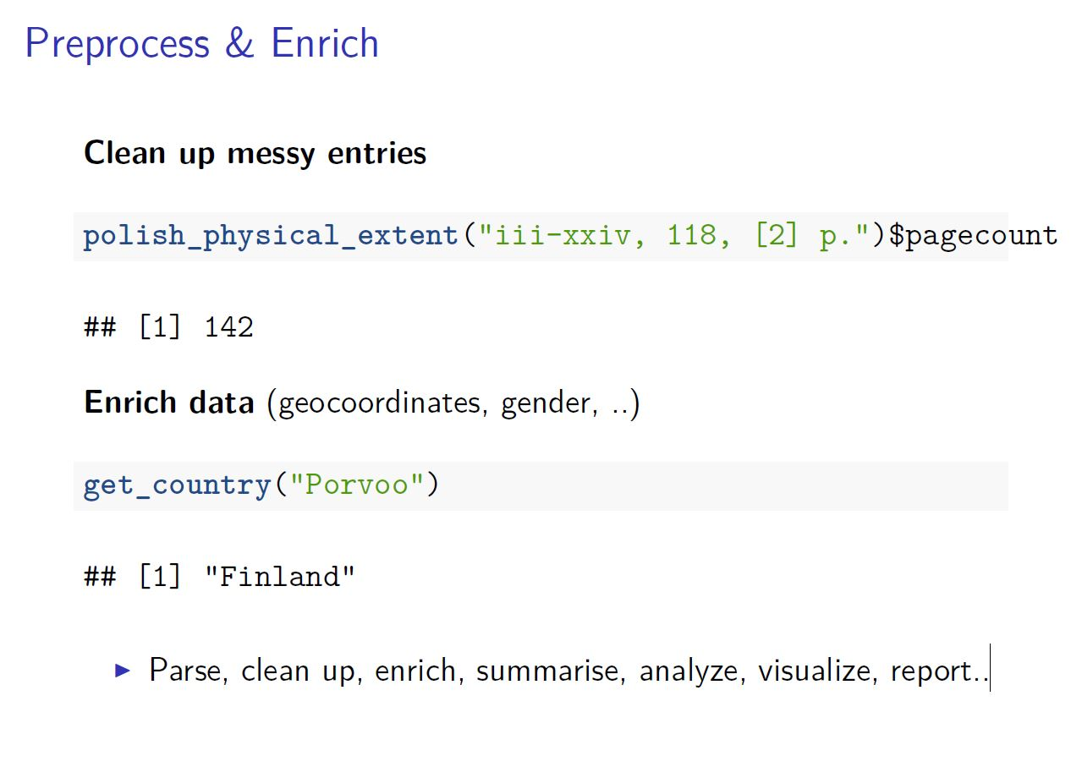
MT

Slide 3
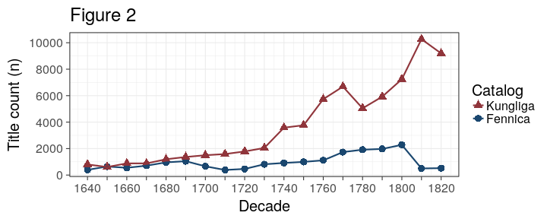
Titles in Kungliga and Fennica 1640–1820
JM

Slide 4
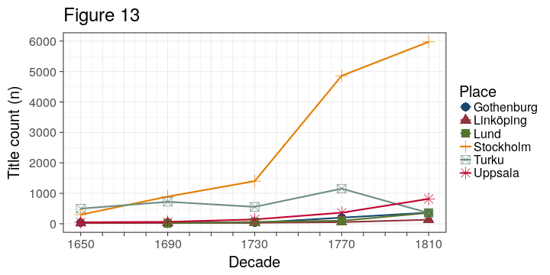
Title count (absolute; kungliga + Turku fennica)
MT

Slide 5
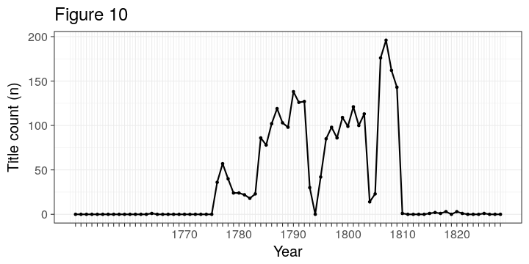
Publications in Vaasa in Fennica, 1750-1828
JM

Slide 6
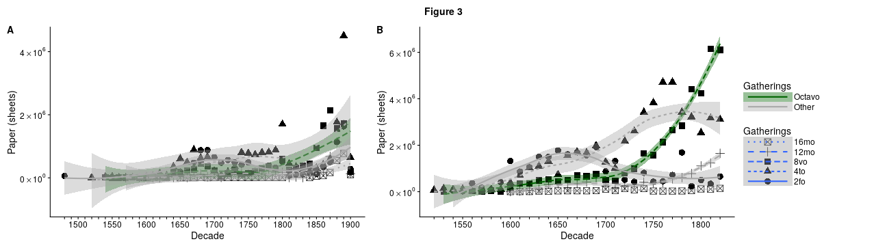
Paper consumption according to book formats in Kungliga and Fennica
MT

Slide 7
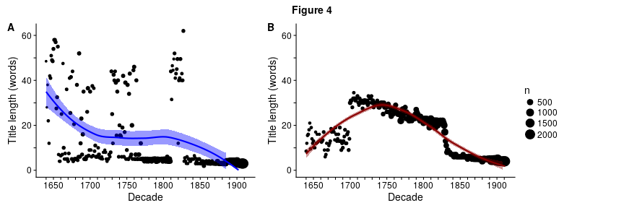
Average word count in titles per year in Fennica and Kungliga 1640–1900
JM

Slide 8
Publishers and book production

Slide 9
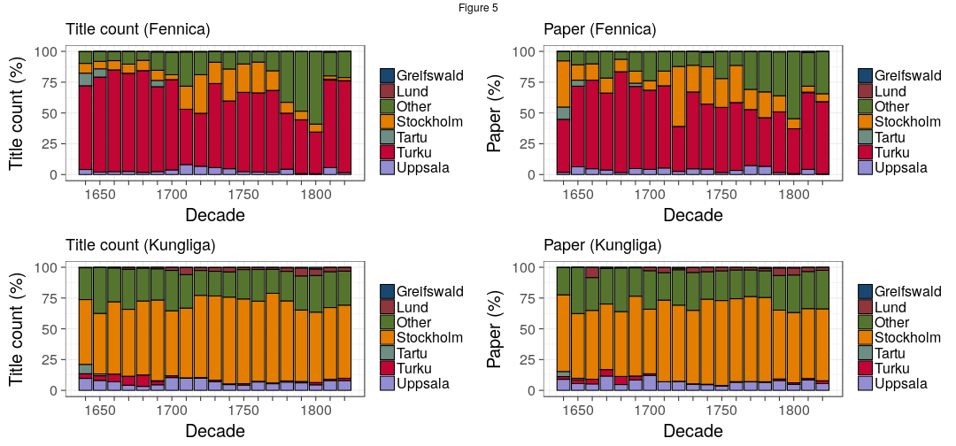
Book production by year in Swedish university towns
MT

Slide 10
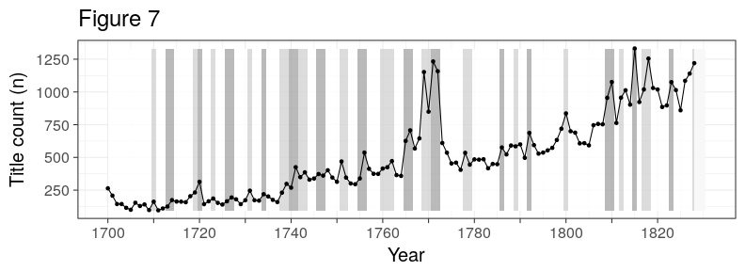
Book production and Riksdag assemblies in the the long 18th-century (Kungliga)
JM

Slide 11
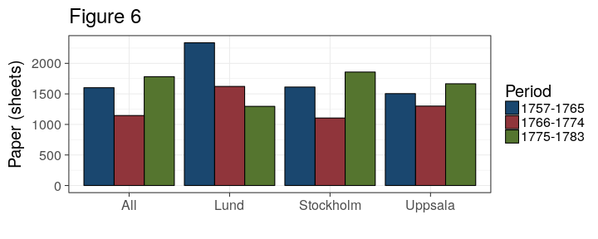
Average paper consumption per title in 1757–1765, 1766–1774, and 1775–1783
MT

Slide 12
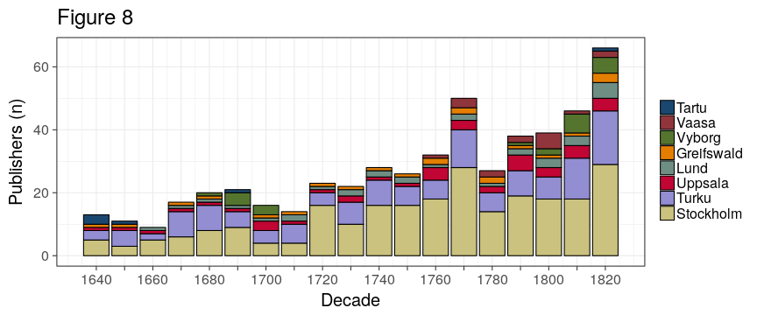
Publishers in particular places (Fennica)
JM

Slide 13
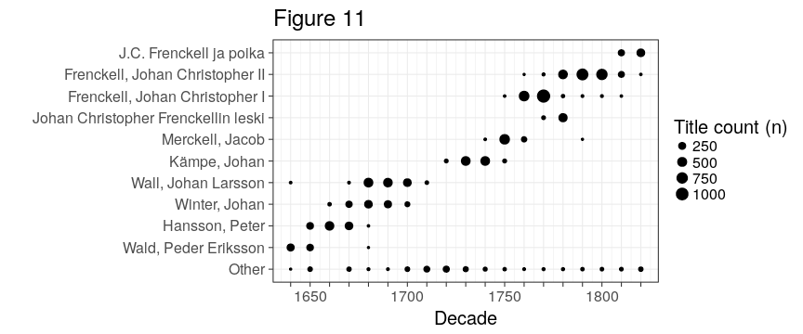
Top publishers in Turku/Fennica
MT

Slide 14
Language and topics

Slide 15
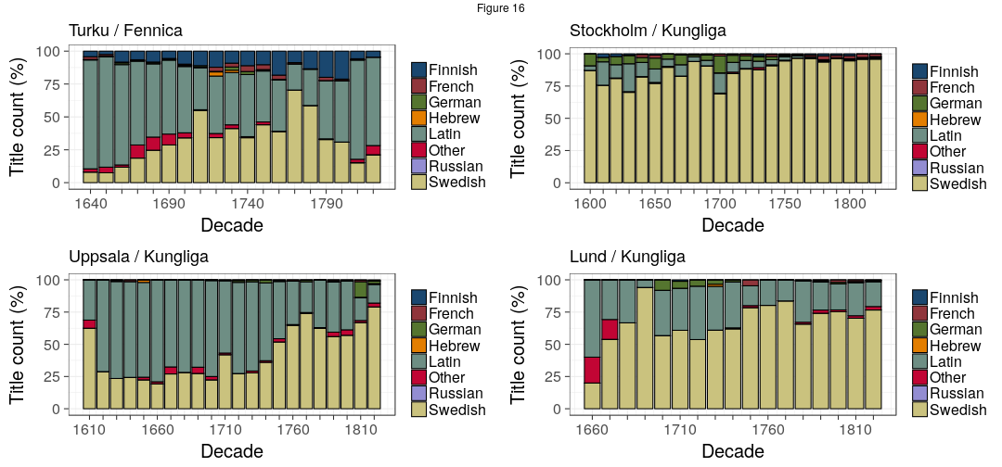
Language use in Turku, Stockholm, Uppsala and Lund
JM

Slide 16
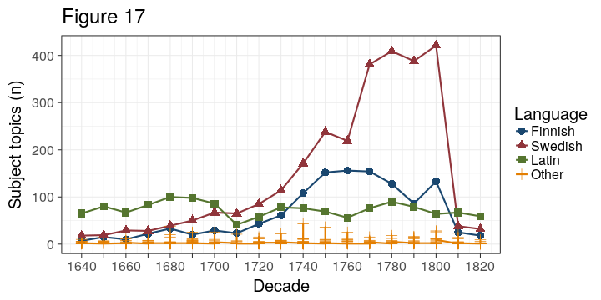
Topic richness per language (Fennica)
MT

Slide 17
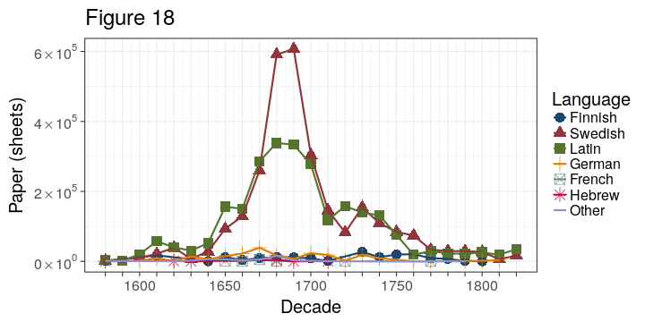
Temporary sermons in Latin and Swedish
JM

Slide 18
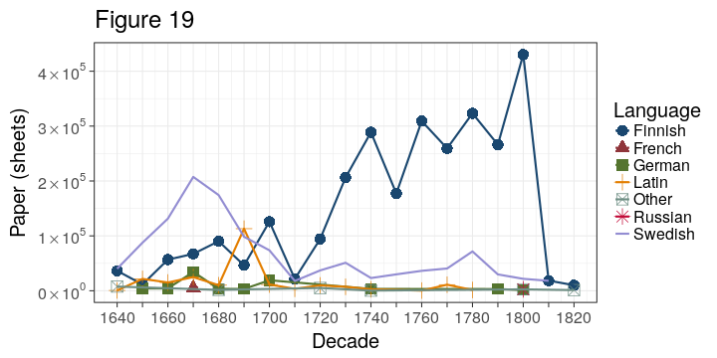
Devotional literature (catechisms, hymns, prayers, etc.)
JM

Slide 19
Conclusion

