Slide 1

COMP 6120 Final Project Presentation
Joshua Boyd, James Browning,
and Her-Bo Lin

Slide 2
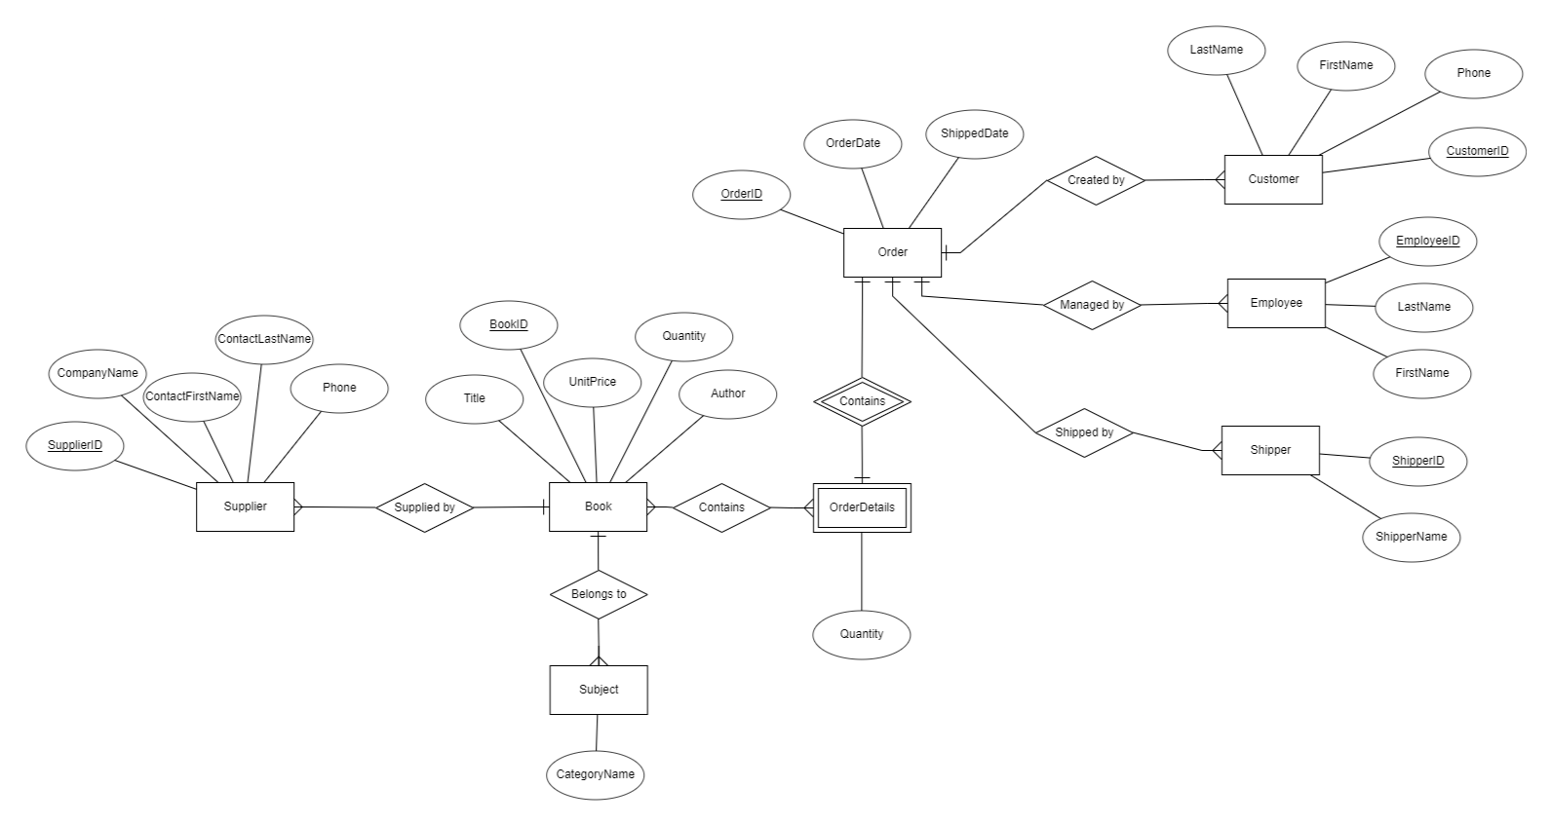

Slide 3
Primary Keys
supplier: PRIMARY KEY (SupplierID)
subject: PRIMARY KEY (SubjectID)
book: PRIMARY KEY (BookID)
customer: PRIMARY KEY (CustomerID)
employee: PRIMARY KEY (EmployeeID)
shipper: PRIMARY KEY (ShipperID)
orders: PRIMARY KEY (OrderID)
order_detail: No primary key.

Slide 4
Foreign Keys
book:
FOREIGN KEY (SupplierID) REFERENCES supplier(SupplierID)
FOREIGN KEY (SubjectID) REFERENCES subject(SubjectID)
orders:
FOREIGN KEY (CustomerID) REFERENCES customer(CustomerID)
FOREIGN KEY (EmployeeID) REFERENCES employee(EmployeeID)
FOREIGN KEY (ShipperID) REFERENCES employee(ShipperID)
order_detail:
FOREIGN KEY (BookID) REFERENCES book(BookID)
FOREIGN KEY (OrderID) REFERENCES orders(OrderID)

Slide 5
1:N Relationships
order:
customer
employee
shipper
book:
subject
supplier

Slide 6
Other Notes
M:N relationship type is used for order_detail ↔ book.
Weak entity (order_detail)
Relies on order for identification.
book does not provide identification. Therefore, it has only one identifying relationship.

Slide 7
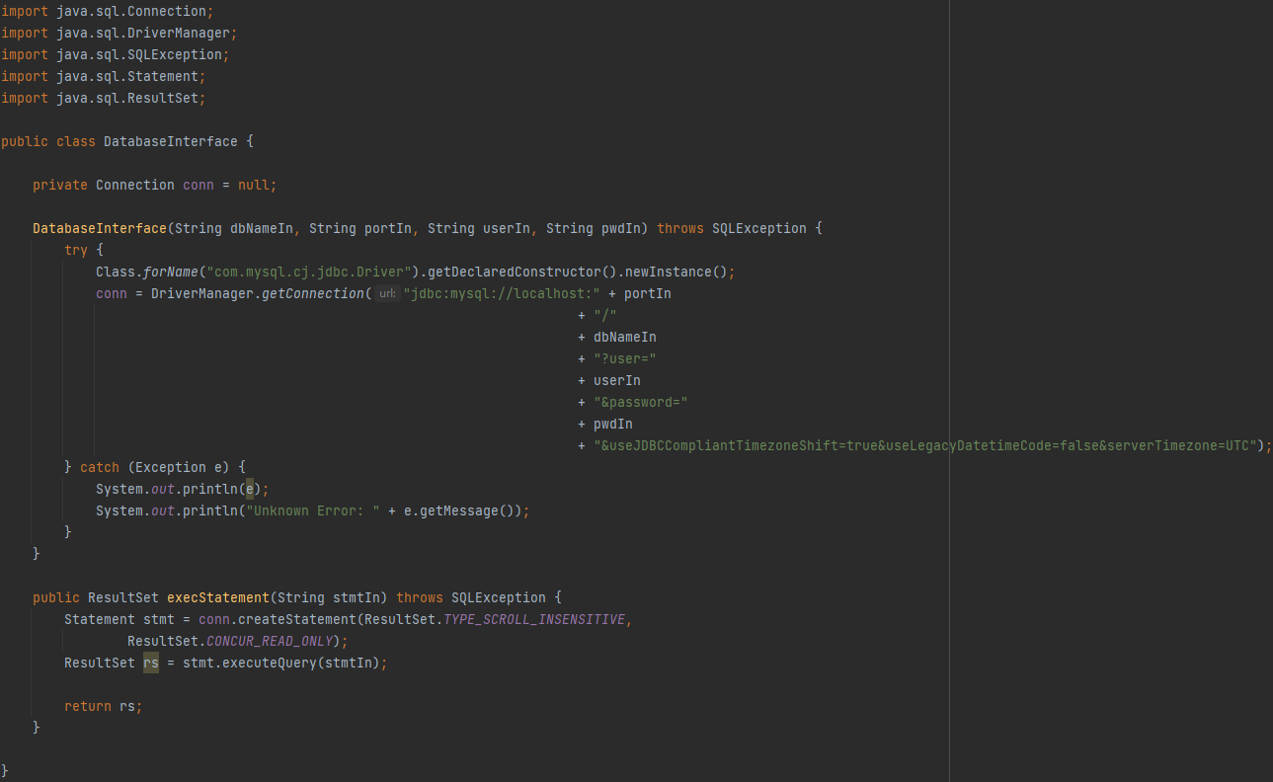

Slide 8
DatabaseInterface.java
Our code for connecting the user application to the database was contained in the DatabaseInterface class.
This class is a fairly straightforward implementation pf JDBC, taking a database name, port, username, and password as arguments for establishing a connection.
The method execStatement takes a query or statement string as an input, then returns the ResultSet.

Slide 9
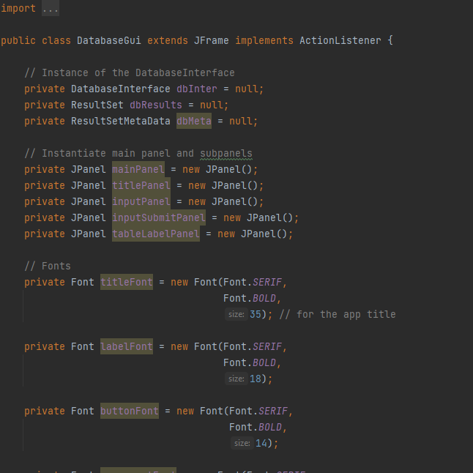

Slide 10
DatabaseGui.java
DatabaseGui.java is our most complex class, defining the look and frontside functionality of the application.
The user interface was developed using Java’s Swing library.

Slide 11
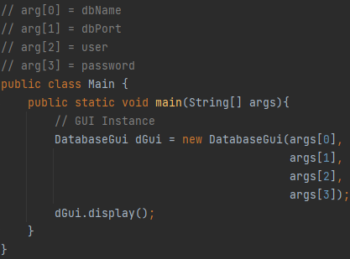

Slide 12
Main.java
Our main class is the simplest, serving only as a driver for the other two classes.
The database name, port, username, and password, provided by the user as command line arguments, are fed into a new DatabaseGui object.

Slide 13
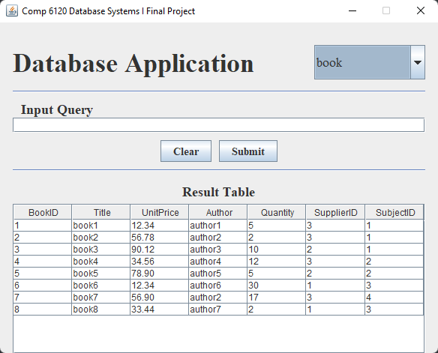
Interface
To the right is the first screen users see when opening our application.
The entirety of the book table (as much as will fit on screen, at least) is displayed by default.

Slide 14
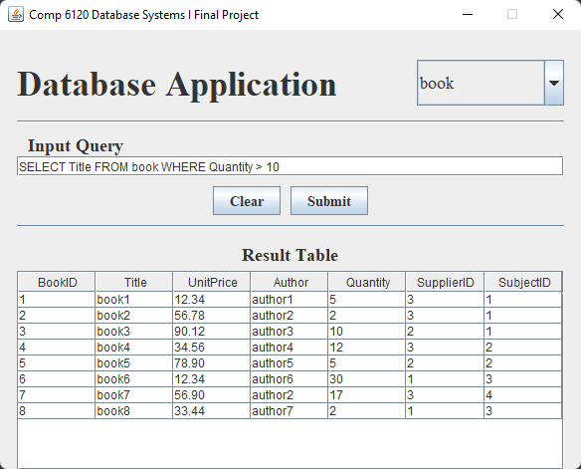
Interface Functionality
To demonstrate the functionality of our user interface, we’ll use question four from the sql.txt assignment.
This question is rather simple: “Show the title of books which have more than 10 units in stock.”

Slide 15
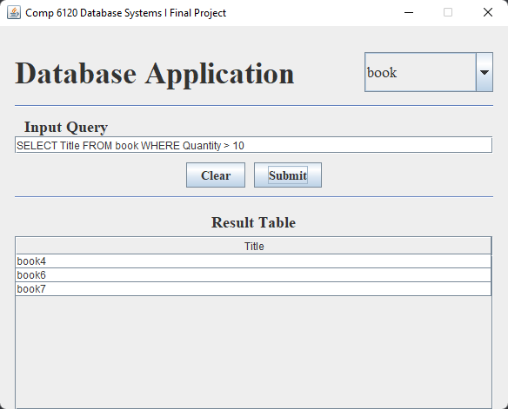
Interface Functionality (Cont.)
As you can see, the result table updates to reflect the outcome of the query.
This result is the same result we received using IntelliJ’s database console.
This result was also verified by comparing it to the original data provided.

