Slide 1
Mathematical Operations
Base 2: the native base for computer systems
Glyphs: 0, 1
On a computer, we are limited to a certain number of digits bits.
Recall, the results are summarized via the use of status flags.
For unsigned operations:
the final value is Zero (Z)
the calculation resulted in final carry (C)
For signed values
the final value is Negative (S)
the calculation resulted in an overflow (V) [ used when singed numbers are involved]

Slide 2
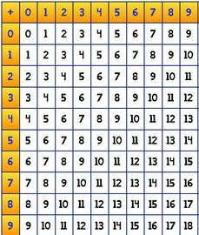
Binary Addition:
Base 2
Base 10
+ |  | B
 |  | 0 | 1
A | 0 | 0 | 1
 | 1 | 1 | ?
We have only two digits
0 + 0 = 0
0 + 1 = 1
1 + 0 = 1
1 + 1 = ?
What do we do in base 10
9 + 9 = ?
1
9
+
9
8

Slide 3
Binary Addition (1-digit):
Base 2
Base 10
+ |  | B
 |  | 0 | 1
A | 0 | 00 | 01
 | 1 | 01 | 10
We have only two digits
0 + 0 = 0
0 + 1 = 1
1 + 0 = 1
1 + 1 = 10
What do we do in base 10
9 + 9 = 18
Half Adder
A | B | C | S
0 | 0 | 0 | 0
0 | 1 | 0 | 1
1 | 0 | 0 | 1
1 | 1 | 1 | 0
9
+
9

Slide 4
In Binary (before)
0
1
1
0
0
1
0
0
C + A + B = C, S
+
0
0
1
1
+
1
0
1
1
C | A | B | C | S
0 | 0 | 0 | 0 | 0
0 | 0 | 1 | 0 | 1
0 | 1 | 0 | 0 | 1
0 | 1 | 1 | 1 | 0
?
?
?
?
C
V
S
Z
C
V
S
Z
C + A + B = C, S
1
1
0
1
1
0
1
1
C | A | B | C | S
1 | 0 | 0 | 0 | 1
1 | 0 | 1 | 1 | 0
1 | 1 | 0 | 1 | 0
1 | 1 | 1 | 1 | 1
+
0
0
1
1
+
0
1
1
0
?
?
?
?
C
V
S
Z
C
V
S
Z

Slide 5
In Binary (after)
0
1
1
0
0
0
0
0
0
0
0
1
1
0
0
1
0
0
C + A + B = C, S
+
0
0
1
1
+
1
0
1
1
C | A | B | C | S
0 | 0 | 0 | 0 | 0
0 | 0 | 1 | 0 | 1
0 | 1 | 0 | 0 | 1
0 | 1 | 1 | 1 | 0
0
?
?
0
1
0
0
1
0
?
?
0
1
1
1
1
C
V
S
Z
C
V
S
Z
1
1
1
1
0
1
1
1
0
0
C + A + B = C, S
1
1
0
1
1
0
1
1
C | A | B | C | S
1 | 0 | 0 | 0 | 1
1 | 0 | 1 | 1 | 0
1 | 1 | 0 | 1 | 0
1 | 1 | 1 | 1 | 1
+
0
0
1
1
+
0
1
1
0
1
?
?
1
0
0
0
0
1
?
?
0
0
0
0
1
C
V
S
Z
C
V
S
Z

Slide 6
Binary Addition: Practice
0
1
1
1
0
1
1
1
1
0
0
1
1
1
0
1
1
1
C + A + B = C, S
+
0
0
1
1
+
0
0
1
1
C | A | B | C | S
0 | 0 | 0 | 0 | 0
0 | 0 | 1 | 0 | 1
0 | 1 | 0 | 0 | 1
0 | 1 | 1 | 1 | 0
0
?
?
0
1
0
1
0
1
?
?
0
1
0
1
0
C
O
S
Z
C
V
S
Z
C + A + B = C, S
C | A | B | C | S
1 | 0 | 0 | 1 | 1
1 | 0 | 1 | 1 | 0
1 | 1 | 0 | 1 | 0
1 | 1 | 1 | 1 | 1
+
+
?
?
?
?
C
V
S
Z
C
V
S
Z

Slide 7
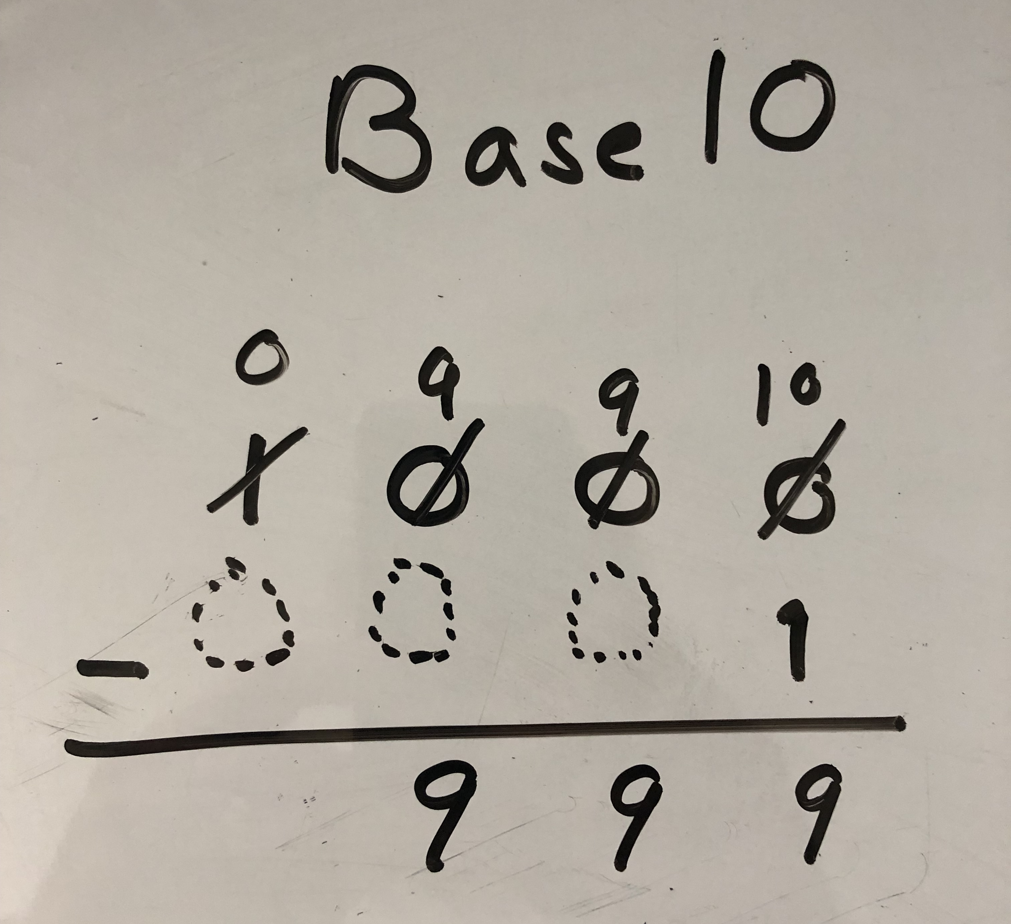
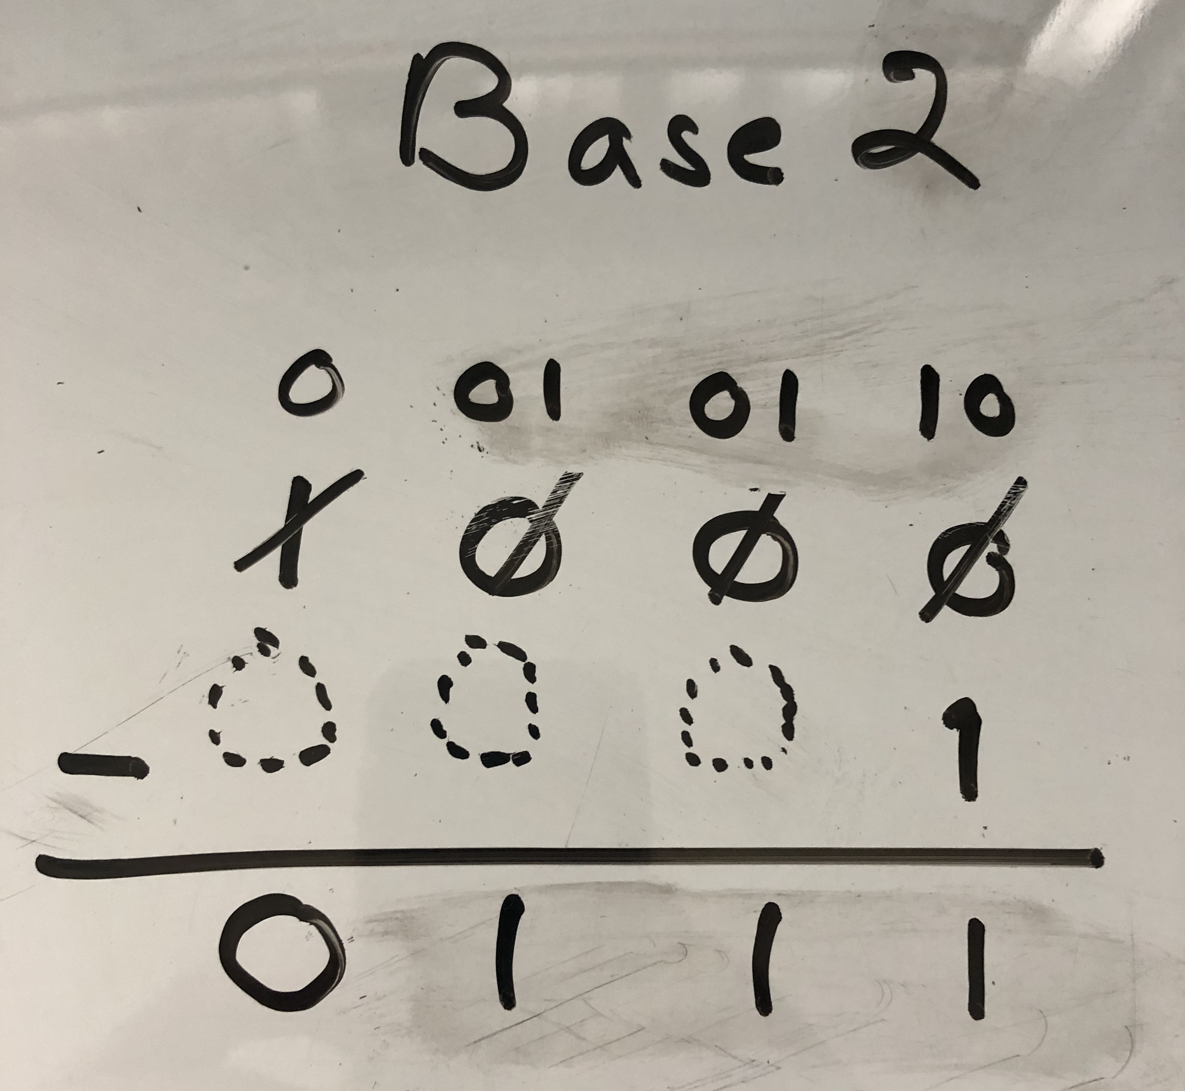
Binary Subtraction (via Borrow)
A - B = V
A | B | V
0 | 0 | 0
0 | 1 | ?
1 | 0 | 1
1 | 1 | 0
Traditional Method ⇒
Notice the extra squares
Notice the extra bookkeeping
8 - 1 = 7
Recall Method of Complements
allows us to leverage binary addition
need a method to encode negative numbers
We need to borrow!
0
A |  | B | V
0 | 0 | 1 | x
1 | 0 | 1 | x
1
0
0
0
Again, We need to borrow!
-
0
0
0
1
0
1
1
1

Slide 8
Binary Subtraction (via Borrow)
A - B = V
A | B | V
0 | 0 | 0
0 | 1 | ?
1 | 0 | 1
1 | 1 | 0
Traditional Method ⇒
Notice the extra squares
Notice the extra bookkeeping
8 - 1 = 7
Recall Method of Complements
allows us to leverage binary addition
need a method to encode negative numbers
We need to borrow!
0
0
0
1
0
1
1
0
A |  | B | V
0 | 0 | 1 | x
1 | 0 | 1 | x
1
0
0
0
Again, We need to borrow!
-
0
0
0
1
0
1
1
1

Slide 9

Method of Complements
note: I can take the complement of each digit individually
V | ~V
0 | 1
1 | 0
A technique to encode both positive and negative numbers
uses the same algorithm to perform addition, subtraction performed by the addition of complements
Complement: a thing that completes or brings to perfection:
Radix 10:
10's complement
7 + x = 10; x = 3
46 + y = 100; y = 54
9's complement
7 + a = 9; a = 2
46 + b = 99; b = 53
As we shall see, for Base 2
The 2’s complement of X is: –X (~X + 1)
The 1’s complement of X is: ~X
$X+Y=2^{n}$ (1 0…0 )
Radix 2:
2's complement
0111 + x = 1 0000 ; x = 1001
0010 1110 + y = 1 0000 0000 ; y = 1101 0010
1's complement
0111 + a = 1111 ; a = 1000
0010 1110 + b = 1111 1111 ; b = 1101 0001

Slide 10
Method of Complements
1's Complement
 | Positive | Negative
0 | 0000 | 1111
1 | 0001 | 1110
2 | 0010 | 1101
3 | 0011 | 1100
4 | 0100 | 1011
5 | 0101 | 1010
6 | 0110 | 1001
7 | 0111 | 1000
8
A technique to encode both positive and negative numbers
MSb used to denote the sign bit (0 positive, 1 negative)
Table assumes a 4-bit represent
Use 1's complement to represent negative numbers
Divide the number range in half
Encode a positive and a negative value for each number
Pros/cons:
ease to compute
positive and negative representations of zero -7, -6, -5, -4, -3, -2, -1, -0, 0, 1, 2, 3, 4, 5, 6, 7
Use 2's complete to represent negative numbers
the predecessor of -7
-1
-1
-1

Slide 11
Method of Complements
2's Complement
 | Positive | Negative
0 | 0000
1 | 0001 | 1110 + 1 = 1111
2 | 0010 | 1101 + 1 = 1110
3 | 0011 | 1100 + 1 = 1101
4 | 0100 | 1011 + 1 = 1100
5 | 0101 | 1010 + 1 = 1011
6 | 0110 | 1001 + 1 = 1010
7 | 0111 | 1000 + 1 = 1001
8 |  | 1000
A technique to encode both positive and negative numbers
MSb used to denote the sign bit (0 positive, 1 negative)
Table assumes a 4-bit represent
Use 2's complete to represent negative numbers
Hold Zero as special
Fold the resulting range to assign values
Pros/cons:
Not symmetric: extra negative number
Need to flip all bits and add one to form the negative number
Consider then the predecessor of -8: -8, -7, -6, … 0, 1, … 7
-1
-1
-1
-1

Slide 12
Comparison of 1's and 2's Complement Encodings
1's Complement
2's Complement
 | Positive | Negative
0 | 0000 | 1111
1 | 0001 | 1110
2 | 0010 | 1101
3 | 0011 | 1100
4 | 0100 | 1011
5 | 0101 | 1010
6 | 0110 | 1001
7 | 0111 | 1000
 | Positive | Negative
0 | 0000
1 | 0001 | 1110 + 1 = 1111
2 | 0010 | 1101 + 1 = 1110
3 | 0011 | 1100 + 1 = 1101
4 | 0100 | 1011 + 1 = 1100
5 | 0101 | 1010 + 1 = 1011
6 | 0110 | 1001 + 1 = 1010
7 | 0111 | 1000 + 1 = 1001
8 |  | 1000

Slide 13
Status Flags Explained!
C
V
S
Z
Example: 13 - 9 ⇒ 01101 + 10111 * 9: 01001 → -9 : 10110 + 1 = 10111
C: Carry Flag
the last step resulted in a carry value of 1
V: Overflow Flag
the xor of the last two carry values: c ^ c’
S: Sign Flag
the MSB in the result is set (i.e., a 1)
Z: Zero Flag
all bits in the result are cleared (i.e., 0)
1
1
1
1
1
0
0
1
1
0
1
^
+
1
0
1
1
1
0
0
1
0
0
1
0
0
0
C
V
S
Z
See: comp122/tidbits/status_bits_explained.gif

Slide 14
Algorithm: Subtraction via 1's Complements
Example: 13 - 9 ⇒ 0013 + - 0009
Convert 13 and 9 into binary (01101 & 01001)
Take the 1's complement of the subtrahend (9)
01001 → 10110
Add the complement to the minuend
Drop the leading "1"
Add 1
Optimization: introduce initial carry in
+
+
1
1
+
C
V
S
Z

Slide 15
Algorithm: Subtraction via 2's Complement
Example: 13 - 9 ⇒ 00013 + - 0009
Encode 13 and 9 into binary (01101 & 01001)
Take the 2's complement of the subtrahend (9)
01001 → 10110 + 1 = 10111
Add the complement to the minuend
Drop the leading "1", i.e., the carry bit.
Providing the answer:
Optimization: Addition of adding one is baked in!
0
+
C
V
S
Z

Slide 16
Algorithm: Subtraction via 2's Complement
Example: 13 - 9 ⇒ 0013 + - 0009
Encode 13 and 9 into binary (01101 & 01001)
Take the 2's complement of the subtrahend (9)
01001 -> 10110 + 1 = 10111
Add the complement to the minuend
Drop the leading "1", i.e., the carry bit.
Providing the answer: 4
Optimization: Addition of adding one is baked in!
1
1
1
1
1
0
0
1
1
0
1
+
1
0
1
1
1
1
0
0
1
0
0
C
V
S
Z

Slide 17
Practice: Addition and Subtraction
1
0
1
0
C
V
S
Z
1
1
1
1
0
0
0
Steps:
transform the operation to addition
convert abs(X) to binary
encode both numbers in 2's complement
perform binary addition
convert result to decimal
if negative result: compute 2's complement first
8 + 9 = 17
7 - 4 = 3
-5 + 2 = -3
-16 - 3 = -19
-25 - 4 = -29 => (-25) + (-4)
1
0
0
1
1
1
+
1
1
1
1
0
0
1
0
0
0
1
1

Slide 18
Practice: Addition and Subtraction
C
V
S
Z
0
1
0
0
0
0
Steps:
transform the operation to addition
convert abs(X) to binary
encode both numbers in 2's complement
perform binary addition
convert result to decimal
if negative result: compute 2's complement first
8 + 9 = 17
7 - 4 = 3
-5 + 2 = -3
-16 - 3 = -19
0
0
1
0
0
0
+
0
0
1
0
0
1
2. 8: 001000, 9: 001001 3. 5. 17

Slide 19
Practice: Addition and Subtraction
C
V
S
Z
1
1
1
1
0
0
0
Steps:
transform the operation to addition
convert abs(X) to binary
encode both numbers in 2's complement
perform binary addition
convert result to decimal
if negative result: compute 2's complement first
8 + 9 = 17
7 - 4 = 3
-5 + 2 = -3
-16 - 3 = -19
0
0
0
1
1
1
+
1
1
1
1
0
0
0
0
0
0
1
1
2. 7: 000111, 4: 000100 3. -4: 111011+1 ⇒ 111100 5. 3

Slide 20
Practice: Addition and Subtraction
C
V
S
Z
0
0
0
0
1
0
0
Steps:
transform the operation to addition
convert abs(X) to binary
encode both numbers in 2's complement
perform binary addition
convert result to decimal
if negative result: compute 2's complement first
8 + 9 = 17
7 - 4 = 3
-5 + 2 = -3
-16 - 3 = -19
0
0
0
0
1
0
+
1
1
1
0
1
1
1
1
1
1
0
1
2. 5: 000101, 2: 000010 3. -5: 111010+1 ⇒ 111011 5. 000010+1 ⇒ 000011 = -3

Slide 21
Practice: Addition and Subtraction
C
V
S
Z
1
1
0
0
0
0
0
Steps:
transform the operation to addition
convert abs(X) to binary
encode both numbers in 2's complement
perform binary addition
convert result to decimal
if negative result: compute 2's complement first
8 + 9 = 17
7 - 4 = 3
-5 + 2 = -3
-16 - 3 = -19
1
1
0
0
0
0
+
1
1
1
1
0
1
1
0
1
1
0
1
2. 16: 010000 3: 000011 3. -16: 110000 -3: 111101 5. 010010+1 ⇒ 010011 = -19

