Slide 1
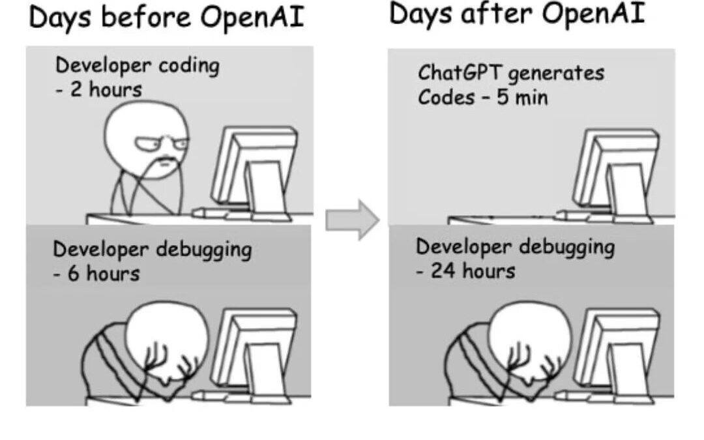
Good Minnrog Cmp21o2
Tod'ays lurctee is all aoubt bwiitse oaoirpetns. But borfee we start this ltecrue cdsieonr the flnoowlig craoton. Waht mesgase do you recveie form it?

Slide 2
Boolean-based Bitwise Operations
A | B | nor | & | | | ^
0 | 0 | 1 | 0 | 0 | 0
0 | 1 | 0 | 0 | 1 | 1
1 | 0 | 0 | 0 | 1 | 1
1 | 1 | 0 | 1 | 1 | 0
Let's assume 4-bit chunks:
Complement: s1 = ~ t1 nor $s1, $t1, $zero
And: s1 = t1 & t2 and $s1, $t1, $t2
Or: s1 = t1 | t2 or $s1, $t1, $t2
Xor: s1 = t1 ^ t2 xor $s1, $t1, $t2
0
1
1
0
0
1
1
0
0
1
1
0
0
1
1
0
6
~
0
1
1
0
nor
1
1
0
0
&
1
1
0
0
|
1
1
0
0
^
1
1
0
0
12
1
0
0
1
0
0
0
1
0
1
0
0
1
1
1
0
1
0
1
0

Slide 3
Shift-based Operations
Foreshadow:
Integers are encoded in 2’s complement
In such numbers, the MSb is represents the sign
1 -> a negative number
Java and MIPS supported:
Shift Left Logical s1 = t1 << 2; sll $s1, $t1, 2
Shift Right Logical s1 = t1 >>> 2; srl $s1, $t1, 2
Shift Right Arithmetic s1 = t1 >> 2; sra $s1, $t1, 2
Arithmetic Shifting a value in a register
sllv, srlv, srav
Let's Assume 4-bits and a shift of "1"
shift left logical
shift right logical
shift right arithmetic
1
0
1
0
1
0
1
0
1
0
1
0
1
0
1
0
0
0
0
0
1
0
1
0
1
1
0
1
0

Slide 4
Additional Shift-based Operations
sll $s1, $t1, 2 srl $at, $t1, 30
or $s1, $s1, $at
Rotates or Circular Shifts
Rotate Left Logical rol $s1, $t1, 2
Rotate Right Logical ror $s1, $t1, 2
Typically, not supported in high-level languages
Let's Assume 4-bits and a shift of "1"
srl $s1, $t1, 2 sll $at, $t1, 30
or $s1, $s1, $at
rotate left
rotate right
1
0
1
0
1
0
1
0
0
1
0
1
0
1
0
1

Slide 5
Bitwise Operations
Bitwise operations in high-level languages are applied to integers
Java has three primary sizes for signed integers
Two types of Bitwise Operations
Boolean based operations
Shift-based operations
Boolean-based Operations:
Complement: s1 = ~ t1; nor $s1, $t1, $zero # s1 = ~ ( t1 | 0 )
And: s1 = t1 & t2; and $s1, $t1, $t2
Or: s1 = t1 | t2; or $s1, $t1, $t2
Xor: s1 = t1 ^ t2; xor $s1, $t1, $t2
Shift-based Operations:
Un/Signed Left Shift s1 = t1 << 2; sll $s1, $t1, 2 # Shift Left Logical
Unsigned Right Shift s1 = t1 >>> 2; srl $s1, $t1, 2 # Shift Right Logical
Signed Right Shift s1 = t1 >> 2; sra $s1, $t1, 2 # Shift Right Arithmetic
Unsigned Left Shift s1 = t1 <<< t2;
short (16 bit chunks)
int (32 bit chunks)
long (64 bit chunks)

Slide 6
Repositioning Fields within a Register
The blue cells represent a field within the register!
Consider a register (16 bits) containing information
Consider extracting a subrange of bits
x
x
x
x
1
0
1
1
x
x
x
x
x
x
x
x
A
mask
0
0
0
0
1
1
1
1
0
0
0
0
0
0
0
0
0x0F00
0
0
0
0
1
0
1
1
0
0
0
0
0
0
0
0
A & 0x0F00
0
0
0
0
0
0
0
0
0
0
0
0
0
1
0
1
1
(A & 0x0F00) >>> 8

Slide 7
Bit Manipulation: Testing the bit value
Consider a register (16 bits) containing information
Consider testing the value of a particular bit
x
x
x
x
x
x
x
x
x
x
?
x
x
x
x
x
A
mask
0
0
0
0
0
0
0
0
0
0
1
0
0
0
0
0
0x020
0
0
0
0
0
0
0
0
0
0
0
0
0
0
0
0
A & 0x020

Slide 8
Bit Manipulation: Clearing a bit
Consider a register (16 bits) containing information
Consider testing the value of a particular bit
Native instruction on ARM: bic A, A #0x200
x
x
x
x
x
x
x
x
x
x
?
x
x
x
x
x
A
mask
0
0
0
0
0
0
0
0
0
0
1
0
0
0
0
0
0x020
x
x
x
x
x
x
x
x
x
x
?
x
x
x
x
x
A & ~ 0x020

Slide 9
Bit Manipulation: Flipping the value of a set of bits
Consider a register (16 bits) containing information
Consider extracting a subrange of bits
x
x
x
x
1
x
x
0
0
x
x
1
x
x
1
x
A
mask
0
0
0
0
1
0
0
1
1
0
0
1
0
0
1
0
0x0992
x
x
x
x
0
x
x
1
1
x
x
0
x
x
0
x
A ^ 0x0992

