Slide 1
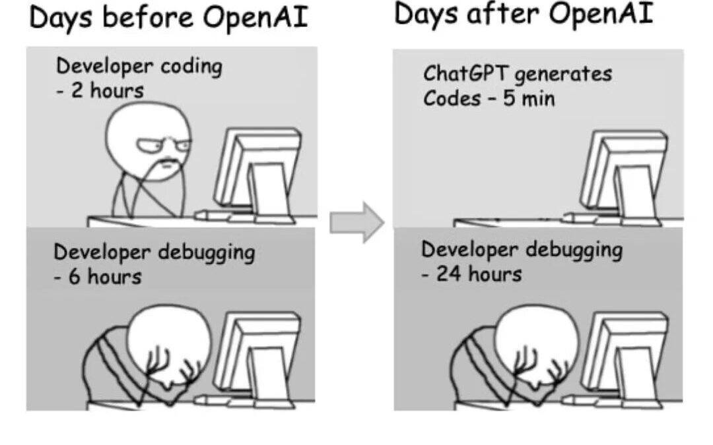
Good Minnrog Cmp21o2
Tdyo'as letcure is auobt the cisvrenoon of nemrbus itno ohter bases.
T'adoys lab you will be gievn tmie to wrok on your eocdne ba3nryi2 aenmgssint.
But borfee we start this ltecrue cdsieonr the flnoowlig craoton. Waht mesgase do you recveie form it?

