Slide 1
Macros
Uses:
to improve readability of your program
to eliminate repetitive code construction
to reduce overhead associated with subroutines
Register usage must be carefully considered
Register Approaches:
New Pseudo Instruction: use the $at register -- but don't use any pseudo instructions
Marshalling: use only the registers provided as arguments
Inlined- subroutine: Utilize: $a0, $a1, $a2, $a3, $v0, and $v1
Syntax:
.macro <name>(%arg1 .. %argn) <list of native instructions> .end_macro

Slide 2
Stack Operations
Push(a) ⇔ sp = sp + 1 sp[0] = a
x = Pop() ⇔
x = sp[0] sp = sp - 1
Stack is an abstract data structure
The stack is an array of words
Operations:
Push: Push(A), Push(B), Push(C)
Pop: X = Pop();
Push: Push(Z);
sp:
C
C
sp:
Z
sp:
B
B
sp:
B
B
sp:
A
A
A
A
A
sp:
Push(A);
Push(B);
Push(C);
X = Pop()
Push(Z)

Slide 3
But the MIPS Way
Push(a) ⇔
sp = sp - 1 sp[0] = a
x = Pop() ⇔
x = sp[0] sp = sp + 1
Stack is an abstract data structure
Operations:
Push: Push(A), Push(B), Push(C)
Pop: X = Pop();
sp: points to the current top of stack
Push(a) ⇔
subi $sp, $sp, 4 sw $a0, 0($sp)
x = Pop() ⇔
lw $v0, 0($sp) addi $sp, $sp, 4
sp:
A
A
A
A
sp:
B
B
sp:
B
sp:
C
C
Push(A);
Push(B);
Push(C);
X = Pop()

Slide 4
Multiple Pushes / Pops
Push(a) ⇔
sp = sp - 1 sp[0] = a
x = Pop() ⇔
x = sp[0] sp = sp + 1
sp:
X
sp:
X
Push(t0);
Push(t1);
Push(t2);
sp:
Push(a) ⇔
subi $sp, $sp, 4 sw $a0, 0($sp)
x = Pop() ⇔
lw $v0, 0($sp) addi $sp, $sp, 4
t0
sp:
t1
sp:
t2
t0 = Pop();
t1 = Pop();
t2 = Pop();
sp:
X
sp:
X
subi $sp, $sp, 12
sw $t0, 8($sp)
sw $t1, 4($sp)
sw $t2, 0($sp)
t0
sp+8
t1
sp+4
lw $t0, 8($sp)
lw $t1, 4($sp)
lw $t2, 0($sp)
addi $sp, $sp, 12
sp:
t2
sp+0

Slide 5
Printf: print(variable); println("string");
Java Prototype
public PrintStream printf(String format, Object... args)
Java Example
printf("the value of x is %d", x);
printf("x=%d, y=%d, z=%d\n", x, y, z);
Format Specifier,
%conversion
Format Conversions:
d: decimal, u: unsigned decimal
o: octal
x: hexadecimal
c: character
s: string
f: floating point
t: binary (bi"t")
MIPS Macros:
print_d, print_u, print_di
print_o
print_x
print_c
print_s
print_f
print_t

Slide 6
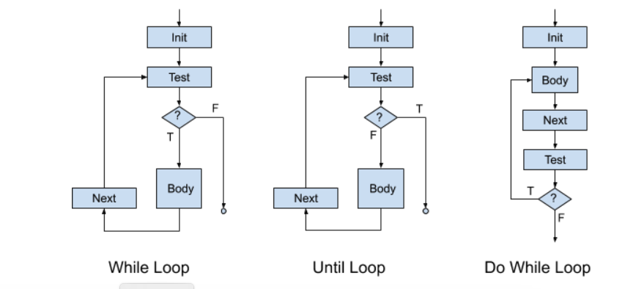
Control Flow Graph
A graphic representation of the representation between basic blocks
A basic block:
a list of instructions with
a single entry point (starting point)
a single exit point (last instruction)
Such representations model the behavior of our code
Recall the while loop, and other control structures
What about subroutines calls (subroutine: general term for … methods, functions, procedures, etc.)

Slide 7
Three Address Code (TAC)
Examples:
a = y + x
a = y
a = x + 2
b = d * 2 + y
t0 = d * 2
t1 = t0 + y
b = t1
A generic assembly language in which all instructions have at most three addresses
An address references either
a register location
a memory location
an immediate value, e.g., “2”
Immediate values are stored as part of the instruction in a location

Slide 8
Basic Blocks
label:
x = 3;
z = 5;
y = 3; goto label2
A number of instructions in which there is
a single entry point (via a label), and
a single exit point (via a goto)
All programs can be broken down into a set of basic blocks
A control flow graph determines which a basic block is executed.
Standard control flow graphs
if-then-else and all other variants (e.g., switch)
while, do-while and all other variants
for loop and all other variants
call-return
label2:

Slide 9
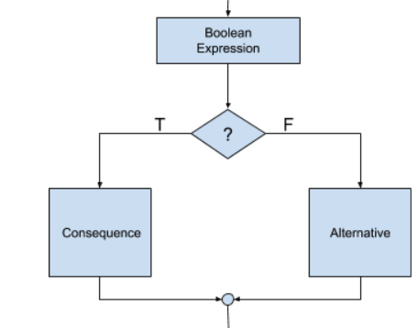
Code Flow: If-then-else
B1: a == b
if true goto C1
goto A1
C1: x = 3
z = 5
y = 3
goto N1
A1:
goto N1
N1:
if ( a == b ){
x = 3;
z = 5;
y = 3;
} else {
null ;
}
B1:
a == b
C1:
x= 3;
z= 5;
y =3 ;
A1:
null ;
N1:

Slide 10
Control Flow: Loops
x = 1;
until ( x>= 10 ) { a = x * 2;
x ++;
}
X = 1; do {
a = x * 2;
x ++;
} while ( x < 10);
X= 1;
while ( x < 10 ) { a = x * 2;
x ++;
}
for ( i = 0; i < 10 ; i++ ) {
a = x * 2;
}

