Slide 1
Languages, Compilers, and Hardware:
cc: ← .h, .c
.i ← cpp
.s ← ccom .o ← as
.out ← ld
Languages
Source: .java
Languages
Domain Specific
Compilers & Interpreters
Analysis
lexicographic
syntactic
semantic
Language Optimization
Machine Optimization
Translation: TAC → MIPS
Hardware
General Types: Registers / Stack
Specific CPU Controls
CLI: compilation exercise
Source: .c
javac
Source: .i
Object: .class
Assembly: .s
java
Translation Process
Object: .o
Virtual Machine
Executable: a.out
Hardware
kernel
kernel

Slide 2
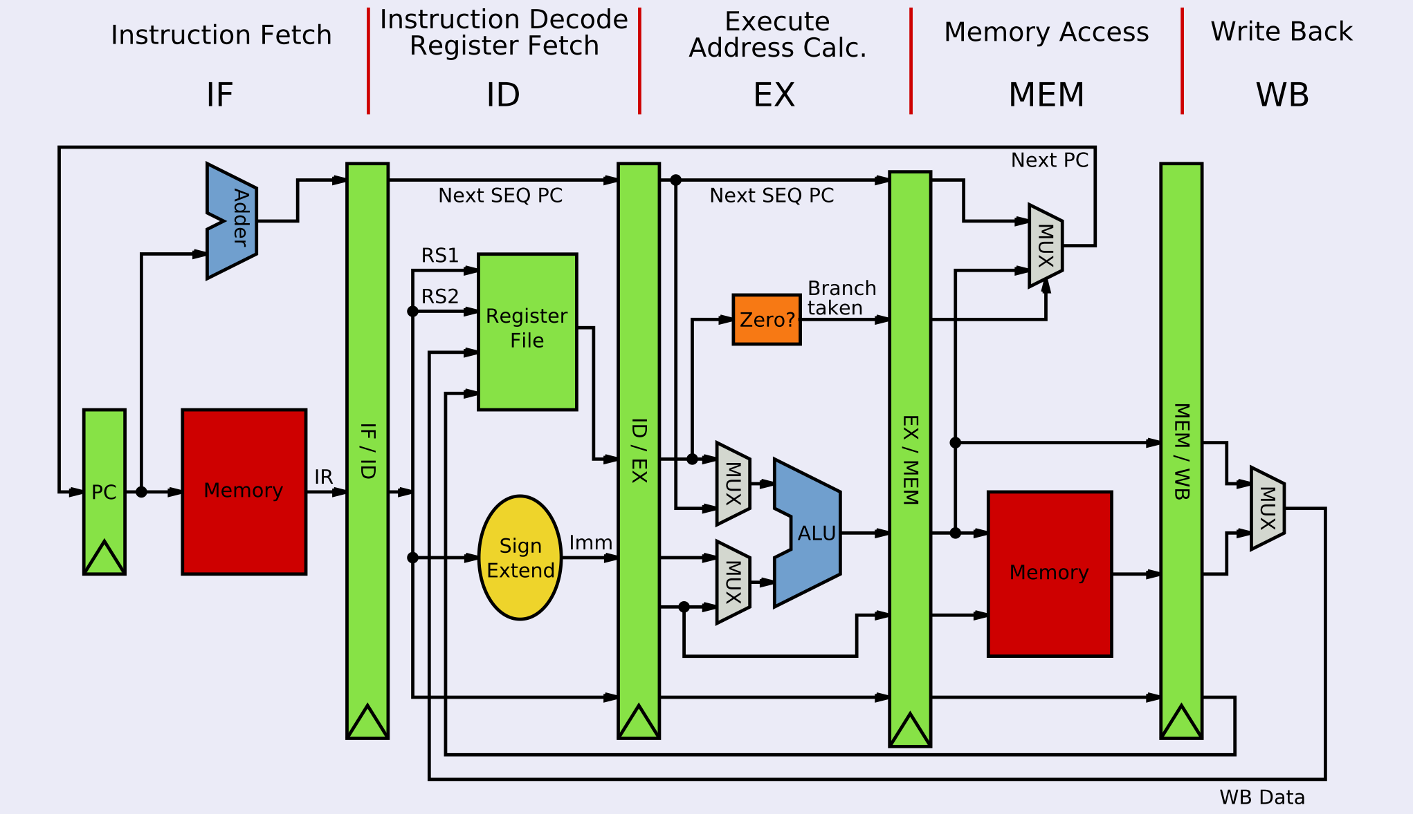
MIPS Microarchitecture

Slide 3
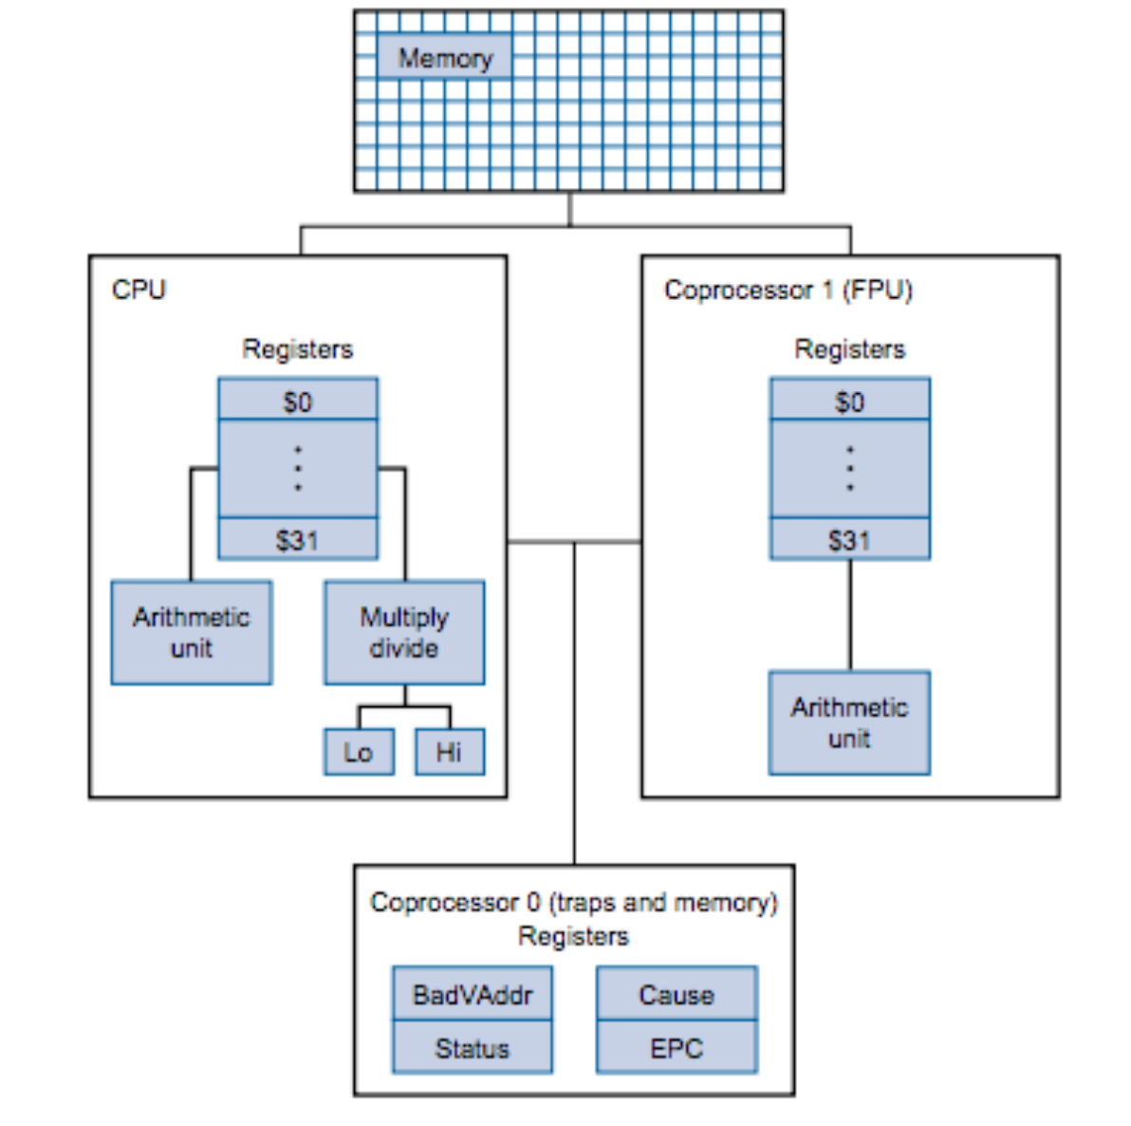
MIPS Instruction Set Architecture (ISA)
x86: has 4 general purpose registers
General Architecture
RISC (Reduced Instruction Set Computer)
Simple Instructions
Lots of Registers
Remember Memory is SLOW!
CPU
ALU
32 general purpose registers
Instruction Set:
List of Instructions Supported by the Architecture
MIPS Cheat Sheet
Coprocessors
Floating point
Traps, Exceptions, Interrupts
Memory

Slide 4
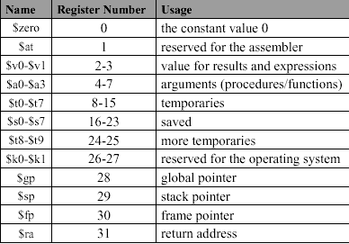
MIPS ISA Architecture: Registers
Data types:
byte, half, word
integer (signed/unsigned), binary32, binary64
Registers:
32: 32-bit integer registers
32: 32-bit floating point registers
binary32: $fp0 .. $fp31
binary64: {$fp0, $fp1} .. {$fp30, $fp31}
3: system registers: pc, hi, lo
Integer Registers

Slide 5
Registers
System
PC: Program Counter
IR: Instruction Register
BadVAddr: memory address where exception occurred
Status: Interrupt mask, enable bits and status when exception occurred
Cause: Type of exception
EPC: Address of instruction that caused the exception
Reserved (Don't use!)
$at: reserved for the Assembler
$k1, $k2: reserved for the Kernel
$gp: global pointer defined by the compiler
Special (Access via specific instructions)
PC: program counter
hi, lo: used double word results
(hi, lo) = val1 * val2
(hi, lo) = val1 % val2
General Purpose
32 32-bit integer registers: $0..$31
32 32-bit floating point registers: $f0..$f31

Slide 6
Category of Instructions
native instructions:
defined by the ISA, directly corresponds to a hardware operation
idioms:
defined by the ISA, an alternate form of a hardware instruction
b label
beq $zero, $zero, label
pseudo instructions:
an alternate syntactic form of an instruction
pseudo instruction is textual replaced with native instruction
lb $t1, label+offset
lui $at, &label
lb $t1, offset($at)
macros:
user-defined pseudo instruction
average $v0, $t2, $t3
average($v0, $t2, $t3)
subroutines
user defined abstraction, resulting
jal subroutine
nop
a change in control-flow
a ownership of registers
.macro average(%d, %s, %t) addu %d, %s, %t
srl %d, 2
.end_macro
.text
subroutine: nop
jr $ra

Slide 7
MIPS ISA Architecture: Instructions
MEM
0
1
2
3
Three basic instruction types
Arithmetic, bitwise logic, etc.
Data transfers
Basic control flow
Examples:
add $v0, $v0, $a0 # $v0 = $v0 + $a0
addi $v0, $v0, 2 # $v0 = $v0 + 2
srl $a0, $a1, 4 # $a0 = $a1 >>> 4
li $t0, 4 # $t0 = 4
move $t1, $t2 # $t1 = $t2
lb $s0, 0($t0) # $s0 = MEM[$t0] lh $s1, 3($t0) # $s1 = concat(MEM[$t0+3+1],MEM[$t0+3+0])
beq $t3, $t5, label # if ($t3 == $t5) goto label
jal proc # method()
t0:
4
n-1
$t0 = 4; 0($t0) ⇔ $t0[0]

Slide 8
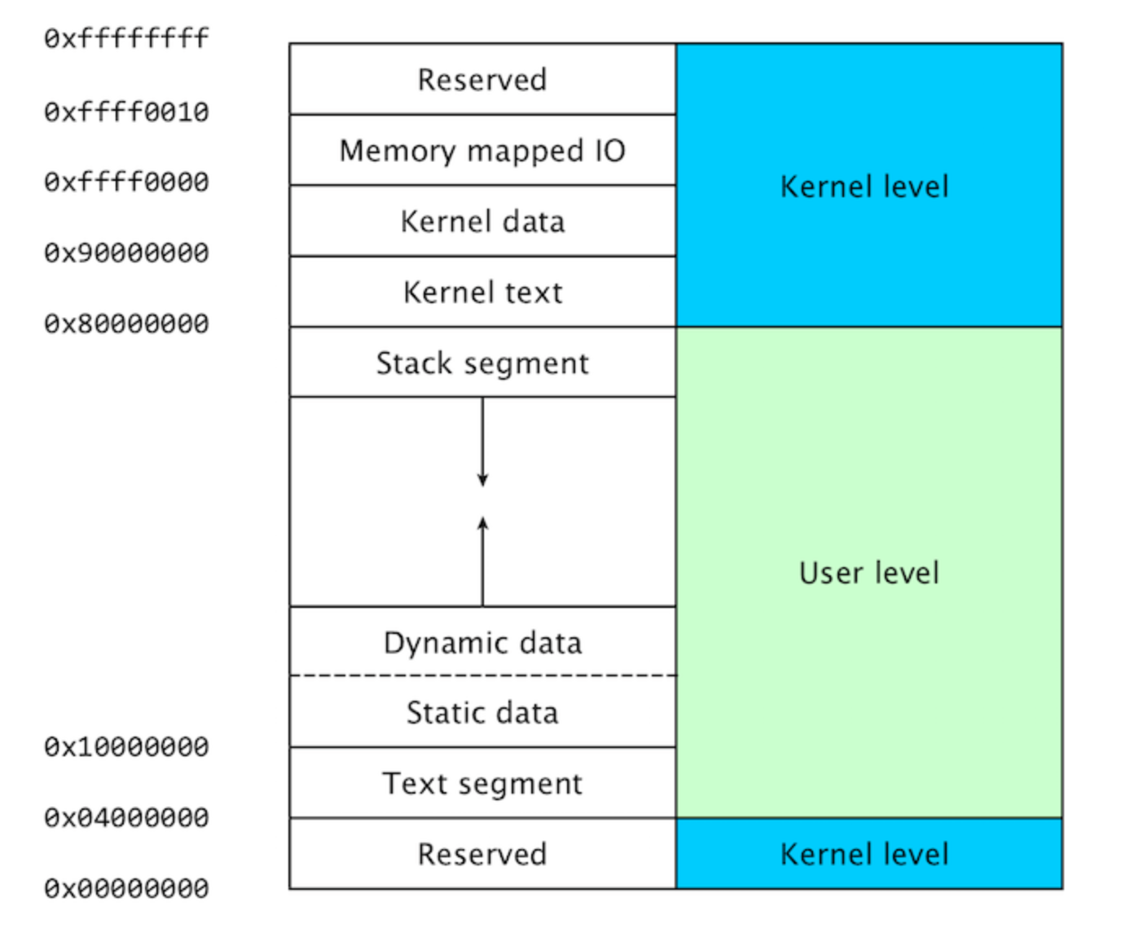
MIPS ISA (Architecture) Memory Layout
endiance: the order of bytes within a word
big: 1,2,3,4 (yy/mm/dd)
little: 4,3,2,1 (dd/mm/yy)
middle: 3,4,1,2 (mm/dd/yy)
Memory:
memory layout
byte addressable
lowest address at bottom
32-bit words
little endian format
Little endian format
recall 32-bit registers (4 bytes)
fall to the left
$fp
$sp
$gp
4: DE
3: AD
2: BE
1: EF
4: DE
3: AD
2: BE
1: EF
1: EF
2: BE
3: AD
4: DE

Slide 9
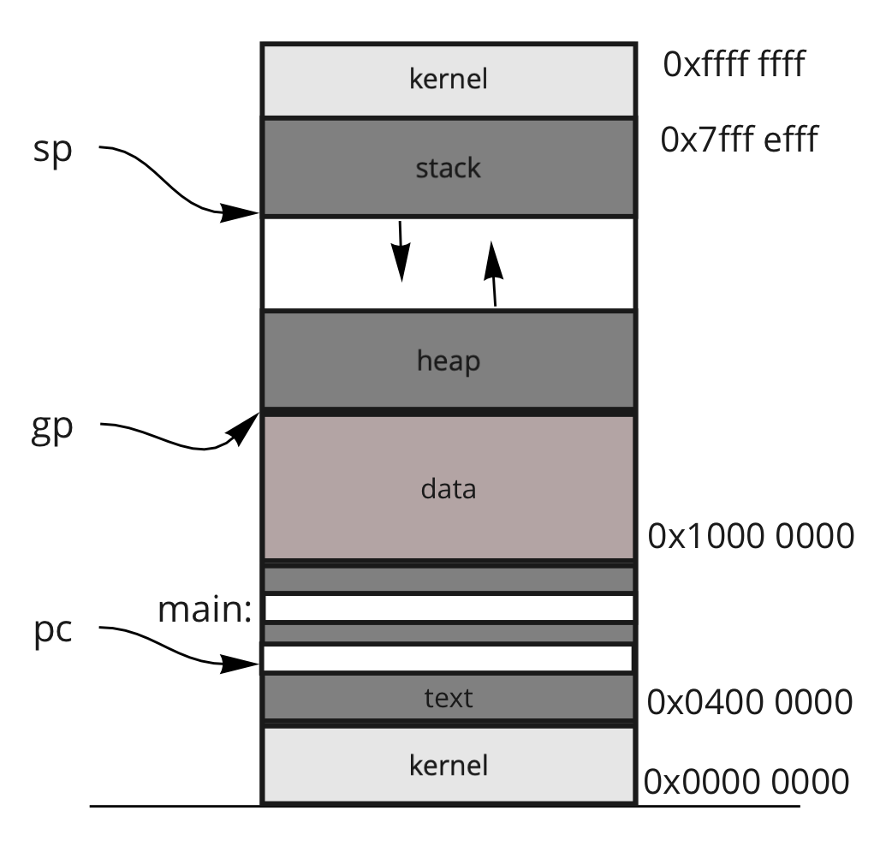
Main Memory
current address saved in a register
well-known addresses
View & Orientation
Array of Bytes: (i.e., byte addressable)
Data Segments: (to name a few)
.text
.data
.lit4, .lit8 (4 and 8 byte literals)
.bss (block storage)
heap
stack
Data Declarations and Sizes
.byte, .half, .word
.ascii, .asciiz
.float, .double
.space
Alignment
Endianness

Slide 10
Memory Organization (Java program)
class Main { public static int x = 5; int y = 7; public int addNumbers(int a, int b) { int sum = a + b; return sum; } public static void main(String[] args) { int num1 = 25; int num2 = 15; // create an object of Main Main obj = new Main(); int result = obj.addNumbers(num1, num2); System.out.println("Sum is: " + result); } }
STACK int a; int b;
}
Dynamic: Locations defined at runtime.
HEAP
Static: Locations are defined when the program starts.
.data
}
.text (INSTRUCTIONS)

Slide 11
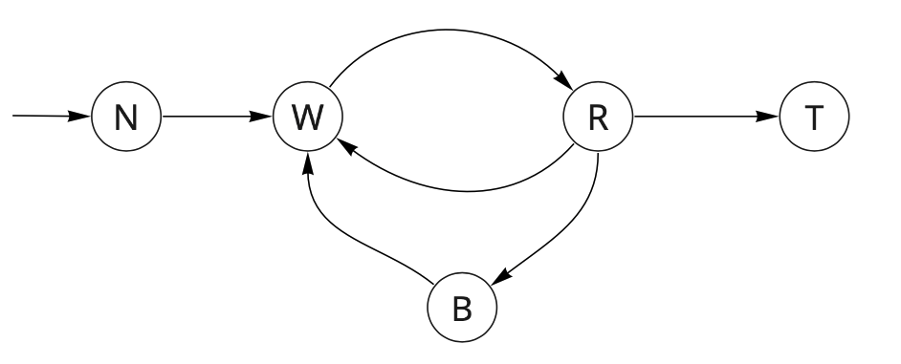
Process Status Diagram
dispatch
admit
exit
interrupt
Control of the computer moves through a well-defined cycle
Transitions:
admit: A request is made to allow your program to content for control
dispatch: Your program is given control
exit: Your program asserts that it is done
interrupt: The OS seizes control
trap: Your program (implicitly or explicitly) requests a service to be performed
completion: The request is satisfied
Traps are calls to the Kernel (the OS)
completion
trap

Slide 12
MIPS System Calls: SystemCallAPI.png
print integer
print float
print double
print string
read integer
read float
read double
read string
allocate memory
terminate
print character
read character
file open
file read
file write
file close

Slide 14
Three Address Code (TAC)
Examples:
a = y + x
a = y
a = x + 2
b = d * 2 + y
t0 = d * 2
t1 = t0 + y
b = t1
A generic assembly language in which all instructions have at most three addresses
An address references either
a register location
a memory location
Immediate values are stored in a location within memory
Assumption: the assembly language is for a register-based machine, with an infinite number of registers.

Slide 15
Basic Blocks
label:
x = 3;
z = 5;
y = 3; goto label2
A number of instructions in which there is
a single entry point (via a label), and
a single exit point (via a goto)
All programs can be broken down into a set of basic blocks
A control flow graph determines which a basic block is executed.
Standard control flow graphs
if-then-else and all other variants (e.g., switch)
while, do-while and all other variants
for loop and all other variants
call-return
label2:

