Slide 1
Control Flow, Call Graphs and Subroutine Construction

Slide 2
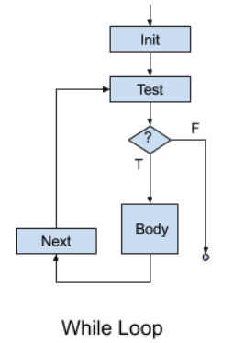
Control Flow Graph
A graphic representation of the representation between basic blocks
A basic block:
a list of instructions with
a single entry point (starting point)
a single exit point (last instruction)
Such representations model the behavior of our code
Recall the while loop, and other control structures
What about subroutines calls (subroutine: general term for … methods, functions, procedures, etc.)

Slide 3
Call Graph
a control flow graph depicting the relationships between subroutines
Call Graph for the "Hello World" program
main
print
print
println
class HelloWorld
{
public static void main(String args[])
{
System.out.print("Hello ");
System.out.print("World"); System.out.println("");
}
}
call:
return:

Slide 4
Call Graph II
main
public static void A(void) {
int x = 5;
C();
}
public static void B(void) {
C();
D();
}
public static void C(void) {
;
}
public static void D(void) {
;
}
public static void main(String args[])
{
A();
B();
}
}
A
B
D
C
leaf nodes

Slide 5
Call Graph with a Loop (Recursion)
main
public static void A(void) {
int x = 5;
C();
}
public static void B(void) {
C();
D();
}
public static void C(void) {
A();
}
public static void D(void) {
;
}
public static void main(String args[])
{
A();
B();
}
}
A
B
D
C
leaf node

Slide 6
Dynamic Call Graph (Runtime)
main
public static void A(void) {
static int x = 5;
C();
}
public static void B(void) {
C();
D();
}
public static void C(void) {
A();
}
public static void D(void) {
;
}
public static void main(String args[])
{
A();
B();
}
}
x = 5;
A
C
x = 5;
A
C

Slide 7
Memory Organization (Java program)
class Main { public static int x = 5; int y = 7; public int addNumbers(int a, int b) { int sum = a + b; return sum; } public static void main(String[] args) { int num1 = 25; int num2 = 15; // create an object of Main Main obj = new Main(); int result = obj.addNumbers(num1, num2); System.out.println("Sum is: " + result); } }
STACK int a; int b;
}
Dynamic: Locations defined at runtime.
HEAP
Static: Locations are defined when the program starts.
.data
}
.text (INSTRUCTIONS)

Slide 8
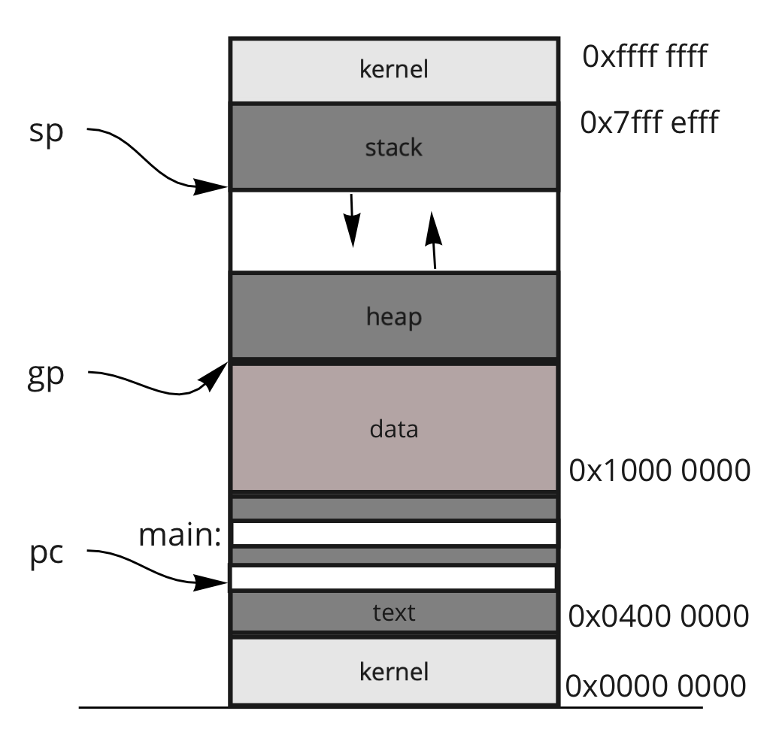
Frames
current address saved in a register
well-known addresses
Frame: a collection of variables:
Classes variables → "heap"
Methods variables → "stack"
Static variables → ".data"
args
locals
main
temps
args
fp:
A
locals
temps
args
sp:
C
locals
temps

Slide 9
Layout of the Frame
fp:
X
FormalArgs
X ⇔ 0($fp)
Y ⇔ -4($fp)
Z ⇔ -8($fp)
j ⇔ -12($fp)
k ⇔ -16($fp)
t0 ⇔ -20($fp)
-
t9 ⇔ -56($fp)
s0 ⇔ -60($fp)
s7 ⇔ -88($fp)
gp ⇔ -92($fp)
sp ⇔ -96($fp)
fp ⇔ -100($fp)
ra ⇔ -104($fp)
Y
Z
Locals
int my(int X, int Y, int Z) {
int j;
int k = Y + Z
j = sub(1, k, 3);
;
return j; }
When do we store values onto the frame?
in theory?
in practice?
j
k
t0
Referencing variables
Temps
My Frame
...
s0
...
gp
sp
fp
sp:
ra
1
Args to "sub"
sub(1,k,3)
k
sp:
3

Slide 10
Subroutine Transition: Calling a Subroutine
The Client (C) needs to:
Place actual args into the Frame
Precall (preparation for the call)
Transition
The Producer (P) needs to:
Setup
Do it's Thing
$ra = PC + 4; PC = P
precall
set up
C
P
C: nop ... nop # precall jal P nop nop # postcall
...
jr $ra # return
P: nop nop # set up
...
nop # cleanup
nop # return value
jr $ra

Slide 11
Subroutine Transition: Return from a Subroutine
The Client (C) needs to:
Postcall
Continue doing it's thing
The Producer (P) needs to:
Clean up
Position the return value
Transition back
C
P
postcall
PC = $ra
clean up
C: nop ... nop # precall jal P nop nop # postcall
...
jr $ra # return
P: nop nop # set up
...
nop # cleanup
nop # return value
jr $ra

Slide 12
MIPS: Subroutine Process
The Client (C) needs to:
Postcall ← Restore saved registers
Do it's Thing
The Producer (P) needs to:
Cleanup ← Restore S registers
Position the return value
Transition back
$ra = PC + 4; PC = P
precall
set up
C
P
postcall
PC = $ra
cleanup
C: nop ... nop # precall jal P nop nop # postcall
...
jr $ra # return
P: nop nop # set up
...
nop # cleanup
nop # return value
jr $ra

Slide 13
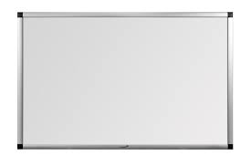
Subroutines
Save! s registers
Causes:
a change in control-flow: jal sub, jr $ra
a change in ownership of registers
A Subroutine Calling Convention Exists
pushing arguments onto the stack
MIPS Conventions ($a0, $a1, $a2, $a3) → {$v0, $v1}
preserving registers (e.g., temps) onto the stack
Special cases (short circuit the MIPS Calling Convention)
Main subroutine: the first subroutine in the dynamic call graph
No need to save the "s" registers upon entry
Give preference to "s" register utilization
Leaf Subroutines: the last subroutine in the dynamic call graph
Give preference to "t" register utilization

Slide 14
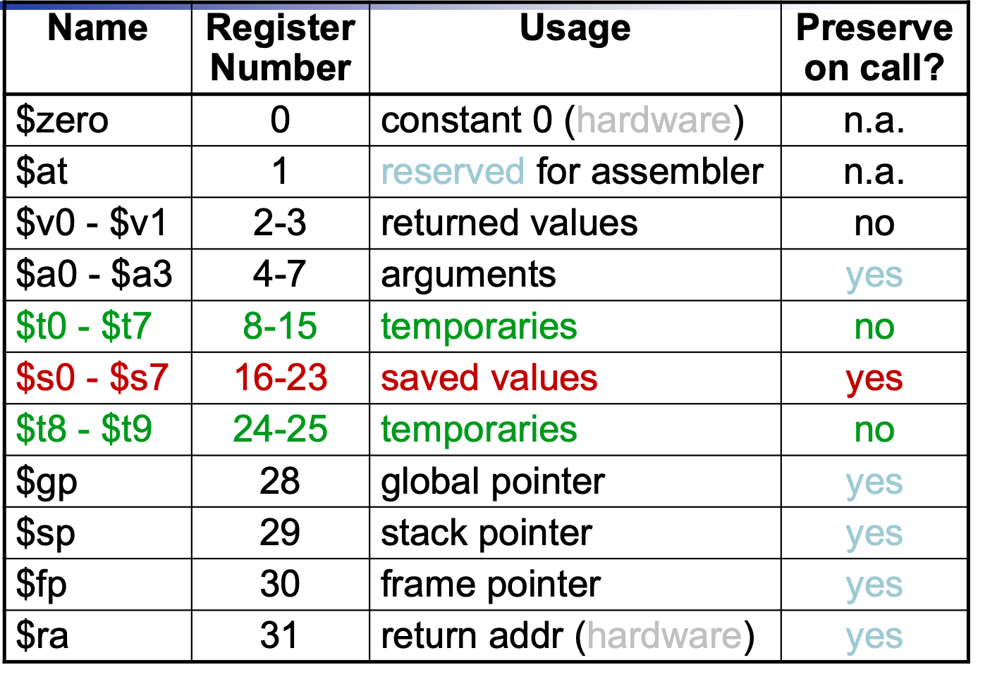
Shared Resource: Registers
You need to perform setup and cleanup routines for any shared resource!
Precall:
Save what you need,
Clear what you want private,
Leave alone what is passed along!
Brute Force Approach:
ignore: $zero, $at, $k1, $k2
save all other registers
especially:
$gp: might as well!
$sp: this is the end of my frame
$fp: this is the start of my frame
$ra: this is my "return to" location
C
P
save

Slide 15
Shared Resource: Registers
You need to perform setup and cleanup routines for any shared resource!
Semi-Optimal
ignore: $zero, $at, $k1, $k2
save only registers in local use
but always save:
$gp: might as well!
$sp: this is the end of my frame
$fp: this is the start of my frame
$ra: this is my "return to" location
used by both C & P
C
P
save

Slide 16
Shared Resource: Registers
You need to perform setup and cleanup routines for any shared resource!
MIPS Conventions
Client (C): saves:
all T registers
$gp: might as well!
$sp: this is the end of my frame
$fp: this is the start of my frame
$ra: this is my "return to" location
Provider (P): saves:
all S registers
C
P
save
save

Slide 17
Stack Operations
Push(a) ⇔ sp = sp + 1 sp[0] = a
x = Pop() ⇔
x = sp[0] sp = sp - 1
Stack is an abstract data structure
The stack is an array of words
Operations:
Push: Push(A), Push(B), Push(C)
Pop: X = Pop();
Push: Push(Z);
sp:
C
C
sp:
Z
sp:
B
B
sp:
B
B
sp:
A
A
A
A
A
sp:
Push(A);
Push(B);
Push(C);
X = Pop()
Push(Z)

Slide 18
But the MIPS Way
Push(a) ⇔
sp = sp - 1 sp[0] = a
x = Pop() ⇔
x = sp[0] sp = sp + 1
Stack is an abstract data structure
The stack is an array of words
Operations:
Push: Push(A), Push(B), Push(C)
Pop: X = Pop();
sp: points to the current top of stack
Push(a) ⇔
subi $sp, $sp, 4 sw $a0, 0($sp)
x = Pop() ⇔
lw $v0, 0($sp) addi $sp, $sp, 4
sp:
A
A
A
A
sp:
B
B
sp:
B
sp:
C
C
Push(A);
Push(B);
Push(C);
X = Pop()

Slide 19
Multiple Pushes / Pops
Push(a) ⇔
sp = sp - 1 sp[0] = a
x = Pop() ⇔
x = sp[0] sp = sp + 1
sp:
X
sp:
X
Push(t0);
Push(t1);
Push(t2);
sp:
Push(a) ⇔
subi $sp, $sp, 4 sw $a0, 0($sp)
x = Pop() ⇔
lw $v0, 0($sp) addi $sp, $sp, 4
t0
sp:
t1
sp:
t2
t0 = Pop();
t1 = Pop();
t2 = Pop();
sp:
X
sp:
X
subi $sp, $sp, 12
sw $t0, 8($sp)
sw $t1, 4($sp)
sw $t2, 0($sp)
t0
sp+8
t1
sp+4
lw $t0, 8($sp)
lw $t1, 4($sp)
lw $t2, 0($sp)
addi $sp, $sp, 12
sp:
t2
sp+0

Slide 20
Frames in Detail
int sub(int X, int Y, int Z) {
int j;
int k = Y + Z
j = sub(1, k, 3);
;
return j; }
fp:
X
Args
Y
Precall steps before "sub"
push args
save registers
jal sub # jump and link
Steps to set up
build the frame
fp = sp + arg_size
sp = fp - frame_size
save S registers
Steps to clean up
restore S registers
delete the frame (no need to!)
but sp = fp + 1
position the return value: ($sp), $v0
jr $ra # jump register
Postcall steps after "sub"
restore registers
move return value?
-4($sp), ($fp), or $v0
Z
Locals
j
k
X ⇔ 0($fp)
Y ⇔ -4($fp)
Z ⇔ -8($fp)
j ⇔ -12($fp)
k ⇔ -16($fp)
t0 ⇔ -20($fp)
-
t9 ⇔ -56($fp)
s0 ⇔ -60($fp)
s7 ⇔ -88($fp)
gp ⇔ -92($fp)
sp ⇔ -96($fp)
fp ⇔ -100($fp)
ra ⇔ -104($fp)
t0
Temps
Client's Frame
...
s0
...
gp
sp
fp
sp:
ra

Slide 21
Calling "sub"
Client
...
fp
int sub(int X, int Y, int Z) {
int j;
int k = Y + Z
j = sub(1, k, 3);
;
return j; }
sp:
ra
fp:
X
Y
Precall steps before "sub"
push args
save registers
jal sub # jump and link
Steps to set up
build the frame
fp = sp + arg_size
sp = fp - frame_size
save S registers
Steps to clean up
restore S registers
delete the frame (no need to!)
but sp = fp + 1
position the return value: ($sp), $v0
jr $ra # jump register
Postcall steps after "sub"
restore registers
move return value?
-4($sp), ($fp), or $v0
Z
j
k
X ⇔ 0($fp)
Y ⇔ -4($fp)
Z ⇔ -8($fp)
j ⇔ -12($fp)
k ⇔ -16($fp)
t0 ⇔ -20($fp)
...
t9 ⇔ -56($fp)
s0 ⇔ -60($fp)
s7 ⇔ -88($fp)
gp ⇔ -92($fp)
sp ⇔ -96($fp)
fp ⇔ -100($fp)
ra ⇔ -104($fp)
Client
t0
...
s0
...
gp
sp
fp
sp:
ra

Slide 22
Calling "sub"
Client
...
fp
int sub(int X, int Y, int Z) {
int j;
int k = Y + Z
j = sub(1, k, 3);
;
return j; }
sp:
ra
fp:
X
1
Precall steps before "sub"
push args
save registers
jal sub # jump and link
Steps to set up
build the frame
fp = sp + arg_size
sp = fp - frame_size
save S registers
Steps to clean up
restore S registers
delete the frame (no need to!)
but sp = fp + 1
position the return value: ($sp), $v0
jr $ra # jump register
Postcall steps after "sub"
restore registers
move return value?
-4($sp), ($fp), or $v0
Y
k
args
Z
sp:
3
j
k
X ⇔ 0($fp)
Y ⇔ -4($fp)
Z ⇔ -8($fp)
j ⇔ -12($fp)
k ⇔ -16($fp)
t0 ⇔ -20($fp)
...
t9 ⇔ -56($fp)
s0 ⇔ -60($fp)
s7 ⇔ -88($fp)
gp ⇔ -92($fp)
sp ⇔ -96($fp)
fp ⇔ -100($fp)
ra ⇔ -104($fp)
Client
t0
...
s0
...
gp
sp
fp
ra

Slide 23
Calling "sub"
Client
...
fp
int sub(int X, int Y, int Z) {
int j;
int k = Y + Z
j = sub(1, k, 3);
;
return j; }
sp:
ra
fp:
X
1
Precall steps before "sub"
push args
save registers
jal sub # jump and link
Steps to set up
build the frame
fp = sp + arg_size
sp = fp - frame_size
save S registers
Steps to clean up
restore S registers
delete the frame (no need to!)
but sp = fp + 1
position the return value: ($sp), $v0
jr $ra # jump register
Postcall steps after "sub"
restore registers
move return value?
-4($sp), ($fp), or $v0
Y
k
args
Z
sp:
3
j
k
X ⇔ 0($fp)
Y ⇔ -4($fp)
Z ⇔ -8($fp)
j ⇔ -12($fp)
k ⇔ -16($fp)
t0 ⇔ -20($fp)
...
t9 ⇔ -56($fp)
s0 ⇔ -60($fp)
s7 ⇔ -88($fp)
gp ⇔ -92($fp)
sp ⇔ -96($fp)
fp ⇔ -100($fp)
ra ⇔ -104($fp)
Client
t0
...
s0
...
gp
sp
fp
sp:
ra

Slide 24
Transition to "sub"
Client
...
fp
int sub(int X, int Y, int Z) {
int j;
int k = Y + Z
j = sub(1, k, 3);
;
return j; }
ra
fp:
X
1
Precall steps before "sub"
push args
save registers
jal sub # jump and link
Steps to set up
build the frame
fp = sp + arg_size
sp = fp - frame_size
save S registers
Steps to clean up
restore S registers
delete the frame (no need to!)
but sp = fp + 1
position the return value: ($sp), $v0
jr $ra # jump register
Postcall steps after "sub"
restore registers
move return value?
-4($sp), ($fp), or $v0
Y
k
args
Z
sp:
3
j
k
X ⇔ 0($fp)
Y ⇔ -4($fp)
Z ⇔ -8($fp)
j ⇔ -12($fp)
k ⇔ -16($fp)
t0 ⇔ -20($fp)
...
t9 ⇔ -56($fp)
s0 ⇔ -60($fp)
s7 ⇔ -88($fp)
gp ⇔ -92($fp)
sp ⇔ -96($fp)
fp ⇔ -100($fp)
ra ⇔ -104($fp)
Client
t0
...
s0
...
gp
sp
fp
sp:
ra

Slide 25
Producer: The set up
Client
...
fp
int sub(int X, int Y, int Z) {
int j;
int k = Y + Z
j = sub(1, k, 3);
;
return j; }
ra
fp:
X
1
Precall steps before "sub"
push args
save registers
jal sub # jump and link
Steps to set up
build the frame
fp = sp + arg_size
sp = fp - frame_size
save S registers
Steps to clean up
restore S registers
delete the frame (no need to!)
but sp = fp + 1
position the return value: ($sp), $v0
jr $ra # jump register
Postcall steps after "sub"
restore registers
move return value?
-4($sp), ($fp), or $v0
Y
k
args
Z
sp:
3
j
k
X ⇔ 0($fp)
Y ⇔ -4($fp)
Z ⇔ -8($fp)
j ⇔ -12($fp)
k ⇔ -16($fp)
t0 ⇔ -20($fp)
...
t9 ⇔ -56($fp)
s0 ⇔ -60($fp)
s7 ⇔ -88($fp)
gp ⇔ -92($fp)
sp ⇔ -96($fp)
fp ⇔ -100($fp)
ra ⇔ -104($fp)
Client
t0
...
s0
...
gp
sp
fp
sp:
ra

Slide 26
Producer: The set up
Client
...
fp
int sub(int X, int Y, int Z) {
int j;
int k = Y + Z
j = sub(1, k, 3);
;
return j; }
ra
X
fp:
1
Precall steps before "sub"
push args
save registers
jal sub # jump and link
Steps to set up
build the frame
fp = sp + arg_size
sp = fp - frame_size
save S registers
Steps to clean up
restore S registers
delete the frame (no need to!)
but sp = fp + 1
position the return value: ($sp), $v0
jr $ra # jump register
Postcall steps after "sub"
restore registers
move return value?
-4($sp), ($fp), or $v0
Y
k
args
Z
sp:
3
j
locals
X ⇔ 0($fp)
Y ⇔ -4($fp)
Z ⇔ -8($fp)
j ⇔ -12($fp)
k ⇔ -16($fp)
t0 ⇔ -20($fp)
...
t9 ⇔ -56($fp)
s0 ⇔ -60($fp)
s7 ⇔ -88($fp)
gp ⇔ -92($fp)
sp ⇔ -96($fp)
fp ⇔ -100($fp)
ra ⇔ -104($fp)
k
Producer
Client
t0
...
s0
...
temps
gp
sp
fp
ra
sp:

Slide 27
Producer: The set up
Client
...
fp
int sub(int X, int Y, int Z) {
int j;
int k = Y + Z
j = sub(1, k, 3);
;
return j; }
ra
X
fp:
1
Precall steps before "sub"
push args
save registers
jal sub # jump and link
Steps to set up
build the frame
fp = sp + arg_size
sp = fp - frame_size
save S registers
Steps to clean up
restore S registers
delete the frame (no need to!)
but sp = fp + 1
position the return value: ($sp), $v0
jr $ra # jump register
Postcall steps after "sub"
restore registers
move return value?
-4($sp), ($fp), or $v0
Y
k
args
Z
3
j
Producer
locals
X ⇔ 0($fp)
Y ⇔ -4($fp)
Z ⇔ -8($fp)
j ⇔ -12($fp)
k ⇔ -16($fp)
t0 ⇔ -20($fp)
...
t9 ⇔ -56($fp)
s0 ⇔ -60($fp)
s7 ⇔ -88($fp)
gp ⇔ -92($fp)
sp ⇔ -96($fp)
fp ⇔ -100($fp)
ra ⇔ -104($fp)
k
Client
t0
...
s0
s0
...
...
temps
gp
sp
fp
ra
sp:

Slide 28
Executing "sub"
Client
...
{
fp
int sub(int X, int Y, int Z) {
int j;
int k = Y + Z
j = sub(1, k, 3);
;
return j; }
ra
X
fp:
1
Precall steps before "sub"
push args
save registers
jal sub # jump and link
Steps to set up
build the frame
fp = sp + arg_size
sp = fp - frame_size
save S registers
Steps to clean up
restore S registers
delete the frame (no need to!)
but sp = fp + 1
position the return value: ($sp), $v0
jr $ra # jump register
Postcall steps after "sub"
restore registers
move return value?
-4($sp), ($fp), or $v0
Y
k
args
Z
3
j
j
Producer
locals
X ⇔ 0($fp)
Y ⇔ -4($fp)
Z ⇔ -8($fp)
j ⇔ -12($fp)
k ⇔ -16($fp)
t0 ⇔ -20($fp)
...
t9 ⇔ -56($fp)
s0 ⇔ -60($fp)
s7 ⇔ -88($fp)
gp ⇔ -92($fp)
sp ⇔ -96($fp)
fp ⇔ -100($fp)
ra ⇔ -104($fp)
k
k
Client
t0
t0
...
...
s0
s0
...
...
temps
gp
gp
sp
sp
fp
fp
ra
sp:
ra

Slide 29
Returning from "sub"
Client
...
fp
int sub(int X, int Y, int Z) {
int j;
int k = Y + Z
j = sub(1, k, 3);
;
return j; }
ra
X
fp:
1
Precall steps before "sub"
push args
save registers
jal sub # jump and link
Steps to set up
build the frame
fp = sp + arg_size
sp = fp - frame_size
save S registers
Steps to clean up
restore S registers
delete the frame (no need to!)
but sp = fp + 1
position the return value: ($sp), $v0
jr $ra # jump register
Postcall steps after "sub"
restore registers
move return value?
-4($sp), ($fp), or $v0
Y
k
args
Z
3
j
j
locals
X ⇔ 0($fp)
Y ⇔ -4($fp)
Z ⇔ -8($fp)
j ⇔ -12($fp)
k ⇔ -16($fp)
t0 ⇔ -20($fp)
...
t9 ⇔ -56($fp)
s0 ⇔ -60($fp)
s7 ⇔ -88($fp)
gp ⇔ -92($fp)
sp ⇔ -96($fp)
fp ⇔ -100($fp)
ra ⇔ -104($fp)
k
k
Producer
Client
t0
t0
...
...
s0
s0
...
...
temps
gp
gp
sp
sp
fp
fp
ra
sp:
ra

Slide 30
Returning from "sub"
Client
...
fp
int sub(int X, int Y, int Z) {
int j;
int k = Y + Z
j = sub(1, k, 3);
;
return j; }
ra
X
fp:
1
Precall steps before "sub"
push args
save registers
jal sub # jump and link
Steps to set up
build the frame
fp = sp + arg_size
sp = fp - frame_size
save S registers
Steps to clean up
restore S registers
delete the frame (no need to!)
but sp = fp + 1
position the return value: ($sp), $v0
jr $ra # jump register
Postcall steps after "sub"
restore registers
move return value?
-4($sp), ($fp), or $v0
Y
k
args
Z
3
j
j
locals
X ⇔ 0($fp)
Y ⇔ -4($fp)
Z ⇔ -8($fp)
j ⇔ -12($fp)
k ⇔ -16($fp)
t0 ⇔ -20($fp)
...
t9 ⇔ -56($fp)
s0 ⇔ -60($fp)
s7 ⇔ -88($fp)
gp ⇔ -92($fp)
sp ⇔ -96($fp)
fp ⇔ -100($fp)
ra ⇔ -104($fp)
k
k
Producer
Client
t0
t0
...
...
s0
s0
lw $s0, -60($fp)
lw $s1, -64($fp)
lw $s2, -68($fp)
…
lw $s7, -88($fp)
...
...
temps
gp
gp
sp
sp
fp
fp
ra
sp:
ra

Slide 31
Returning from "sub"
Client
...
fp
int sub(int X, int Y, int Z) {
int j;
int k = Y + Z
j = sub(1, k, 3);
;
return j; }
sp:
ra
X
fp:
1
Precall steps before "sub"
push args
save registers
jal sub # jump and link
Steps to set up
build the frame
fp = sp + arg_size
sp = fp - frame_size
save S registers
Steps to clean up
restore S registers
delete the frame (no need to!)
but sp = fp + 1
position the return value: ($sp), $v0
jr $ra # jump register
Postcall steps after "sub"
restore registers
move return value?
-4($sp), ($fp), or $v0
Y
k
args
Z
3
j
j
Producer
locals
X ⇔ 0($fp)
Y ⇔ -4($fp)
Z ⇔ -8($fp)
j ⇔ -12($fp)
k ⇔ -16($fp)
t0 ⇔ -20($fp)
...
t9 ⇔ -56($fp)
s0 ⇔ -60($fp)
s7 ⇔ -88($fp)
gp ⇔ -92($fp)
sp ⇔ -96($fp)
fp ⇔ -100($fp)
ra ⇔ -104($fp)
k
k
Client
t0
t0
...
...
s0
s0
...
...
temps
gp
gp
sp
sp
fp
fp
ra
sp:
ra

Slide 32
Returning from "sub"
Client
...
fp
int sub(int X, int Y, int Z) {
int j;
int k = Y + Z
j = sub(1, k, 3);
;
return j; }
ra
sp:
X
fp:
j
Precall steps before "sub"
push args
save registers
jal sub # jump and link
Steps to set up
build the frame
fp = sp + arg_size
sp = fp - frame_size
save S registers
Steps to clean up
restore S registers
delete the frame (no need to!)
but sp = fp + 1
position the return value: ($sp), $v0
jr $ra # jump register
Postcall steps after "sub"
restore registers
move return value?
-4($sp), ($fp), or $v0
Y
k
args
Z
3
j
j
locals
X ⇔ 0($fp)
Y ⇔ -4($fp)
Z ⇔ -8($fp)
j ⇔ -12($fp)
k ⇔ -16($fp)
t0 ⇔ -20($fp)
...
t9 ⇔ -56($fp)
s0 ⇔ -60($fp)
s7 ⇔ -88($fp)
gp ⇔ -92($fp)
sp ⇔ -96($fp)
fp ⇔ -100($fp)
ra ⇔ -104($fp)
k
k
Producer
Client
t0
t0
...
...
s0
s0
...
...
temps
gp
gp
sp
sp
fp
fp
ra
ra

Slide 33
Transition back
Client
...
fp
int sub(int X, int Y, int Z) {
int j;
int k = Y + Z
j = sub(1, k, 3);
;
return j; }
ra
sp:
X
fp:
i
Precall steps before "sub"
push args
save registers
jal sub # jump and link
Steps to set up
build the frame
fp = sp + arg_size
sp = fp - frame_size
save S registers
Steps to clean up
restore S registers
delete the frame (no need to!)
but sp = fp + 1
position the return value: ($sp), $v0
jr $ra # jump register
Postcall steps after "sub"
restore registers
move return value?
-4($sp), ($fp), or $v0
Y
k
args
Z
3
j
j
locals
X ⇔ 0($fp)
Y ⇔ -4($fp)
Z ⇔ -8($fp)
j ⇔ -12($fp)
k ⇔ -16($fp)
t0 ⇔ -20($fp)
...
t9 ⇔ -56($fp)
s0 ⇔ -60($fp)
s7 ⇔ -88($fp)
gp ⇔ -92($fp)
sp ⇔ -96($fp)
fp ⇔ -100($fp)
ra ⇔ -104($fp)
k
k
Producer
Client
t0
t0
...
...
s0
s0
...
...
temps
gp
gp
sp
sp
fp
fp
ra
ra

Slide 34
Client: The Postcall
Client
...
fp
int sub(int X, int Y, int Z) {
int j;
int k = Y + Z
j = sub(1, k, 3);
;
return j; }
ra
sp:
X
fp:
j
Precall steps before "sub"
push args
save registers
jal sub # jump and link
Steps to set up
build the frame
fp = sp + arg_size
sp = fp - frame_size
save S registers
Steps to clean up
restore S registers
delete the frame (no need to!)
but sp = fp + 1
position the return value: ($sp), $v0
jr $ra # jump register
Postcall steps after "sub"
restore registers
move return value?
-4($sp), ($fp), or $v0
Y
k
args
Z
Z
j
j
locals
X ⇔ 0($fp)
Y ⇔ -4($fp)
Z ⇔ -8($fp)
j ⇔ -12($fp)
k ⇔ -16($fp)
t0 ⇔ -20($fp)
...
t9 ⇔ -56($fp)
s0 ⇔ -60($fp)
s7 ⇔ -88($fp)
gp ⇔ -92($fp)
sp ⇔ -96($fp)
fp ⇔ -100($fp)
ra ⇔ -104($fp)
k
k
Producer
Client
t0
t0
...
...
s0
s0
...
...
temps
gp
gp
sp
sp
fp
fp
ra
sp:
ra

Slide 35
Client: The set up
Client
...
fp
int sub(int X, int Y, int Z) {
int j;
int k = Y + Z
j = sub(1, k, 3);
;
return j; }
sp:
ra
fp:
X
fp:
1
Y
Precall steps before "sub"
push args
save registers
jal sub # jump and link
Steps to set up
build the frame
fp = sp + arg_size
sp = fp - frame_size
save S registers
Steps to clean up
restore S registers
delete the frame (no need to!)
but sp = fp + 1
position the return value: ($fp), $v0
jr $ra # jump register
Postcall steps after "sub"
restore registers
move return value?
-4($sp), ($fp), or $v0
k
Z
Z
j
j
k
k
X ⇔ 0($fp)
Y ⇔ -4($fp)
Z ⇔ -8($fp)
j ⇔ -12($fp)
k ⇔ -16($fp)
t0 ⇔ -20($fp)
...
t9 ⇔ -56($fp)
s0 ⇔ -60($fp)
s7 ⇔ -88($fp)
gp ⇔ -92($fp)
sp ⇔ -96($fp)
fp ⇔ -100($fp)
ra ⇔ -104($fp)
Client
lw $sp, 4($fp)
lw $fp, 4($sp)
-------------
lw $t0, -20($fp)
lw $t1, -24($fp)
…
lw $ra, -104($fp)
t0
t0
...
...
s0
s0
...
...
gp
gp
sp
sp
fp
fp
sp:
ra
ra

Slide 36
Client: The Postcall
Client
...
fp
int sub(int X, int Y, int Z) {
int j;
int k = Y + Z
j = sub(1, k, 3);
;
return j; }
sp:
ra
fp:
X
j
Y
Precall steps before "sub"
push args
save registers
jal sub # jump and link
Steps to set up
build the frame
fp = sp + arg_size
sp = fp - frame_size
save S registers
Steps to clean up
restore S registers
delete the frame (no need to!)
but sp = fp + 1
position the return value: ($fp), $v0
jr $ra # jump register
Postcall steps after "sub"
restore registers
move return value?
-4($sp), ($fp), or $v0
k
Z
Z
j
j
k
k
X ⇔ 0($fp)
Y ⇔ -4($fp)
Z ⇔ -8($fp)
j ⇔ -12($fp)
k ⇔ -16($fp)
t0 ⇔ -20($fp)
...
t9 ⇔ -56($fp)
s0 ⇔ -60($fp)
s7 ⇔ -88($fp)
gp ⇔ -92($fp)
sp ⇔ -96($fp)
fp ⇔ -100($fp)
ra ⇔ -104($fp)
Producer
Client
t0
t0
...
...
old data
s0
s0
...
...
gp
gp
sp
sp
fp
fp
sp:
ra
ra
1

Slide 37
The Next Instruction:
int sub(int X, int Y, int Z) {
int j;
int k = Y + Z
j = sub(1, k, 3);
;
return j; }
fp:
X
Y
Precall steps before "sub"
push args
save registers
jal sub # jump and link
Steps to set up
build the frame
fp = sp + arg_size
sp = fp - frame_size
save S registers
Steps to clean up
restore S registers
delete the frame (no need to!)
but sp = fp + 1
position the return value: ($fp), $v0
jr $ra # jump register
Postcall steps after "sub"
restore registers
move return value?
-4($sp), ($fp), or $v0
Z
j
k
X ⇔ 0($fp)
Y ⇔ -4($fp)
Z ⇔ -8($fp)
j ⇔ -12($fp)
k ⇔ -16($fp)
t0 ⇔ -20($fp)
...
t9 ⇔ -56($fp)
s0 ⇔ -60($fp)
s7 ⇔ -88($fp)
gp ⇔ -92($fp)
sp ⇔ -96($fp)
fp ⇔ -100($fp)
ra ⇔ -104($fp)
Client
t0
...
s0
...
gp
sp
fp
sp:
ra

Slide 38
Client -- Producer Convention Caveats:
Main Memory is slow:
first 4 arguments should not be passed via the stack but via: $a0, $a1, $a2, $a3
the 2 return values should not be passed via the stack but via: $v0, $v1
Although there are 32 general purpose registers:
Can't use: $zero, $at, $k1, $k2
If you use: $gp, $sp, $fp, $ra
you must take steps to save--restore these registers at call boundaries
if you use: $a0, $a1, $a2, $a3, $v0, $v1
you must take steps to save--restore these registers at call boundaries
A compiler MUST follow this convention,
but the assembly level programmer can "optimize" their code!

