Slide 1
Lecture:
Last Time:
  Control Lines and the CPU
    On-Off Switch
    Decoder to select which register.
    Mux to select ALU Output
    CPU Overview: Data with some control lines.
    High-level memory schematic
  Questions
Today:
  Sequential Circuits: clocks, latches, and flip/flops:
  CPU Control: PC/IR
  MIPS pipeline architecture

Slide 2
Sequential Circuit
Sequential circuit infuses a memory component
Memory serves as both input and output
A clock is used to trigger the update of the memory unit
Combinational
Circuit
Inputs
Outputs
Memory
Unit
Clock

Slide 3
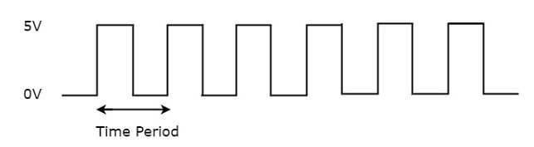
Clock: an electronic device
Generates a periodic signal
Forms a square wave
Frequence = 1 / (Time Period)
Used as a control signal to active parts of a circuit
Types of Triggers:*
  Level Trigger
  Edge Trigger
Level of Triggers:
  Positive Level (Hi)
  Negative Level (Lo)
* Recall you can active some GUI elements on a mouse click, mouse press, OR a mouse release

Slide 4
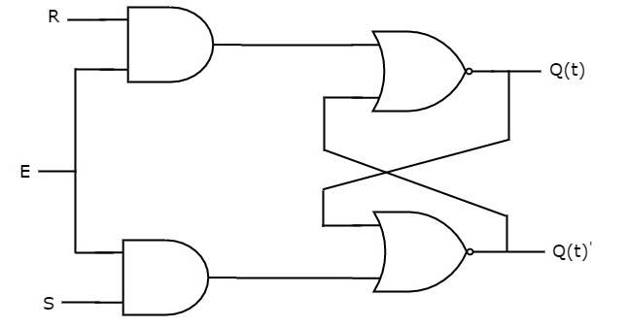
SR Latch
Memory Cell
Q(t)
S | R | Q(t+1)
0 | 0 | Q(t)
0 | 1 | 0
1 | 0 | 1
1 | 1 | -
SR Latch also called a Set and Reset Latch
Functionally:
  E: Used to enabled the circuit: i.e., trigger an update
  R: Used to clear (reset) the memory unit
  S: Used to set the memory unit
memory
unit
Q(t)'
Q(t+1)
Q(t+1)
Must be complements
Q(t)
Q(t+1)'
A | B | NOR
0 | 0 | 1
0 | 1 | 0
1 | 0 | 0
1 | 1 | 0

Slide 5
SR Latch: Set at (1,0)
S | R | Q(t+1)
0 | 0 | Q(t)
0 | 1 | 0
1 | 0 | 1
1 | 1 | -
SR Latch also called a Set and Reset Latch
Functionally:
  E: Used to enabled the circuit: i.e., trigger an update
  R: Used to clear (reset) the memory unit
  S: Used to set the memory unit
memory
unit
1
Q(t) == ?
1
1
Q(t+1)
0000000000
10
Must be complements
1
00
1000000
A | B | NOR
0 | 0 | 1
0 | 1 | 0
1 | 0 | 0
1 | 1 | 0
1
1
Consider
with Q=0

Slide 6

D Latch: Data Latch
E | D | Q(t+1)
0 | 0 | Q(t)
0 | 1 | Q(t)
1 | 0 (reset) | 0
1 | 1 (set) | 1
Forces S & R to be complements
Functionally:
  E: Used to trigger the memory unit, i.e., perform a write
  D': Used to clear (reset) the memory unit
  D: Used to set the memory unit
memory
unit
1
1
1
1
Must be complements
0
A | B | NOR
0 | 0 | 1
0 | 1 | 0
1 | 0 | 0
1 | 1 | 0
0
0
D

Slide 7
Latches and Flip-Flops
Logically the same!
Clk / E
Latches:
  RS Latch
  D Latch
  JK Latch
  T Latch
Flip-Flop:
  RS Flip-Flop
  D Flip-Flop
  JK Flip-Flop
  T Flip-Flop
D
Differences:
Latches | Flip-flops
Different underlying technology is used
Uses a enable signal | Uses a clock signal
Level triggered | Edge triggered
Consumes less power | Consumes more power
Faster | Slower
Used for transitioning (Consider a lock, e.g., at the Panama Canal.) | Used as storage

Slide 8
4-bit Register
D Flip-Flop
D₃
D₂
D₁
D₀
FF₃
FF₂
FF₁
FF₀
Clk
Q₃
Q₂
Q₁
Q₀

Slide 9
What do we have now?
Basic understanding of circuitry and its relationship to Boolean algebra.
Knowledge of "state" and how it is used to build registers and memory units
Recognize how we can build components to build a CPU
  ALU, registers, decoders, multiplexers, etc., as well as main memory.
Almost ready for the abstract all this away in favor of an ISA
Instruction Set Architecture
But first, let's put all the pieces together to create the MIPS microarchitecture!

Slide 10
MIPS: CPU Control
.text
int f( int a) {
int x;
int y;
int b;
x = a + 2;
b = ( x > 0 )
if ( b )
x = x + b;
y = x * 3;
y = y << 2 ;
return y;
}
pc
The CPU executes specific circuitry in stepwise fashion
  Fetch, Decode, Execute, Mem Access, WriteBack
  Unnamed Latches are used between each phase
PC: Program Counter
  Holds the address of the NEXT instruction to be executed
  The PC is increment by 1 instruction, i.e., 4 bytes, every cycle
  Each instruction requires 4 bytes to encode
IR: Instruction Register
  Stores the current instruction to be executed
  Each instruction is decoded (electronically) to trigger operations in the circuitry
  Three types of encodings: R, I, J
    Operations involving the Registers and ALU
    Operations involving Immediate values
    Operations involving Jumps and Branches
ir:
encoding of: x = a + 2

Slide 11
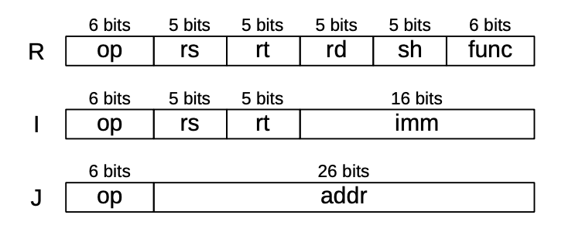
MIPS Instruction Set
Encoding: Instruction Register
Jump and Branch examples:
  jal address ⇔ function call
  jr rs ⇔ function return
  beq rs, rt, imm ⇔ if (rs == rt ) goto imm
ALU examples:
  add rd, rs, rt ⇔ rd = rs + rt
  ori rd, rs, imm ⇔ rd = rs | SignExt(imm)
Memory examples:
  la rs, label ⇔ → $rs = &A
  lb rt, imm(rs) ⇔ rt = SignExt( M₁ [rs + imm] ) → $rt = (char) A[0]
  lwu rt, imm(rs) ⇔ rt = M₄ [rs + imm] → $rt = (unsigned word) ( A[16] )
  sh rt, imm(rs) ⇔ M₂ [rs + imm] = rt → A[32] = (half) $rt

Slide 12
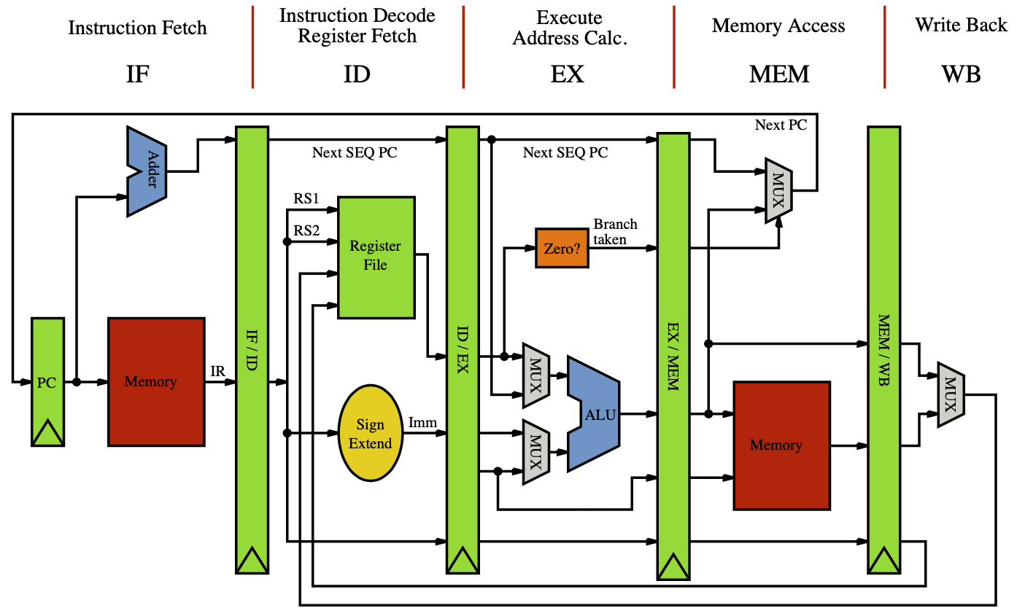
MIPS Pipeline Architecture
Fives Stages →
Major Sections:
  PC update
  ALU
  Memory
PC update
  next instruction
  branch
  (PC + 4) / ALU mux
ALU
  imm / register mux
  register / PC mux
Memory
  Harvard Model
  ALU / memory mux
label

Slide 13
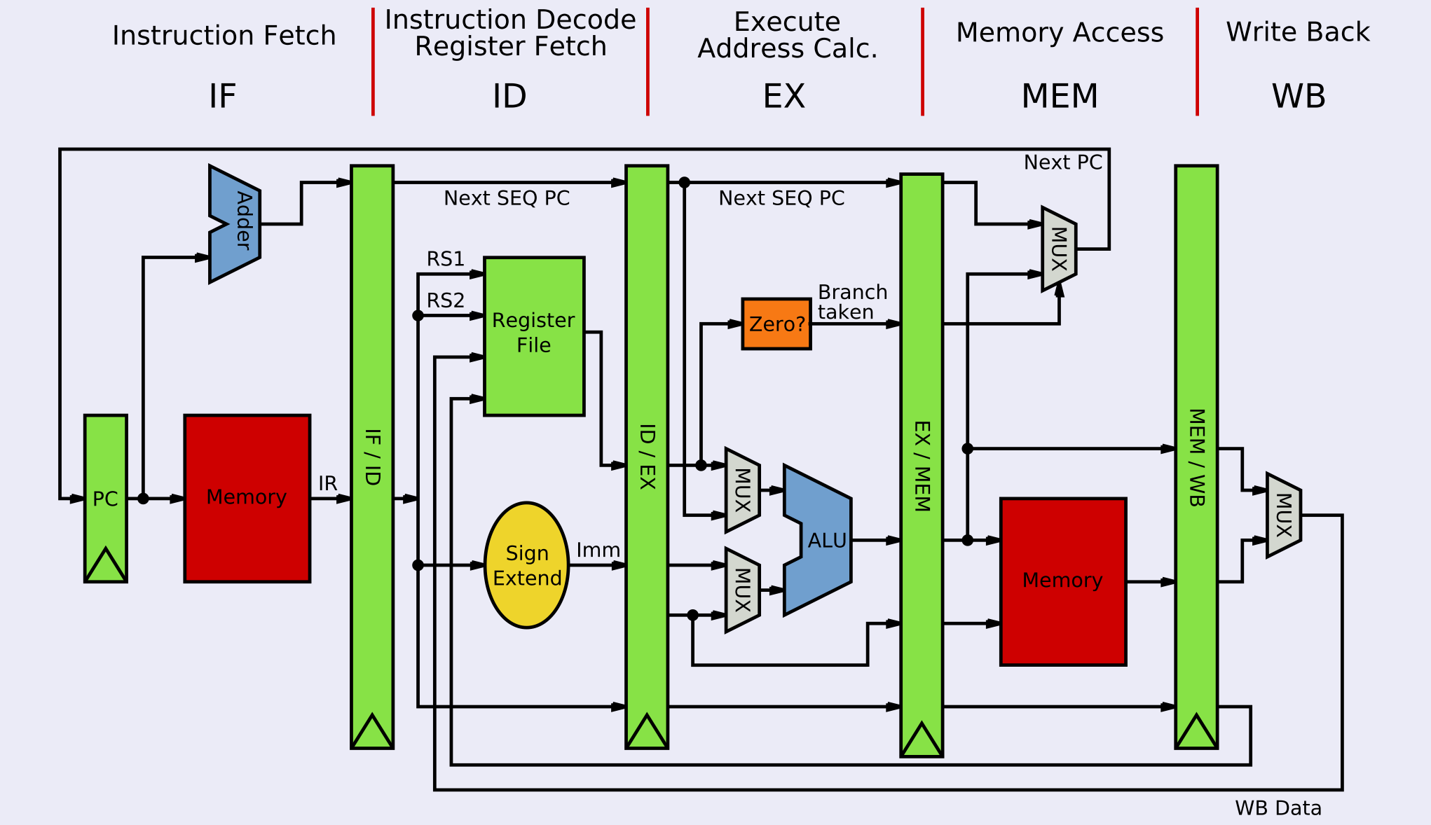
MIPS Pipeline Execution
Instruction | Clock 1 | Clock 2 | Clock 3 | Clock 4 | Clock 5 | Clock 6 | Clock 7 | Clock 8
#1 | Fetch | Decode | Execute | Mem | WB | Fetch #6
#2 |  | Fetch | Decode | Execute | Mem | WB
#3 |  |  | Fetch | Decode | Execute | Mem | WB
#4 |  |  |  | Fetch | Decode | Execute | Mem | WB
#5 |  |  |  |  | Fetch | Decode | Execute | Mem

Slide 14
label
IR

Slide 15
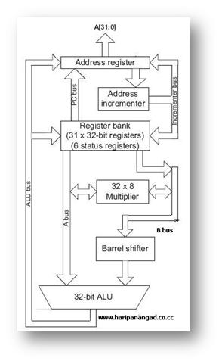
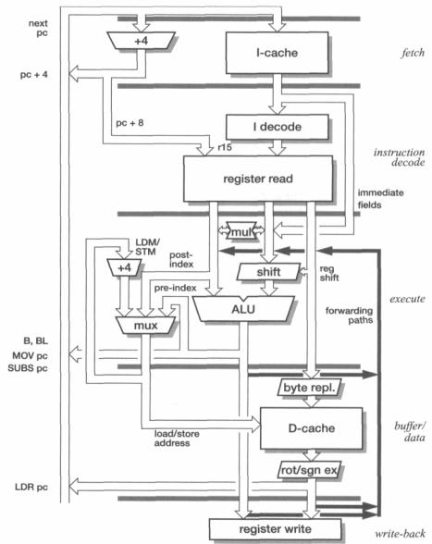
Physical Architectures: Examples

