Slide 1
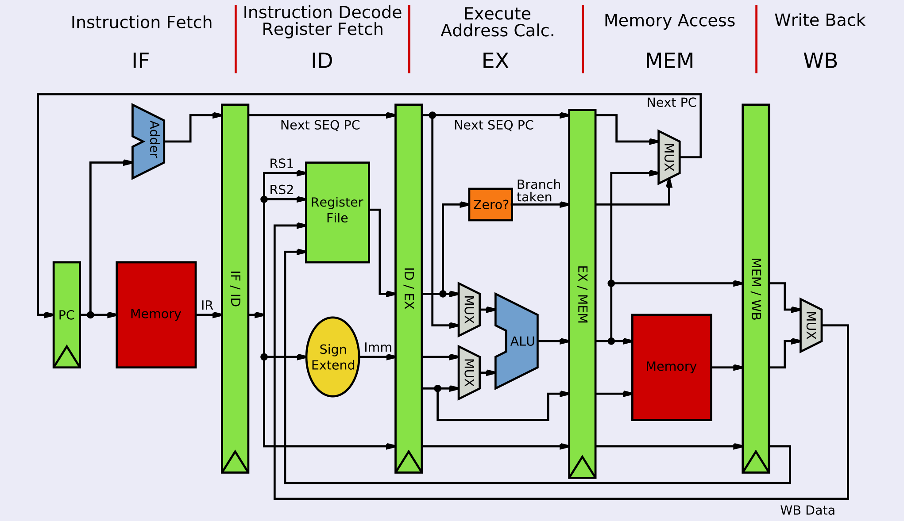
MIPS Microarchitecture

Slide 2
Instruction Set Architectures
endiance: the order of bytes within a word
big: 1,2,3,4 (yy/mm/dd)
little: 4,3,2,1 (dd/mm/yy)
middle: 3,4,1,2 (mm/dd/yy)
The ISA is one level above the physical architecture
Defines the following:
Supported instruction and their semantics
Supported data types
Registers: size, number, and purpose
Memory: layout, addressing, alignment, endiance
Memory is an array of bytes
OS interface:
Does not define the following:
technology used
chip layout
memory implementation
etc
Very Similar to an API:
RISC versus CISC
Reduced Instruction Set Computer (RISC)
Complex Instruction Set Computer (CISC)
RISC Examples
ARM
MIPS
CISC Examples
AMD
INTEL
x86
x86
Easy Read: https://medium.com/swlh/what-does-risc-and-cisc-mean-in-2020-7b4d42c9a9de

Slide 3
Universal Computer
memory
The OS
TM(Q, Σ, 𝚪, 𝛅, q0)
Tape: sufficiently large
A specialized control unit (aka firmware)
A specialized program placed on tape
A generic program placed on tape
Input coming from an I/O device
control unit
h
e
l
l
o
$
$
Sufficiently Large Tape
input string:
$
Universal Computer
Your program

Slide 4
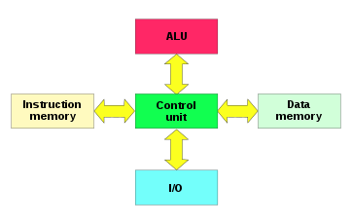
Generalized Execution Cycle
Fetch:
Move the instruction into the control unit
Decode
Set control lines to allow data to flow to ALU
Execute
Activate the ALU
Writeback
Write the data to a register or memory
Harvard Memory

Slide 5
MIPS Microarchitecture

Slide 6
MIPS Pipeline Execution
Instruction | Clock 1 | Clock 2 | Clock 3 | Clock 4 | Clock 5 | Clock 6 | Clock 7 | Clock 8
#1 | Fetch | Decode | Execute | Mem | WB | Fetch #6
#2 |  | Fetch | Decode | Execute | Mem | WB
#3 |  |  | Fetch | Decode | Execute | Mem | WB
#4 |  |  |  | Fetch | Decode | Execute | Mem | WB
#5 |  |  |  |  | Fetch | Decode | Execute | Mem

Slide 7
Instruction Set Architectures
endiance: the order of bytes within a word
big: 1,2,3,4 (yy/mm/dd)
little: 4,3,2,1 (dd/mm/yy)
middle: 3,4,1,2 (mm/dd/yy)
The ISA is one level above the physical architecture
Defines the following:
Supported instruction and their semantics
Supported data types
Registers: size, number, and purpose
Memory: layout, addressing, alignment, endiance
Memory is an array of bytes
OS interface:
Does not define the following:
technology used
chip layout
memory implementation
etc
Very Similar to an API:
RISC versus CISC
Reduced Instruction Set Computer (RISC)
Complex Instruction Set Computer (CISC)
RISC Examples
ARM
MIPS
CISC Examples
AMD
INTEL
x86
x86
Easy Read: https://medium.com/swlh/what-does-risc-and-cisc-mean-in-2020-7b4d42c9a9de

Slide 8
MIPS ISA Architecture: Instructions
MEM
0
1
2
3
Three basic instruction types
Arithmetic, bitwise logic, etc.
Data transfers
Basic control flow
Examples:
add $v0, $v0, $a0 # $v0 = $v0 + $a0
addi $v0, $v0, 2 # $v0 = $v0 + 2
srl $a0, $a1, 4 # $a0 = $a1 >>> 4
li $t0, 4 # $t0 = 4
move $t1, $t2 # $t1 = $t2
lb $s0, 0($t0) # $s0 = MEM[$t0] lh $s1, 3($t0) # $s1 = concat(MEM[$t0+3+1],MEM[$t0+3+0])
beq $t3, $t5, label # if ($t3 == $t5) goto label
jal proc # method()
t0:
4
n-1
$t0 = 4; 0($t0) ⇔ $t0[0]

Slide 9
Category of Instructions
native instructions:
defined by the ISA, directly corresponds to a hardware operation
idioms:
defined by the ISA, an alternate form of a hardware instruction
b label
beq $zero, $zero, label
pseudo instructions:
an alternate syntactic form of an instruction
pseudo instruction is textual replaced with native instruction
lb $t1, label+offset
lui $at, &label
lb $t1, offset($at)
macros:
user-defined pseudo instruction
average $v0, $t2, $t3
average($v0, $t2, $t3)
subroutines
user defined abstraction, resulting
jal subroutine
nop
a change in control-flow
a ownership of registers
.macro average(%d, %s, %t) addu %d, %s, %t
srl %d, 2
.end_macro
.text
subroutine: nop
jr $ra

Slide 10
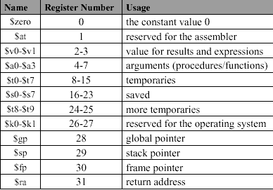
MIPS ISA Architecture: Registers
Data types:
byte, half, word
integer (signed/unsigned), binary32, binary64
Registers:
32: 32-bit integer registers
32: 32-bit floating point registers
binary32: $fp0 .. $fp31
binary64: {$fp0, $fp1} .. {$fp30, $fp31}
3: system registers: pc, hi, lo
Integer Registers

Slide 11
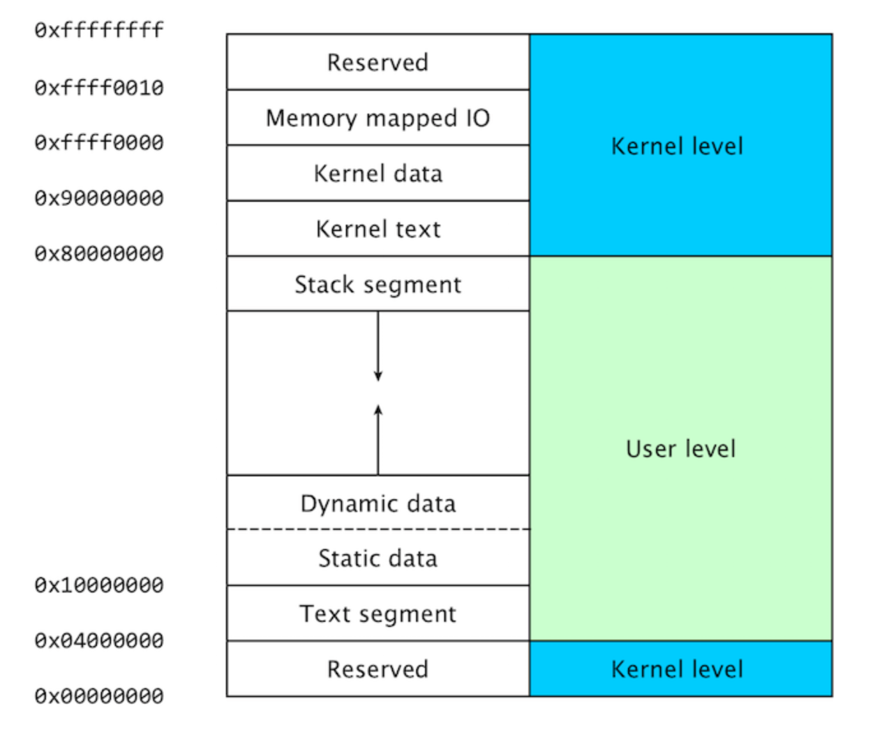
MIPS ISA (Architecture) Memory Layout
endiance: the order of bytes within a word
big: 1,2,3,4 (yy/mm/dd)
little: 4,3,2,1 (dd/mm/yy)
middle: 3,4,1,2 (mm/dd/yy)
Memory:
memory layout
byte addressable
lowest address at bottom
32-bit words
little endian format
Little endian format
recall 32-bit registers (4 bytes)
fall to the left
$fp
$sp
$gp
4: DE
3: AD
2: BE
1: EF
4: DE
3: AD
2: BE
1: EF
1: EF
2: BE
3: AD
4: DE

Slide 12
MIPS ISA Architecture: OS interface
# Print the integer ‘1’ # Macro: print_di %imm li $a0, %imm li $v0, 1 syscall
Service Requests to the operating system via the ‘syscall' instruction
Service Name | $v0 | input: $a0..$a3 | output: $v0..$v1
print integer | 1 | $a0 = value | none
read integer | 5 | none | $v0 = value
malloc | 9 | $a0 = size | $v0 = buffer address
exit | 10 | none | none
file read | 14 | $a0 = fd, $a1 = buffer address $a2 = num bytes | $v0 = bytes read -1 == error 0 == eof

