Slide 1
The Process and Standard File Descriptors (fds)
environment
$? the return value
A process is a running program
From the CLI:
java program arg0 arg1 arg2
program arg0 arg1 arg2
From within the program
public static void main(String[] args) //Java
void main(int argc, char* argv[], char** env)// C
Variables within memory:
process
stdout (1)
stdin (0)
stderr (2)
Java Parlance:
System.in == stdin
System.out == stdout
System.err == stderr
argv[ ]
"arg0"
argc:
3
argv:
"arg1"
envp:
"arg2"

Slide 2
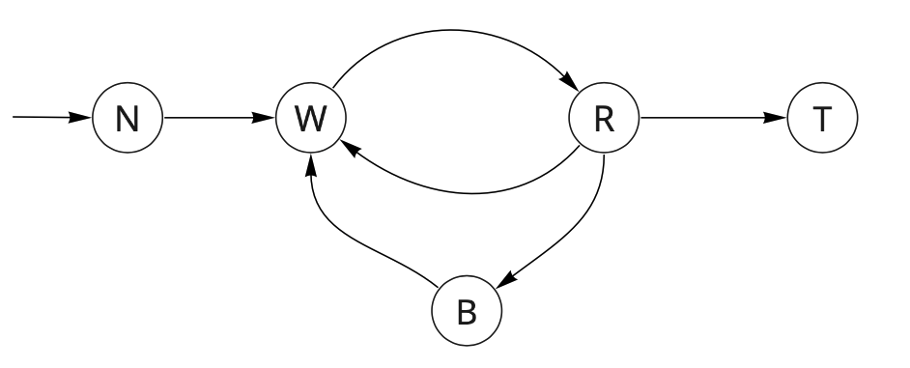
Process Status Diagram
dispatch
admit
exit
interrupt
Control of the computer moves through a well-defined cycle
At any point in time, a single process is in control
loosely speaking a process is equivalent to a program
Transitions:
admit: A request is made to allow your program to content for control
dispatch: Your program is given control
exit: Your program asserts that it is done
interrupt: The OS seizes control
trap: Your program (implicitly or explicitly) requests a service to be performed
completion: The request is satisfied
completion
trap

Slide 3
MIPS ISA Architecture: OS interface
# Print the integer ‘1’ # Macro: print_di %imm li $a0, %imm li $v0, 1 syscall
Service Requests to the operating system via the ‘syscall' instruction
Service Name | $v0 | input: $a0..$a3 | output: $v0..$v1
print integer | 1 | $a0 = value | none
read integer | 5 | none | $v0 = value
malloc | 9 | $a0 = size | $v0 = buffer address
exit | 10 | none | none
file read | 14 | $a0 = fd, $a1 = buffer address $a2 = num bytes | $v0 = bytes read -1 == error 0 == eof

Slide 4
Execution of your program
dispatch
admit
exit
interrupt
completion
trap
Invoke the program:
Wait to use the CPU
Execute for as long as you can -- Until
(Exit) You are done
(Interrupt) You get interrupted by some outside force
(Trap) You need help because you made an error or you requested it
If you were interrupted, goto Step 2
If you trap, and then goto Step 2
recover from the error, or
obtain the requested server
Analogy: Driving your Car from LA to Vegas

Slide 5
Interrupts and Traps: (results in the kernel seizing control)
Interrupts are asynchronous events
such events occur outside of your process/program
such events may or may not be associated with your program
Examples:
data has arrived on the NIC
a disk request for a different process has been completed
Traps are synchronous events
such events occur inside of your process/program
some events are error conditions, e.g.,
division by zero
invalid or illegal memory access
some events are requests, e.g.,
read/write from a file
create a child process
Exits are a specific type of trap that results in a different flow through the PSD
For speed, traps are to be avoided!

Slide 6
"read" system call
int retval; int fd; fd = open("/home/steve/filename", O_RDONLY);
You need to allocate a buffer, a block of memory.
byte buffer[8]; int * p = &buffer;
Make a read request to the OS, providing:
the identifier of the file to read
the location of the buffer
the number of bytes to read
retval = read(fd, &buffer, 8);
What are the values passed to read?
Value of retval informs what happened.
retval == -1: error
retval == 0: end of file
retval <= 8: number of bytes read
Cast the code
retval = read(fd, (void *) &buffer, 8);
p:
0x0002
0x000A
p:
0x0002
0x0009
0x0008
buffer[5]:
0x0007
buffer[4]:
0x0006
D
0x0005
E
0x0004
E
0x0003
buffer:
F
0x0002
0x0001
Java: File fd = new scanner("/home/steve/filename"); buffer = fd.nextByte(); // in C: read(fd, &buffer, 1)
0x0000

Slide 7
Reading a block of 10 bytes!
Java Example:
Equivalent C Example
byte header[10];
stdin = new Scanner(System.in);
for( i = 0; i < 10 ; i++ ) {
header[i] = stdin.nextByte();
}
The Scanner class only handles primitive types
We are not in a position to reimplement it.
The OS knows nothing about my Java class
Consequently, this results in 10 systems calls
byte header[10];
for( i = 0; i < 10 ; i++ ) {
header[i] = (byte) getchar();
}
retval = read(fd, &header, 10);

Slide 8
A More Efficient Approach
Read does not care what it is reading
This results in 1 system call
But we need to understand pointers: * and &
Moreover we need to cast our variables
Via 'read' system call (1 trap):
Java Example (10 traps):
byte header[10];
retval = read(STDIN_FILENO, (void *) &header, 10);
\0
0x000A
s
0x0009
g
0x0008
n
0x0007
i
0x0006
t
0x0005
header:
e
0x0004
byte header[10];
stdin = new Scanner(System.in);
for( i = 0; i < 10 ; i++ ) {
header[i] = stdin.nextByte();
}
0x0003
e
r
0x0002
G
0x0001
0x0000

Slide 9
Variables: Names and Values
determine the lval for “c”
extract the rval of “c” at MEM[lval]
add 1 to that value
Write the value from #3 into MEM[lval]
lval
We all know what variables are, right!
A variable has two values: a lval and a rval
Consider the following assignment:
c = c + 1
The lval of c is the address in memory
The rval of c is the value located at that address in memory
The rval can be a "integer", "float", "char", etc.
If the rval is an address, than it is known as a "pointer"
int * p = & c;
Hold that thought! (* p ) == 2
0x000A
0
0x0009
0
rval
d:
0x0008
5
c:
0x0006
2
0x0007
0
c:
0x0006
2
0x0005
b:
0x0004
6
p:
0x0003
?
p:
?
0x0002
0
a:
0x0001
1
0x0000
42

Slide 10
Memory
0x8000 000A
0
0x8000 0009
sasank:
3
0x8000 0008
We all know what an array is right!
Memory is just an array of integers (from 0..255):
mem[ index ] = value
Do you know what an associative array is?
It's just an array that stores both the lval and rval of a variable:
array[ "name" ] = value; mem[ "steven" ] = 32
You use "name" to lookup the appropriate index
Consider the memory to the right
Update the memory that I have created for this class
Find your name, update the associated value to be equal to your index.
That is to say, if your name is steven execute the following statement
steven = &steven;
0
0x8000 0007
shant:
37
0x8000 0006
0x8000 0005
steven:
32
0x8000 0004
syndey:
?
0x8000 0003
45
0x8000 0002
tyler:
1
0x8000 0001
0
0x8000 0000

Slide 11
Variables: Names and Values
* * * p == 42
0x000A
0
0x0009
0
lval
We all know what variables are, right!
A variable has two values: a lval and a rval
Consider the following assignment:
c = c + 1;
The lval of c is the address in memory
The rval of c is the value located at that address in memory
The rval can be a "integer", "float", "char", etc.
If the rval is an address, than it is known as a "pointer"
int * p = & c;
Hold that thought! (* p ) == 2
d:
0x0008
5
rval
0x0007
0
c:
0x0006
2
c:
2
0x0005
b:
0x0004
6
p:
0x0003
?
0x0002
0
a:
0x0001
1
p:
&c
0x0000
42
What is the address c? What is the value of p? What is the address of p?

