Slide 1
Web Development & Design Foundations with HTML5
8th Edition
CHAPTER 11
KEY CONCEPTS

Slide 2
Learning Outcomes
In this chapter, you will learn how to ...
  Describe the purpose of plug-ins, helper applications, media containers, and codecs
  Describe types of multimedia files used on the Web
  Configure hyperlinks to multimedia files
  Configure audio and video on a web page with HTML5 elements
  Describe features and common uses of Adobe Flash, JavaScript,
  Java applets, Ajax, and jQuery
  Configure a Flash animation on a web page
  Configure a Java applet on a web page
  Create an interactive image gallery with CSS
  Configure the CSS3 transform and transition properties
  Describe the purpose of geolocation, web storage, offline web applications, and canvas HTML5 APIs.

Slide 3
Helper Applications & Plug-ins
Helper Application
  A program that can be designated to handle a particular file type (such as .wav or .mpg) to allow the user to view or otherwise utilize the special file.
  The helper application runs in a separate window from the browser.
Plug-In
  A newer and more common method
  Plug-ins run right in the browser window so that media objects can be integrated directly into the web page.

Slide 4
Containers & Codecs
Container
  Designated by the file extension – contains the media and metadata
Codec
  The algorithm used to compress the media
HTML5 audio & video
  Native to the browser
  ISSUE: Browsers do not all support the same codecs
    http://www.longtailvideo.com/html5/

Slide 5
Commonly Used Plug-ins
Adobe Flash Player
Adobe Reader
Windows Media Player
Apple Quicktime

Slide 6
Common Audio File Types
.wav Wave File
.aiff Audio Interchange File Format
.mid Musical Instrument Digital Interface (MIDI)
.au Sun UNIX sound file
.mp3 MPEG-1 Audio Layer-3
.ogg Ogg Vorbis (open-source)
. m4a MPEG 4 Audio.
This audio-only MPEG-4 format is
supported by Quicktime, iTunes, and iPods.

Slide 7
Common Video File Types
.mov Quicktime
.avi Microsoft Audio Video Interleaved
.wmv Windows Media File
.flv Flash Video File
.mpg MPEG (Motion Picture Experts Group)
.m4v .mp4 (MPEG-4)
.ogv Ogg Theora (open-source)
.webm VP8 codec (open video format, free)

Slide 8
Copyright Issues
Only publish web pages, images, and other media that you have personally created or have obtained the rights or license to use.
Ask permission to use media created by another person instead of simply “grabbing” it.
All work (including web pages) are automatically copyrighted even if there is not copyright mark or date.
Fair Use Clause of the Copyright Act
Creative Commons – A new approach to copyright

Slide 9
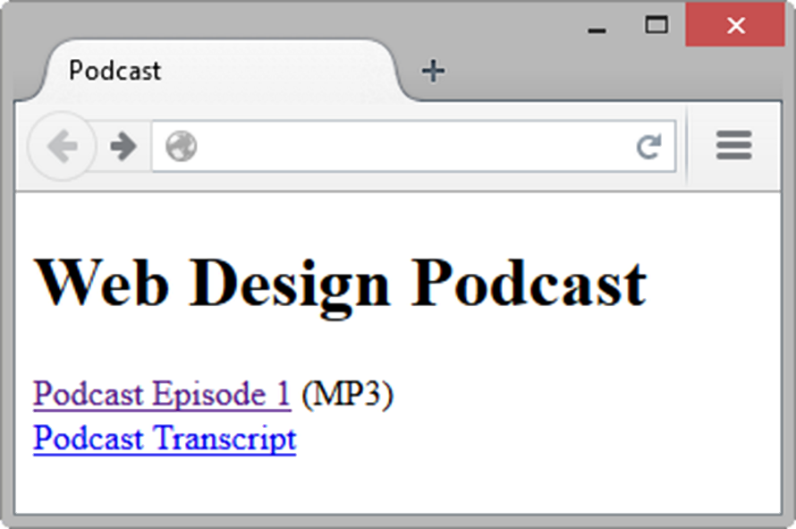
Configure Audio & Video
Most basic method to provide audio or video files:
  Hyperlink
  <a href="wdfpodcast.mp3" title="Web Design Podcast">Web Design Podcast</a>

Slide 10
Multimedia & Accessibility
Provide alternate content
  Transcript (for audio)
  Captions (for video)
  Text format

Slide 11
What is Adobe Flash?
A popular multimedia application
Create multimedia which adds visual interest and interactivity to web pages
Flash movies are saved in “.swf” files
Perception of speedy display
.swf files play as they download
Flash Player
  Free browser plug-in
  Widely installed on desktop browsers but not well-supported by mobile devices

Slide 12
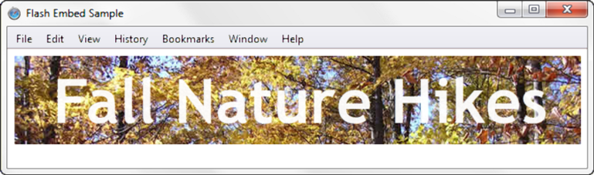
HTML5 Embed Element
<embed type="application/x-shockwave-flash"
src="fall5.swf"
width="640"
height="100"
quality="high”
title="Fall Nature Hikes">

Slide 13
Checkpoint
List three common web browser plug-ins and describe their use.
Describe issues involved with adding media such as audio or video to a web page.
Describe a disadvantage of using Flash on a web page.

Slide 14
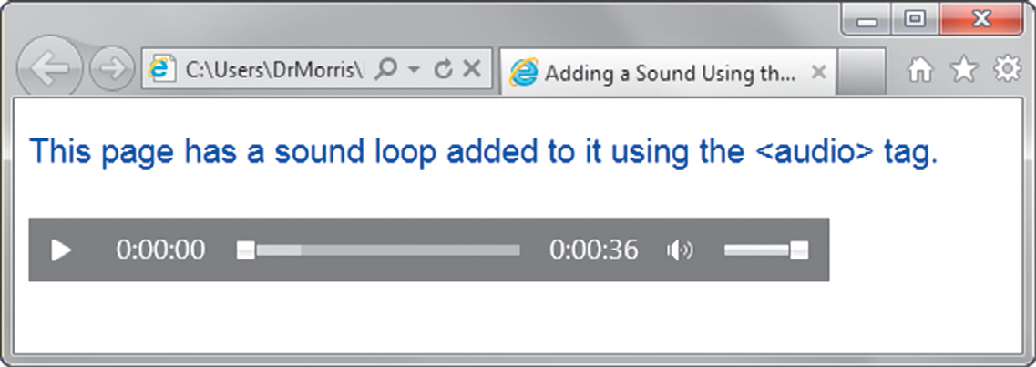
HTML5 Audio & Source Elements
<audio controls="controls">
<source src="soundloop.mp3" type="audio/mpeg">
<source src="soundloop.ogg" type="audio/ogg">
<a href="soundloop.mp3">Download the Audio File</a> (MP3)
</audio>

Slide 15
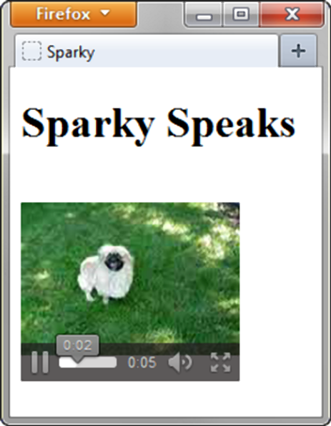
HTML5 Video &
Source Elements
<video controls="controls" poster="sparky.jpg"
width="160" height="150">
<source src="sparky.m4v" type="video/mp4">
<source src="sparky.ogv" type="video/ogg">
<a href="sparky.mov">Sparky the Dog</a> (.mov)
</video>

Slide 16
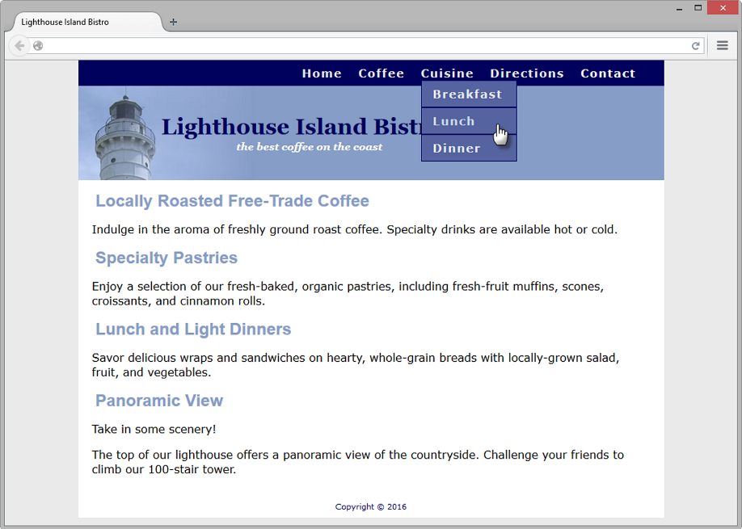
CSS Drop Down Menu
Configure nav container with position relative
Code submenu (drop down menu) ul element with the parent li element
Configure submenu ul element to initially not display
Configure submenu ul element with absolute positioning

Slide 17
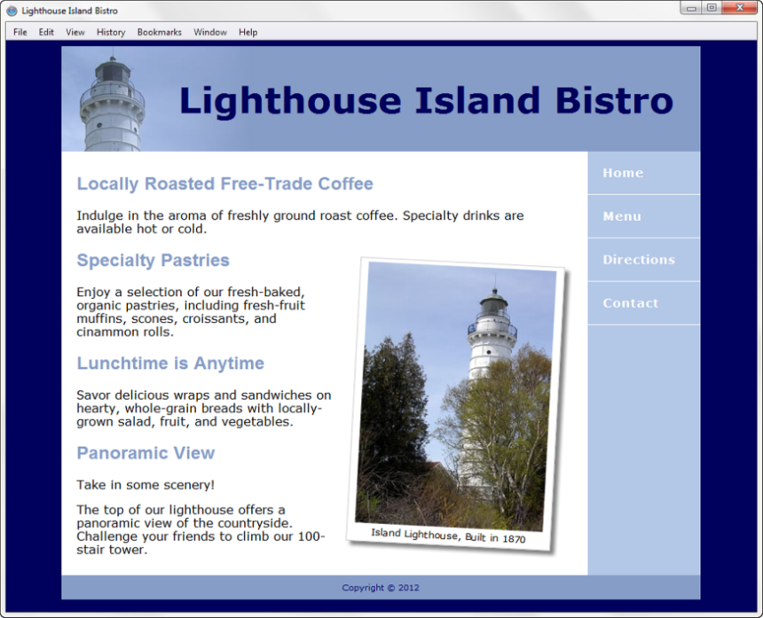
CSS3 Transform Property
Allows you to rotate, scale, skew, or move an element
Example:
transform: rotate(3deg);

Slide 18
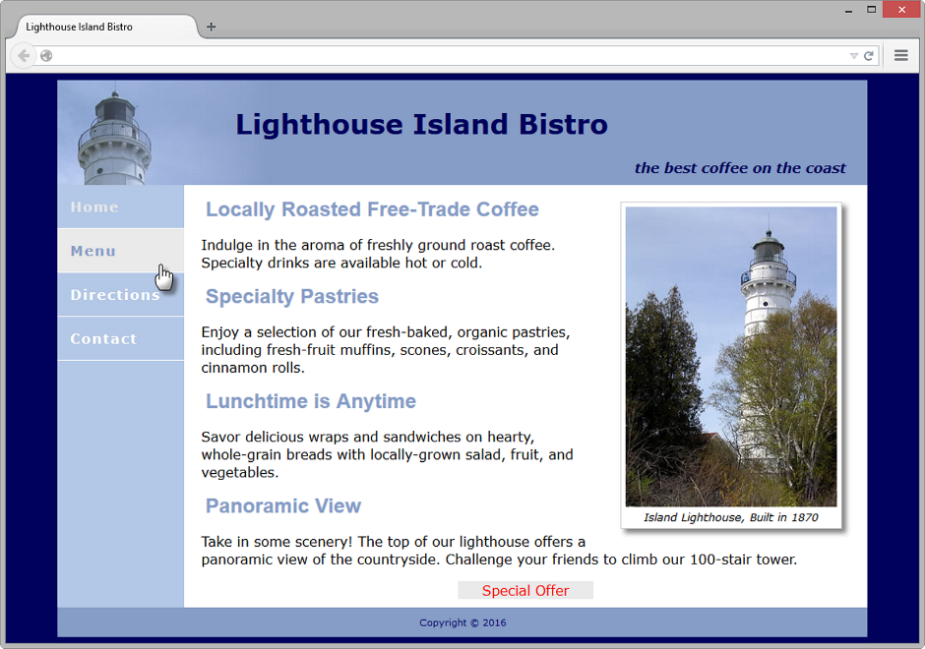
CSS3 Transition Property
Provides for changes in property values to display in a smoother manner over a specified time.
Example:
nav a:hover { color: #869dc7; background-color: #eaeaea;
transition: background-color 2s linear; }

Slide 19
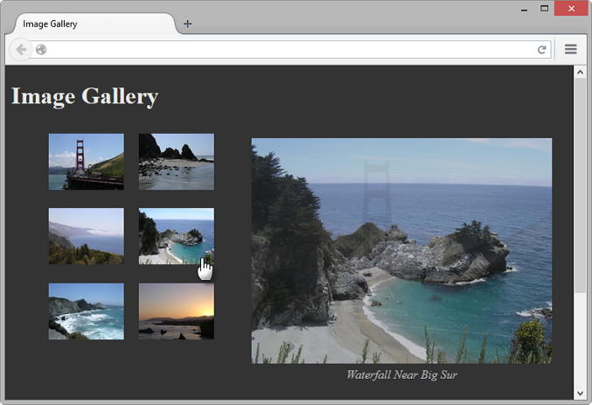
CSS Image Gallery
Configure each thumbnail image:
<li><a href="photo1.jpg"><img src="photo1thumb.jpg" width="100" height="75" alt="Golden Gate Bridge">
<span><img src="photo1.jpg" width="400" height="300“
alt="Golden Gate Bridge"><br>Golden Gate Bridge </span></a>
</li>
The key CSS:
#gallery span { position: absolute;
opacity: 0;
transition: opacity 3s ease-in-out;
left: -1000px; }
#gallery a:hover span {
position: absolute;
top: 16px; left: 320px;
text-align: center; }

Slide 20
What is Java?
Object Oriented Programming (OOP)
Developed by Sun Microsystems
Java is not the same language as JavaScript.
Java is more powerful and much more flexible than JavaScript.
Java can be used to:
  develop stand-alone executable applications
  applets that are invoked by Web pages

Slide 21
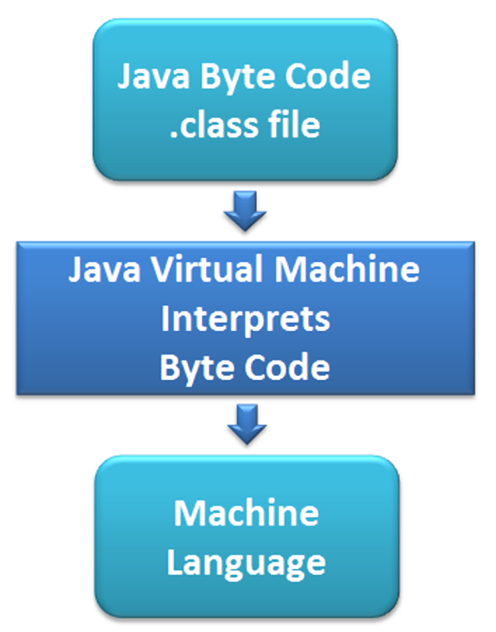
Java Applets
Compiled -- translated from the
English-like Java statements to an encoded form called Byte Code.
Use the “.class” file extension
Java Virtual Machine (JVM)
  interprets the byte code into the proper machine language for the operating system
  After translation, the applet is executed and appears on the Web page.

Slide 22
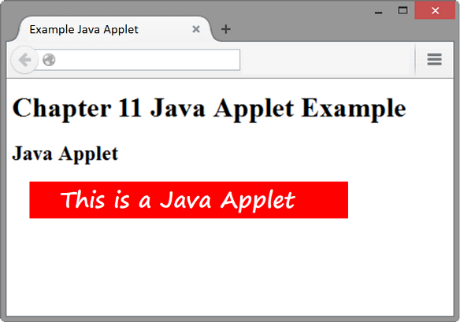
Adding a Java Applet to a Web Page
OBSOLETE: the applet element
HTML5: the object element
<object type="application/x-java-applet" width="610" height="30"
title="This Java Applet displays a message">
<param name="code" value="example.class">
<param name="textColor" value="#FF0000">
<param name="message" value="This is a Java Applet">
<param name="backColor" value="#FFFFFF">
Java Applets can be used to display text, manipulate graphics, play
games, and more.
Visit <a href="http://download.oracle.com/javase/tutorial/">Oracle</a>
for more information.
</object>

Slide 23
Checkpoint
Describe a benefit of using the new HTML5 video and audio elements.
Describe the purpose of the transform property.
Describe a disadvantage of using Java applets on web pages.

Slide 24
What is JavaScript?
Object-based client-side scripting language
Originally developed by Brendan Eich at Netscape
JavaScript is NOT Java
Manipulates the objects associated with a web page document:
  the window
  the document
  the elements such as forms, images, hyperlinks, and so on

Slide 25
Common Uses of JavaScript
Display a message box
Select list navigation
Edit and validate form information
Create a new window with a specified size and screen position
Image Rollovers
Status Messages
Display Current Date
Calculations

Slide 26
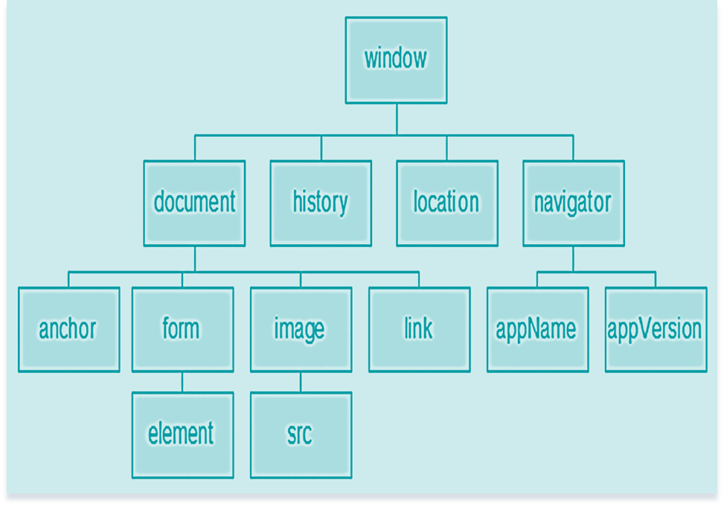
Document Object Model (DOM)
A portion of the DOM is shown at the left.
Defines every object and element on a Web page
Hierarchical structure
Accesses page elements and apply styles to page elements

Slide 27
What is Ajax?
Asynchronous JavaScript and XML
“Ajax” – Jesse James Garrett at Adaptive Path
Existing technologies used in a new way
    Standards-based XHTML and CSS
    Document Object Model
    XML (and the related XSLT technology)
    Asynchronous data retrieval using XMLHttpRequest
    JavaScript
Very Basic Example:
  http://webdevfoundations.net/css

Slide 28
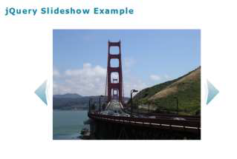
Exploring JQuery
A JavaScript library intended
to simplify client-side scripting
Example: http://webdevfoundations.net/jquery
API – Application Programming Interface
  A protocol that allows software components to communicate – interacting and sharing data.
The jQuery API can be used to configure many interactive features, including:
  image slideshows
  animation (moving, hiding, fading)
  event handling (mouse movements and mouse clicking)
  document manipulation
  Ajax

Slide 29
HTML5 APIs
API – a protocol that allows software components to communicate – interacting and sharing data
A variety of APIs that are intended to work with HTML5, CSS, and JavaScript are currently under development and in the W3C approval process, including:
  geolocation
  web storage
  offline web applications
  canvas

Slide 30
HTML5 Geolocation
Allows your web page visitors to share their geographic location
Their location may be determined by the IP address, wireless network connection, local cell tower, or GPS hardware depending on the type of device and browser.
JavaScript is used to work with the latitude and longitude coordinates provided by the browser.
Examples:
  http://webdevfoundations.net/geo and http://html5demos.com/geo

Slide 31
HTML5 Web Storage
Traditionally, the JavaScript cookie object has been used to store information in key-value pairs on the client (the website visitor’s computer).
NEW FOR HTML5: Web Storage API
  provides two new ways to store information on the client side:
  local storage and session storage.
  Advantage: increase in the amount of data that can be stored (5MB per domain).
  The localStorage object stores data without an expiration date.
  The sessionStorage object stores data only for the duration of the current browser
  JavaScript is used to work with the values stored in the localStorage and sessionStorage objects.
Examples:
  http://webdevfoundations.net/storage and http://html5demos.com/storage

Slide 32
HTML5 Offline Web Applications
An offline web application enables website visitors to view documents and access web applications even when they are not connected to the Internet.
A web application (app) can be written with HTML, CSS and JavaScript and can run in any browser – as long as you are online.
An offline web application takes this one step further and stores the HTML, CSS, and JavaScript files on the visitor’s device for use offline, even when the device is not connected to the Internet.
Examples:
  http://html5demos.com/offlineapp
  http://www.w3schools.com/html/html5_app_cache.asp

Slide 33
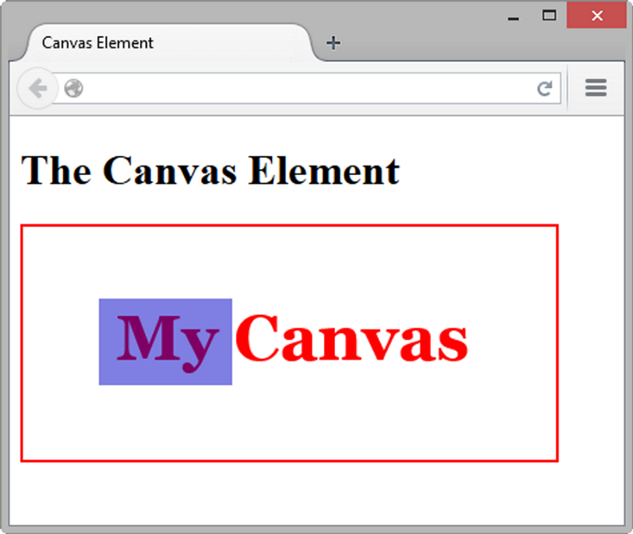
HTML5 Canvas Element
Configures dynamic graphics
  Draw lines, shapes, text, image
  Interact with actions taken by the user
Canvas API (application programming interface)
JavaScript – client-side scripting language
<script type="text/javascript">
function drawMe() {
var canvas = document.getElementById("myCanvas");
if (canvas.getContext) {
var ctx = canvas.getContext("2d");
ctx.fillStyle = "rgb(255, 0, 0)";
ctx.font = "bold 3em Georgia";
ctx.fillText("My Canvas", 70, 100);
ctx.fillStyle = "rgba(0, 0, 200, 0.50)";
ctx.fillRect (57, 54, 100, 65);
}
}
</script>

Slide 34
Checkpoint
Describe two uses of JavaScript.
Describe two technologies used in Ajax.
Describe the purpose of the HTML5 canvas element.

Slide 35
Multimedia & Accessibility
Provide links to plug-ins
Provide text descriptions and captions
Verify keyboard access
Check for screen flickering
Verify functionality if JavaScript is disabled
If media is used for main navigation, provide plain text links

Slide 36
Summary
This chapter introduced the HTML & CSS techniques and technologies used to configure sound, video, and interactivity on web pages.
Issues related to accessibility and copyright were also discussed.
The number one reason for visitors to leave web pages is too long of a download time. When using multimedia, be careful to minimize this issue.

