Slide 1
Web Development & Design Foundations with HTML5
8th Edition
CHAPTER 12
KEY CONCEPTS
Copyright © Terry Felke-Morris

Slide 2
Learning Outcomes
In this chapter, you will learn how to
  define e-commerce
  identify benefits and risks of e-commerce
  describe e-commerce business models
  describe e-commerce security and encryption
  define Electronic Data Interchange (EDI)
  describe trends and projections for e-commerce
  describe issues related to e-commerce
  describe options for order and payment processing

Slide 3
What is E-Commerce?
The integration of communications, data management, and security technologies to allow individuals and organizations to exchange information related to the sale of goods and services.
Major functions of E-Commerce include:
  the buying of goods,
  the selling of goods, and
  performance of financial transactions on the Internet.

Slide 4
E-Commerce Advantages for Businesses
Reduced Costs
Increased Customer Satisfaction
More Effective Data Management
Potentially Higher Sales

Slide 5
E-Commerce Advantages for Consumers
Convenience
Easier Comparison Shopping
Wider Selection of Goods

Slide 6
E-Commerce Risks for Businesses
Need for a robust, reliable web site
Fraudulent transactions
Customer reluctance to purchase online
Increased competition

Slide 7
E-Commerce Risks for Consumers
Possible Security Issues
Possible Privacy Issues
Purchasing from photos & descriptions
Possible difficulty with returns

Slide 8
E-Commerce
Business Models
B2C – Business-to-Consumer
B2B – Business-to-Business
C2C – Consumer-to-Consumer
B2G – Business-to-Government

Slide 9
Electronic Data Interchange (EDI)
The transfer of data between different companies using networks.
  Facilitates the exchange of standard business documents including purchase orders and invoices
EDI is not new -- In existence since the 1960s
Trading Partners
  Organizations that exchange EDI transmissions
Newer technologies
  XML and Web Services are replacing traditional EDI
  Provide opportunities to customize secure information exchange
  over the Internet

Slide 10
E-Commerce U.S. Retail Sales
What do people buy online?
Clothing, accessories, and footwear ($40 billion)
Electronics and appliances ($22.75 billion)
Furniture and home furnishings ($20 billion)
Drugs, health aids, and beauty aids ($17 billion)
Computer hardware ($14.7 billion)
Music and videos ($10.25 billion)
Books and magazines ($10.2 billion)
Sporting goods ($7.8 billion)
Computer software ($5.41 billion)
Food, beer, and wine ($5.15 billion)
2013 Sales Figures
http://www2.census.gov/retail/releases/current/arts/ecommerce4541.xls

Slide 11
Who’s On the Internet?
Category | Percentage That Use the Internet
Men | 87%
Women | 86%
Age: 18-29 | 97%
Age: 30-49 | 93%
Age: 50-64 | 88%
Age: Over 65 | 57%
Household Income: Less than $30,000 | 77%
Household Income: $30,000 to $49,999 | 85%
Household Income: $50,000 to $74,999 | 93%
Household Income: $75,000 or higher | 99%
Education: High school graduate | 77%
Education: Some college | 91%
Education: College graduate | 97%
Source: http://www.pewinternet.org/data-trend/internet-use/latest-stats/
Other Demographics:
  http://www.pewinternet.org/
  http://www.clickz.com
  http://www.census.gov/eos/www/ebusiness614.htm

Slide 12
E-Commerce Issues
Intellectual Property
Security
Fraud
Taxation
International Commerce

Slide 13
E-Commerce Security
Encryption
  Ensures privacy within an organization and on the Internet.
  The conversion of data into an unreadable form, called a ciphertext.
Decryption
  The process of converting the ciphertext back into its original form, called plaintext or cleartext, so it can be understood.
The encryption/decryption process requires an algorithm and a key.

Slide 14
E-Commerce Security
Encryption Types
Secure E-Commerce transactions use the encryption technologies below:
  Symmetric-key Encryption
  Asymmetric-key Encryption
  Hash Encryption
SSL (Secure Sockets Layer)
  Utilizes these encryption technologies
  Provides for secure transmission of data on the Internet.

Slide 15
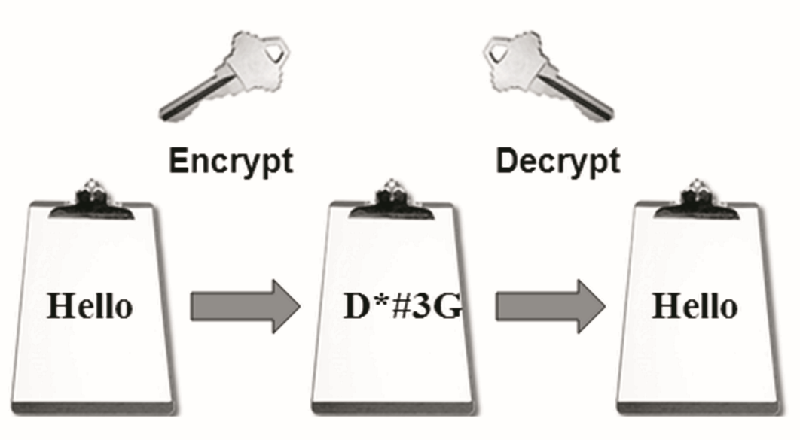
E-Commerce Security: Symmetric-Key
Symmetric-Key Encryption
Also called single-key encryption
Both encryption and decryption
use the same key
Both the sender and receiver must know the key before
communicating using encryption.
Advantage: speed

Slide 16
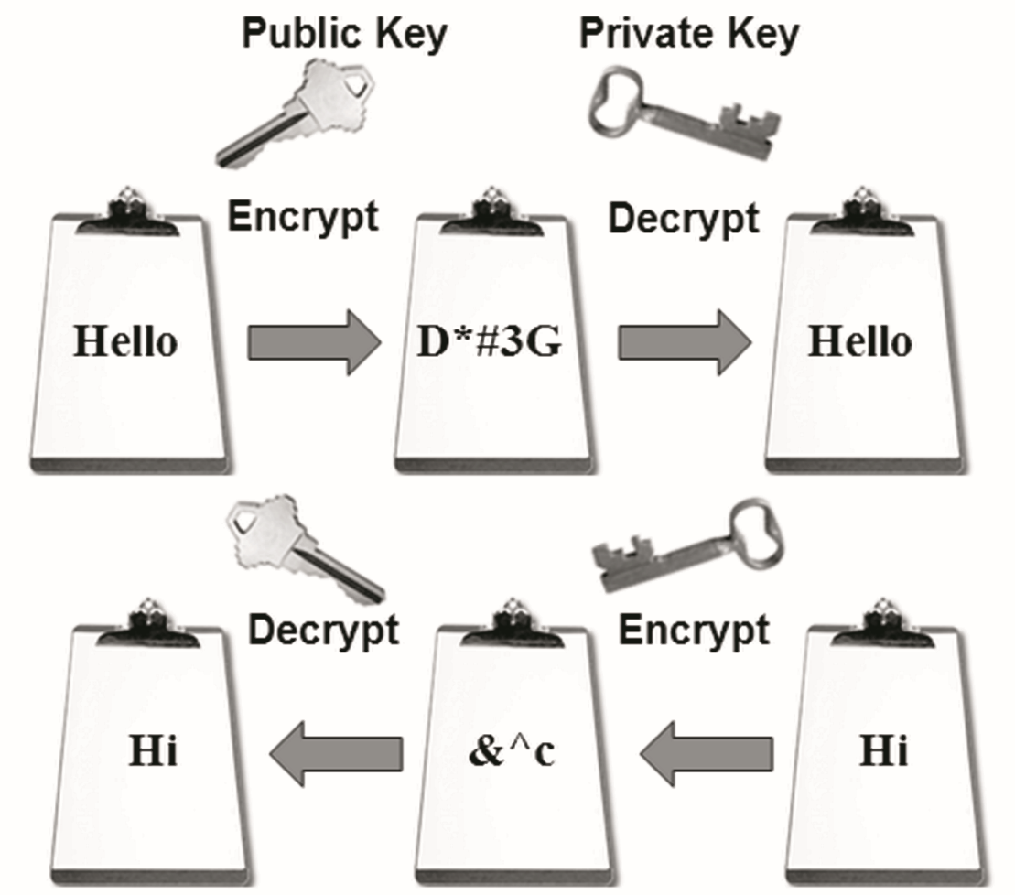
E-Commerce Security: Asymmetric-key
Asymmetric-Key Encryption
Also called public-key encryption
There is no shared secret
Two keys are
created at the same time:
  Public key
  Private key
Asymmetric-key encryption
is much slower than
symmetric-key encryption.

Slide 17
E-Commerce Security: Hash
Hash Encryption
A hash algorithm transforms a string of characters into a “digest”
  A shorter fixed-length value or key that represents the original string
One-way encryption
Used for information that will not be read or decrypted
Purpose: verify the integrity of information

Slide 18
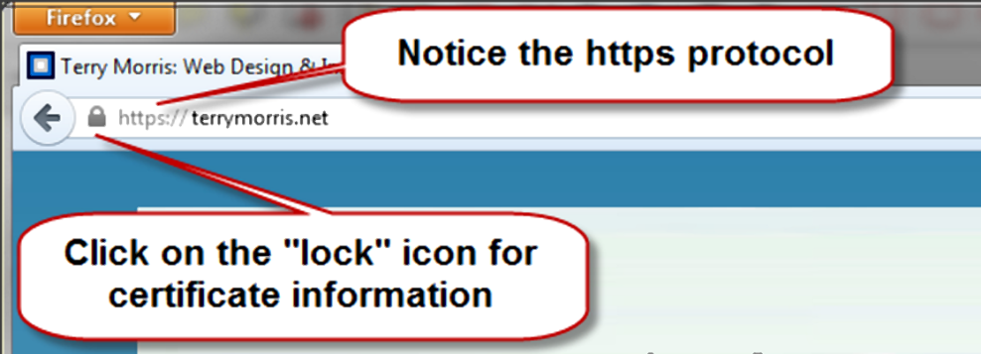
Secure Sockets Layer (SSL)
A protocol that allows data to be privately exchanged over public networks
Developed by Netscape
Encrypts data sent between a client (usually a Web browser) and a Web server.
Utilizes both symmetric and asymmetric keys.
“https” protocol
Browsers display a “lock” icon

Slide 19
Secure Sockets Layer (SSL)
SSL provides secure communication between a client and server by using:
  Server and (optionally) client digital certificates for authentication
  Symmetric-key cryptography using a "session key" for bulk encryption
  Public-key cryptography for transfer of the session key
  Message Digests (hash encryption) to verify the integrity of the transmission

Slide 20
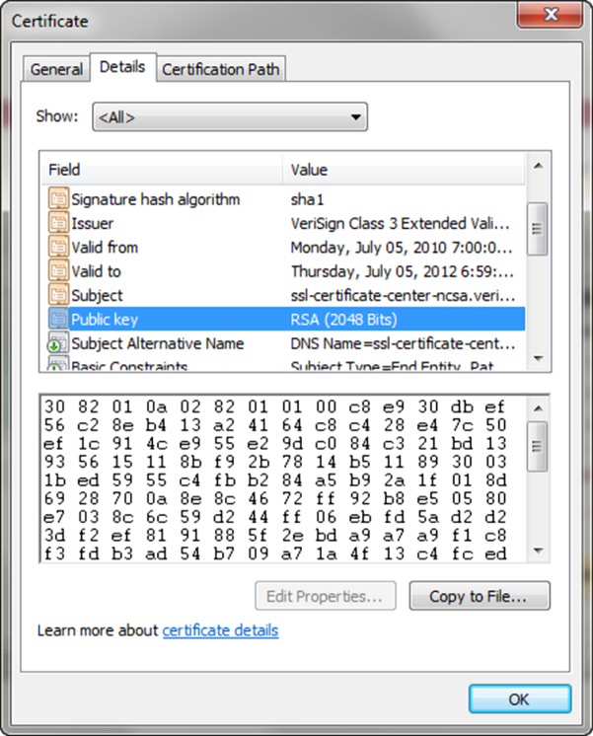
SSL & Digital Certificate
Digital Certificate
  A form of an asymmetric key
    Also contains information about the certificate, the holder of the certificate, and the issuer of the certificate.
  Used by SSL to authenticate the
  identity of the web server

Slide 21

Digital Certificate
The contents of a digital certificate include:
  The public key
  Effective date of the certificate
  Expiration date of the certificate
  Details about the Certificate Authority -- the issuer of the certificate
  Details about the certificate holder
  A digest of the certificate content

Slide 22
Certificate Authority
A trusted third-party organization or company that issued digital certificates.
Well-known Certificate Authorities:
  Verisign
    http://www.verisign.com
  Thawte
    http://www.thawte.com

Slide 23
Checkpoint
Describe three advantages of e-commerce for an entrepreneur just starting a business.
Describe three risks that businesses face when engaging in e-commerce.
Define SSL. Describe how an online shopper can tell that an e-commerce site is using SSL.

Slide 24
Order & Payment Processing
E-Commerce Payment Methods:
  Credit Card
  Stored-value Card
  Smart Card
  Digital Cash

Slide 25
E-Commerce Storefront Solutions
Instant Online Storefront
  Shopify, BigCommerce
Off-The-Shelf Shopping Cart Software
  Agoracart, osCommerce, ZenCart
Custom Built Solution
  IBM's WebSphere Commerce Suite, Microsoft's Commerce Server
  Microsoft Visual Studio, Adobe Dreamweaver
Semi-Custom Built Solutions on a Budget
    Paypal order processing
    Free shopping cart scripts

Slide 26
Checkpoint
List three payment methods commonly used on the Web.
Have you purchased online? If so, think of the last item that you purchased.
  Why did you purchase it online instead of at a store?
  Did you check to see if the transaction was secure? Why or why not?
  How will your shopping habits be different in the future?
Describe three types of e-commerce solutions available. Which provides the easiest entry to e-commerce? Explain.

Slide 27
Summary
This chapter introduced you to basic e-commerce concepts and implementations.
Consider taking an E-Commerce course in the future to continue your study of this dynamic and growing area of web development.

