Slide 1
Web Development & Design Foundations with HTML5
8th Edition
CHAPTER 8
KEY CONCEPTS

Slide 2
Learning Outcomes
In this chapter, you will learn how to ...
  Create a basic table with the table, table row, table header, and table cell elements
  Configure table sections with the thead, tbody, and tfoot elements
  Increase the accessibility of a table
  Style an HTML table with CSS
  Describe the purpose of CSS structural pseudo-classes

Slide 3
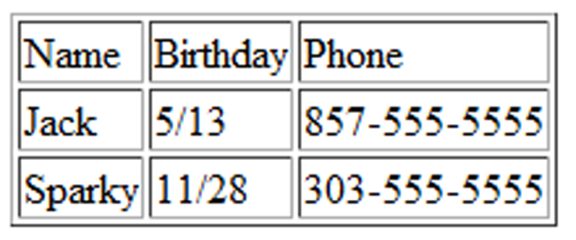
HTML Table
Tables are used on web pages
to organize tabular information
Composed of rows and columns – similar to a spreadsheet.
Each individual table cell is at the intersection of a specific row and column.
Configured with table, tr, and td elements

Slide 4
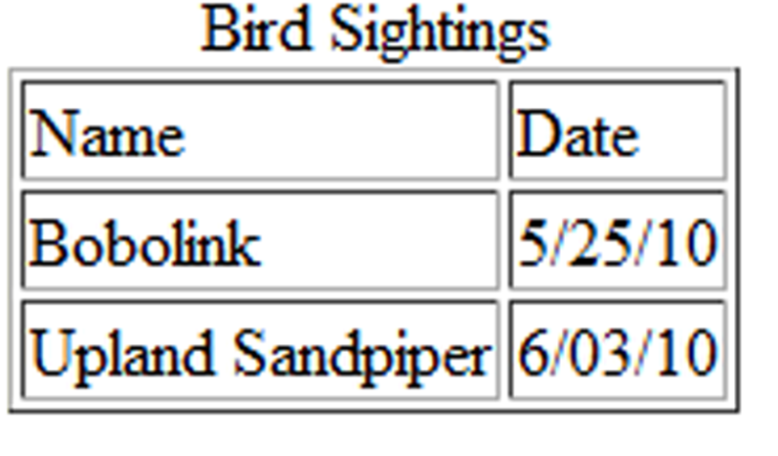
HTML Table Elements
<table>
Contains the table
<tr>
Contains a table row
<td>
Contains a table cell
<caption>
Configures a description of the table

Slide 5
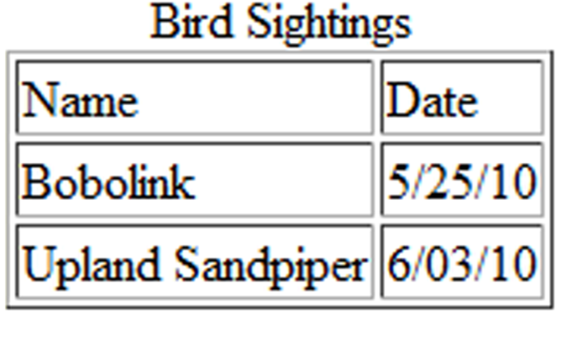
HTML
Table Example
<table border="1">
<caption>Bird Sightings</caption>
<tr>
<td>Name</td>
<td>Date</td>
</tr>
<tr>
<td>Bobolink</td>
<td>5/25/10</td>
</tr>
<tr>
<td>Upland Sandpiper</td>
<td>6/03/10</td>
</tr>
</table>

Slide 6
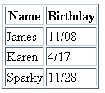
HTML
Table Example 2
<table border="1">
<tr>
<th>Name</th>
<th>Birthday</th>
</tr>
<tr>
<td>James</td>
<td>11/08</td>
</tr>
<tr>
<td>Karen</td>
<td>4/17</td>
</tr>
<tr>
<td>Sparky</td>
<td>11/28</td>
</tr>
</table>
Using the <th> Element

Slide 7
HTML Table Attributes
align (obsolete)
bgcolor (obsolete)
border
cellpadding (obsolete)
cellspacing (obsolete)
summary (obsolete but may be reinstated)
width (obsolete)
Use CSS to configure table characteristics instead of HTML attributes

Slide 8
HTML Common Table Cell Attributes
align (obsolete)
bgcolor (obsolete)
colspan
rowspan
valign (obsolete)
height (deprecated)
width (deprecated)
Use CSS to configure most table cell characteristics instead of HTML attributes

Slide 9

HTML colspan Attribute
<table border="1">
<tr>
<td colspan=“2”>
Birthday List</td>
</tr>
<tr>
<td>James</td>
<td>11/08</td>
</tr>
<tr>
<td>Karen</td>
<td>4/17</td>
</tr>
</table>

Slide 10
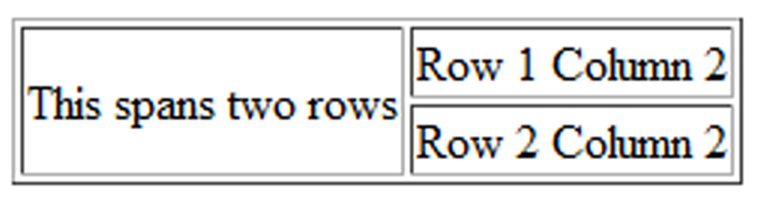
HTML rowspan Attribute
<table border="1">
<tr>
<td rowspan="2">This spans two rows</td>
<td>Row 1 Column 2</td>
</tr>
<tr>
<td>Row 2 Column 2</td>
</tr>
</table>

Slide 11
Accessibility and Tables
Use table header elements (<th> tags) to indicate column or row headings.
Use the caption element to provide a text title or caption for the table.
Complex tables:
Associate table cell values with their corresponding headers
  <th> tag id attribute
  <td> tag headers attribute

Slide 12
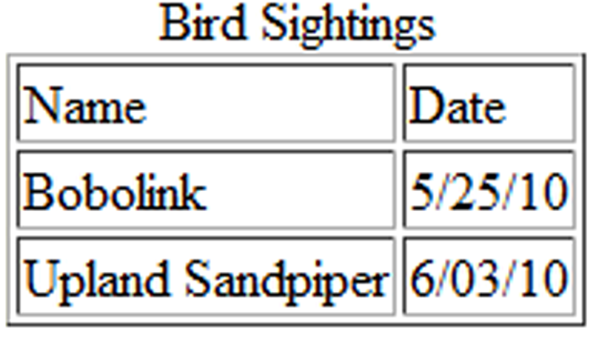
<table border="1">
<caption>Bird Sightings</caption>
<tr>
<th id="name">Name</th>
<th id="date">Date</th>
</tr>
<tr>
<td headers="name">Bobolink</td>
<td headers="date">5/25/10</td>
</tr>
<tr>
<td headers="name">Upland Sandpiper</td>
<td headers="date">6/03/10</td>
</tr>
</table>

Slide 13
Checkpoint
Describe the purpose of using a table on a web page.
How is the text contained in a th element displayed by the browser?
Describe one coding technique that increases the accessibility of an HTML table.

Slide 14
Using CSS to Style a Table
HTML Attribute | CSS Property
align | Center align a table: table { width: 75%; margin: auto; } Center align within a table cell: text-align: center;
bgcolor | background-color
cellpadding | padding
cellspacing | border-spacing or border-collapse
height | height
valign | vertical-align
width | width
border | border, border-style, or border-spacing
-- | background-image

Slide 15
CSS Structural Pseudo-classes
Pseudo-class | Purpose
:first-of-type | Applies to the first element of the specified type
:first-child | Applies to the first child of an element (CSS2 selector)
:last-of-type | Applies to the last element of the specified type
:last-child | Applies to the last child of an element
:nth-of-type(n) | Applies to the “nth” element of the specified type Values: a number, odd, or even
Zebra Stripe a Table
tr:nth-of-type(even) { background-color: #eaeaea; }

Slide 16
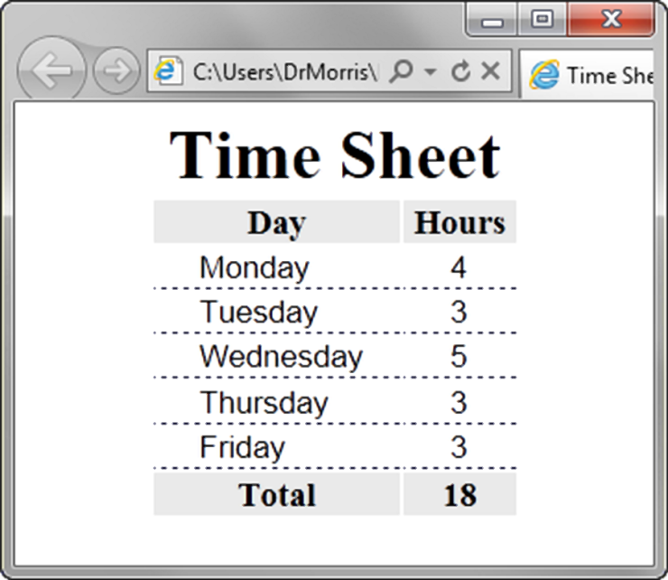
Table Row
Groups
<table> <caption>Time Sheet</caption>
<thead>
<tr>
<th id="day">Day</th>
<th id="hours">Hours</th>
</tr>
</thead>
<tbody>
<tr>
<td headers="day">Monday</td>
<td headers="hours">4</td>
</tr>
…
<tr>
<td headers="day">Friday</td>
<td headers="hours">3</td>
</tr>
</tbody>
<tfoot>
<tr>
<td headers="day">Total</td>
<td headers="hours">18</td>
</tr>
</tfoot> </table>
<thead>
table head rows
<tbody >
table body rows
<tfoot>
table footer rows

Slide 17
Checkpoint
1. Describe a reason to configure a table with CSS properties instead of HTML attributes.
2. List three elements that are used to group table rows.

Slide 18
Summary
This chapter introduced the HTML and CSS techniques used to create and configure tables on web pages.

