Slide 1
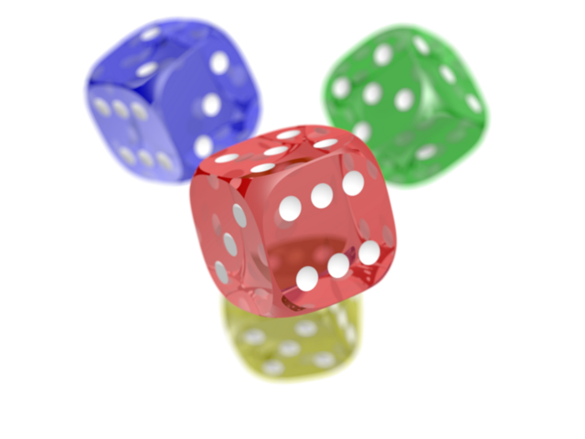

Test
Content would be here Why bullet points
People involved:
- God
- John
- Jesus

