Slide 1
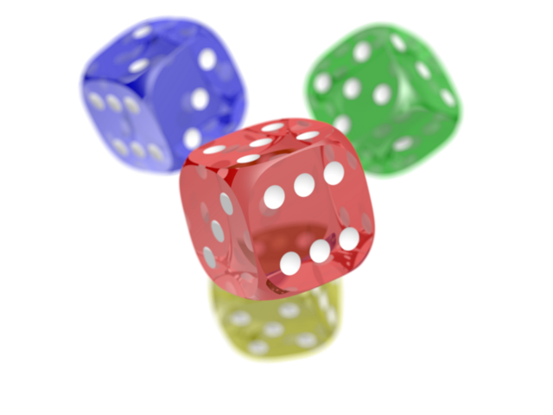

Cjfshbvfhjsbfhsb
kdsnxzbfjhsdbfdsbfu
People involved:
- C
- j
- f
- s
- h
- b
- v
- f
- h
- j
- s
- b
- f
- h
- s
- b

