Slide 1
Centennial College Token System
Release 01
By
Team 04

Slide 2
Why Token System?
There is no real-time application for students to generate tokens on their own to meet respective department advisors for their issues.
Our application mainly concentrates on avoiding the big queues in front of Student Hub, ICET departments etc. for explaining the issue and generating the tokens.
Rather, it allows the students to create their own tickets with a friendly Android application and gives them the estimated time on which they can meet their advisors.

Slide 3
Technologies Used For Development
Asp.Net4.5.1
MVC 5
WebAPI 2.0
MS SQL Server 2012.
AngularJS
Bootstrap
Android

Slide 4
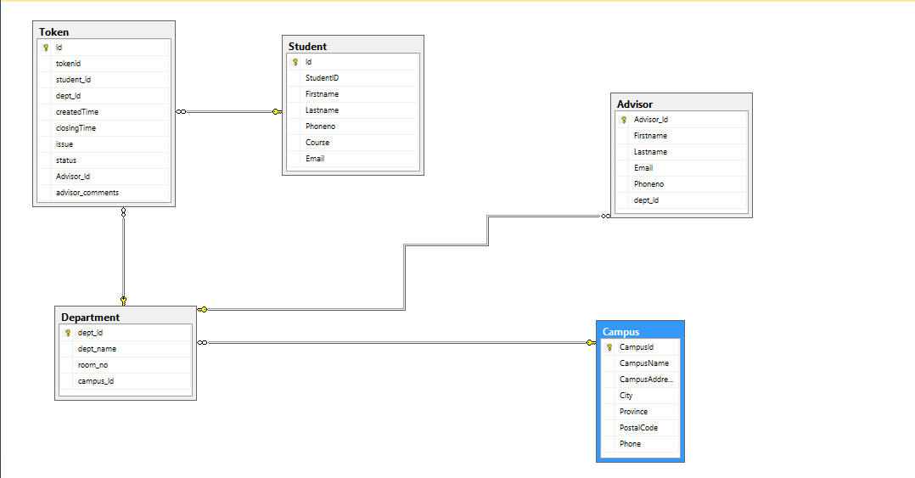
Database Diagram

Slide 5
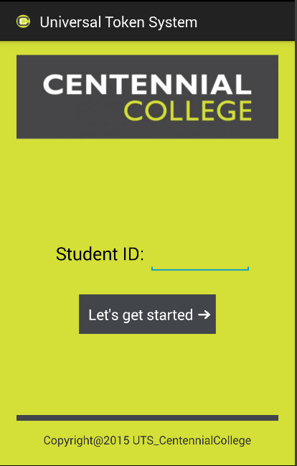
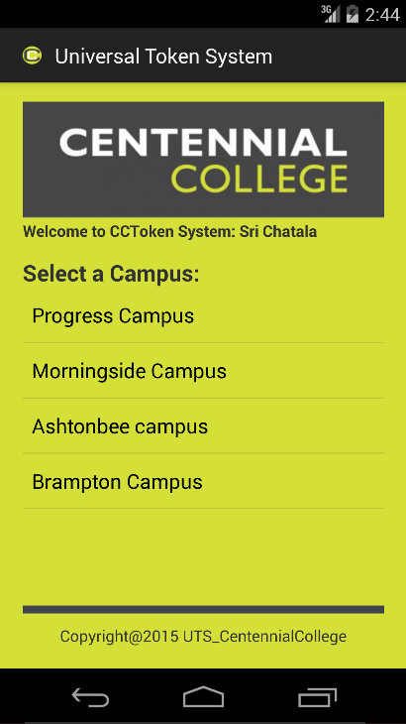
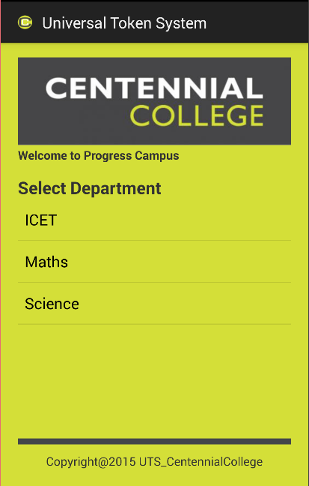
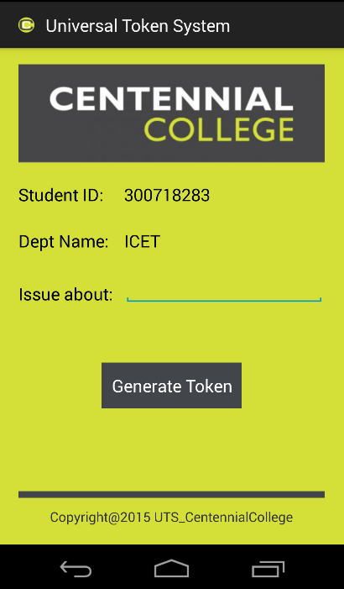
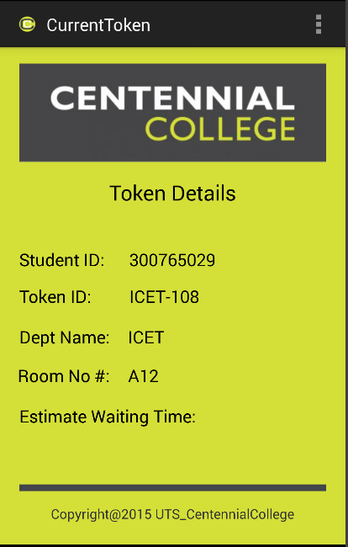
Android UI

Slide 6
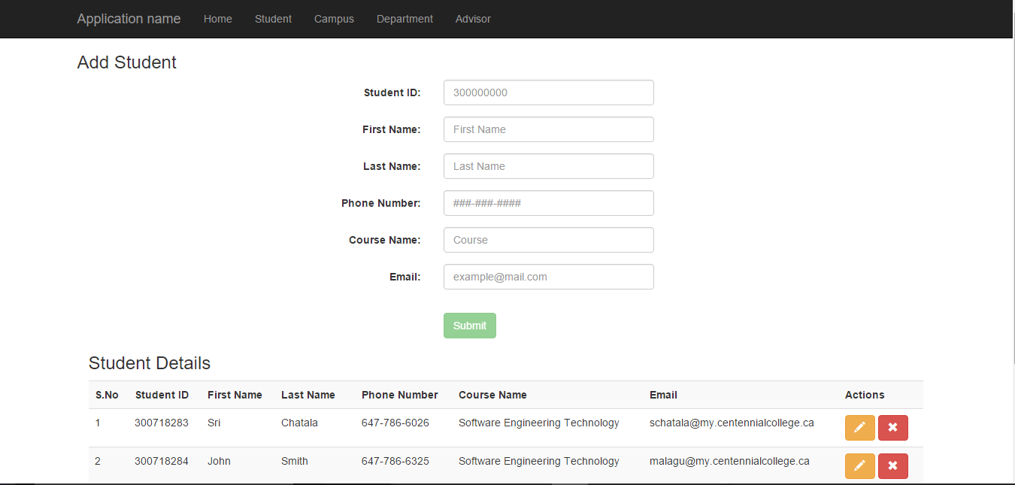
Web Admin UI

Slide 7
Work Under Progress
Advisor can View and Close the Tokens
Students can view his/her list of tokens
Estimated Waiting Time for tokens generated
Notification to Students through Android Application
Overall Improvement of Design/ Cosmetics of the app

Slide 8
GitHub Repository
https://github.com/COMP313Team4/UniversalTokenSytem-AndoridApplication

Slide 9
DEMO
tokensys.azurewebsites.net

Slide 10
Thank You
QUESTIONS?

