Slide 1
Procedural Generation

Slide 2

What is Procedural Generation
Used for:
Level & Terrain Generation
Character Dialogue & Animation
Object Instantiation
Loot Systems
Many More!

Slide 3
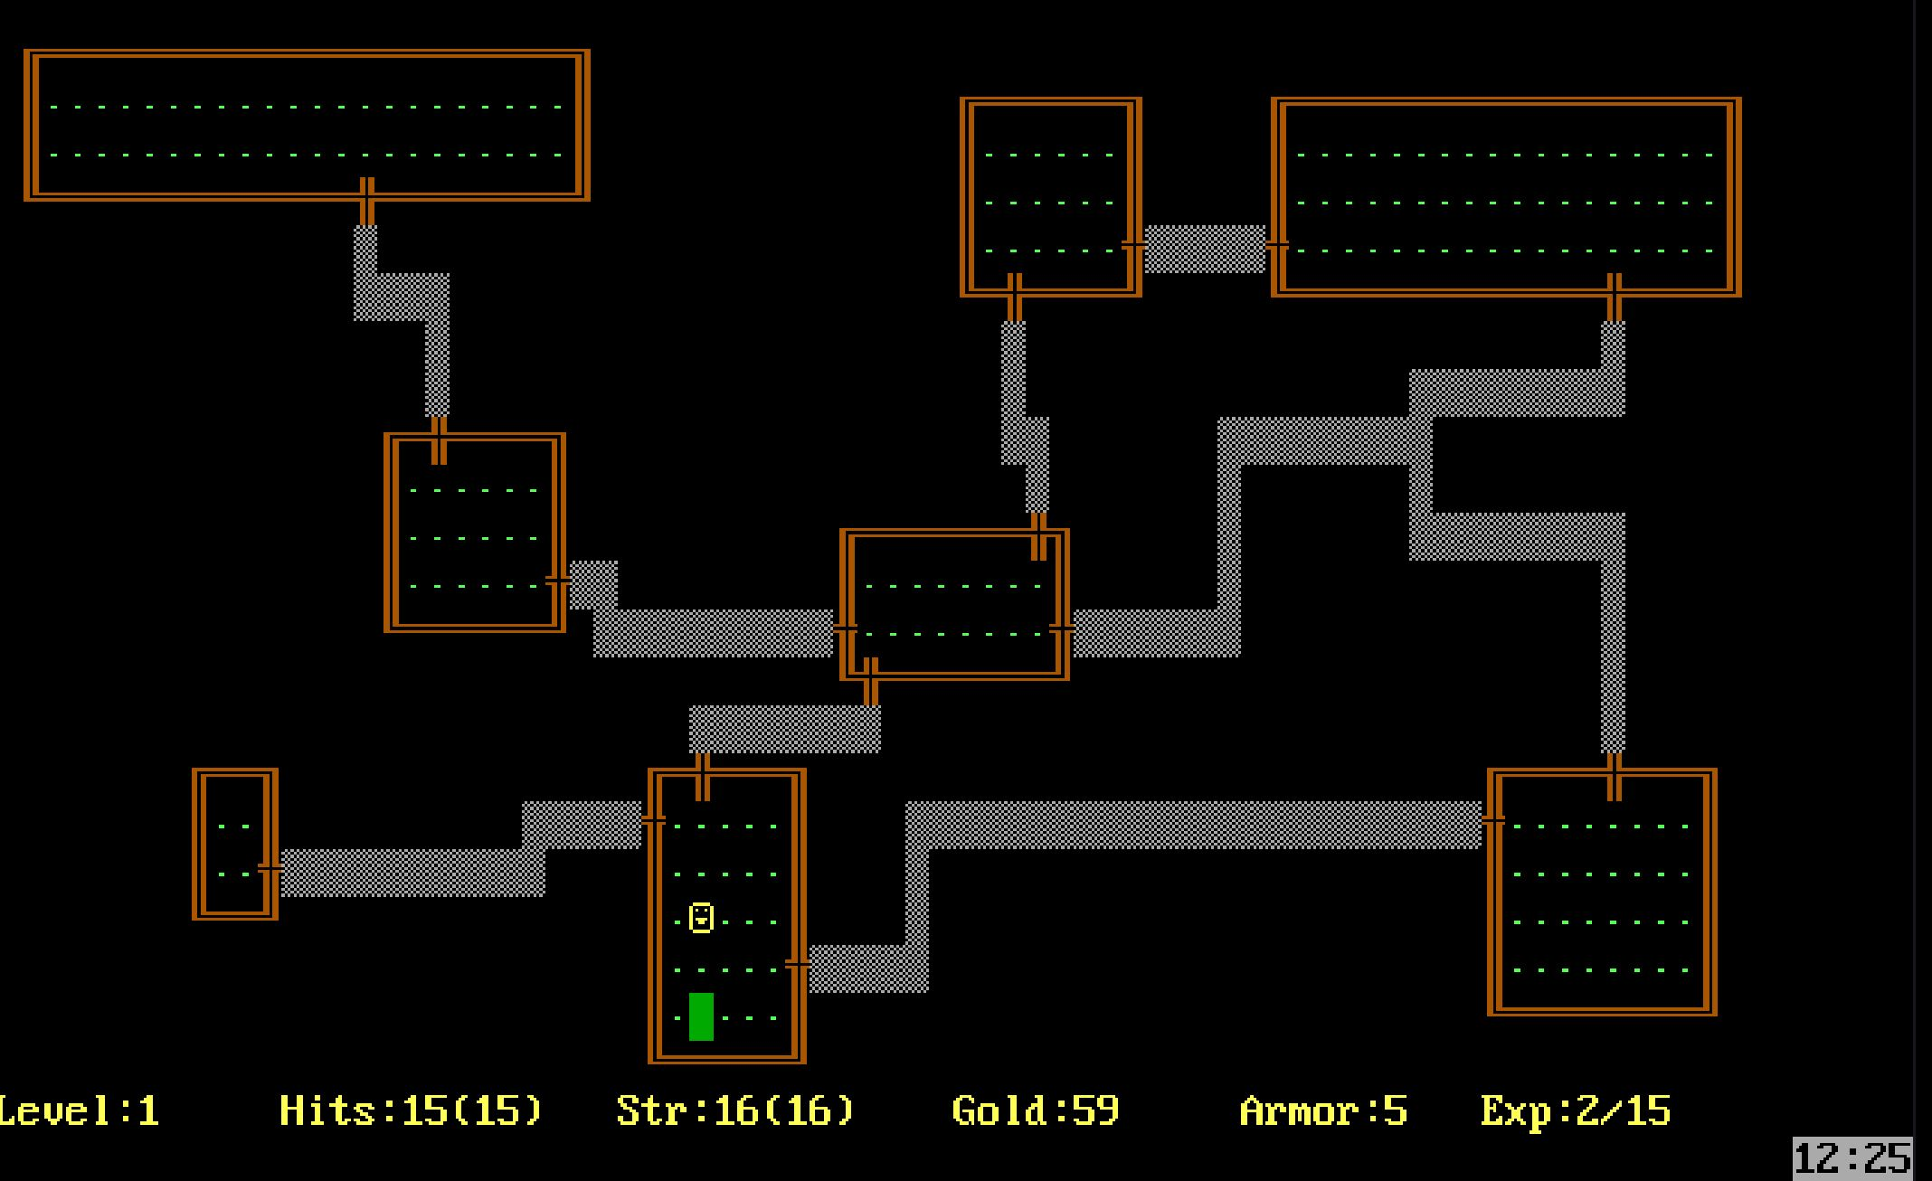
How It Started
Used for:
Level & Terrain Generation
Character Dialogue & Animation
Object Instantiation
Loot Systems
Many More!

Slide 4
How it started

Slide 5
Relevancy

Slide 6
How its used

Slide 7
Level Generation

Slide 8
What's Missing

Slide 9
Learning Goals

Slide 10
Deliverables

