Slide 1
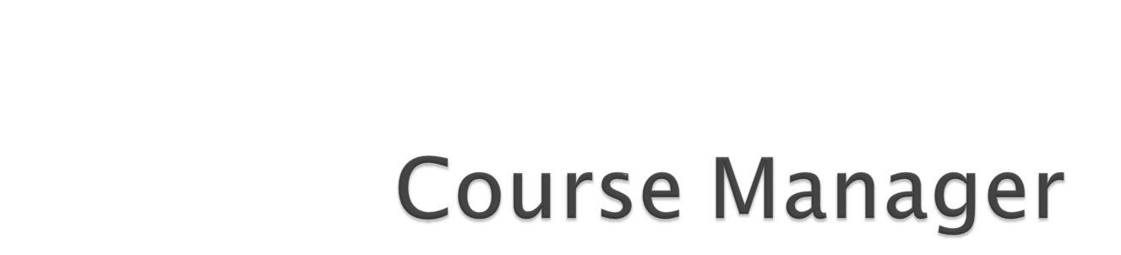
COMP 3350
GROUP 8

Slide 2

David Owasi
Graham Silver
Ian Smith
Yusuf Sholaja
Anthony Yee
Notes:
Mention who worked on what if there was a specific thing they did

Slide 3

An Android application that is designed to keep track of a student's academic performance by calculating their grades, and tracking both the courses they are taking and the tasks they must complete for each course

Slide 4

Students are the primary customer for this application. The application will allow students to track of their progress in their courses and degree program.

Slide 5

Login Screen – this feature allows each student to have their own customized experience and their personal information stored
Class List / Class Information – add your classes that you are currently attending with any specific information about the class (teacher, time, etc.)
Task List – keep track of what you have to do for each class

Slide 6

Reviewing our initial vision statement made at the beginning of the project, we believe that the vision for this project remains the same
However, the amount of features created for this application has been scaled down

Slide 7

Login / Create an account
Class List / Add a Class
Task List / Add a Task
Future User Stories that will be completed:
  Calendar / Schedule
  Notifications
Notes:
Use Genymotion and Android Studio, go over each feature

Slide 8
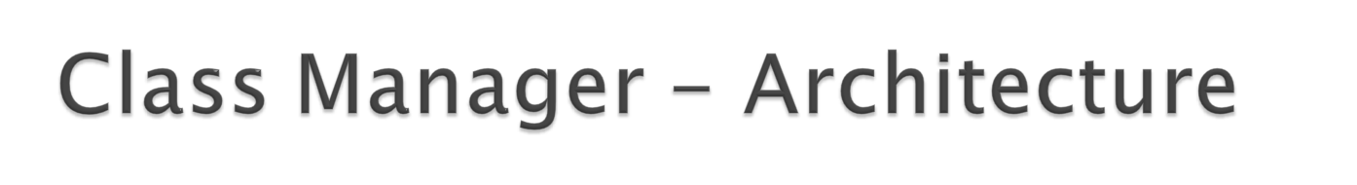
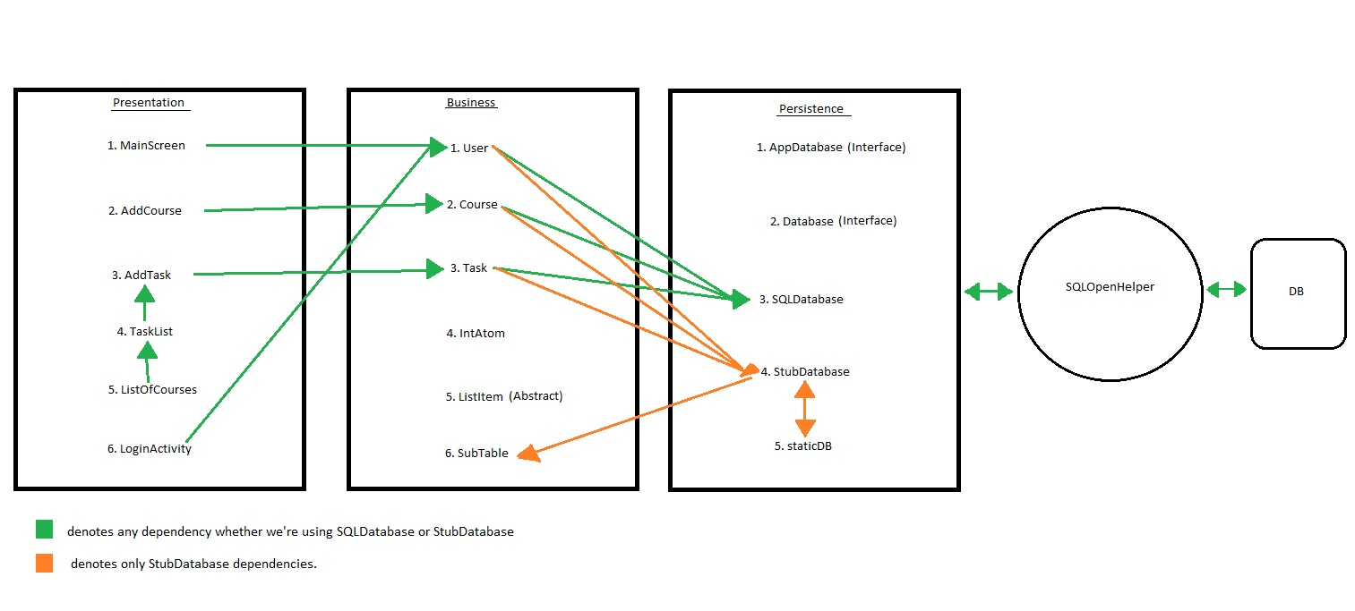

Slide 9
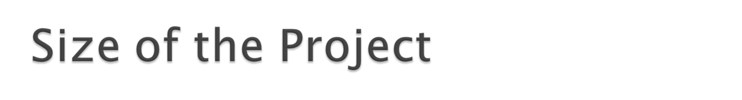
A half dozen test classes
18 methods for the SQLDatabase class, each is overridden in the StubDatabase class
  A staticDB class to ease switching between them
3 main business classes (User, Course, and Task), each extend the ListItem class
  A half dozen methods for each of these classes
  3 corresponding CurrentX classes to track which is currently being operated on by the app
7 activities with corresponding classes and layouts

Slide 10

As a group, we are very pleased with how the GUI is laid out.
  The flow from each feature makes sense
  Simple and user friendly
Our problematic areas
  Switching from our stub database to our SQLite database
    Version number, onUpgrade()
  Initially was difficult to connect our work

Slide 11

Better planning process
  Planning Game would have been beneficial
  Estimating how many features we could complete
Choices during implementation
  Prioritizing what to finish first
  Instead of adding more features, making sure our base features were working perfectly

Slide 12

It was easy to create features on our own ends
However…
  Linking these features together became costly
  Figuring out how to implement our SQLite database instead of the stub database was also costly

Slide 13

As of right now:
  We have a decent amount of commented code in our classes
  Needs refactoring
    Some code can be made into simpler, cleaner code
  No switch statements
  Exploring options to refactor Database classes to reduce duplicated code

Slide 14

Once implemented correctly, the SQLite Database has become a very important piece of our application
Stores our users, class lists, task list, and in the future our schedules

Slide 15
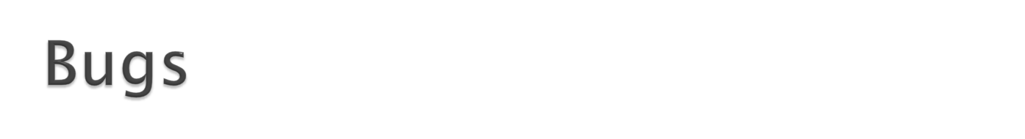
At the moment:
  We still have to implement a table in the database to store our users
  This will give us the capability of storing all the users along with their associated information
  Also, the Login / Create Account interfaces will be fully functional after this is completed

Slide 16
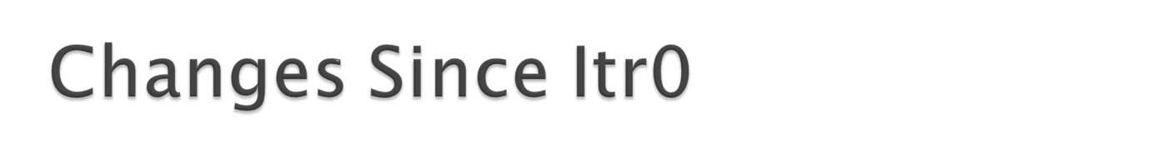
We will not be implementing as many user stories that we thought we would accomplish
The overall look of the application is now simpler than what was initially planned

Slide 17

The estimating and planning process of building an application is crucial
Constantly communicating with one another and having meetings were a great way to stay organized
Get the base features working before attempting to add any more features

Slide 18

The project hasn’t gone quite as well as we would have liked
We have learned a great deal about putting together an application
  Much more complicated than a simple program
It’s important to not leave things too long, they may turn out to be more complicated than anticipated

Slide 19


