Slide 1
COMP 3721
Tutorial 1

Slide 2
Yu Chen
ychenbh@cse.ust.hk
No fixed Office Hour
Tutorials:
Selected Questions from Question Bank
Solutions will be posted on course webpage after each tutorial.

Slide 3
Sets
Languages and Regular Expressions

Slide 4
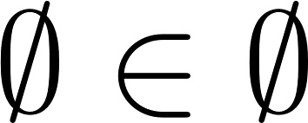
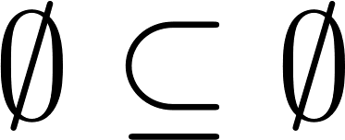
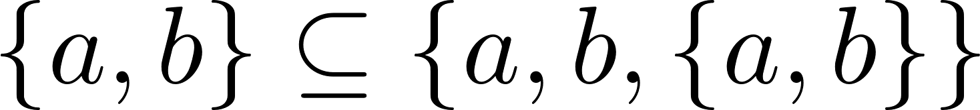
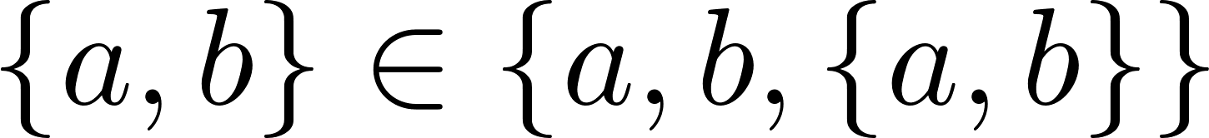
Sets
Determine whether each of the following is true or false.

Slide 5
Sets
Determine whether each of the following is true or false.
False. Empty set contains no elements.

Slide 6
Sets
Determine whether each of the following is true or false.
False.
True.

Slide 7
Sets
Determine whether each of the following is true or false.
False.
True.
True.

Slide 8
Sets
Determine whether each of the following is true or false.
False.
True.
True.
True.

Slide 9
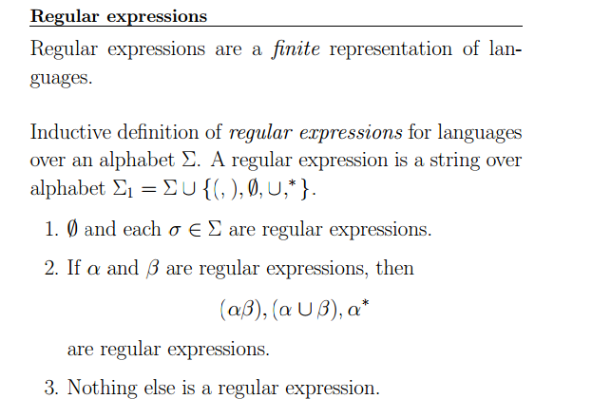
Languages and Regular Expressions
Definition:

Slide 10

Languages and Regular Expressions
Show that if a and b are distinct symbols, then
Hint:

Slide 11
Languages and Regular Expressions
Show that if a and b are distinct symbols, then
Proof:
It is clear that .
Need to show that .

Slide 12
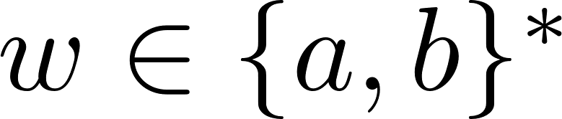
Languages and Regular Expressions
Show that if a and b are distinct symbols, then
Proof:
It is clear that .
Need to show that .
For any string . If we mark all the occurrence of b’s in w, then w can be rewritten as:

Slide 13
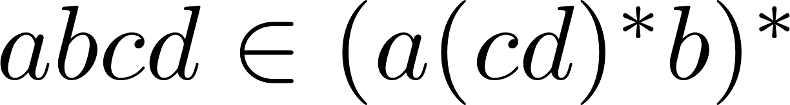
Languages and Regular Expressions
True or False. Justification.

Slide 14
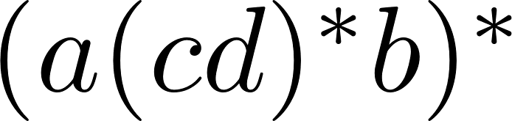
Languages and Regular Expressions
True or False. Justification.
False.
Because any nonempty string in must ends with b.

Slide 15
Languages and Regular Expressions
True or False. Justification.
False.
Counter example: abbbcc

Slide 16
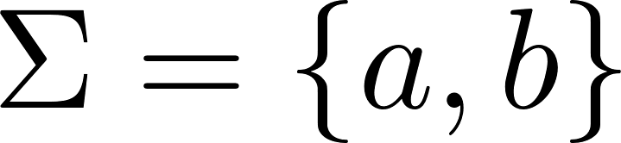

Languages and Regular Expressions
Let . Write regular expressions for the following sets.
All strings in with no more than 3 a’s.
All strings in with a number of a’s divisible by 3.
All strings in that does not have aab as a substring.

Slide 17
Languages and Regular Expressions
Let . Write regular expressions for the following sets.
All strings in with no more than 3 a’s.
All strings in with a number of a’s divisible by 3.
All strings in that does not have aab as a substring.

Slide 18
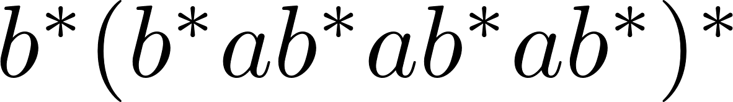
Languages and Regular Expressions
Let . Write regular expressions for the following sets.
All strings in with no more than 3 a’s.
All strings in with a number of a’s divisible by 3.
All strings in that does not have aab as a substring.

Slide 19
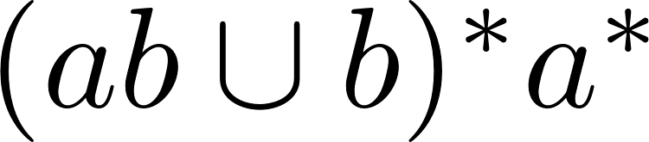
Languages and Regular Expressions
Let . Write regular expressions for the following sets.
All strings in with no more than 3 a’s.
All strings in with a number of a’s divisible by 3.
All strings in that does not have aab as a substring.

Slide 20
Languages and Regular Expressions
Prove that if L is regular, then so is
Hint: Follow the definition of regular expression.

Slide 21
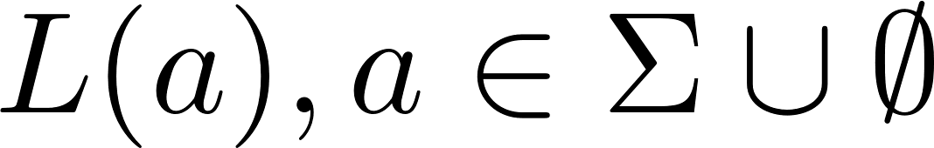
Languages and Regular Expressions
Proof(sketch):
We first prove that if for any , then Pref(L(a)) is regular.
Then we prove that if L1 and L2 are regular and have their Pref also regular, so do their union, concatenation and Kleene Star.

