Slide 1
COMP 3721
Tutorial 2

Slide 2
Countability
DFA

Slide 3


Countability
Prove that is countable.
Hints:
It is equinumerous with .
Find a way to enumerate every element in it within finite steps.
Using conclusions from the lecture.

Slide 4
Countability
Prove that is countable.
Proof 1(a little bit complicated):
Find a bijection between and .
The following function is such a bijection:
f(a, b) = (a + b - 1)*(a + b - 2)/2 + a
Prove that it is a bijection….

Slide 5
Countability
Prove that is countable.
Proof 2:
A way to enumerate all elements:
enumerate tuple (a, b) where:
a + b = 0
a + b = 1
a + b = 2
…
Every (a, b) will be reached in finite step..
(0,0) | (0,1) | (0,2) | (0,3) | …
(1,0) | (1,1) | (1,2) | (1,3)
(2,0) | (2,1) | (2,2) | (2,3)
(3,0) | (3,1) | (3,2) | (3,3)
…

Slide 6
Countability
Prove that is countable.
Proof 3:
Use that:
the Cartesian product of two countable sets is countable…

Slide 7
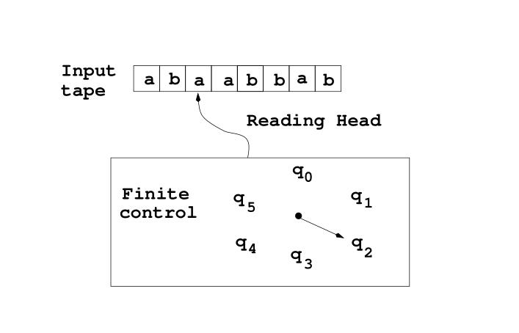
DFA

Slide 8
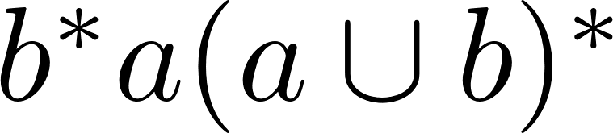
DFA
Construct a DFA for accepting the language with regular expression .
Construct a DFA for accepting each of the following languages:
{w ∈ {a, b}∗ : w contains the string abbab}.
{w ∈ {a, b}∗: w don’t have abb as a substring}.
{w ∈ {a, b}∗: w has a number of a’s divisible by 3}.
{w ∈ {a, b}∗: w has an odd number of a’s and an even number of b’s}.

Slide 9
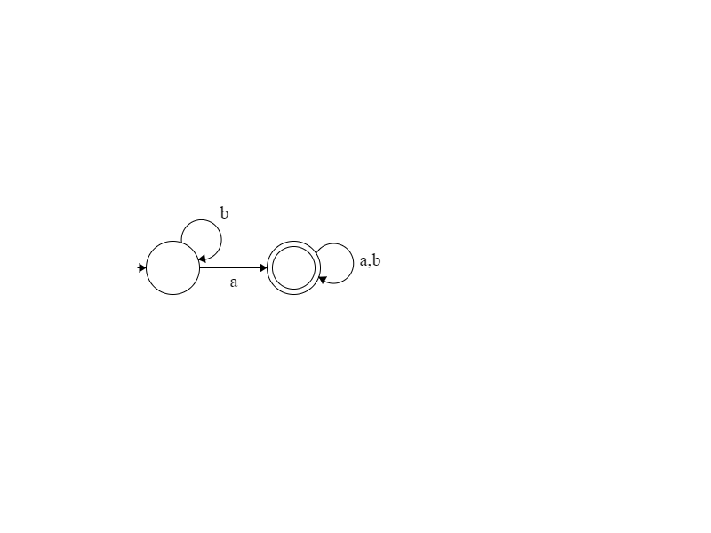
DFA
Construct a DFA for accepting the language with regular expression .

Slide 10
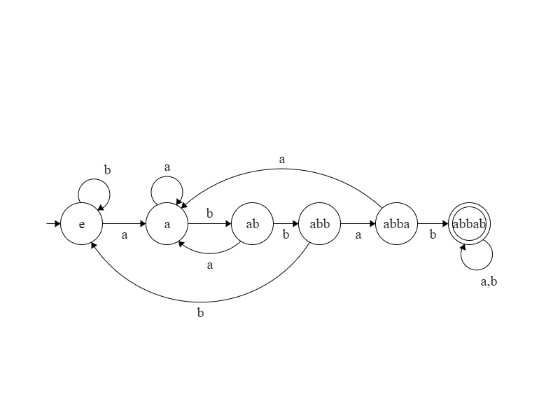
DFA
Construct a DFA for accepting each of the following languages:
{w ∈ {a, b}∗ : w contains the string abbab}.

Slide 11
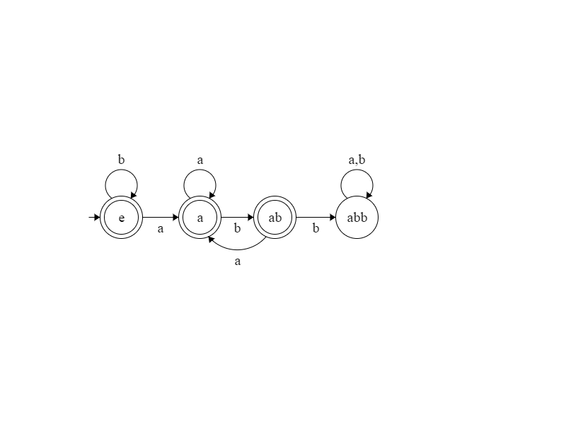
DFA
Construct a DFA for accepting each of the following languages:
{w ∈ {a, b}∗ : w contains the string abbab}.
{w ∈ {a, b}∗: w don’t have abb as a substring}.

Slide 12
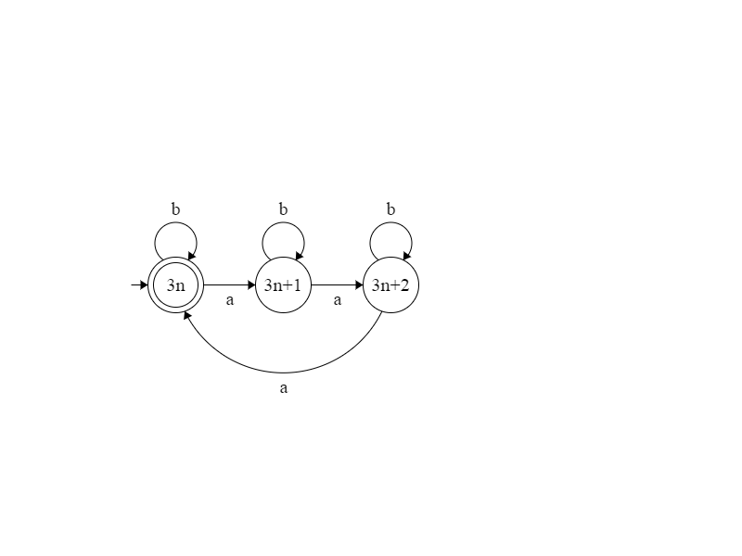
DFA
Construct a DFA for accepting each of the following languages:
{w ∈ {a, b}∗ : w contains the string abbab}.
{w ∈ {a, b}∗: w don’t have abb as a substring}.
{w ∈ {a, b}∗: w has a number of a’s divisible by 3}.

Slide 13
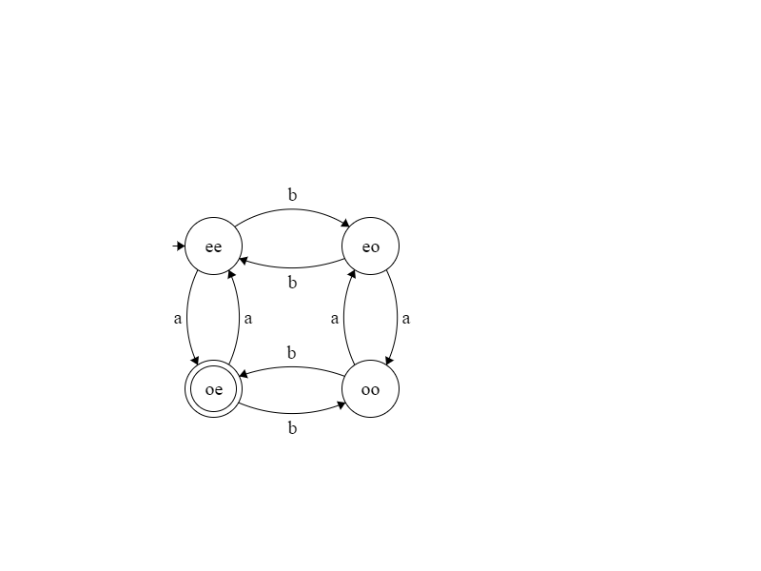
DFA
Construct a DFA for accepting each of the following languages:
{w ∈ {a, b}∗ : w contains the string abbab}.
{w ∈ {a, b}∗: w don’t have abb as a substring}.
{w ∈ {a, b}∗: w has a number of a’s divisible by 3}.
{w ∈ {a, b}∗: w has an odd number of a’s and an even number of b’s}.

