Slide 1
COMP 3721
Tutorial 3

Slide 2
NFA
NFA = DFA = Regular Language

Slide 3
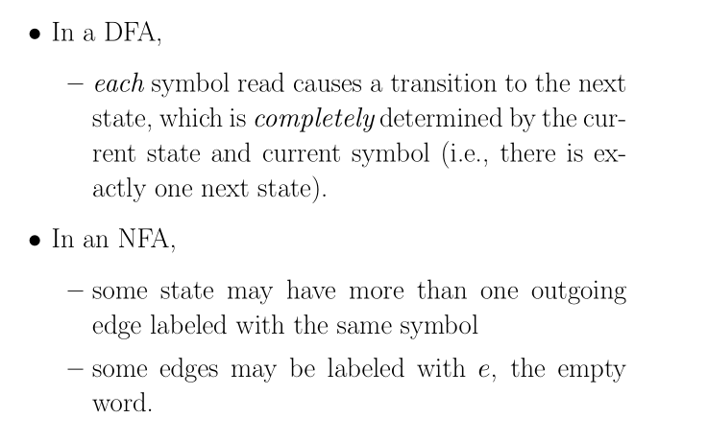
NFA

Slide 4
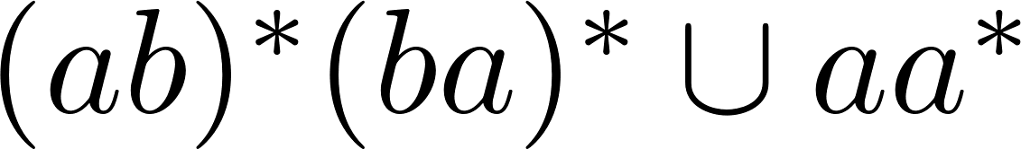
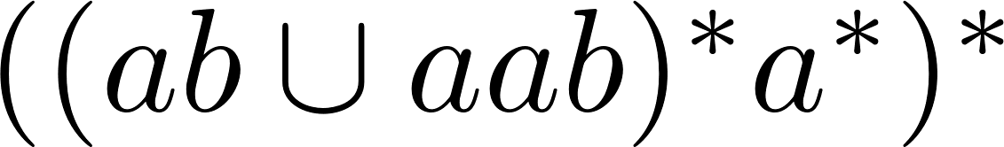
NFA
Draw state diagrams for NFAs that accepts the following languages.
Hints: Use ideas from the proof which shows that every regular language is accepted by some NFA.

Slide 5
NFA
Draw state diagrams for NFAs that accepts the following languages.

Slide 6
NFA
Draw state diagrams for NFAs that accepts the following languages.

Slide 7
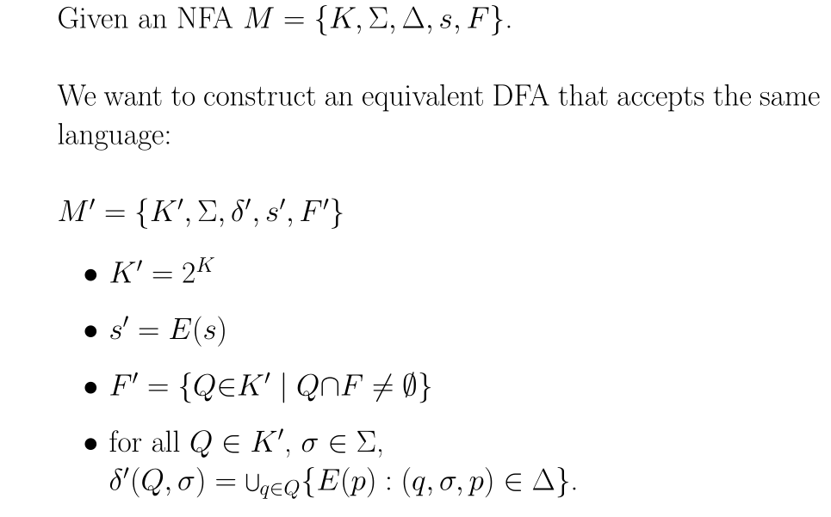
NFA = DFA

Slide 8
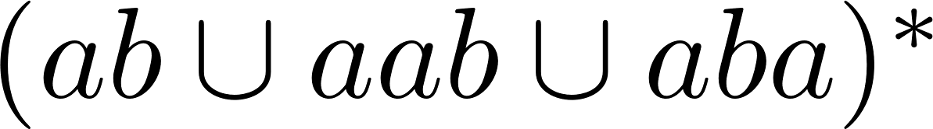
NFA = DFA
Find a simple NFA accepting .
Convert the NFA of (a) to DFA.

Slide 9
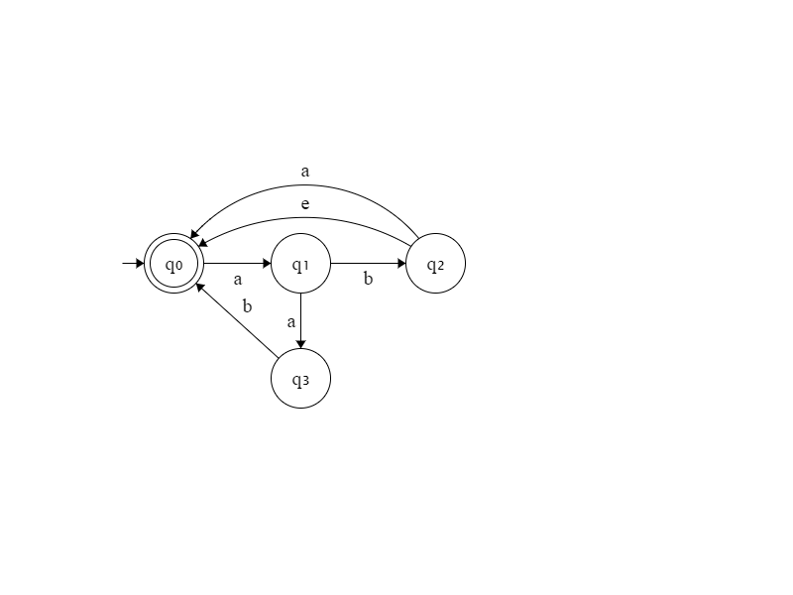
NFA = DFA
Find a simple NFA accepting .
Convert the NFA of (a) to DFA.

Slide 10
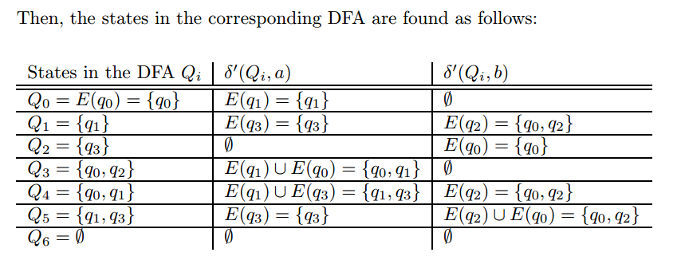
NFA = DFA
Find a simple NFA accepting .
Convert the NFA of (a) to DFA.

Slide 11
NFA = DFA
Find a simple NFA accepting .
Convert the NFA of (a) to DFA.
The start state is E(q0) = Q0.
The accepting states are those contains q0. {Q0, Q3, Q4}

Slide 12
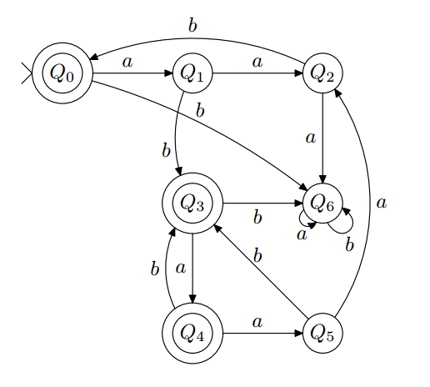
NFA = DFA
Find a simple NFA accepting .
Convert the NFA of (a) to DFA.

Slide 13
DFA = NFA = Regular Expression
Prove that if L is regular, then so is
Hints:
Construct NFA/DFA accepting Pref(L) from that accepting L

Slide 14
DFA = NFA = Regular Expression
Prove that if L is regular, then so is
Proof: Since L is regular, it is accepted by some NFA.
M = {K, Σ, Δ, s, F}. Next we will construct a NFA M′ that accepts Pref(L). We let M′ = (K, Σ, Δ, s, F′) where
F′ = {q ∈ K : in M, there is a path from q to f for some f ∈ F}.
We claim that M′ accepts Pref(L) and hence Pref(L) is regular.

Slide 15
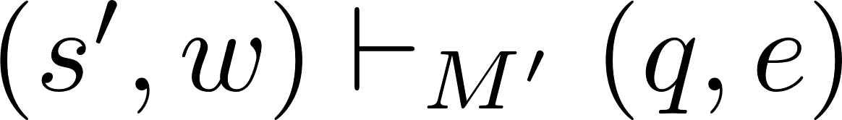
DFA = NFA = Regular Expression
Prove that if L is regular, then so is
Proof(cont’d):
To see why M′ accepts Pref(L) , consider any string w.
w ∈ Pref(L) iff
wy ∈ L for some y ∈ Σ∗, iff
wy is accepted by M, iff
for some q ∈ K and f ∈ F, iff
for some q ∈ F’ iff w is accepted by M′

