Slide 1
COMP 3721
Tutorial 4

Slide 2
NFA -> Regular Expression
NFA = DFA = Regular Expressions
Pumping Theorem

Slide 3
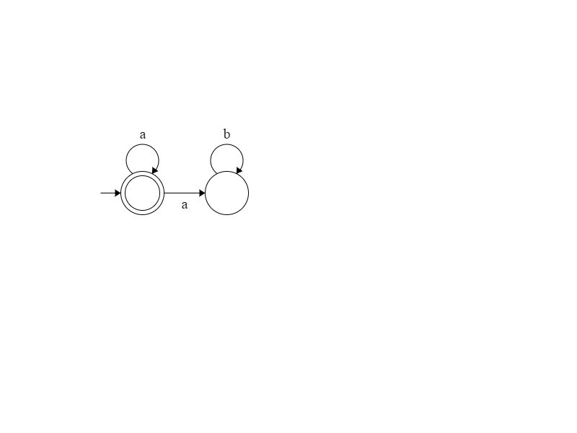
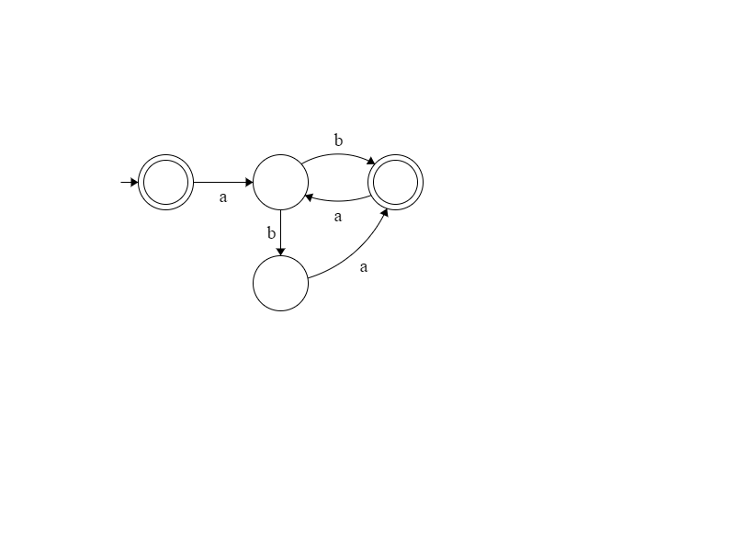
NFA -> Regular Expression
Write regular expressions for the languages accepted by the following NFA.

Slide 4
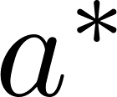
NFA -> Regular Expression
Write regular expressions for the languages accepted by the following NFA.

Slide 5
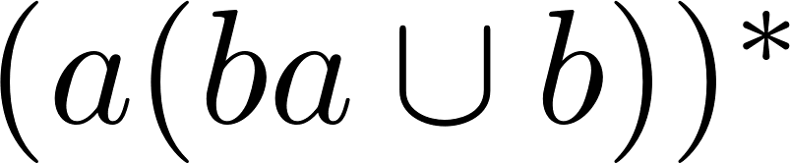
NFA -> Regular Expression
Write regular expressions for the languages accepted by the following NFA.

Slide 6
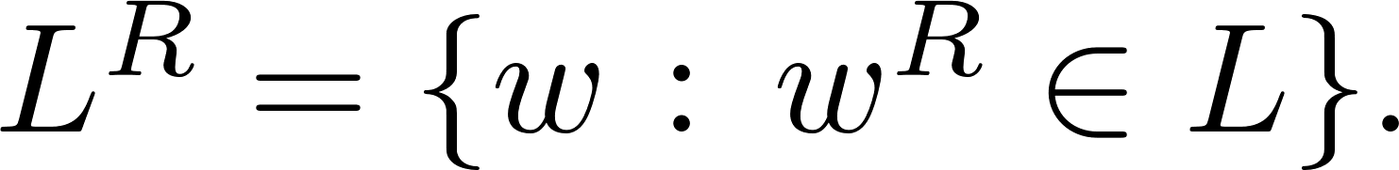
NFA = DFA = Regular Expressions
Prove that if L is regular, then the following languages are also regular

Slide 7
NFA = DFA = Regular Expressions
Prove that if L is regular, then the following languages are also regular
Proof:
Since L is regular, it is accepted by some NFA M = {K, Σ, Δ, s, F}.
Next we will construct a NFA M′ that accepts Subseq(L).

Slide 8
NFA = DFA = Regular Expressions
Prove that if L is regular, then the following languages are also regular
Proof:
Since L is regular, it is accepted by some NFA M = {K, Σ, Δ, s, F}.
Next we will construct a NFA M′ that accepts Subseq(L).
We look at any pair (p, q) of states in M, if there is a path from p to q, we draw an arrow from p to q labeled with e.

Slide 9
NFA = DFA = Regular Expressions
Prove that if L is regular, then the following languages are also regular
Proof:
Since L is regular, it is accepted by some NFA M = {K, Σ, Δ, s, F}.
Next we will construct a NFA M′ that accepts Subseq(L). We look at any pair (p, q) of states in M, if there is a path from p to q, we draw an arrow from p to q labeled with e. More precisely, M′ = (K, Σ, Δ′, s, F) where
Δ′ = Δ ∪ {(p, e, q) : there is a path from p to q in M}.

Slide 10
NFA = DFA = Regular Expressions
Prove that if L is regular, then the following languages are also regular
Proof:
Since L is regular, it is accepted by some NFA M = {K, Σ, Δ, s, F}.
Next we will construct a NFA M′ that accepts Subseq(L). We look at any pair (p, q) of states in M, if there is a path from p to q, we draw an arrow from p to q labeled with e. More precisely, M′ = (K, Σ, Δ′, s, F) where
Δ′ = Δ ∪ {(p, e, q) : there is a path from p to q in M}.
We claim that M′ accepts Subseq(L) and hence Subseq(L) is regular. Details are omitted

Slide 11
NFA = DFA = Regular Expressions
Prove that if L is regular, then the following languages are also regular
Proof:
Since L is regular, it is accepted by some NFA M = {K, Σ, Δ, s, f}. Without loss of generality, we assume that M has single final state.

Slide 12
NFA = DFA = Regular Expressions
Prove that if L is regular, then the following languages are also regular
Proof:
Since L is regular, it is accepted by some NFA M = {K, Σ, Δ, s, f}. Without loss of generality, we assume that M has single final state.
Next we will construct a NFA M′ that accepts L^{R} by reversing all the transitions in M.

Slide 13
NFA = DFA = Regular Expressions
Prove that if L is regular, then the following languages are also regular
Proof:
Since L is regular, it is accepted by some NFA M = {K, Σ, Δ, s, f}. Without loss of generality, we assume that M has single final state.
Next we will construct a NFA M′ that accepts L^{R} by reversing all the transitions in M.
More precisely, we let M′ = (K, Σ, Δ′, s′, f′) where
s′ = f, f′ = s, and Δ′ = {(p, a, q) : (q, a, p) ∈ Δ}.
We claim that M′ accepts L^{R} and hence L^{R} is regular. Details are omitted

Slide 14
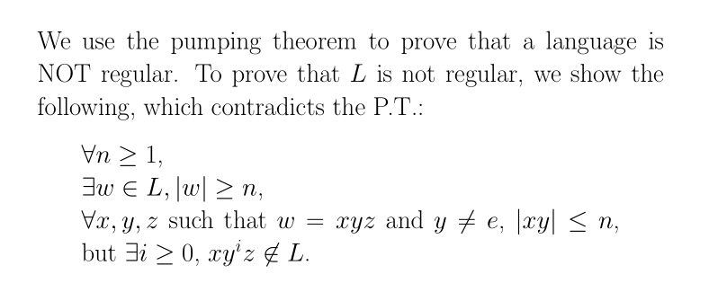
Pumping Theorem

Slide 15
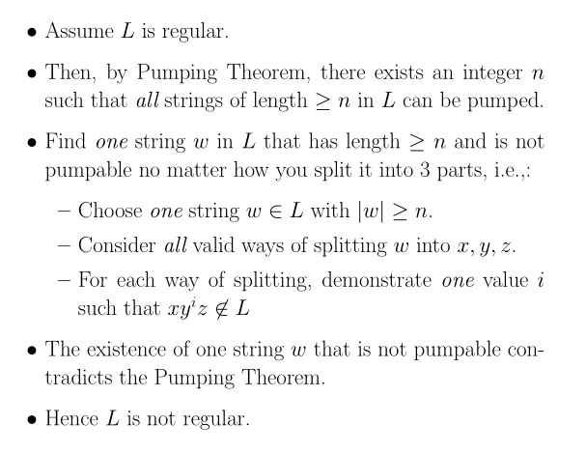
Pumping Theorem

Slide 16
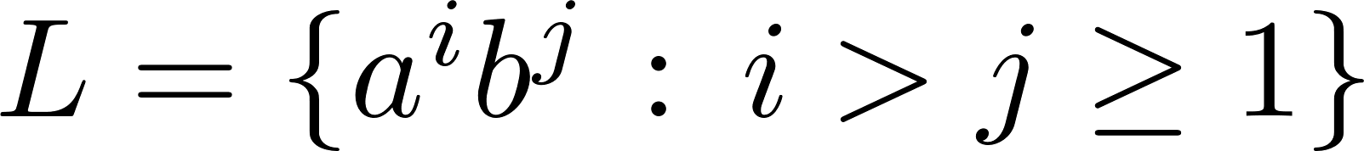
Pumping Theorem
Are the following languages on {a, b} regular or not? Prove your answer.

Slide 17
Pumping Theorem
Are the following languages on {a, b} regular or not? Prove your answer.
Not regular.

Slide 18
Pumping Theorem
Are the following languages on {a, b} regular or not? Prove your answer.
Not regular.
Proof: Assume L is regular. Then pumping theorem applies for some integer n.

Slide 19
Pumping Theorem
Are the following languages on {a, b} regular or not? Prove your answer.
Not regular.
Proof: Assume L is regular. Then pumping theorem applies for some integer n.
Consider the string w = a^{n+1}b^{n} ∈ L.

Slide 20
Pumping Theorem
Are the following languages on {a, b} regular or not? Prove your answer.
Not regular.
Proof: Assume L is regular. Then pumping theorem applies for some integer n.
Consider the string w = a^{n+1}b^{n} ∈ L.
Let x, y, and z be specified as in pumping theorem.
Then x = a^{i}, y = a^{j}, z = a^{k}b^{n} for i, k ≥ 0 and j > 0.

Slide 21
Pumping Theorem
Are the following languages on {a, b} regular or not? Prove your answer.
Not regular.
Proof: Assume L is regular. Then pumping theorem applies for some integer n.
Consider the string w = a^{n+1}b^{n} ∈ L.
Let x, y, and z be specified as in pumping theorem.
Then x = a^{i}, y = a^{j}, z = a^{k}b^{n} for i, k ≥ 0 and j > 0.
By the theorem, xy⁰z is in L.

Slide 22
Pumping Theorem
Are the following languages on {a, b} regular or not? Prove your answer.
Not regular.
Proof: Assume L is regular. Then pumping theorem applies for some integer n.
Consider the string w = a^{n+1}b^{n} ∈ L.
Let x, y, and z be specified as in pumping theorem.
Then x = a^{i}, y = a^{j}, z = a^{k}b^{n} for i, k ≥ 0 and j > 0.
By the theorem, xy⁰z is in L.
But this is impossible since there are at most n a′s and exactly n b′s in xy⁰z.

Slide 23
Pumping Theorem
Are the following languages on {a, b} regular or not? Prove your answer.
Not regular.
Proof: Assume L is regular. Then pumping theorem applies for some integer n.
Consider the string w = a^{n+1}b^{n} ∈ L.
Let x, y, and z be specified as in pumping theorem.
Then x = a^{i}, y = a^{j}, z = a^{k}b^{n} for i, k ≥ 0 and j > 0.
By the theorem, xy⁰z is in L.
But this is impossible since there are at most n a′s and exactly n b′s in xy⁰z.
Hence L is not regular.

Slide 24
Pumping Theorem
Are the following languages on {a, b} regular or not? Prove your answer.
Not regular.

Slide 25
Pumping Theorem
Are the following languages on {a, b} regular or not? Prove your answer.
Not regular.
Not regular.

Slide 26
Pumping Theorem
Are the following languages on {a, b} regular or not? Prove your answer.
Not regular.
Proof: Assume L is regular. Then pumping theorem applies for some integer n.
Consider the string w = a^{n+1}ba^{n+1}b ∈ L.
Let x, y, and z be specified as in pumping theorem.
Then x = a^{i}, y = a^{j}, z = a^{k}ba^{n+1}b for i, k ≥ 0 and j > 0.
By the theorem, xy⁰z is in L.
But this is impossible since there are at most n a′s and exactly n b′s in xy⁰z.
Hence L is not regular.

Slide 27
Pumping Theorem
Are the following languages on {a, b} regular or not? Prove your answer.
Not regular.
Not regular.

Slide 28
Pumping Theorem
Are the following languages on {a, b} regular or not? Prove your answer.
Not regular.
Not regular.
Regular.

Slide 29
Pumping Theorem
Are the following languages on {a, b} regular or not? Prove your answer.
Not regular.
Not regular.
Regular.
Proof.
In fact,
L = (babbabbab)⁺=(babbabbab)(babbabbab)∗

Slide 30
Properties of R. L.
Are the following statements true or false?
Every subset of a regular language is regular.

Slide 31
Properties of R. L.
Are the following statements true or false?
Every subset of a regular language is regular.
False.

Slide 32
Properties of R. L.
Are the following statements true or false?
Every subset of a regular language is regular.
False.
Counter example:
{a^{n}b^{n}: n ≥ 0} is a subset of (a ∪ b)∗, but is not regular.

Slide 33
Properties of R. L.
Are the following statements true or false?
Every subset of a regular language is regular. False.
If L is regular, then so is L′ = {xy : x ∈ L and y ∉ L }.

Slide 34
Properties of R. L.
Are the following statements true or false?
Every subset of a regular language is regular. False.
If L is regular, then so is L′ = {xy : x ∈ L and y ∉ L }.
True.

Slide 35
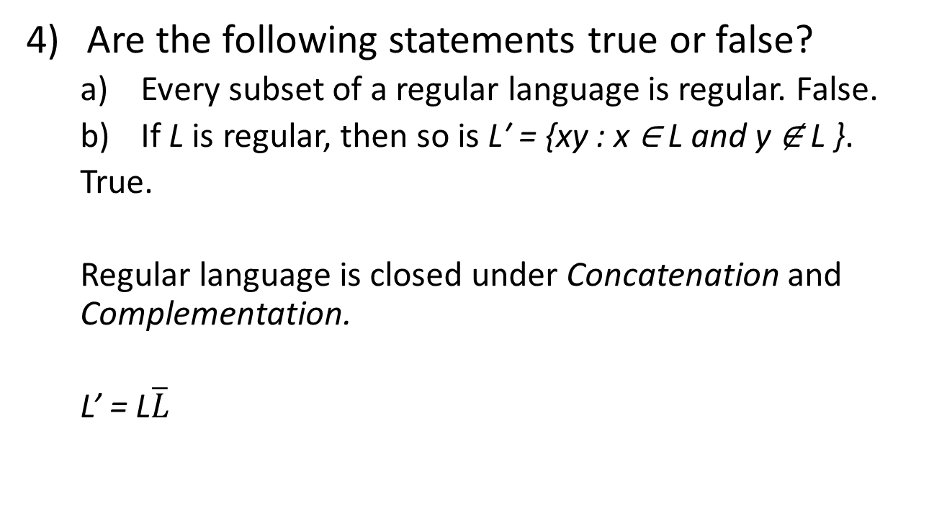
Properties of R. L.
Are the following statements true or false?
Every subset of a regular language is regular. False.
If L is regular, then so is L′ = {xy : x ∈ L and y ∉ L }.
True.
Regular language is closed under Concatenation and Complementation.
L’ = L$\overline{L}$

Slide 36
Properties of R. L.
Are the following statements true or false?
Every subset of a regular language is regular. False.
If L is regular, then so is L′ = {xy : x ∈ L and y ∉ L }. True.
{w : w = w^{R}} is regular.

Slide 37
Properties of R. L.
Are the following statements true or false?
Every subset of a regular language is regular. False.
If L is regular, then so is L′ = {xy : x ∈ L and y ∉ L }. True.
{w : w = w^{R}} is regular.
False.
Can be proved by pumping theorem.

Slide 38
Properties of R. L.
Are the following statements true or false?
Every subset of a regular language is regular. False.
If L is regular, then so is L′ = {xy : x ∈ L and y ∉ L }. True.
{w : w = w^{R}} is regular. False

