Slide 1
COMP 3721
Tutorial 6

Slide 2
Context-Free Language
Pumping Theorem
Closure Property

Slide 3
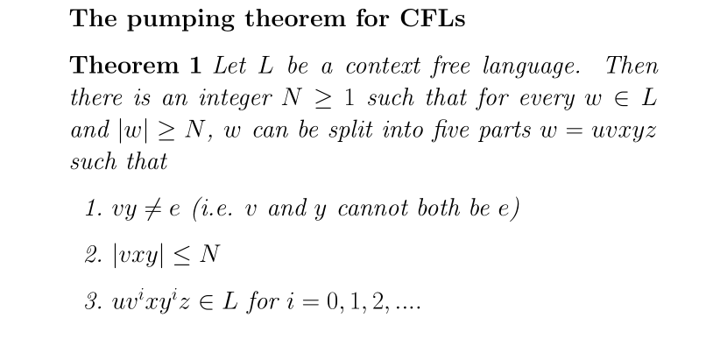
Pumping Theorem

Slide 4
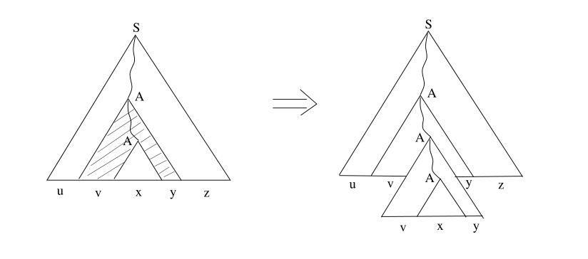
Pumping Theorem

Slide 5
Pumping Theorem
For each of the following languages L, state whether L is context-free or not.
{a^{i}b^{j}c^{k} : i + j = k, i, j, k ≥ 0}
{a^{i}b^{i}c^{2i} : i ≥ 0}
{a^{i}b^{j}c^{k} : j = max(i, k), i, j, k ≥ 0}
Justify your answer. If context free show a PDA or CFG, if not apply Pumping Lemma for CFL

Slide 6
Pumping Theorem
For each of the following languages L, state whether L is context-free or not.
{a^{i}b^{j}c^{k} : i + j = k, i, j, k ≥ 0}
Context-free.
K = {a, b, c, S}
Σ = {a, b, c}
R = { S -> aSc, S-> bSc, S -> e} NOT CORRECT!
R = { S -> e|A, A -> aAc|B, B -> bBc|e}

Slide 7
Pumping Theorem
For each of the following languages L, state whether L is context-free or not.
{a^{i}b^{j}c^{k} : i + j = k, i, j, k ≥ 0} Context-Free.
{a^{i}b^{i}c^{2i} : i ≥ 0} Not Context Free.

Slide 8
Pumping Theorem
For each of the following languages L, state whether L is context-free or not.
L = {a^{i}b^{i}c^{2i} : i ≥ 0} Not Context Free.
Proof.
Assume L is context-free. Let N be the integer in the Pumping Theorem.
w = a^{N}b^{N}c^{2N} = uvxyz. |vy| > 0 , |vxy| ≤ N.
vxy contains at most 2 alphebet(a or b or c or a,b or b,c).
Show that,
For all cases, can find i such that uv^{i}xy^{i}z is not in L.

Slide 9
Pumping Theorem
For each of the following languages L, state whether L is context-free or not.
{a^{i}b^{j}c^{k} : i + j = k, i, j, k ≥ 0} Context-Free.
{a^{i}b^{i}c^{2i} : i ≥ 0} Not Context-Free.
{a^{i}b^{j}c^{k} : j = max(i, k), i, j, k ≥ 0} Not Context-Free.

Slide 10
Pumping Theorem
For each of the following languages L, state whether L is context-free or not.
L = {a^{i}b^{j}c^{k} : j = max(i, k), i, j, k ≥ 0} Not Context-Free.
Proof.
Assume L is context-free. Let N be the integer in the Pumping Theorem.
w = a^{N}b^{N}c^{N} = uvxyz. |vy| > 0 , |vxy| ≤ N.
vxy contains at most 2 alphebet(a or b or c or a,b or b,c).
Show that,
For all cases, can find i such that uv^{i}xy^{i}z is not in L.

Slide 11
Pumping Theorem
For each of the following languages L, state whether L is context-free or not.
{a^{i}b^{j}c^{k} : i + j = k, i, j, k ≥ 0} Context-Free.
{a^{i}b^{i}c^{2i} : i ≥ 0} Not Context-Free.
{a^{i}b^{j}c^{k} : j = max(i, k), i, j, k ≥ 0} Not Context-Free.

Slide 12
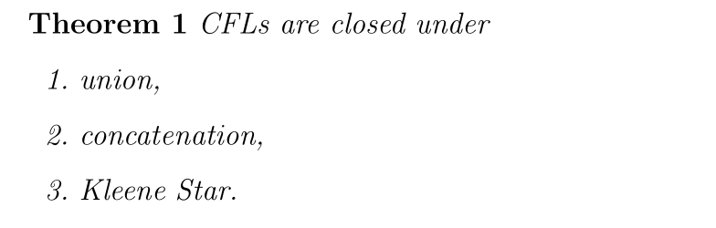
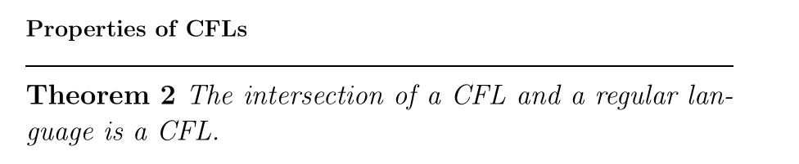
Closure Property of CFL

Slide 13
Closure Property of CFL
Use closure property of CFL to show that the following languages are context-free.
{a^{i}b^{j} : i ≠ j}
{xx^{R}yy^{R}zz^{R} : x, y, z ∈ {a, b}∗}
L − R, where L is context-free and R is regular.

Slide 14
Closure Property of CFL
Use closure property of CFL to show that the following languages are context-free.
L = {a^{i}b^{j} : i ≠ j}
{xx^{R}yy^{R}zz^{R} : x, y, z ∈ {a, b}∗}
L − R, where L is context-free and R is regular.
L is the union of:
L₁ = {a^{i}b^{j} : i > j}
L₂ = {a^{i}b^{j} : i < j}

Slide 15
Closure Property of CFL
Use closure property of CFL to show that the following languages are context-free.
{a^{i}b^{j} : i ≠ j}
{xx^{R}yy^{R}zz^{R} : x, y, z ∈ {a, b}∗}
L − R, where L is context-free and R is regular.
L’ = {ww^{R} : w ∈ {a, b}∗}

Slide 16
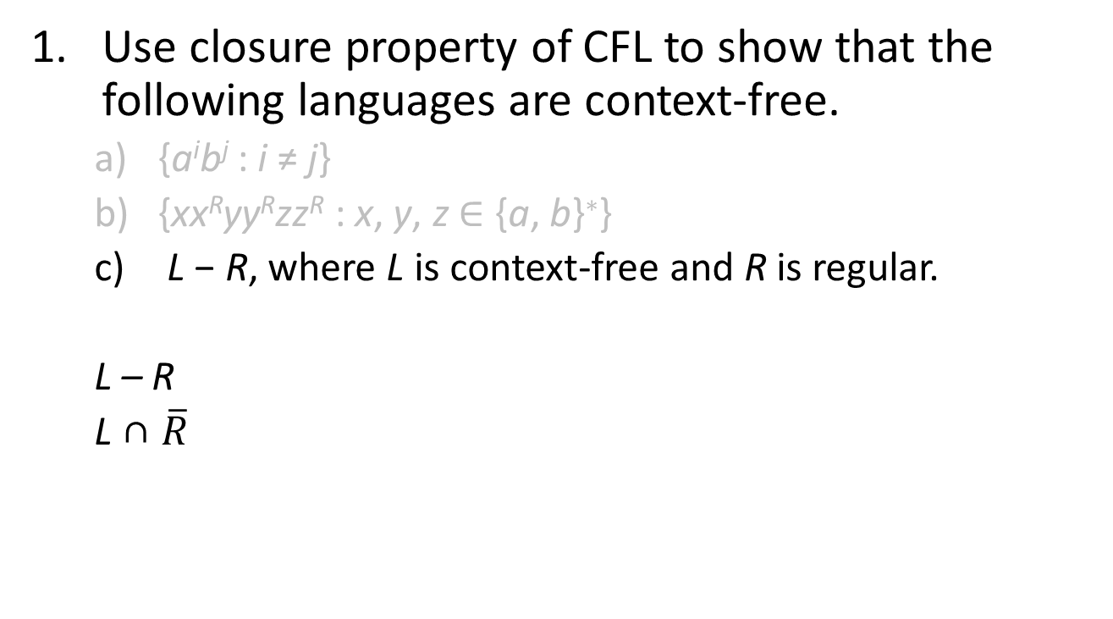
Closure Property of CFL
Use closure property of CFL to show that the following languages are context-free.
{a^{i}b^{j} : i ≠ j}
{xx^{R}yy^{R}zz^{R} : x, y, z ∈ {a, b}∗}
L − R, where L is context-free and R is regular.
L – R
L ∩ $\overline{R}$

