Slide 1
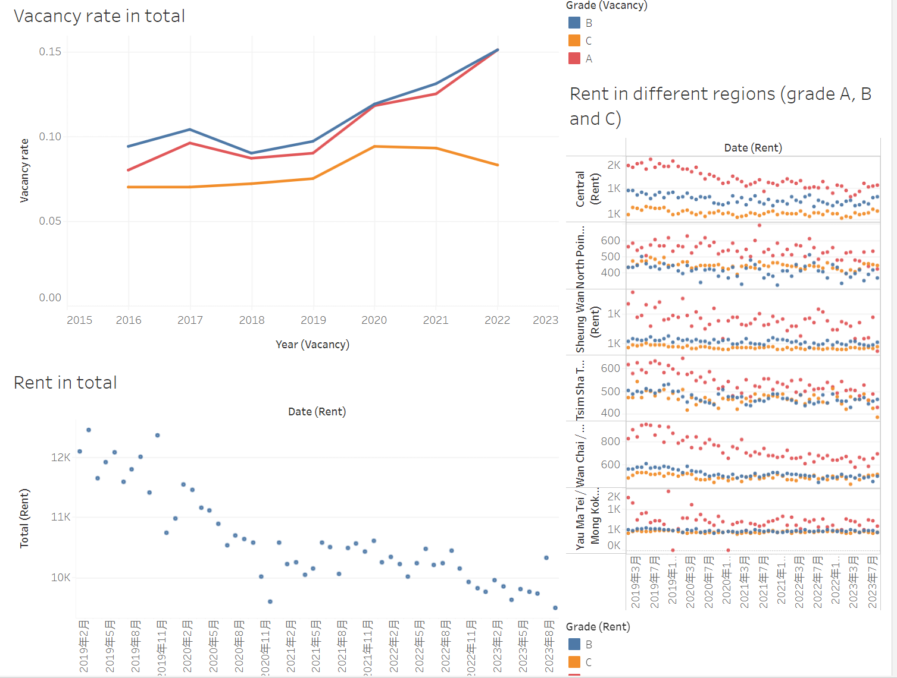
Visual Analysis of the COVID-19 Pandemic Recovery of Hong Kong
Group 7
Office Vacancy

Slide 2
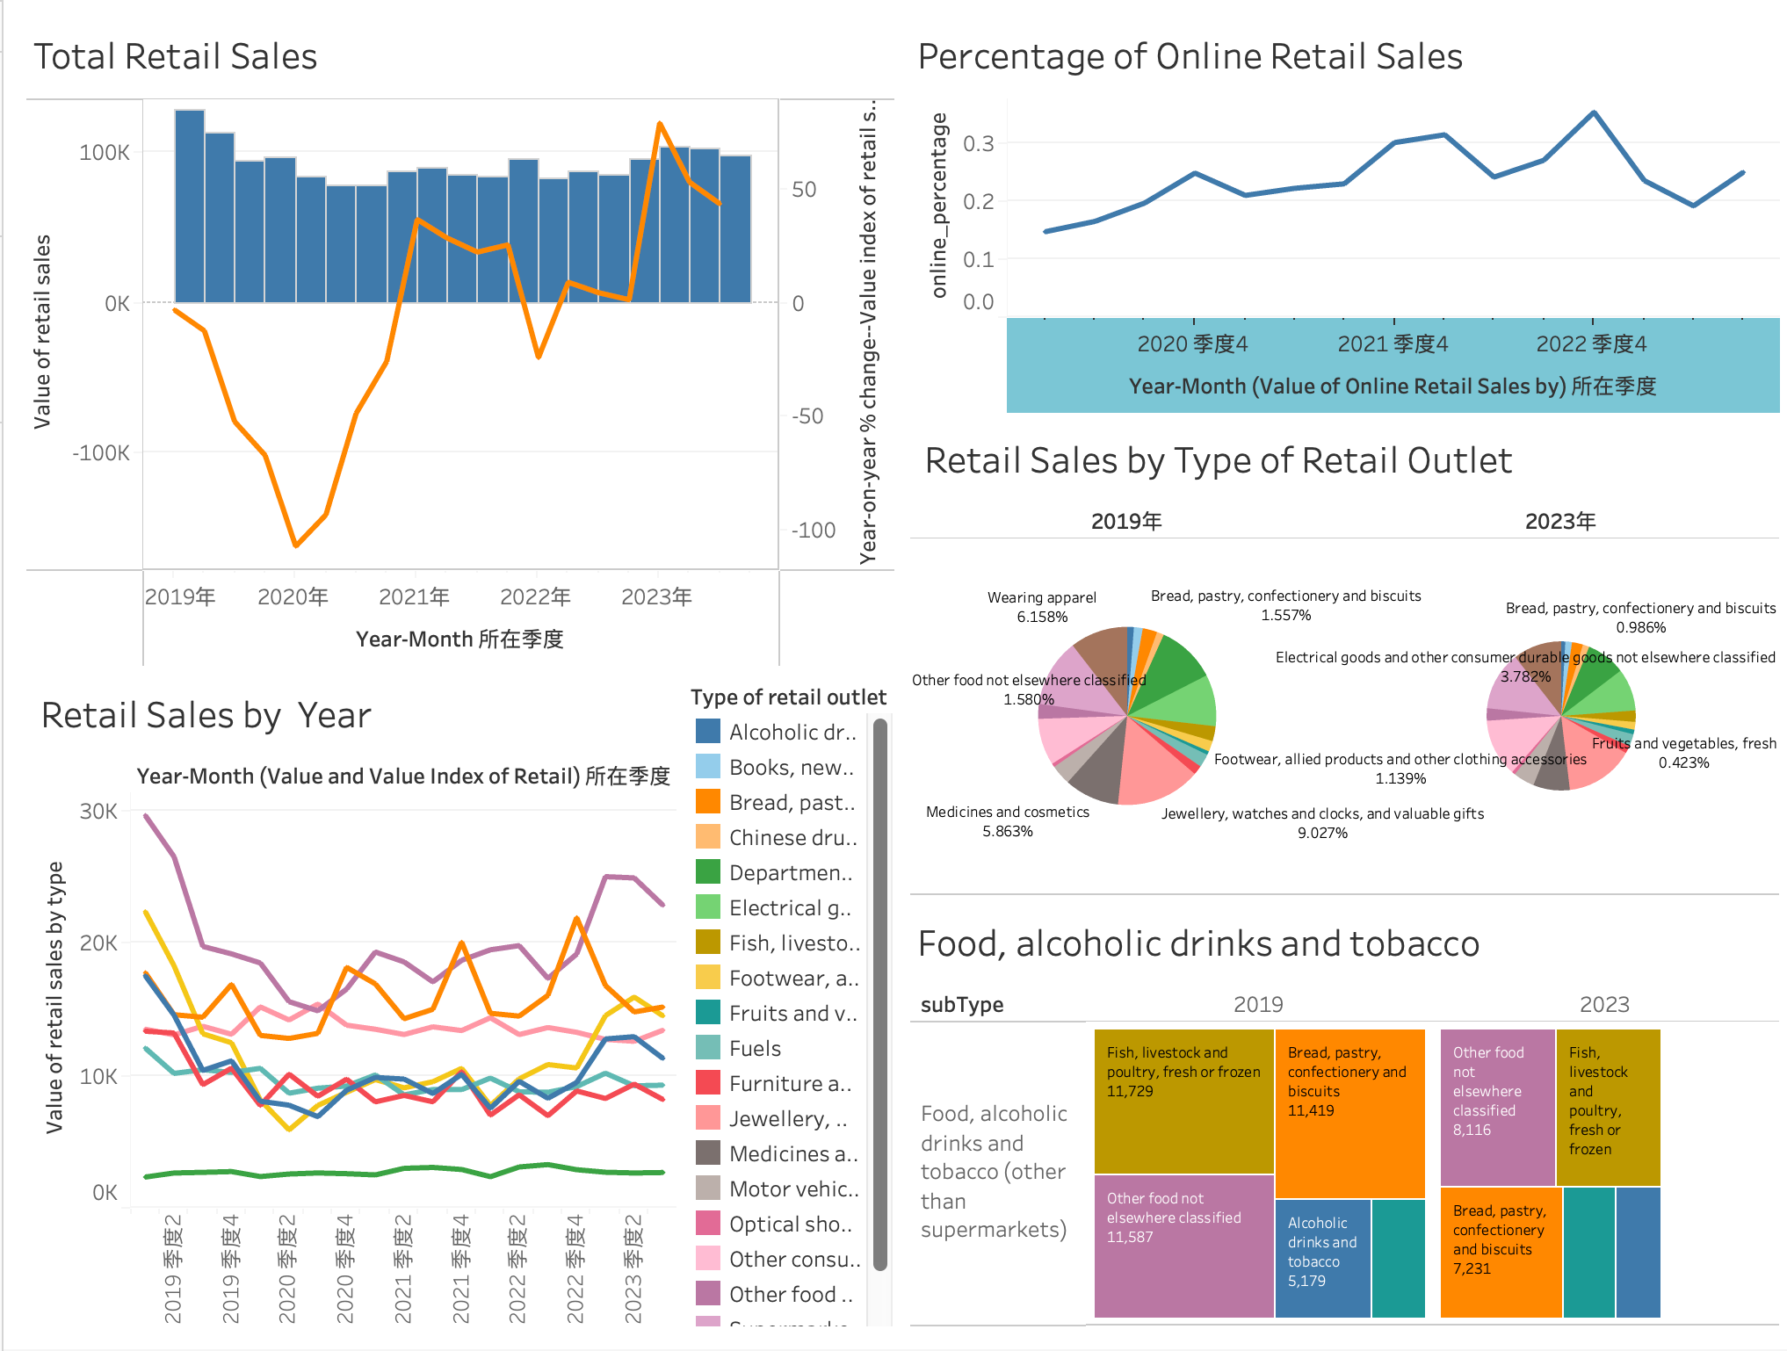
Visual Analysis of the COVID-19 Pandemic Recovery of Hong Kong
Group 7
Retail Sales

Slide 3
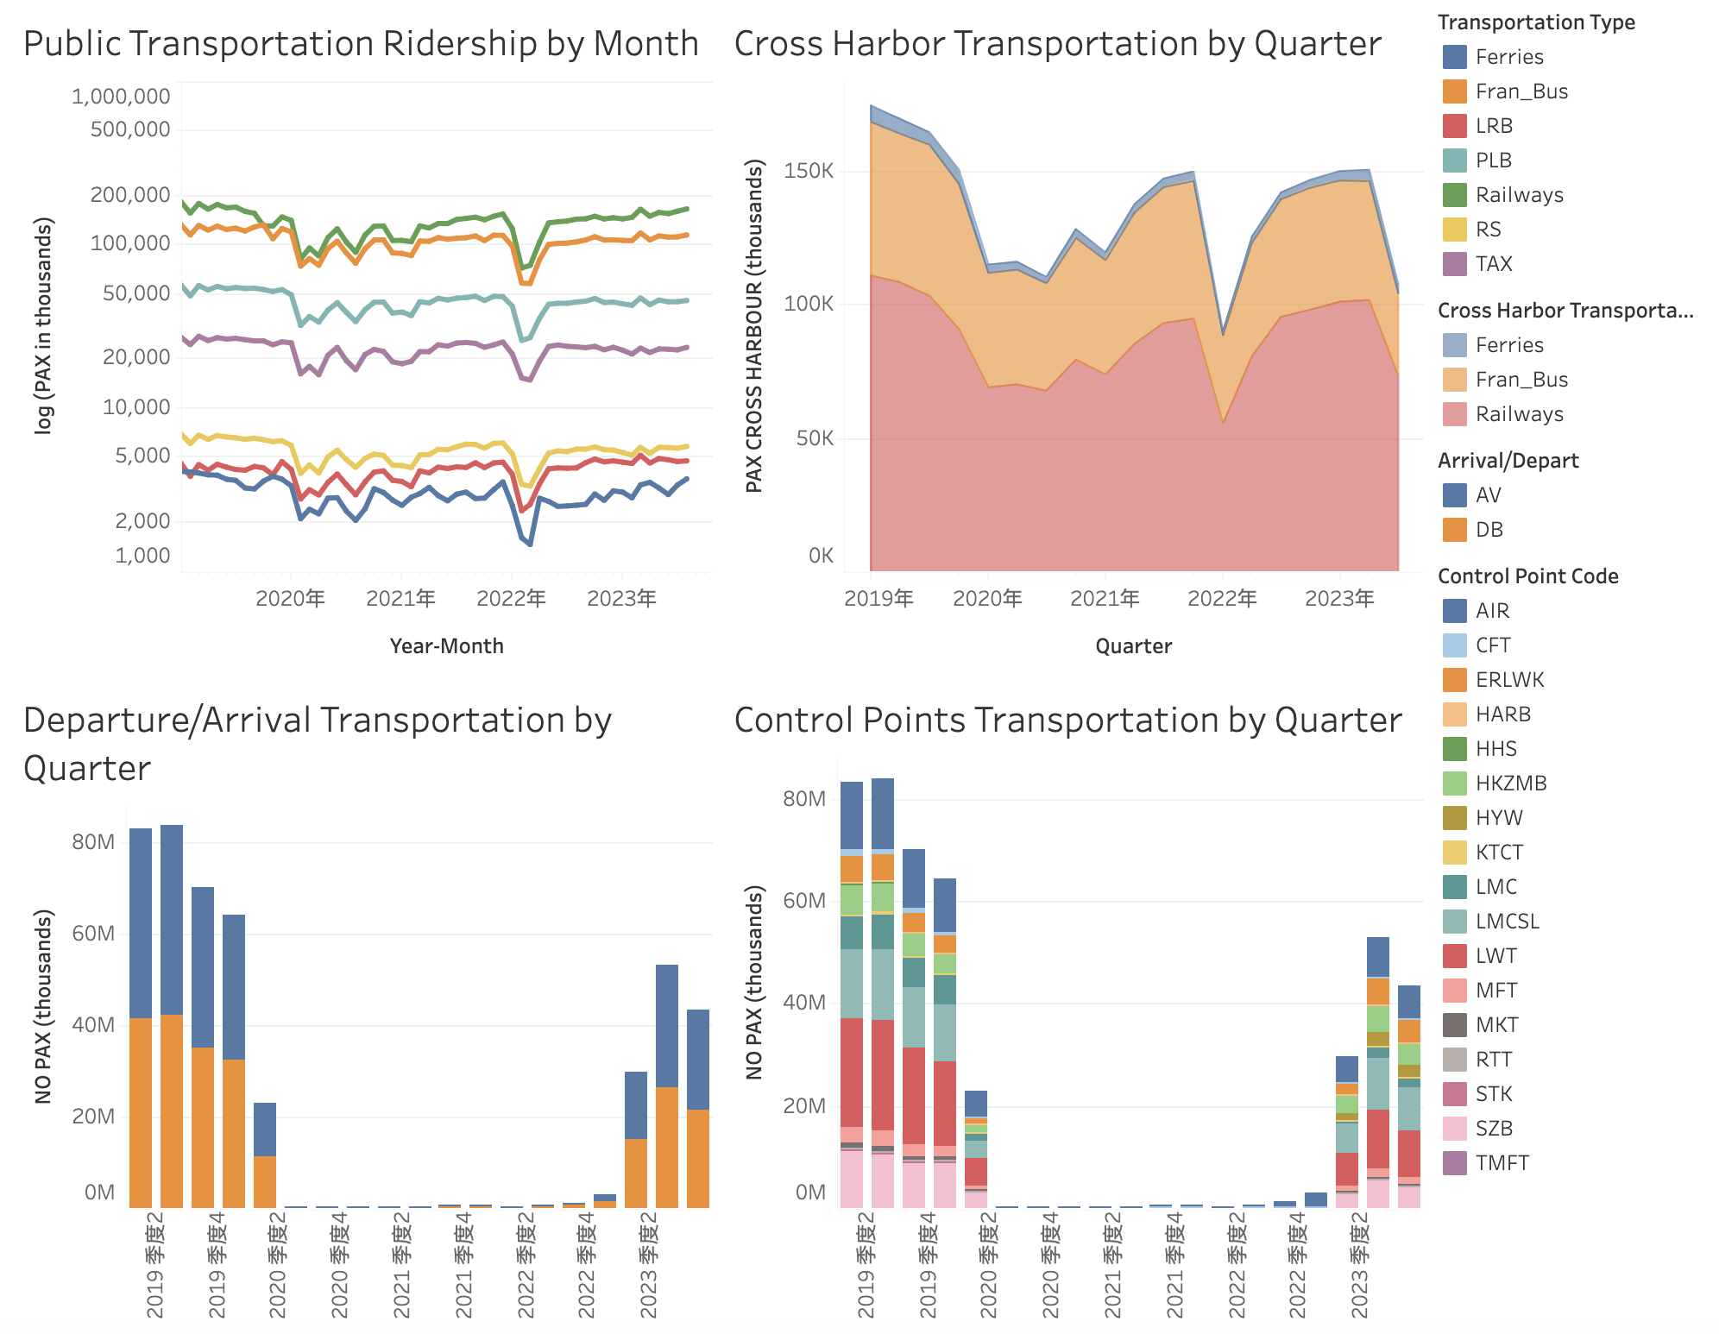
Visual Analysis of the COVID-19 Pandemic Recovery of Hong Kong
Group 7
Transportation

