Slide 1

COMP90024 Cluster and Cloud Computing
Assignment 2 – Team 19
Semester 1, 2020

Slide 2





TEAM 19
Ansible
Design & Documentation
Mukhammad Karimov
Student Id: 1019332
Email: mkarimov@student.unimelb.edu.au
City: Melbourne
Course Master of Computer Science
Sayan Chatterjee
Student Id: 569301
Email: sayanc@student.unimelb.edu.au
City: Melbourne
Couch DB & MapReduce
Web Site
Carlos Davalos Castrillon
Student Id: 1020724
Email: cdavaloscast@student.unimelb.edu.au
City: Melbourne
Rezatama Fathullah
Student Id: 1052987
Email: rfathullah@student.unimelb.edu.au
City: Melbourne
Sentiment Analysis
Aali Alqarni
Student Id: 1002741
Email: alqarnia@student.unimelb.edu.au
City: Melbourne

Slide 3

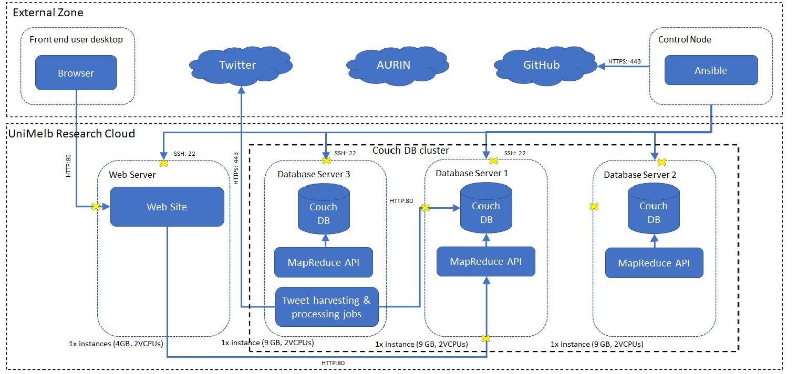
Architecture
Three guiding principles
Speed of development
Performance
Fault tolerance
Key highlights
3 Nodes Couch DB Cluster for high availability
Co-hosting Twitter harvester jobs on secondary node of Couch DB cluster
Security Groups

Slide 4
Key scenarios
• Study of social, health and financial situations
  Median age
  Median income
  Mental health
  Overseas born rate
  Employment rate
• Study of sentiments of Australian residents on Australian politics
  Politics
  COVIDSafe
• Comparison of sentiments on Australian politics against social, economic and health situations

Slide 5
Demo
Link to the video

Slide 6
Thank You

