Slide 1
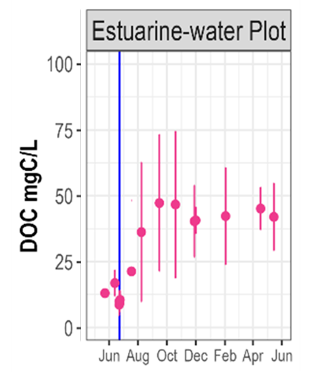
Pre-treatment:
System at quasi-equilibrium with respect to OC-mineral interactions
Solution Phase
Low mass C (e.g., acetate)
Colloids (mineral, organic, mineral/organic)
sorption
Organic macromolecule (dispersed/random coil)
Solid Phase
desorption
Organic macromolecule (aggregated)
Low mass C has relatively low affinity for soil surfaces so is primarily in solution
Organic macromolecules preferentially sorbed (in a variety of conformations); those in solution are relatively dispersed (random coil conformation)…Note: macromolecular C can also be colloidal depending on size
Colloids tend to be surface associated, but some are dispersed in solution

Slide 2
Treatment
Introduction of brackish (high ionic strength) water disrupts previous sorption/desorption equilibrium
Solution Phase
Low mass C (e.g., acetate)
Colloids (mineral, organic, mineral/organic)
sorption
Organic macromolecule (dispersed/random coil)
Solid Phase
desorption
Organic macromolecule (aggregated)
Little effect on low mass C molecules, they essentially remain in solution
Organic macromolecules preferentially sorbed/aggregated, thereby removed from solution (“salted out”)
Colloids previously in solution aggregate and associate with the solids
Depending on composition (Ca²⁺:Na⁺) of the treatment water, extent of Ca bridging may increase or decrease

Slide 3
Post-treatment:
As ionic strength/conductivity decreases over time due to introduction of rain, dispersive forces increase, promoting desorption
Solution Phase
Low mass C (e.g., acetate)
Colloids (mineral, organic, mineral/organic)
sorption
Organic macromolecule (dispersed/random coil)
Solid Phase
desorption
Organic macromolecule (aggregated)
Low mass C has relatively low affinity for soil surfaces, so is primarily in solution
Increasing electrostatic repulsion (uncoiling) within and between organic macromolecules leads to desorption/dispersion
Electrostatic repulsion between colloids and soil surfaces leads to dispersion/desorption

