Slide 1
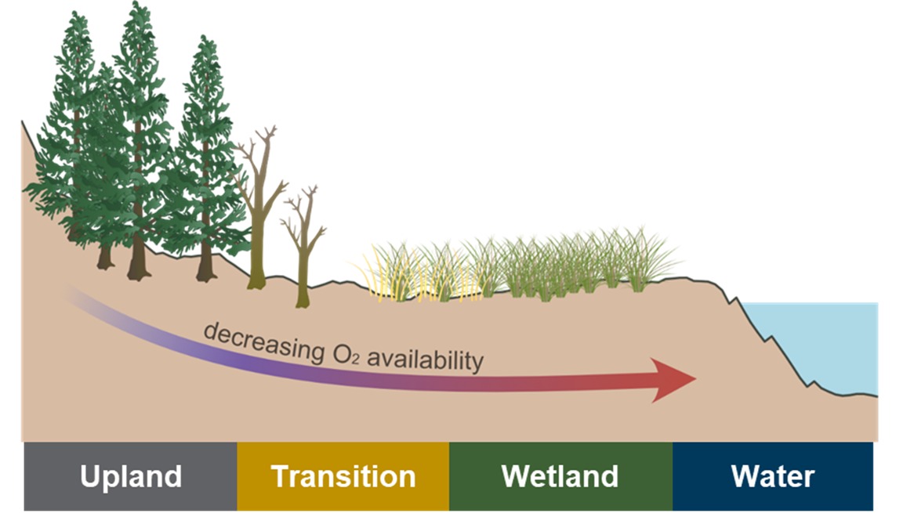
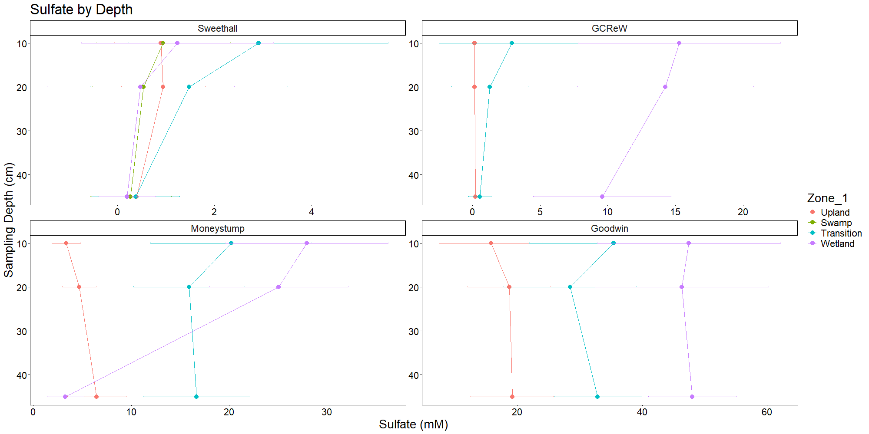
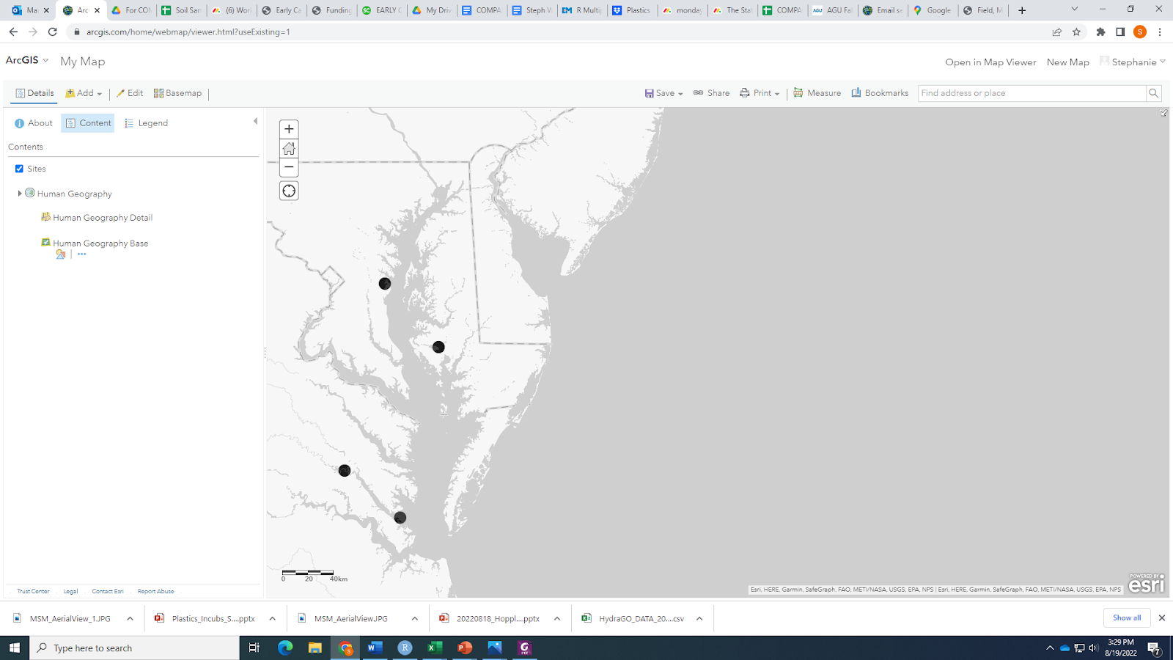

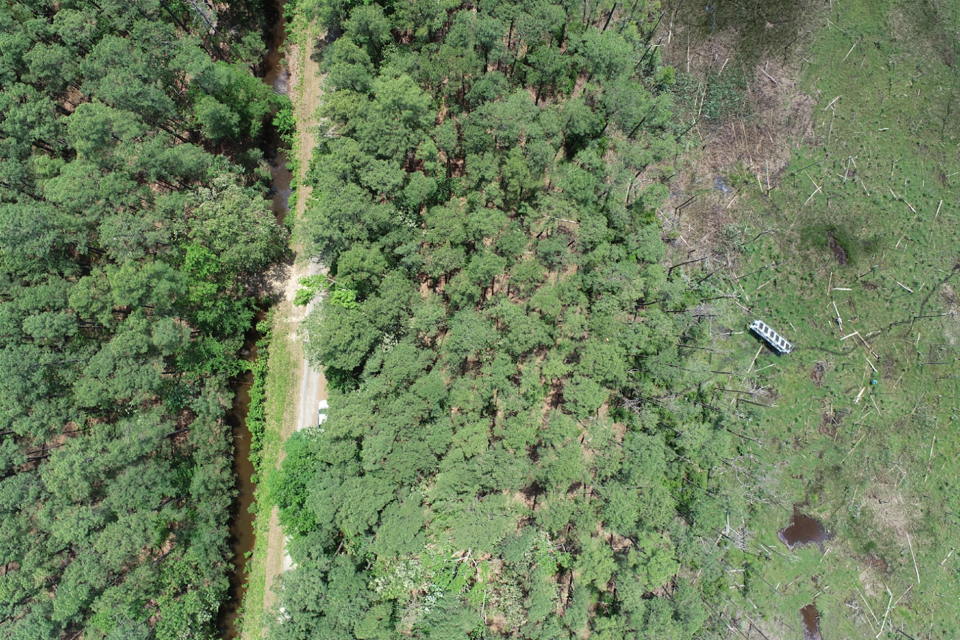
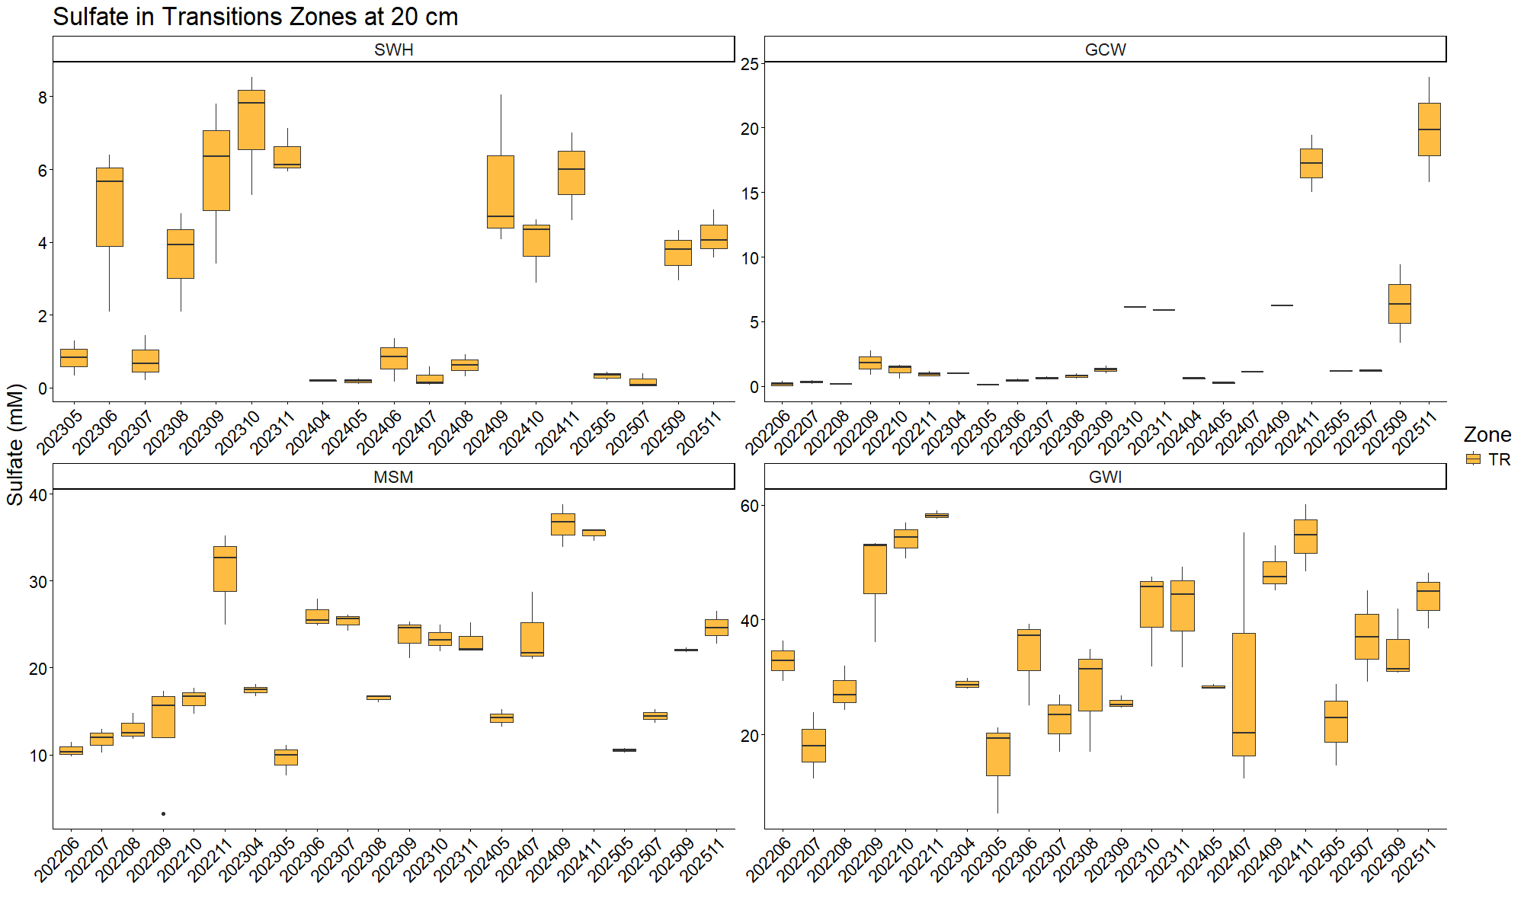
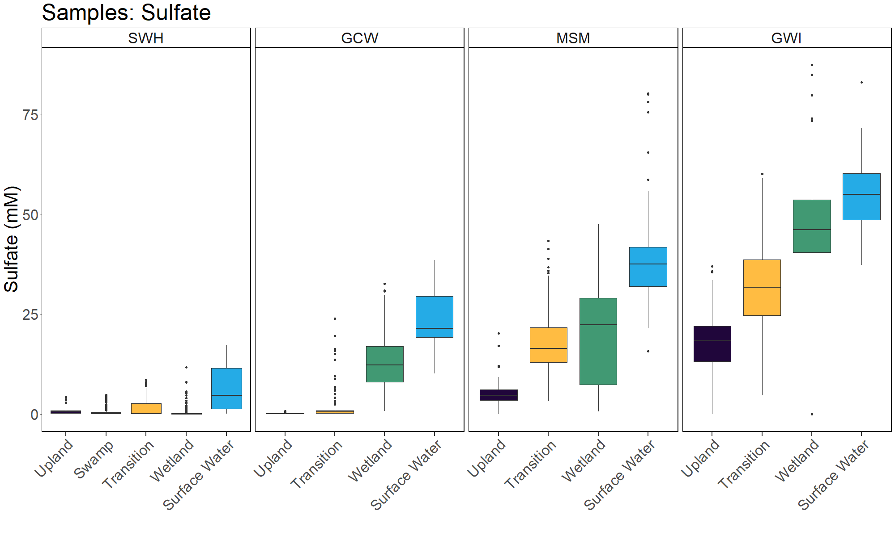
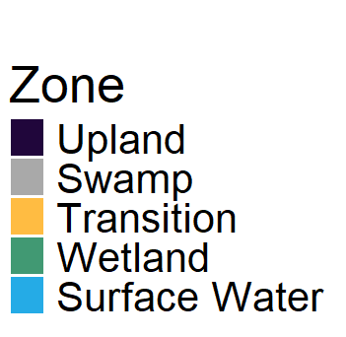
Porewater across time and depth trends…
0668
Zoe Read, Stephanie J. Wilson, Pat Megonigal, Alice Stearns, Evan Phillips, Ben Bond-Lamberty
¹Smithsonian Environmental Research Center, Maryland, USA, ²Pacific Northwest National Laboratory
Background
Study sites: Four coastal wetlands in the Chesapeake Bay Region that are oligohaline, mesohaline, polyhaline
Porewater sampling from 2022-2025
Analyzed for DIC, DOC, Total Alkalinity, CDOM, H₂S, Cl⁻, Nutrients, and SO₄²⁻
Depth
Porewater was sampled at three depths: 10, 20, and 45 cm
Sulfate concentration changes by depth, but this effect varies across site and zone
Site | Salinity
Sweethall | 0-2
GCReW | 8-10
MoneyStump | 8-10
Goodwin Islands | 18-20
GCReW
Money Stump
Sweethall
Goodwin Islands
Upland
Transition
Wetland
Hypothesis: There is a hierarchical structure to spatial variation in ecosystem structure and function at the coastal TAI that is set by:
1) the depth and duration of soil saturation
2) the abundance of redox-sensitive elements
3) their interactions with plant traits
Seasonal variation
Sulfate tends to increase throughout a year and decrease at the start of a new year.
Porewater Sulfate
Porewater was analyzed for SO₄²⁻ in 2,293 samples
Sulfate increased from Upland Forest through transition zones to the wetland
Sulfate also increased from Sweethall site (oligohaline) to Goodwin Islands site (polyhaline).
Surface water was a source of sulfate into these ecosystems.
Take-home messages
Sulfate varies by depth, site, zone, and throughout the year
Notes:
• Contact Digital Duplicating (375-2969, http://digitalduplicating.pnl.gov) to order poster printing and finishing services for your completed poster design.
• Remember to have your poster cleared for public display/distribution through the ERICA Information Release system (http://erica.pnl.gov).

