Slide 1
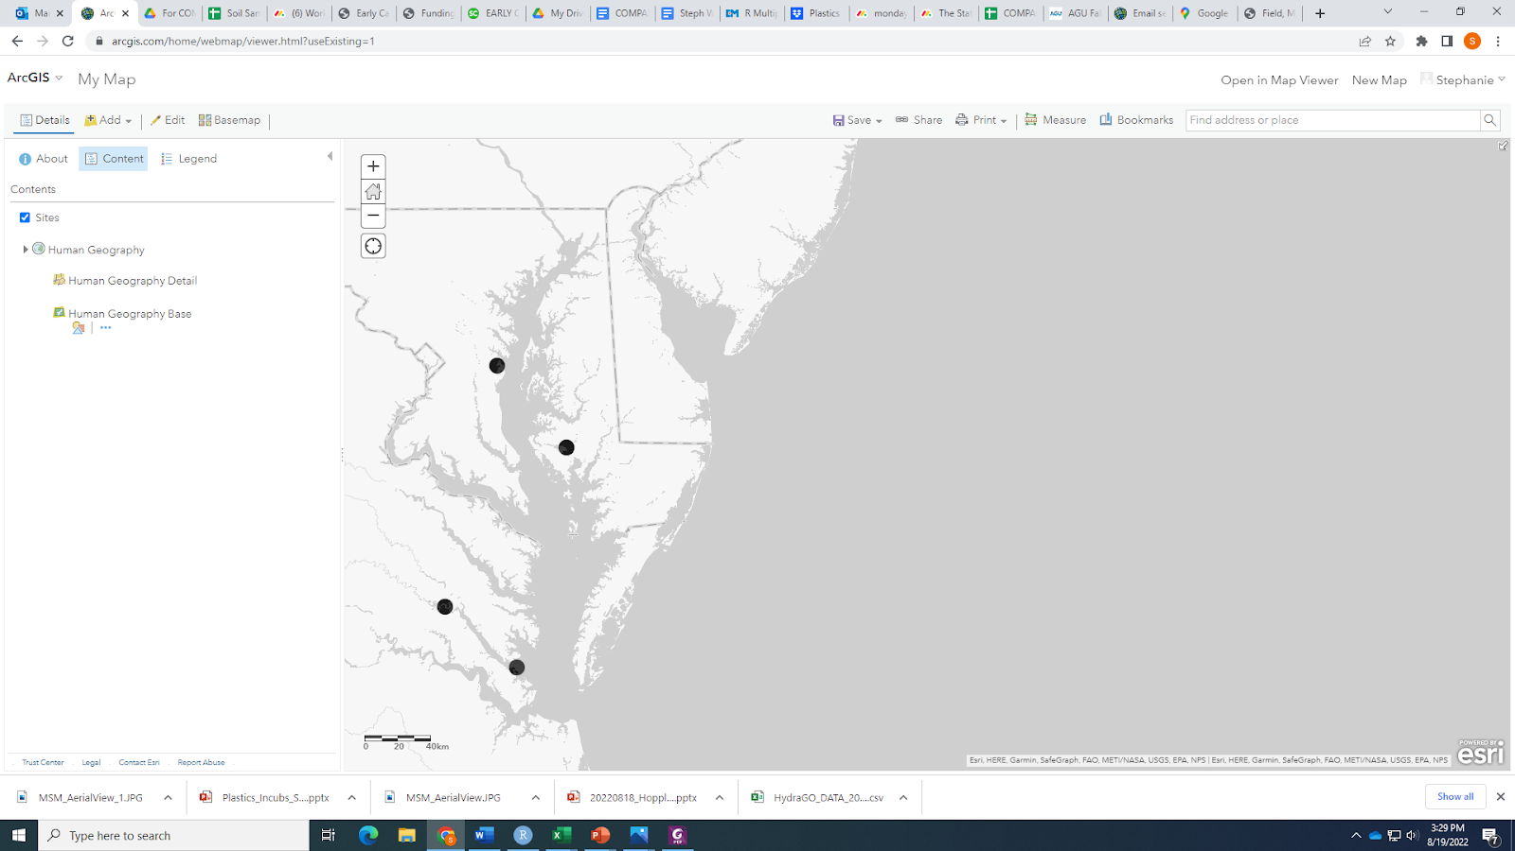
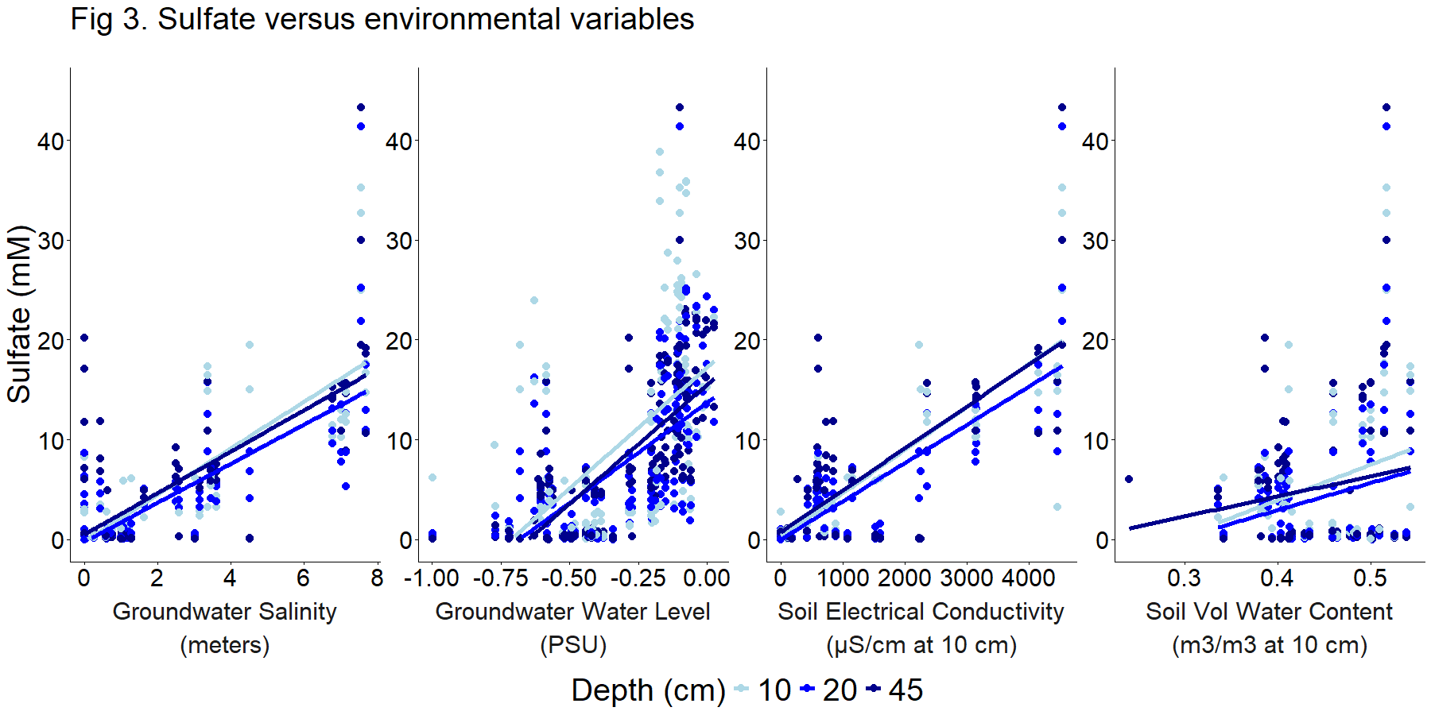
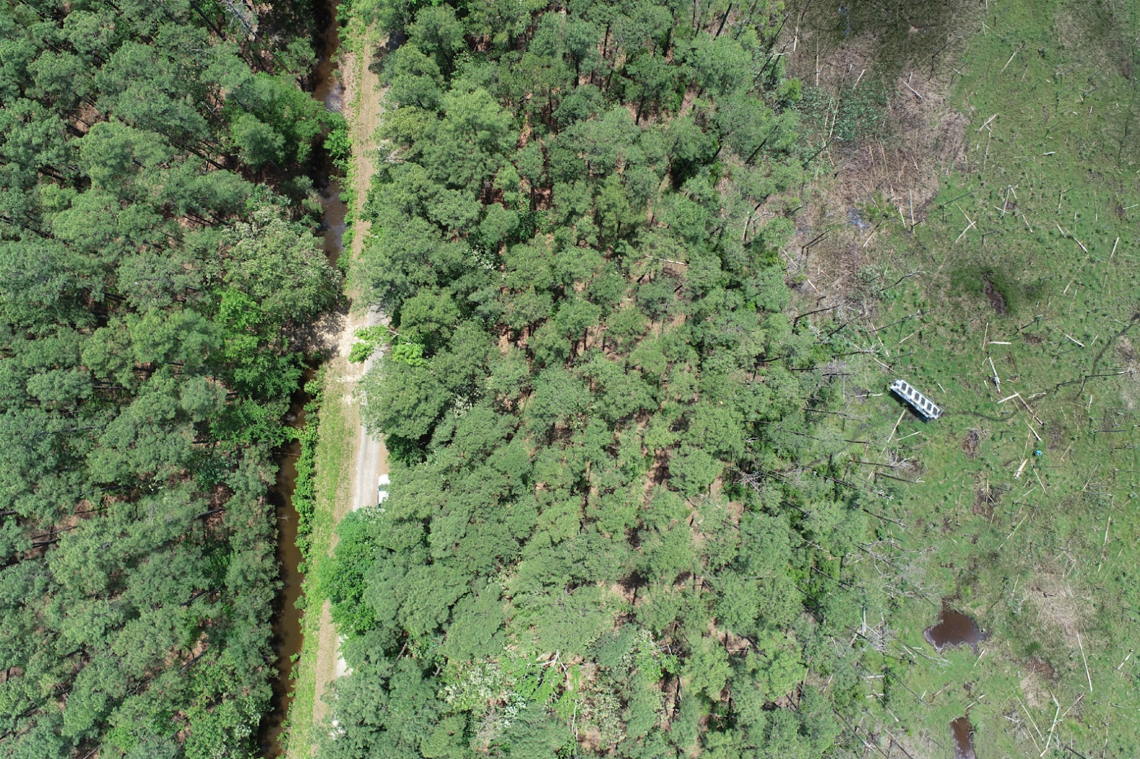
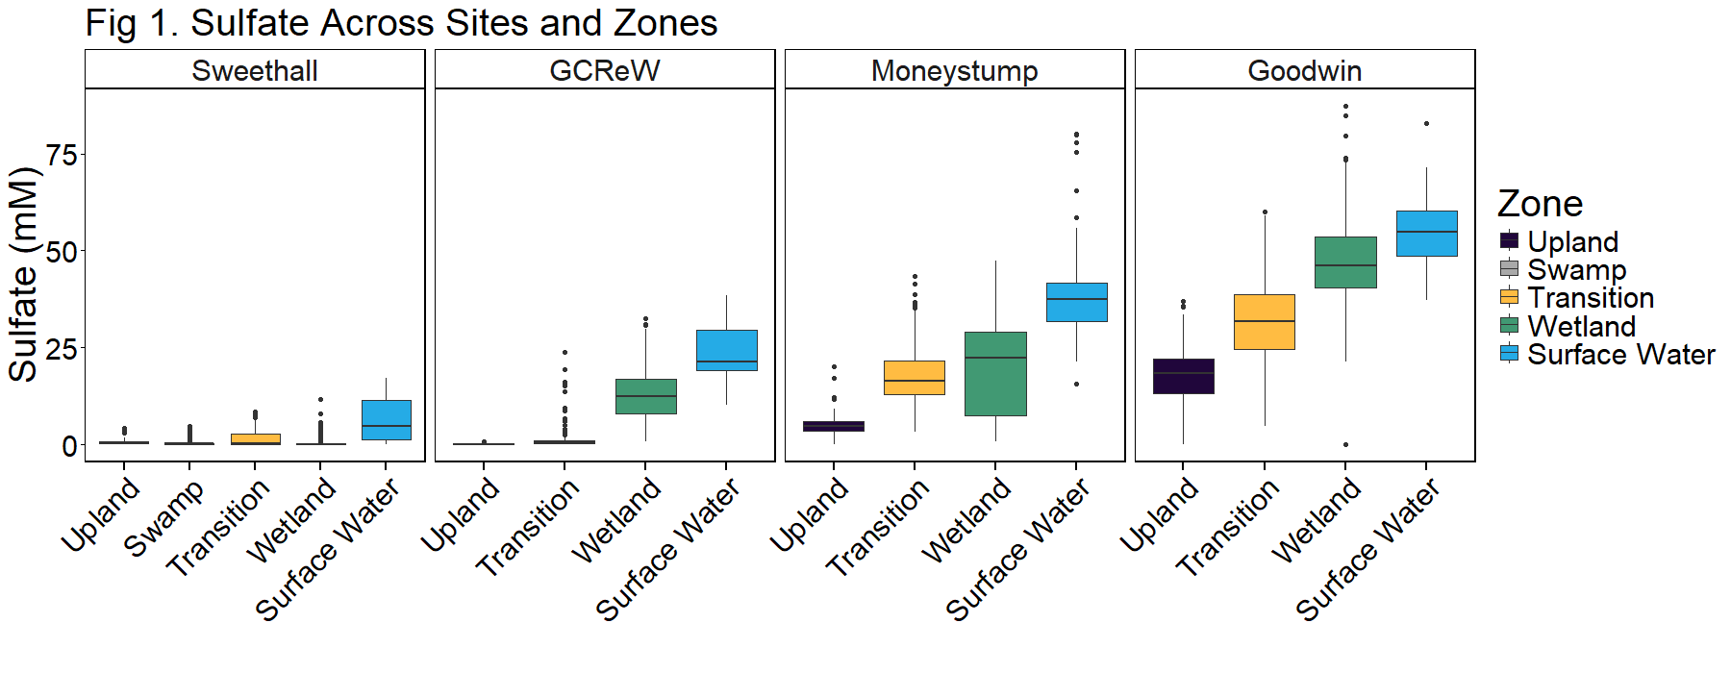
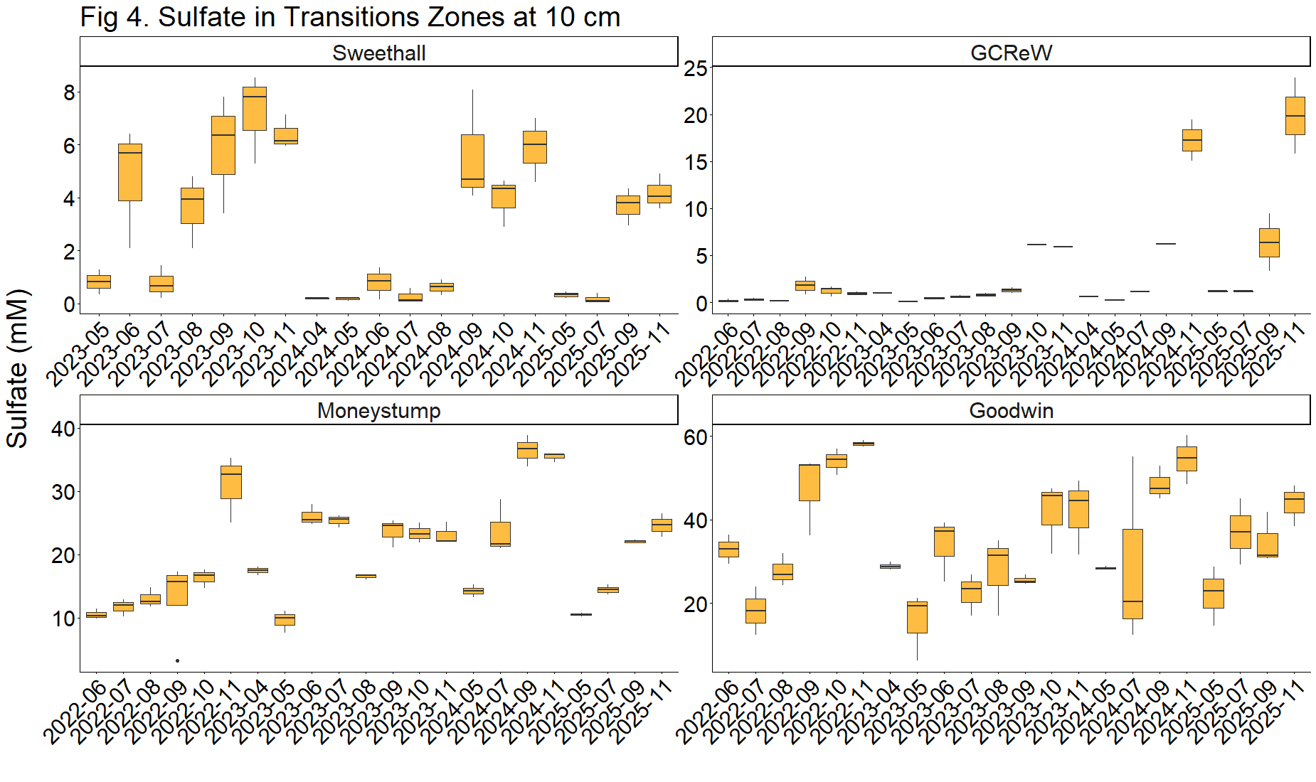
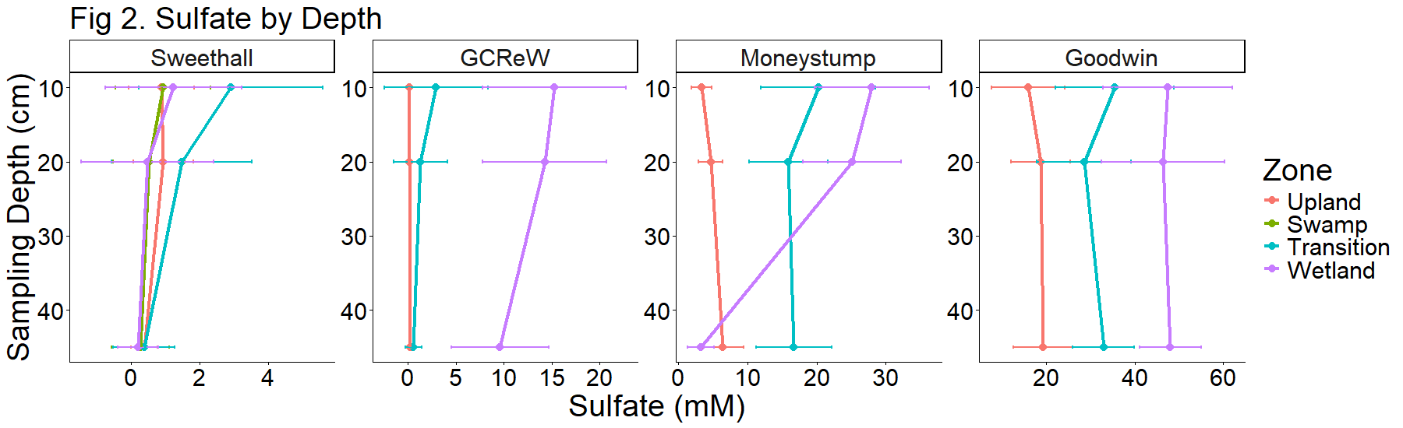
Porewater sulfate varies spatially and temporally across the coastal terrestrial aquatic interface
Zoe Read, Stephanie J. Wilson, Alice Stearns, Evan Phillips, Nathan Chin, Pat Megonigal, Ben Bond-Lamberty, and the COMPASS team
¹Smithsonian Environmental Research Center, Maryland, USA, ²Pacific Northwest National Laboratory
Background
We monitor transects including upland coastal forest, forest transitioning to wetland, and wetlands in the Chesapeake Bay Region at four sites that are oligohaline, mesohaline, and polyhaline
Porewater sampling from 2022-2025 → Analyzed for DIC, DOC, Total Alkalinity, CDOM, H₂S, Cl⁻, Nutrients, and SO₄²⁻
Aquatroll AQ600 sensors deployed in the field, collecting continuous ground and soil water and salinity values
Environmental variables
Sulfate increases with increasing groundwater salinity, groundwater water level, soil electrical conductivity, and soil volumetric water content.
Soil electrical conductivity and soil volumetric water content were measured at 10 cm, but are positively correlated with sulfate at all depths, indicating the 10 cm profile may be influencing or indicative of processes occurring deeper in the soil.
GCReW
Site | Salinity
Sweethall | 0-2
GCReW | 8-10
MoneyStump | 8-10
Goodwin Islands | 18-20
Money Stump
Sweethall
Goodwin Islands
Upland
Transition
Wetland
Hypothesis: There is a hierarchical structure to spatial variation in ecosystem structure and function at the coastal terrestrial aquatic interface (TAI) that is set by:
1) the depth and duration of soil saturation
2) the abundance of redox-sensitive elements
3) their interactions with plant traits
Porewater Sulfate
Porewater was analyzed for Sulfate (SO₄²⁻) in 2,293 samples
Sulfate increased from upland forest through transition zones to the wetland
Sulfate also increased from Sweethall site (oligohaline) to Goodwin Islands site (polyhaline).
Surface water was a source of sulfate into these ecosystems.
Seasonal variation
Sulfate tends to increase throughout each year, especially in the fall, and decrease at the start of a new year. This could be because sulfate-reducing microbes are less active as temperatures decrease at the end of each year.
Sulfate appears to be increasing over time at the GCReW Transition site.
Depth
Porewater was sampled at three soil depths: 10, 20, and 45 cm
Sulfate concentration changes by depth, but this effect differs across site and zone.
Take-home messages
Sulfate, a redox-sensitive element, varies across depth and seasonally, although this effect differs across the coastal terrestrial aquatic interface.
Sulfate was positively correlated with indicators of soil saturation.
In the future, we can examine the sulfate-depth relationship to determine if there are patterns that explain its variability across sites and zones.
Notes:
- If have time, could try adding stacked x-axis with month and year below it

