Slide 1
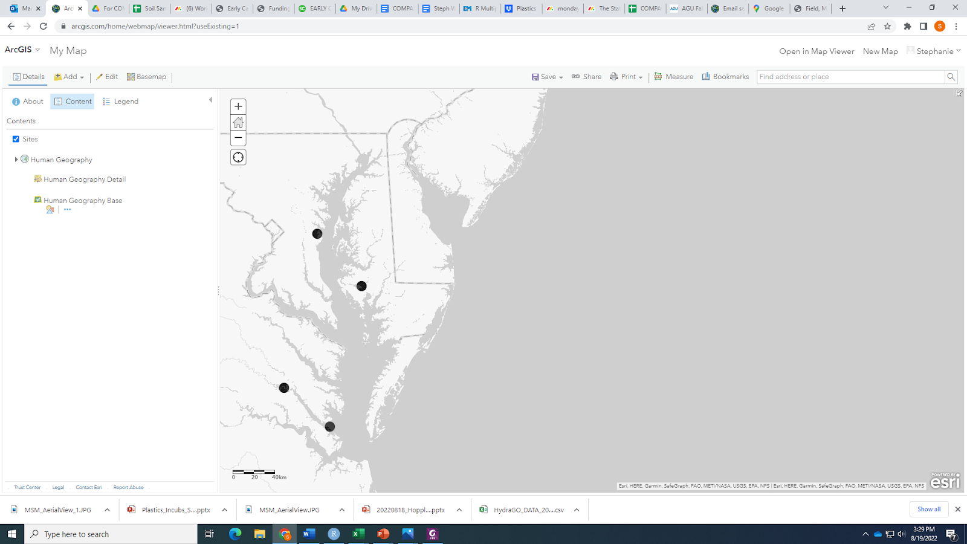
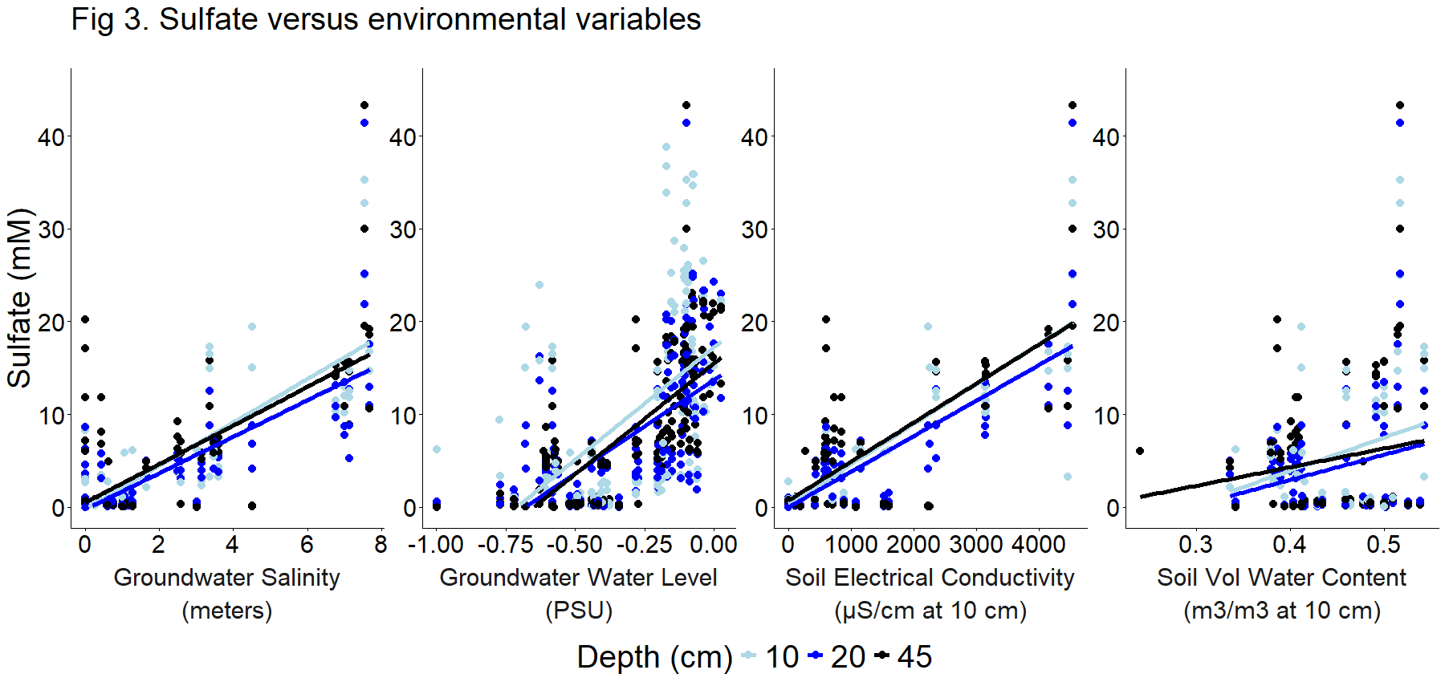
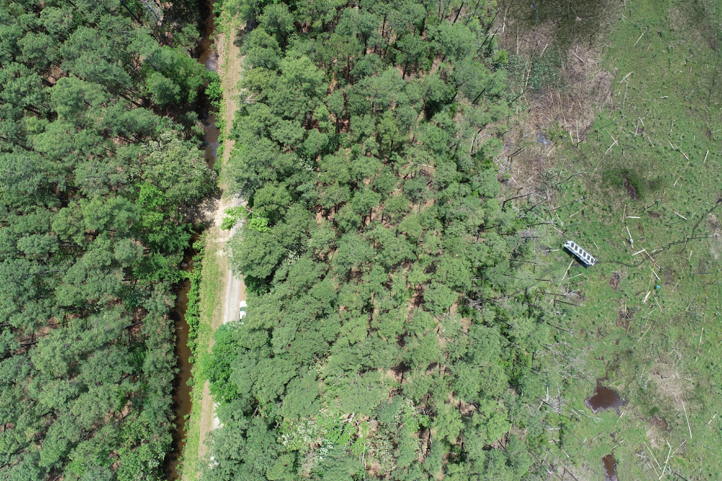
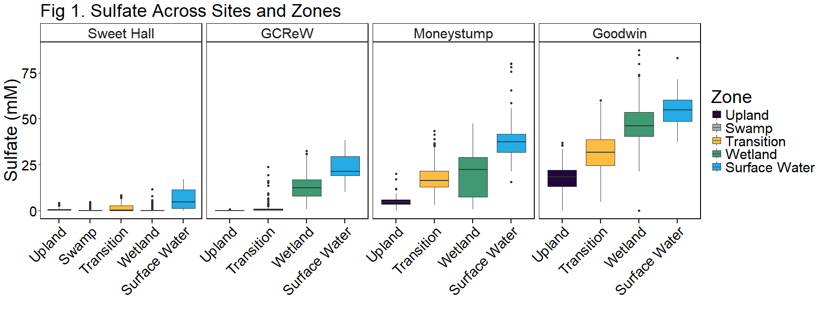
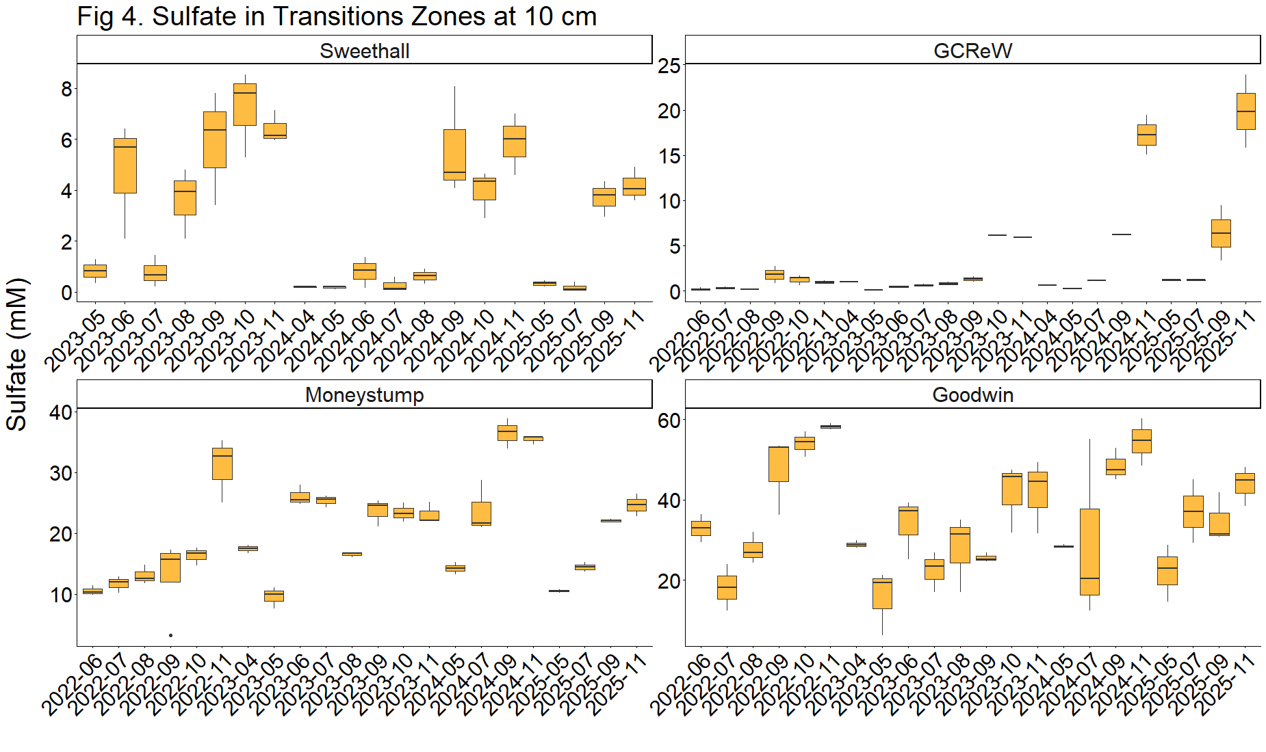
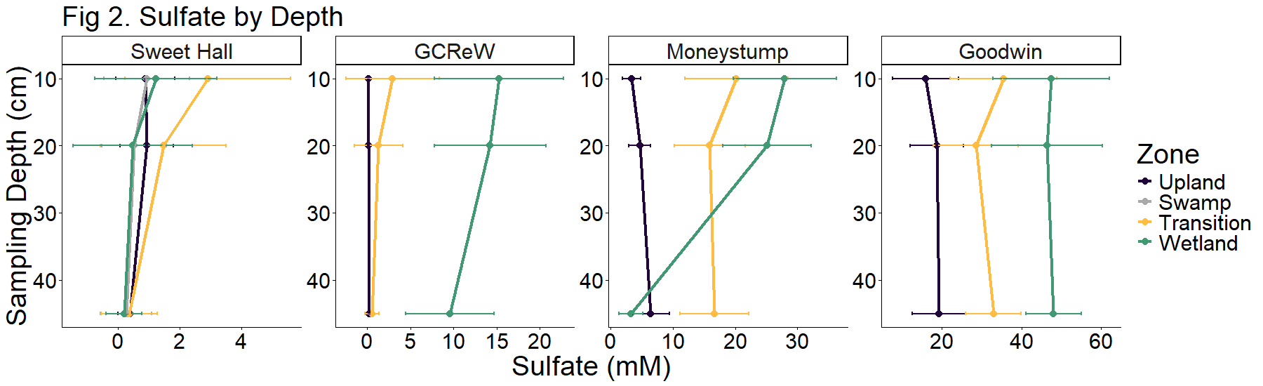
Porewater sulfate varies spatially and temporally across the coastal terrestrial aquatic interface
Zoe Read¹, Stephanie J. Wilson¹, Alice Stearns¹, Evan Phillips¹, Nathan Chin¹, Pat Megonigal¹, Ben Bond-Lamberty², and the COMPASS team
¹Smithsonian Environmental Research Center, Maryland, USA, ²Joint Global Change Research Institute, PNNL, Maryland, USA
Background
Monitoring transects include upland coastal forest, forest transitioning to wetland, and wetlands in the Chesapeake Bay Region at four sites that are oligohaline, mesohaline, and polyhaline.
Porewater sampled from 2022-2025 was analyzed for DIC, DOC, Total Alkalinity, CDOM, H₂S, Cl⁻, Nutrients, and SO₄²⁻.
Aquatroll AQ600 sensors are deployed in the field, collecting continuous ground and soil water and salinity values.
Environmental variables
SO₄²⁻ increases with increasing groundwater salinity, groundwater level, soil electrical conductivity, and soil volumetric water content.
Soil electrical conductivity and soil volumetric water content were measured at 10 cm, but are positively correlated with sulfate at all depths, indicating the 10 cm profile may be influencing or indicative of processes occurring deeper in the soil.
GCReW
Site | Salinity
Sweet Hall | 0-2
GCReW | 8-10
Money Stump | 8-10
Goodwin Islands | 18-20
Money Stump
Sweet Hall
Goodwin Islands
Upland
Transition
Wetland
Hypothesis: There is a hierarchical structure to spatial variation in ecosystem structure and function at the coastal terrestrial aquatic interface (TAI) that is set by:
1) the depth and duration of soil saturation
2) the abundance of redox-sensitive elements
3) their interactions with plant traits
Porewater Sulfate
Porewater was analyzed for Sulfate (SO₄²⁻, n = 2,293).
Across sites SO₄²⁻ increased from upland forest through transition zones to the wetland.
SO₄²⁻ also increased from Sweet Hall site (oligohaline) to Goodwin Islands site (polyhaline).
Surface water serves as a source of SO₄²⁻ into these ecosystems.
Seasonal variation in transitioning forests
SO₄²⁻ tends to increase throughout each year, especially in the fall, and decrease at the start of a new year. This could be because sulfate-reducing microbes are less active as temperatures decrease at the end of each year, or this could be related to changes in precipitation or surface water salinities throughout the year.
Peak annual SO₄²⁻ appears to be increasing over time at the GCReW Transition site.
Depth
Porewater was sampled at three soil depths: 10, 20, and 45 cm.
SO₄²⁻ concentration changes by depth, but the depth pattern differs across site and zone.
Take-home messages
SO₄²⁻, a redox-sensitive element, varies across depth and season, although this effect differs across different sites in the Chesapeake Bay as well as across zones in the coastal terrestrial aquatic interface.
SO₄²⁻ was positively correlated with indicators of soil saturation.
In the future, we can examine the SO₄²⁻ - depth relationship and surface water SO₄²⁻ patterns to determine if there are trends that explain the variability across sites and zones.

