Slide 1
Campaign COMPASS_FY23 12T FT-ICR – Pos ESI
03Nov22

Slide 2
Polysiloxane
dm= 74.01879 (C₂H₆OSi)
Solvent blanks

Slide 3
Solvent blanks

Slide 4
QC-SRFAII – Polysiloxane dominant

Slide 5
QC-SRFAII

Slide 6
Polysiloxane
Samples

Slide 7
Samples

Slide 8
This file Patel_12T_FTICR_PosESI_Processing.pptx
XML_sn5+.zip file contains non-calibrated peaks with s/n>=5 (63 spectra includes SRFFAII QC spectra).
Peaks used in formula assignment are from text files in used_peaks_sn7+.zip (58 spectra)
Formula assignment results are in file xtra_Report_Patel_12T_FTICR_PosESI_MFAssignment.csv
Internal calibration file used with Formularity pos_esi_custom_cal_list_Patel.ref

Slide 9
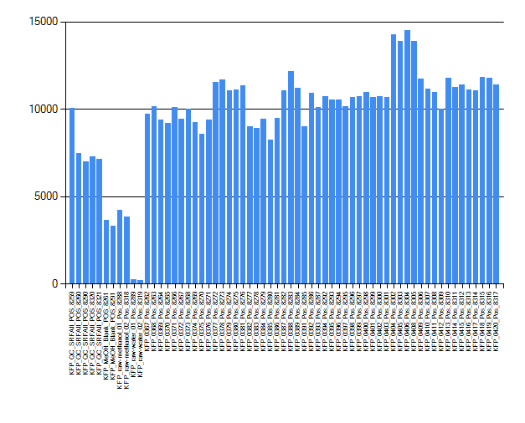
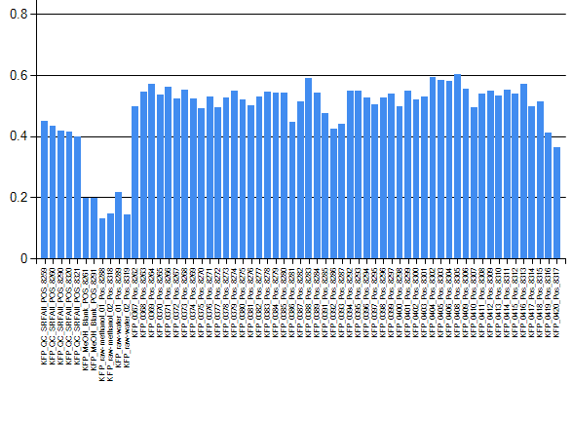
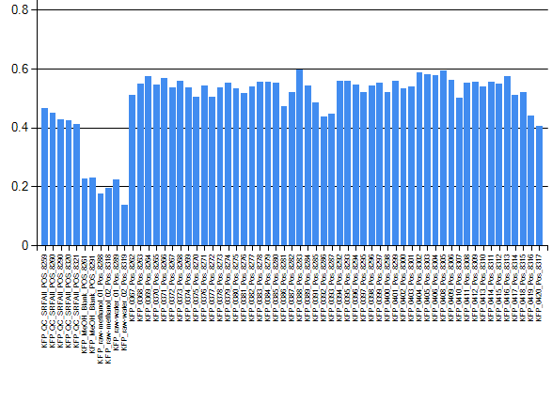
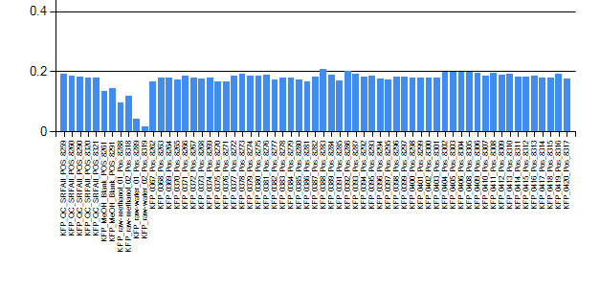
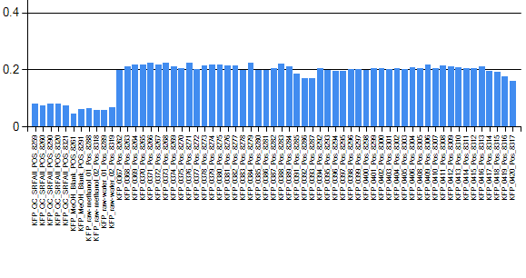
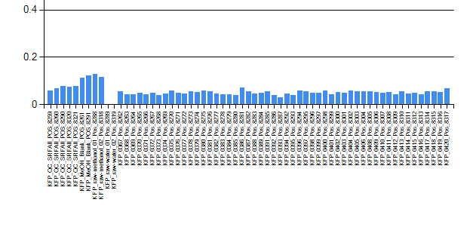
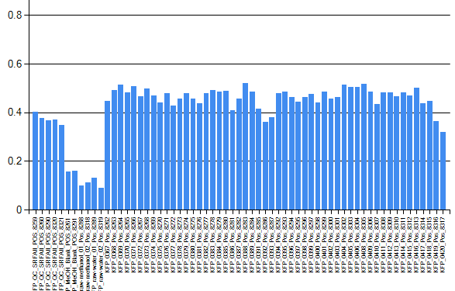
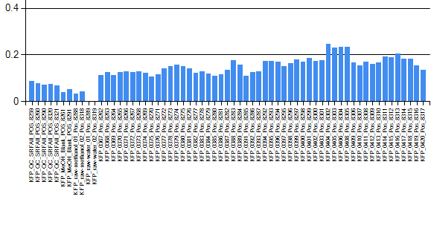
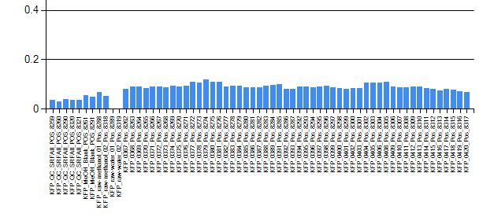
12T FT-ICR – Pos.ESI – s/n>=7 – Diagnostics
peaks count
Search all ion types but primarily [M+H]+, [M+Na]+ , [M+NH₄]+
Recalculate [M+NH₄]+ as [M+H]+ in final report.
SRFA
NOM connectivity - H₂
Blanks
Samples
d ¹²C-¹³C
[M+H]+, [M+Na]+ ions signature
NOM connectivity - O
d ²⁸Si-²⁹Si
[M+H]+, [M+NH₄]+ ions signature
d ³⁵Cl-³⁷Cl
NOM connectivity - CH₄O₋₁

Slide 10
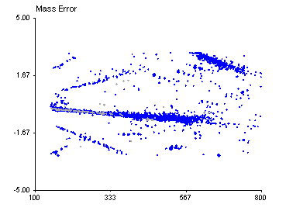
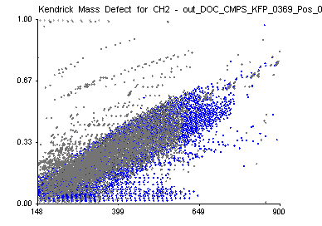
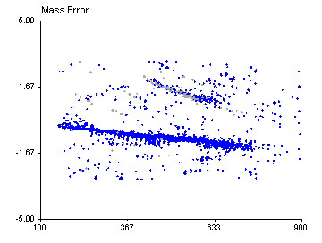
No cal. [M+H]+
Calibration peaks selection strategy:
Select formula detected as both ion types aligned in 40+ spectra and with mass error within 0.1 ppm (628 formula – 1256 peaks)
No cal. [M+Na]+

Slide 11
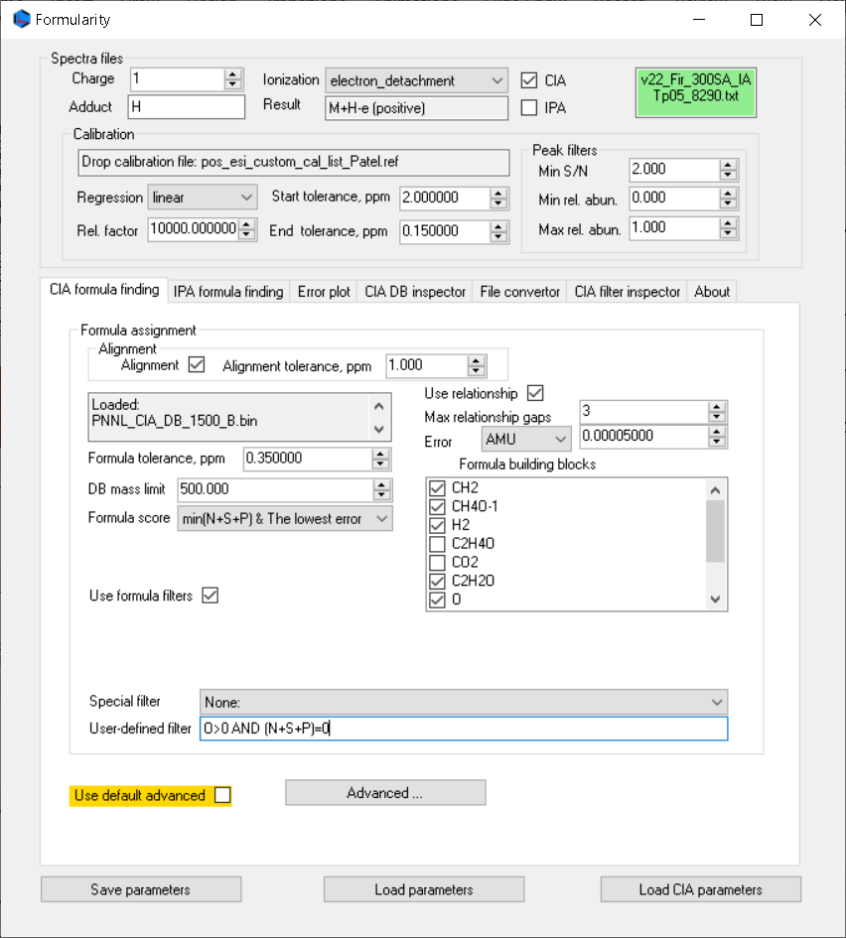
Formularity search strategy
1) Search O>0 AND (N+S+P)=0 for [M+H]+, [M+Na]+ and [M+NH4]+
after this search evaluate contribution from each ion type
2) Search (N+S+P)<2 for [M+H]+, [M+Na]+ and [M+NH4]+
3) Search (N+S+P)<3 AND P<2 for [M+H]+, [M+Na]+ and [M+NH4]+
4) Merge reports ((N+S+P)-> min)
Notes:
Peaks of ions [(M+NH3)+H]+ and [M+NH4]+ are indistinguishable but in the context of mapping constraints, produce extra formula. All these extra formula are recalculated and presented as [M+H] ions.
SRFAII QC runs were not searched with blanks and samples.

Slide 12
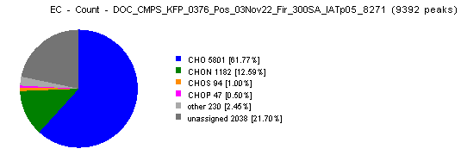
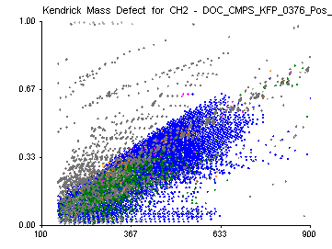
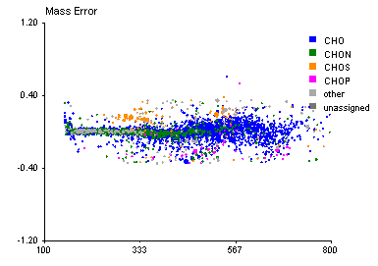
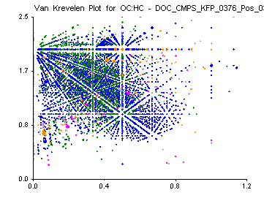
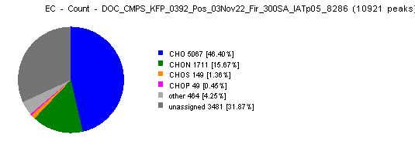
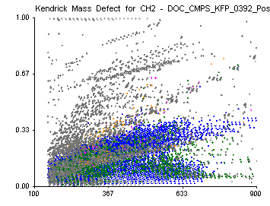
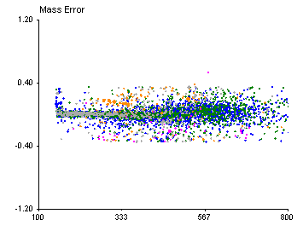
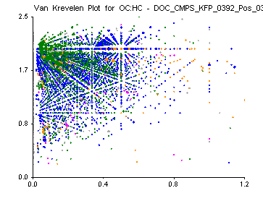

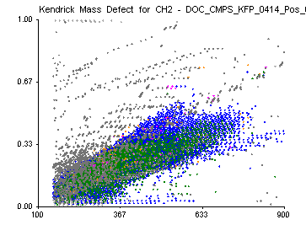

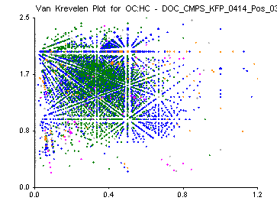
Formula assignment results - examples

Slide 13
IPA function picked polysiloxane formula:
… and some other in some spectra:
Many of these formula were detected also as [M+Na]+ ions, some CHOSi also as [M+NH₄]+ ions

