Slide 1
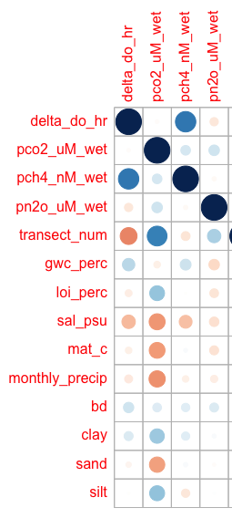
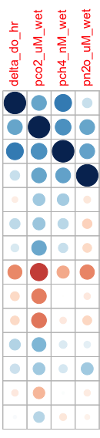
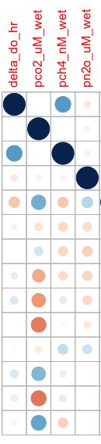
Drivers by location (which has the strongest correlation)
Whole transect: no variables were clearly strongest for the whole transect (put in SI)
Frequently inundated:
DO and CO2
CO2 and CH4
NO2 and CO2
NO2 and CH4
LOI and CO2
Salinity and all gases
BD and MAT
Rarely inundated:
CO2 and sand
CO2 and silt

