Slide 1
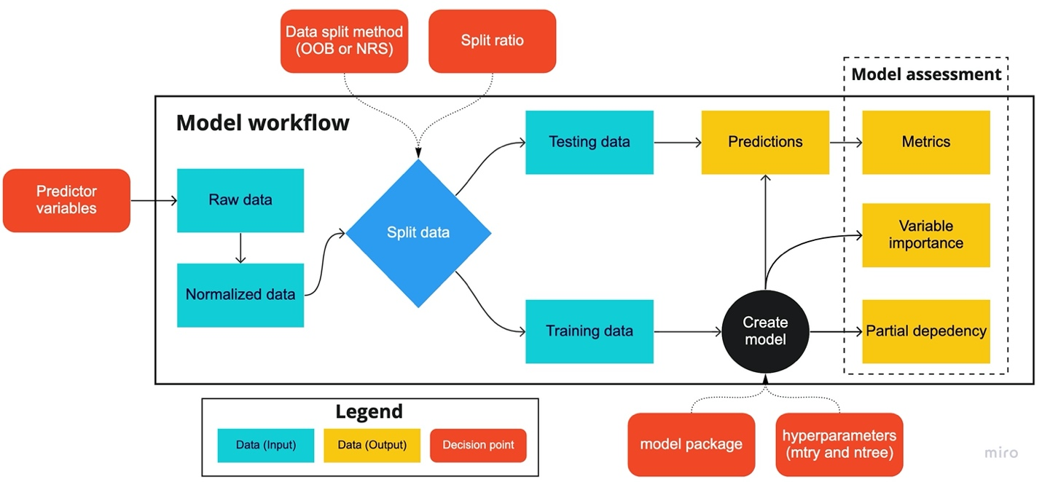

Slide 2
Data split method (OOB or NRS)
Split ratio
Model assessment
Model workflow
Testing data
Predictions
Metrics
Predictor variables
Raw data
Split data
Variable importance
Normalized data
Training data
Create model
Partial dependency
Legend
Model package
Hyperparameters
(mtry and ntree)
Data (input)
Data (output)
Parameter decision

