Slide 1
Investigating Fe as a mechanism for colloidal OC release after saltwater inundation
Connor O’Loughlin

Slide 2
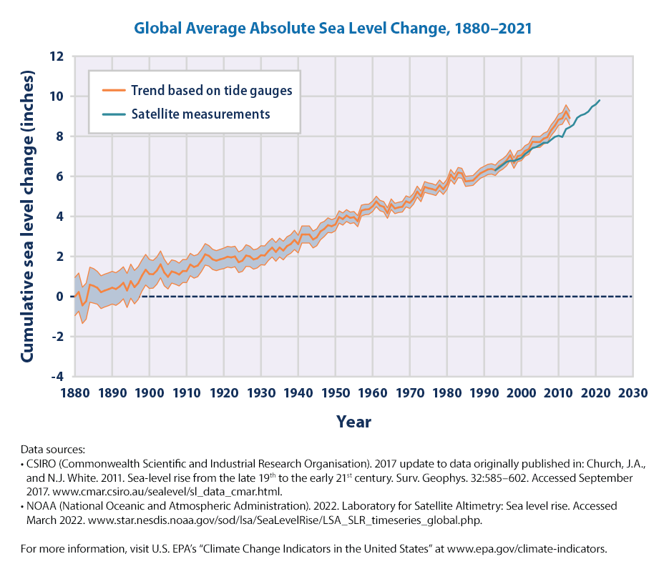
Background Information
Climate change is linked to an increase in
Frequency and intensity of storms
Annual precipitation and temperature
Sea levels
These factors will impact biogeochemical cycling processes
What will inundation of saltwater/estuarine water do to coastal wetlands? Upland forest?

Slide 3
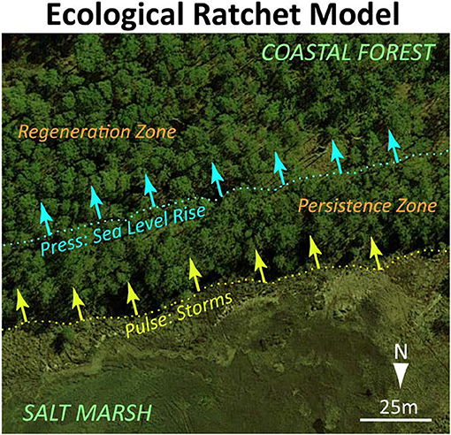
Project Scope
Inundation of seawater can threaten upland forest
Species are not salt tolerant
Soil is (typically) well drained and not waterlogged
How would this impact biogeochemical cycling processes?
Changes in redox state
Nutrient leeching
Mineral-OM interaction/associations
What mechanisms are responsible for the results we observe?
Salinity?
pH?
Mineral-Om?

Slide 4
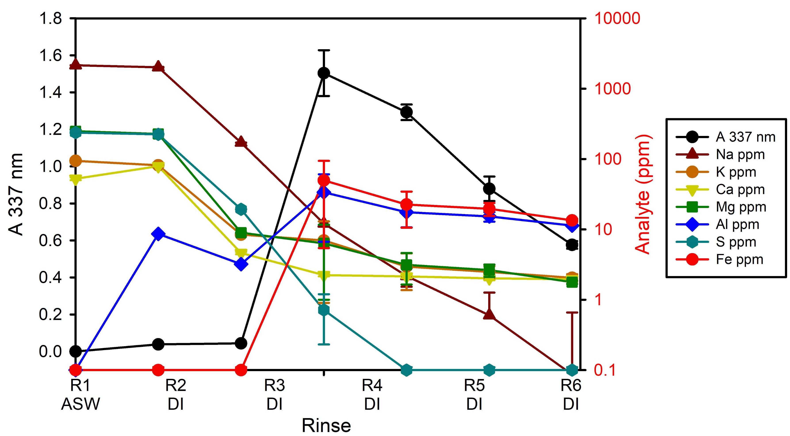
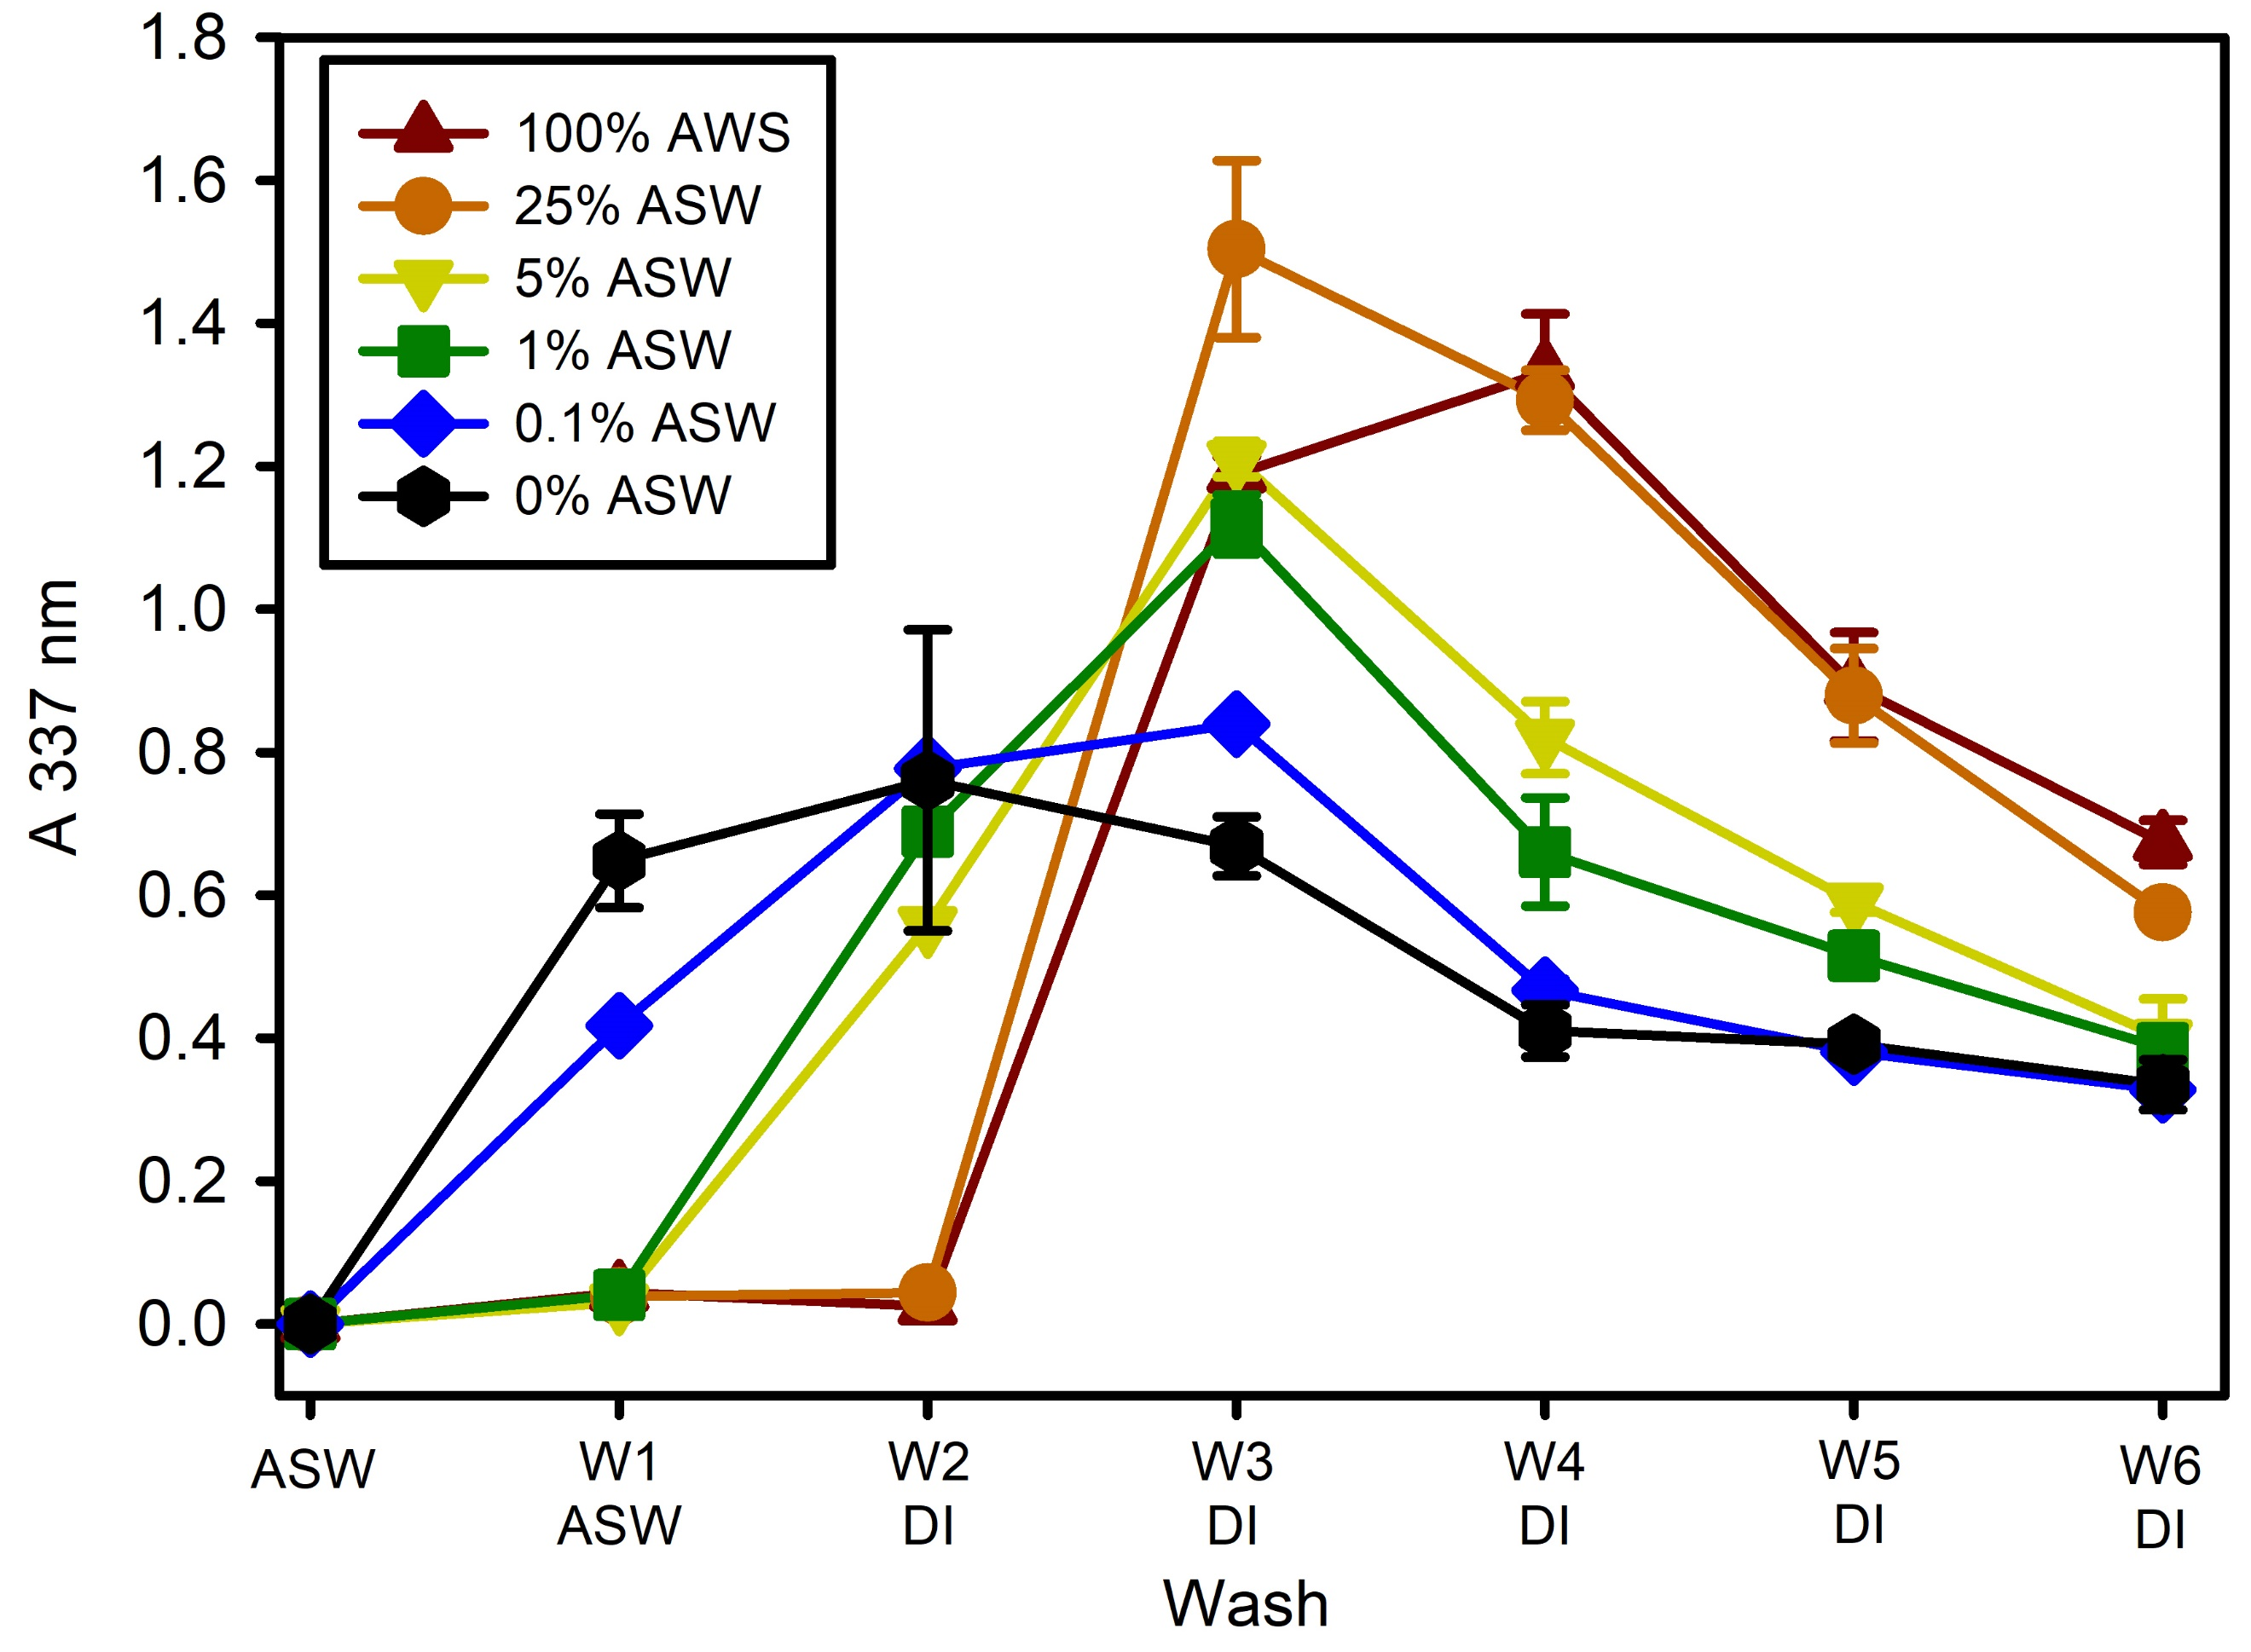
Motivation
Coastal Observations, Mechanisms, and Predictions Across Systems and Scales (COMPASS)
DOE funded project extending across multiple institutions
Aimed at modeling climate impacts on coastal environments
Previous COMPASS experiment conducted…
Investigated how varying ionic strength impacted DOC mobilization from upland forest soil.
They found that 25% Artificial Seawater (ASW) had the most DOC and saw a large release during the third rinse.

Slide 5
Methods
5 g of field moist soil was weighed
Deposited into 50 mL centrifuge tubes
Left in anaerobic chamber for 72 hours
Prepared a 35% ASW solution
Diluted to 25% ASW
Left in anaerobic chamber to become anoxic (some was left in normal atmosphere)

Slide 6
Methods
Samples were prepared in triplicate
90 samples in total
4 procedural blanks per wash
110 samples +blanks
2 treatments
Oxic
Anoxic
3 size fractions
>1.0 μm
1.0-0.45 μm
0.45-0.1 μm
6 systems total
(Per wash)
Wash 1
25% ASW
Wash 2
DI water
Wash 3
DI water
Wash 4
DI water
Wash 5
DI water
5 Washes total

