Slide 1
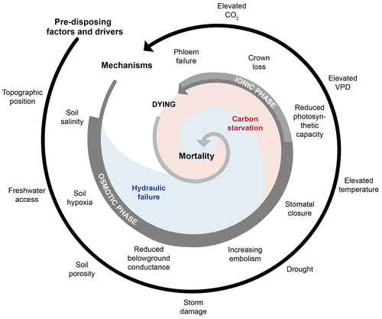
Static
Measured
Inferred
Not presented
Kennedy?

Slide 2
Not measured / inferred by TEMPEST

Slide 3
Position | Factor/driver | Mechanism | Factor dataset | Mechanism dataset
1 | Topographic position | Soil salinity | Assuming static based on stats | TEROS EC
2 | Freshwater access | Soil hypoxia | Floods, sapflow? | Firesting
3 | Soil porosity | Reduced belowground conductance | Kennedy? | Kennedy?
4 | Storm damage | Increasing embolism | None
5 | Drought | Stomatal closure | None | Stomatal conductance
6 | Elevated temp | Reduced photosynthetic capacity | None | photosynthesis
7 | Elevated VPD | Crown loss | Nate? | Antcedotal
8 | Elevated CO2 | Phloem failure | None unless tree CO2 counts? | Nate?

Slide 4
Position | Factor/driver | Mechanism | Factor dataset | Mechanism dataset
1 | Topographic position | Soil salinity | Assuming static based on stats | TEROS EC
2 | Freshwater access | Soil hypoxia | Floods, sapflow? | Firesting
3 | Soil porosity | Reduced belowground conductance | Kennedy? | Kennedy?
4 | Storm damage | Increasing embolism | None
5 | Drought | Stomatal closure | None | Stomatal conductance
6 | Elevated temp | Reduced photosynthetic capacity | None | photosynthesis
7 | Elevated VPD | Crown loss | Nate? | Antcedotal
8 | Elevated CO2 | Phloem failure | None unless tree CO2 counts? | Nate?

Slide 5
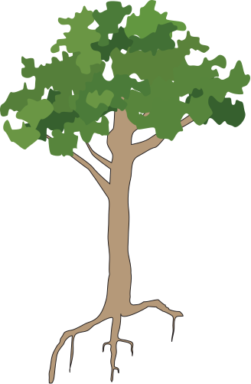
Reduced photosynthesis
Crown loss
Stomatal closure
Increasing embolism
Topographical position
Soil hypoxia
Soil salinity
Soil porosity
Freshwater access
Belowground conductance

Slide 6
Hypothesized disturbance response
Measured/inferred Freshwater response
Measured/inferred Estuarine response
Increased
Decreased
No change

Slide 7
Outside scope of TEMPEST
Freshwater response
Estuarine response
Expected change
Unexpected change
No change
Currently unknown (hoping to address)

Slide 8
Freshwater response
Estuarine response
Expected change
Unexpected change
No change
Pending data
Outside TEMPEST’s scope

Slide 9
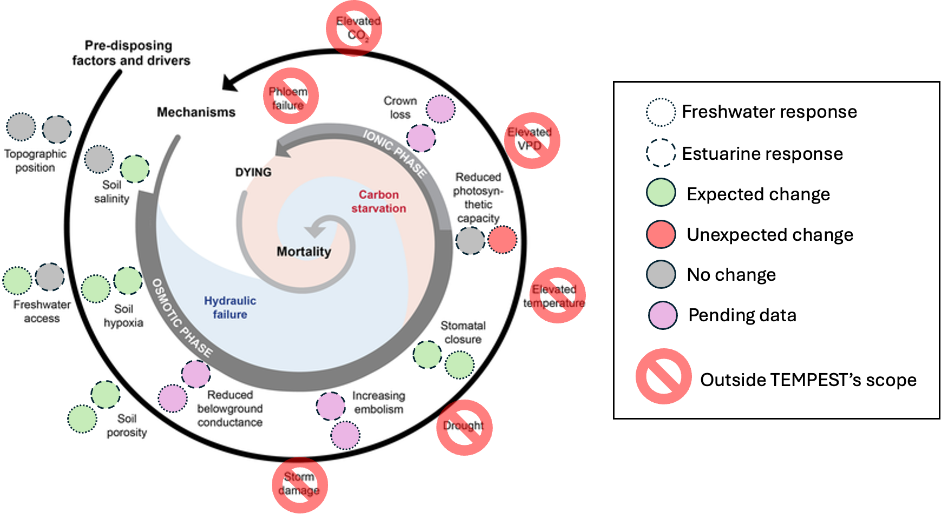

Slide 10
