Slide 1
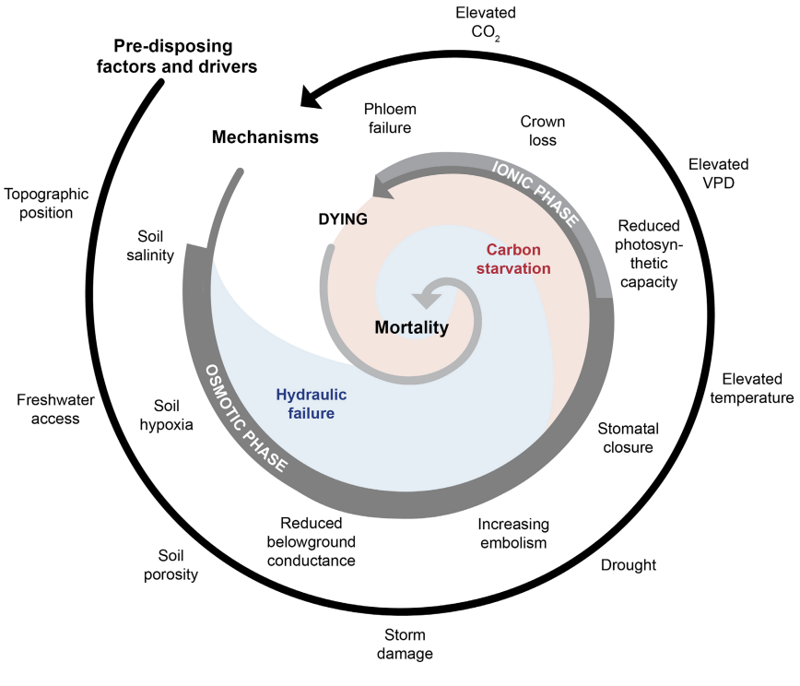

Ci
Gs
A
Gas exchange
Transpiration
Fd
Predicted hierarchy of responses
CO2
Observed
Eh
O2
Belowground
CO2

