Slide 1

Shape Analysis and Retrieval
D2 Shape Distributions
Notes courtesy of
Funk et al., SIGGRAPH 2004

Slide 2
Outline:
Defining the Descriptor
Computing the Descriptor
Comparing the Descriptor (EMD)

Slide 3
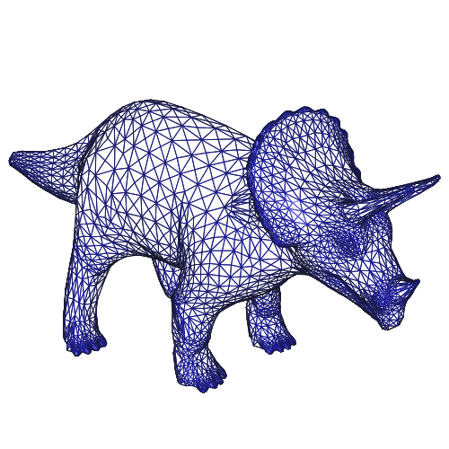
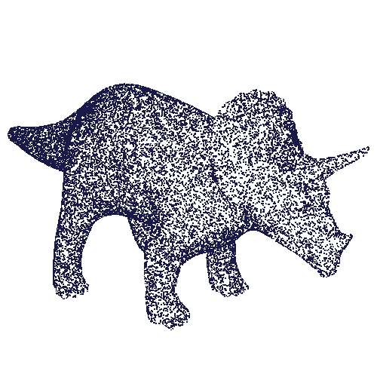
D2 Shape Distributions
Key idea 1:
Map 3D surfaces to common parameterization by randomly sampling points on the shape.
Triangulated Model
Point Set
By only considering point samples, the method avoids all problems of genus, connectivity, tessalation, etc.

Slide 4
D2 Shape Distributions
Key idea 2:
The distance between two points does not change if the points are translated or rotated:
||p₁-p₂||=||T(p₁)-T(p₂)||
for all T that are combinations of translations and rotations.
T(p₁)
p₁
T(p₂)
|| T(p₁) - T(p₂) ||
||p₁-p₂||
p₂

Slide 5
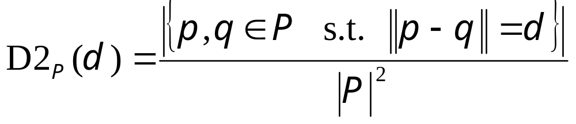
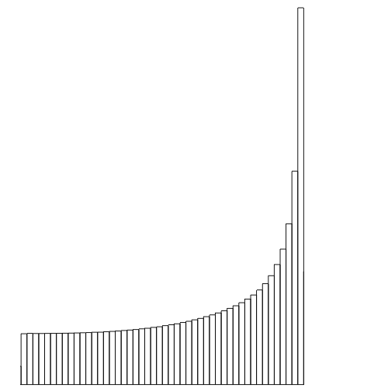
D2 Shape Distributions
Definition: For a set of points P, and a distance d, the value of the D2 Distribution at d is the number of point pairs whose pair-wise distance is d:
probability
Model
distance
D2

Slide 6
D2 Shape Distributions
Properties
  Concise to store?
  Quick to compute?
  Invariant to transforms?
  Efficient to match?
  Insensitive to noise?
  Insensitive to topology?
  Robust to degeneracies?
  Invariant to deformations?
  Discriminating?

Slide 7
D2 Shape Distributions
Properties
  Concise to store?
  Quick to compute?
  Invariant to transforms?
  Efficient to match?
  Insensitive to noise?
  Insensitive to topology?
  Robust to degeneracies?
  Invariant to deformations?
  Discriminating?
Skateboard
Probability
Distance
512 bytes (64 values)
0.5 seconds (10⁶ samples)

Slide 8
D2 Shape Distributions
Properties
  Concise to store
  Quick to compute
  Invariant to transforms?
  Efficient to match?
  Insensitive to noise?
  Insensitive to topology?
  Robust to degeneracies?
  Invariant to deformations?
  Discriminating?
Translation
Rotation
Mirror
Scale (w/ normalization)
Skateboard
Porsche
Normalized Means

Slide 9
D2 Shape Distributions
Properties
  Concise to store
  Quick to compute
  Invariant to transforms
  Efficient to match?
  Insensitive to noise?
  Insensitive to topology?
  Robust to degeneracies?
  Invariant to deformations?
  Discriminating?
Porsche
Probability
Skateboard
Distance

Slide 10
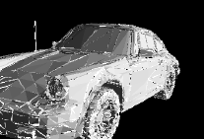
D2 Shape Distributions
Properties
  Concise to store
  Quick to compute
  Invariant to transforms
  Efficient to match
  Insensitive to noise?
  Insensitive to topology?
  Robust to degeneracies?
  Invariant to deformations?
  Discriminating?
1% Noise

Slide 11

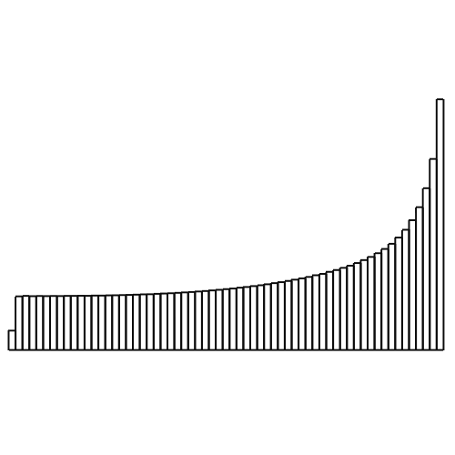

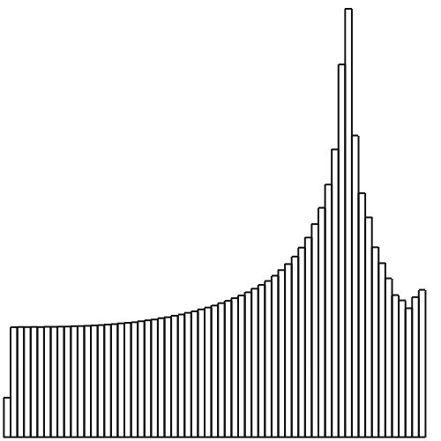

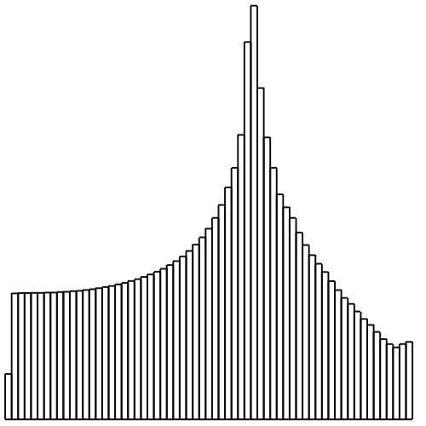

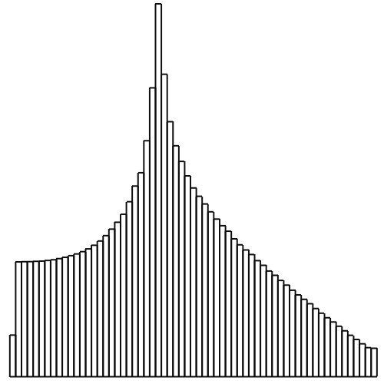

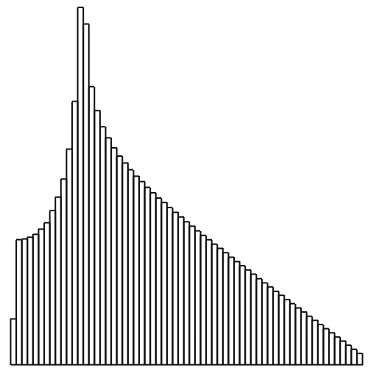
D2 Shape Distributions
Properties
  Concise to store
  Quick to compute
  Invariant to transforms
  Efficient to match
  Insensitive to noise
  Insensitive to topology
  Robust to degeneracies
  Invariant to deformations?
  Discriminating?

Slide 12
D2 Shape Distributions
Properties
  Concise to store
  Quick to compute
  Invariant to transforms
  Efficient to match
  Insensitive to noise
  Insensitive to topology
  Robust to degeneracies
  Invariant to deformations
  Discriminating?
Line Segment
Circle
Cylinder
Cube
Sphere
Two Spheres

Slide 13
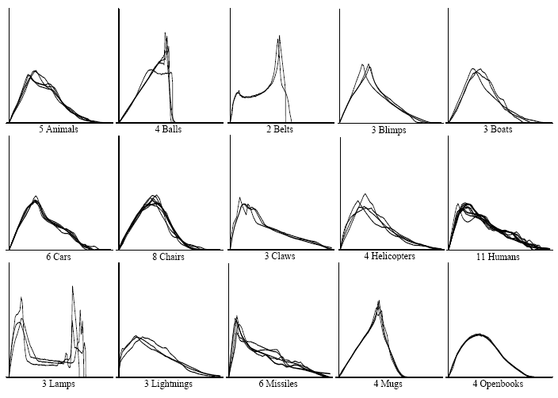
D2 Shape Distributions Results
Does the D2 distribution of a model capture its shape?
D2 shape distributions for 15 classes of objects

Slide 14
D2 Shape Distributions Results
Does the D2 distribution of a model capture its shape?
Line Segment
D2 shape distributions for 15 classes of objects

Slide 15
D2 Shape Distributions Results
Does the D2 distribution of a model capture its shape?
Circle
D2 shape distributions for 15 classes of objects

Slide 16
D2 Shape Distributions Results
Does the D2 distribution of a model capture its shape?
Cylinder
D2 shape distributions for 15 classes of objects

Slide 17
D2 Shape Distributions Results
Does the D2 distribution of a model capture its shape?
Sphere
D2 shape distributions for 15 classes of objects

Slide 18
D2 Shape Distributions Results
Does the D2 distribution of a model capture its shape?
Two Spheres
D2 shape distributions for 15 classes of objects

Slide 19
D2 Shape Distributions Results
Do models in the same class have similar distributions?
Do models in different classes have different distributions?
D2 shape distributions for 15 classes of objects

Slide 20

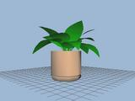
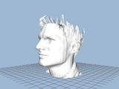

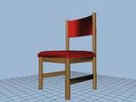
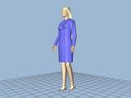
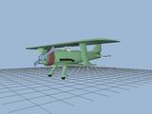
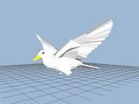
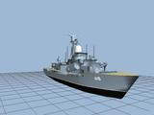
Princeton Shape Benchmark
1814 classified models, 161 classes
Evaluation metrics, software tools, etc.
51 potted plants
33 faces
15 desk chairs
22 dining chairs
100 humans
28 biplanes
14 flying birds
11 ships
http://shape.cs.princeton.edu/benchmark

Slide 21
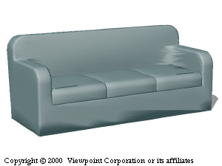
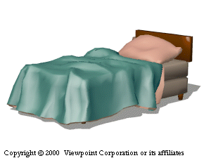
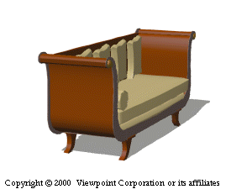
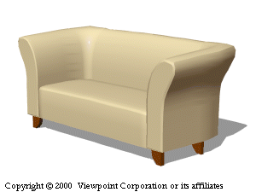
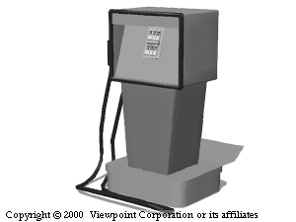
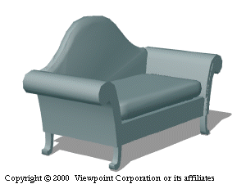
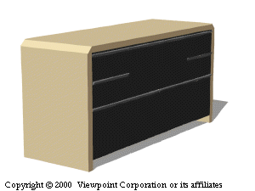
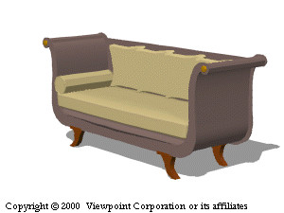
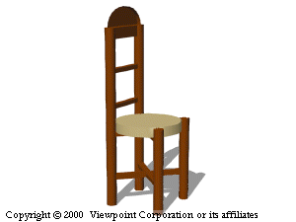
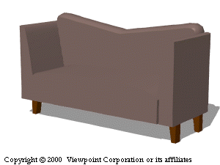
Precision vs. Recall
Precision-recall curves
  Recall = retrieved_in_class / total_in_class
  Precision = retrieved_in_class / total_retrieved
1
1
2
3
0.8
0.6
4
5
6
Precision
0.4
0.2
Query
7
8
9
0
0
0.2
0.4
0.6
0.8
1
Recall
Ranked Matches

Slide 22
Precision vs. Recall
Precision-recall curves
  Recall = 0 / 5
  Precision = 0 / 0
1
1
2
3
0.8
0.6
4
5
6
Precision
0.4
0.2
Query
7
8
9
0
0
0.2
0.4
0.6
0.8
1
Recall
Ranked Matches

Slide 23
Precision vs. Recall
Precision-recall curves
  Recall = 1 / 5
  Precision = 1 / 1
1
1
2
3
0.8
0.6
4
5
6
Precision
0.4
0.2
Query
7
8
9
0
0
0.2
0.4
0.6
0.8
1
Recall
Ranked Matches

Slide 24
Precision vs. Recall
Precision-recall curves
  Recall = 2 / 5
  Precision = 2 / 3
1
1
2
3
0.8
0.6
4
5
6
Precision
0.4
0.2
Query
7
8
9
0
0
0.2
0.4
0.6
0.8
1
Recall
Ranked Matches

Slide 25
Precision vs. Recall
Precision-recall curves
  Recall = 3 / 5
  Precision = 3 / 5
1
1
2
3
0.8
0.6
4
5
6
Precision
0.4
0.2
Query
7
8
9
0
0
0.2
0.4
0.6
0.8
1
Recall
Ranked Matches

Slide 26
Precision vs. Recall
Precision-recall curves
  Recall = 4 / 5
  Precision = 4 / 7
1
1
2
3
0.8
0.6
4
5
6
Precision
0.4
0.2
Query
7
8
9
0
0
0.2
0.4
0.6
0.8
1
Recall
Ranked Matches

Slide 27
Precision vs. Recall
Precision-recall curves
  Recall = 5 / 5
  Precision = 5 / 9
1
1
2
3
0.8
0.6
4
5
6
Precision
0.4
0.2
Query
7
8
9
0
0
0.2
0.4
0.6
0.8
1
Recall
Ranked Matches

Slide 28
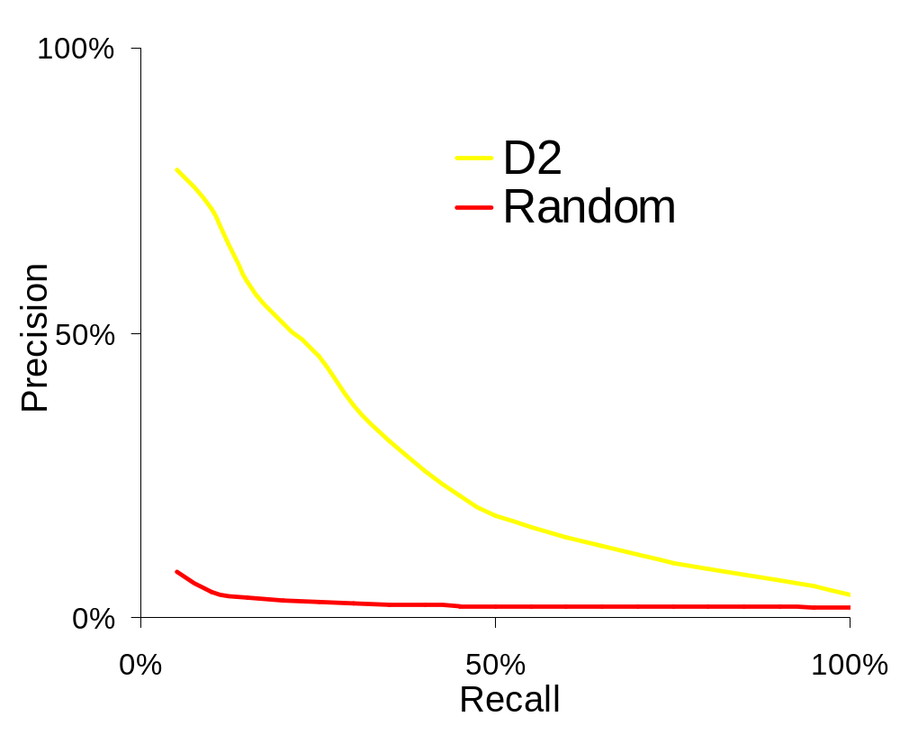
D2 Shape Distributions
Precision vs. recall on Princeton Benchmark

Slide 29
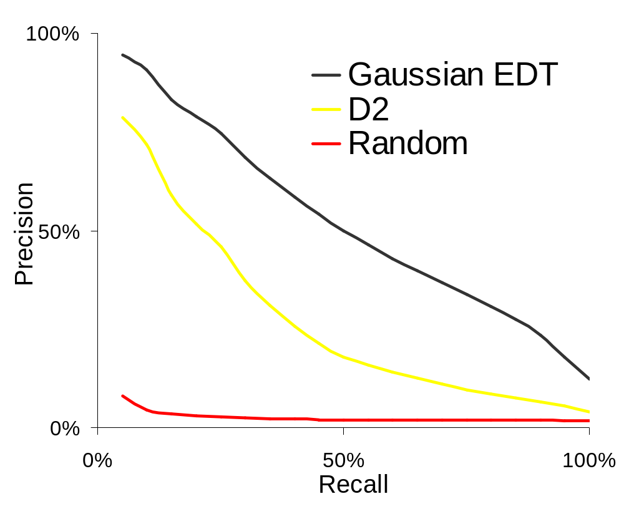
D2 Shape Distributions
Precision vs. recall on Princeton Benchmark

Slide 30
Outline:
Defining the Descriptor
Computing the Descriptor
Comparing the Descriptor (EMD)

Slide 31
Computing From a Point Set
Given a point set P={p₁,…,p_{n}}, a resolution r, a max distance d, and an array d2:
GetD2(P,n,d,d2,r)
  c ←0
  for i=1 to n
    d2[i] ← 0
  for i=1 to n
    for j=1 to i
      t←||p_{i}-p_{j}||
      if (t<d)
        d2[⎣(t/d)*r⎦] ← d2[⎣(t/d)*r⎦] + 1
        c ← c + 1
  for i=1 to n
    d2[i] ← d2[i]/c

Slide 32
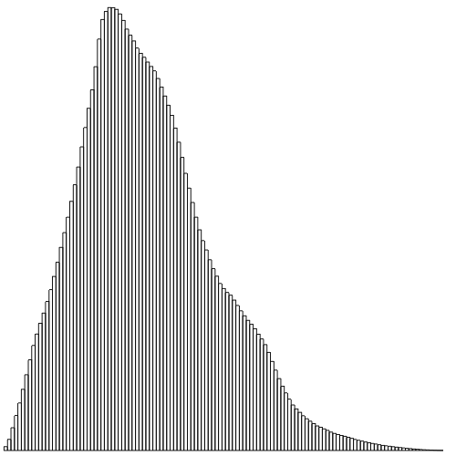
Computing From a Point Set
Computing the D2 distribution is easy if you have a point set.
GetD2(P,n,d,d2,r)
  c ←0
  for i=1 to n
    d2[i] ← 0
  for i=1 to n
    for j=1 to i
      t←||p_{i}-p_{j}||
      if (t<d)
        d2[⎣(t/d)*r⎦] ← d2[⎣(t/d)*r⎦] + 1
        c ← c + 1
  for i=1 to n
    d2[i] ← d2[i]/c
Point Set
D2 Distribution

Slide 33
Computing From a Point Set
Computing the D2 distribution is easy if you have a point set.
How do you get a point set?
(Most often, the query will be
a collection of triangles.)
GetD2(P,n,d,d2,r)
  c ←0
  for i=1 to n
    d2[i] ← 0
  for i=1 to n
    for j=1 to i
      t←||p_{i}-p_{j}||
      if (t<d)
        d2[⎣(t/d)*r⎦] ← d2[⎣(t/d)*r⎦] + 1
        c ← c + 1
  for i=1 to n
    d2[i] ← d2[i]/c
?
Triangulated Model
Point Set
D2 Distribution

Slide 34
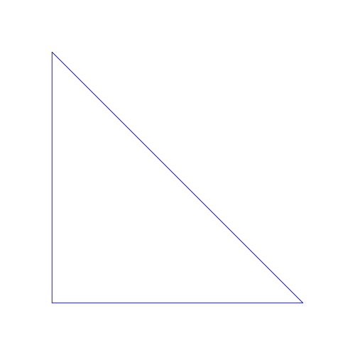
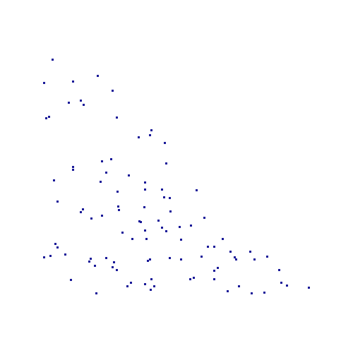
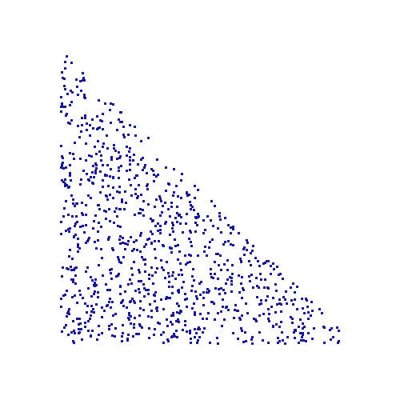
Getting a Uniformly Distributed Random Point Set
Goal:
Given a triangulated surface S={T₁,…,T_{k}}, find n points uniformly distributed on model.
Definition: A distribution is uniformly distributed if the probability of a point being in some sub-region is proportional to the area of the sub-region.
Triangle Model
Point Set (n=100)
Point Set (n=1000)

Slide 35
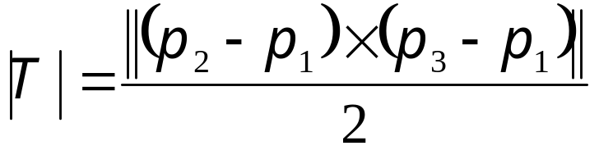
Areas
If T=(p₁,p₂,p₃) is a triangle, the area of T is equal to:
If S={T₁,…,T_{k}} is a triangulated model, the area of S is equal to the sums of the areas of the T_{i}.
p₃
(p₂-p₁)x(p₃-p₁)
(p₃-p₁)
p₂
(p₂-p₁)
p₁

Slide 36
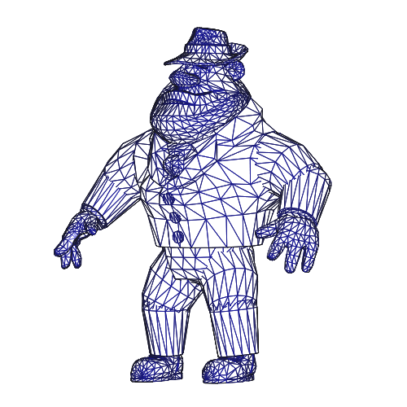
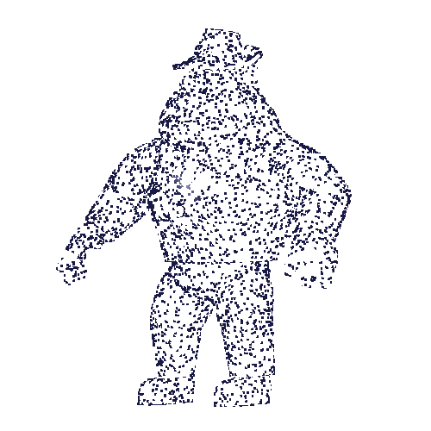
Getting a Random Point
To generate a random sample point:
Randomly choose triangle T_{j}
which the point should be on.
Randomly choose a point in T_{j}.

Slide 37
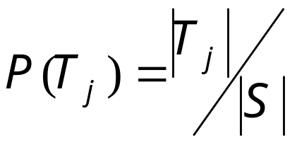
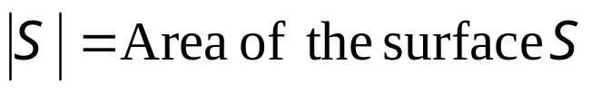
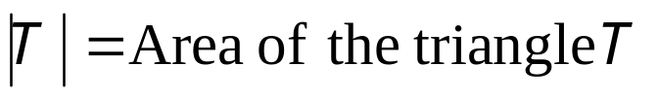
Getting a Random Point
Randomly choose a triangle T_{j} on which the point should be.
The probability of a point being on triangle T_{j} is
proportional to the area of a triangle:

Slide 38
Getting a Random Point
Randomly choose a triangle T_{j} on which the point should be.
Break up the interval [0,1] into k bins where the size
of the j-th bin is equal to P(T_{j})
T_{k-2}
T_{k}
T₁
T₂
T₃
T_{k-1}
…
0
1
…

Slide 39
Getting a Random Point
Randomly choose a triangle T_{j} on which the point should be.
Generate a random number in the interval [0,1] and
find the index j of the bin it falls into.
T_{k-2}
T_{k}
T₁
T₂
T₃
T_{k-1}
…
0
1
…

Slide 40
Getting a Random Point
Randomly choose a point in T_{j}.
If the vertices of the triangle T_{j} are T_{j}=(p₁,p₂,p₃) generate the parallelogram (p₁,p₂,p₃ ,p₂+p₃-p₁).
Generate a random point in the
parallelogram. If the point is in
the original triangle keep it,
otherwise flip it back into the
original.
p₂+p₃-p₁
p₃
p₂
p₁

Slide 41
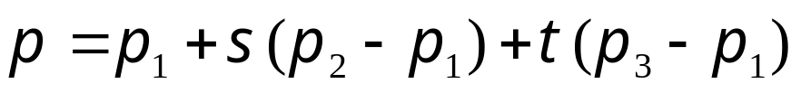

Getting a Random Point
Randomly choose a point in T_{j}.
To generate a random point in the parallelogram, generate two random numbers s and t in the interval [0,1]. Set p to be the point:
If s+t >1 the point will not be
in the original triangle, flip it
by sending:
p₂+p₃-p₁
p₃
p₂
p₁

Slide 42
Outline:
Defining the Descriptor
Computing the Descriptor
Comparing the Descriptor (EMD)

Slide 43
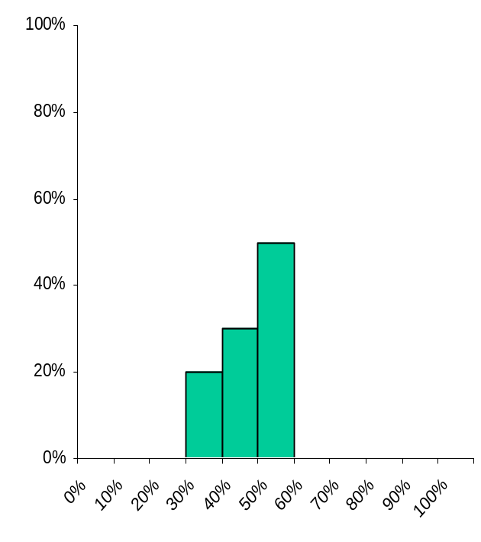
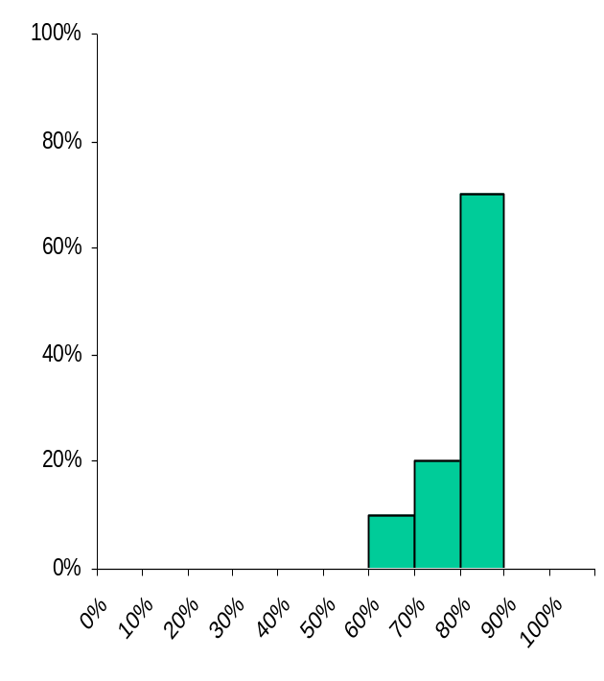
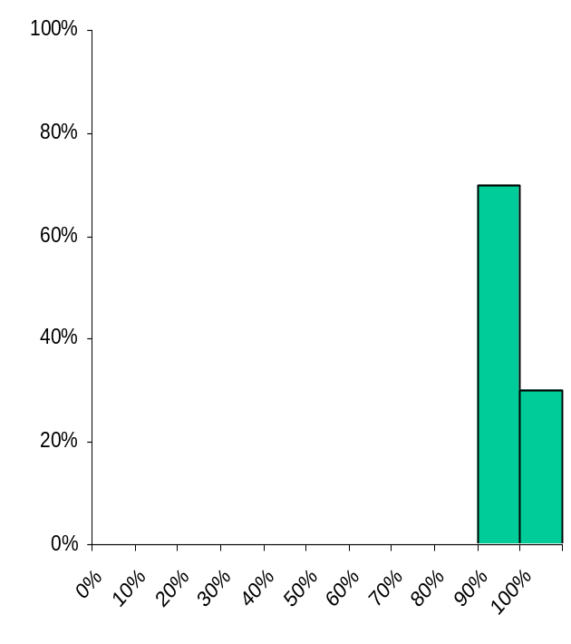
Earth Mover’s Distance
[Rubner et al. 1998]
Example:
Supposing I am given the distribution of grades for a course over the past three years and I want to compare the distributions:
Year 1
Year 2
Year 3

Slide 44
Earth Mover’s Distance
[Rubner et al. 1998]
Example:
If we just compare theses as vectors, the results from Year 3 are as similar to the results from Year 2 as they they are to the results of Year1.
Year 1
Year 2
Year 3

Slide 45
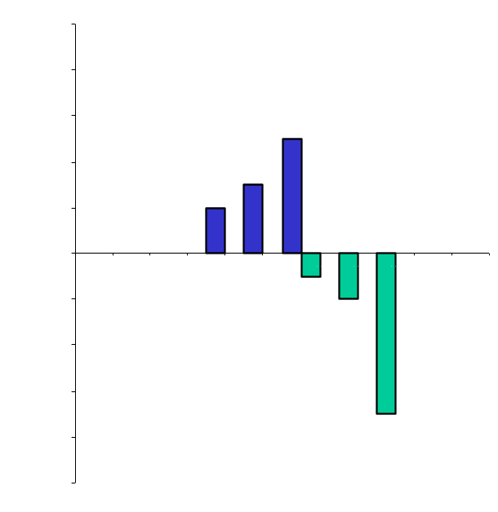
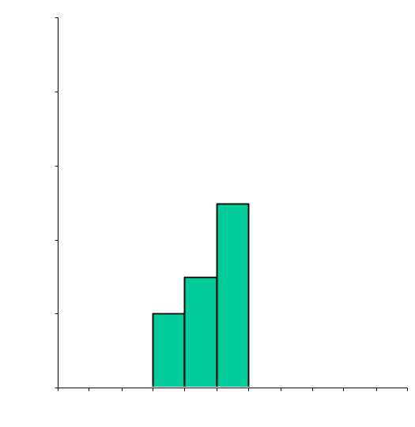
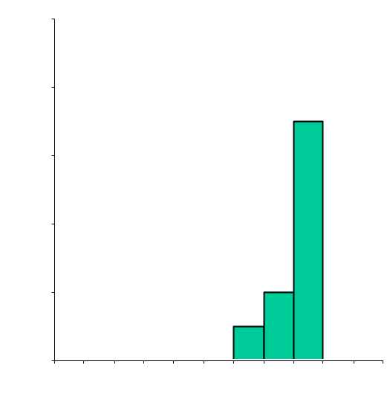
Earth Mover’s Distance
[Rubner et al. 1998]
Idea:
Treat one distribution as hills, the other as valleys and find the minimum amount of work needed to be done to move earth from the hills to the valleys to flatten things out.

Slide 46
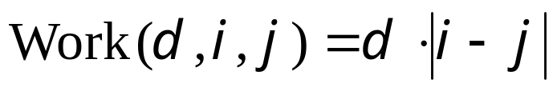
Earth Mover’s Distance
[Rubner et al. 1998]
Approach:
Instead of comparing the values in each bin, compute the amount of work needed to transform on distribution into the other.
Define the cost of moving d values from bin to i to bin j as:
Find the minimal amount of work that needs to be done to transform one distribution into the other.

Slide 47
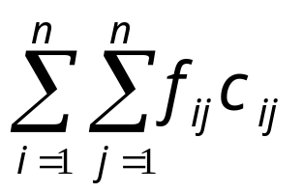
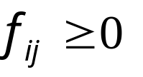

Earth Mover’s Distance
[Rubner et al. 1998]
Challenge:
Given distributions X={x₁,…,x_{n}} and Y={y₁,…,y_{n}}, set c_{ij}=|i-j| and find the values for f_{ij} that minimize:
subject to the constraints:
c_{ij}= cost of moving from bin i to bin j
f_{ij}= amount of data moved from bin i to bin j

Slide 48

Earth Mover’s Distance
[Rubner et al. 1998]
Solution:
In general, this is the transportation problem and can be solved using linear programming.
For 1D histograms, this can be solved using the greedy algorithm.

Slide 49
Earth Mover’s Distance
[Rubner et al. 1998]
Solution:
In general, this is the transportation problem and can be solved using linear programming.
For 1D histograms, this can be solved using the greedy algorithm.
Find the first non-empty bin.
Move earth into first non-empty bin in the other histogram.
Work=0
.1x3

Slide 50


Earth Mover’s Distance
[Rubner et al. 1998]
Solution:
In general, this is the transportation problem and can be solved using linear programming.
For 1D histograms, this can be solved using the greedy algorithm.
Find the first non-empty bin.
Move earth into first non-empty bin in the other histogram.
Work=0.3

Slide 51
Earth Mover’s Distance
[Rubner et al. 1998]
Solution:
In general, this is the transportation problem and can be solved using linear programming.
For 1D histograms, this can be solved using the greedy algorithm.
Find the first non-empty bin.
Move earth into first non-empty bin in the other histogram.
Work=0.3
.1x4

Slide 52


Earth Mover’s Distance
[Rubner et al. 1998]
Solution:
In general, this is the transportation problem and can be solved using linear programming.
For 1D histograms, this can be solved using the greedy algorithm.
Find the first non-empty bin.
Move earth into first non-empty bin in the other histogram.
Work=0.7

Slide 53
Earth Mover’s Distance
[Rubner et al. 1998]
Solution:
In general, this is the transportation problem and can be solved using linear programming.
For 1D histograms, this can be solved using the greedy algorithm.
Find the first non-empty bin.
Move earth into first non-empty bin in the other histogram.
Work=0.7
.1x3

Slide 54


Earth Mover’s Distance
[Rubner et al. 1998]
Solution:
In general, this is the transportation problem and can be solved using linear programming.
For 1D histograms, this can be solved using the greedy algorithm.
Find the first non-empty bin.
Move earth into first non-empty bin in the other histogram.
Work=1.0

Slide 55


Earth Mover’s Distance
[Rubner et al. 1998]
Solution:
In general, this is the transportation problem and can be solved using linear programming.
For 1D histograms, this can be solved using the greedy algorithm.
Find the first non-empty bin.
Move earth into first non-empty bin in the other histogram.
Work=1.0
.2x4

Slide 56


Earth Mover’s Distance
[Rubner et al. 1998]
Solution:
In general, this is the transportation problem and can be solved using linear programming.
For 1D histograms, this can be solved using the greedy algorithm.
Find the first non-empty bin.
Move earth into first non-empty bin in the other histogram.
Work=1.8

Slide 57
Earth Mover’s Distance
[Rubner et al. 1998]
Solution:
In general, this is the transportation problem and can be solved using linear programming.
For 1D histograms, this can be solved using the greedy algorithm.
Find the first non-empty bin.
Move earth into first non-empty bin in the other histogram.
Work=1.8
.5x3

Slide 58


Earth Mover’s Distance
[Rubner et al. 1998]
Solution:
In general, this is the transportation problem and can be solved using linear programming.
For 1D histograms, this can be solved using the greedy algorithm.
Find the first non-empty bin.
Move earth into first non-empty bin in the other histogram.
Work=3.3

Slide 59


Earth Mover’s Distance
[Rubner et al. 1998]
Alternatively:
Compute the cumulative distributions:
Then the Earth Mover’s Distance between X and Y is:
So that for 1D histograms, the EMD can be expressed as a normed difference.

