Slide 1
COMPSCI/MATH 290-04
Lecture 3: Line Segment Intersection, Circumcenters

Slide 2
Announcements
More Slides Now
Mini Assignment 1 Part 1 Due Sunday
Submit README
Part 2 Changed to 2D!
Refresh Page

Slide 3
Announcements
Piazza
http://www.piazza.com/duke/spring2016/compsci29004/home
Ditching Daily BQOTD

Slide 4
Lecture Topics
Line Segment Intersection
Triangle Circumcenter
JSON / Visual Debugging

Slide 5
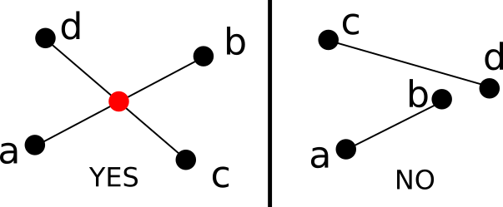
Line Segment Intersection
Let’s do lines first……

Slide 6
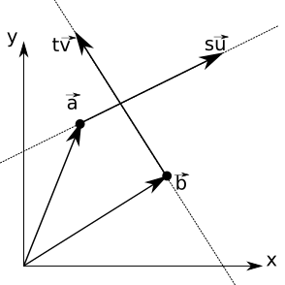
Parametric Form of Lines

Slide 7
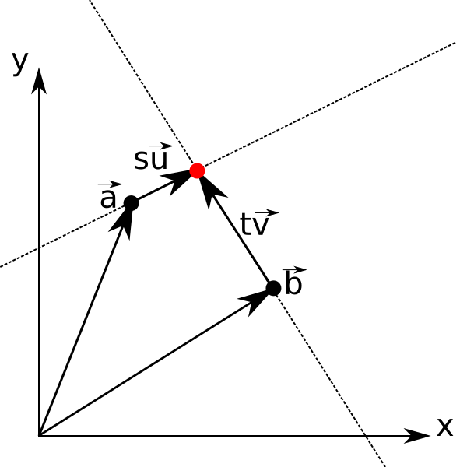
Parametric Form of Lines
Want: a + s u = b + t v

Slide 8
System of Equations
Want: a + s u = b + t v
This means
a_{x} + su_{x} = b_{x} + t v_{x}
a_{y} + su_{y} = b_{y} + t v_{y}

Slide 9
System of Equations
Want: a + s u = b + t v
This means
a_{x} + su_{x} = b_{x} + t v_{x}
a_{y} + su_{y} = b_{y} + t v_{y}
Put variables on left side together
su_{x} - tv_{x} = b_{x -} a_{x}
su_{y} - tv_{y} = b_{y -} a_{y}

Slide 10
Cramer’s Rule (Board)
su_{x} - tv_{x} = b_{x -} a_{x}
su_{y} - tv_{y} = b_{y -} a_{y}
What happens if lines parallel?

Slide 11
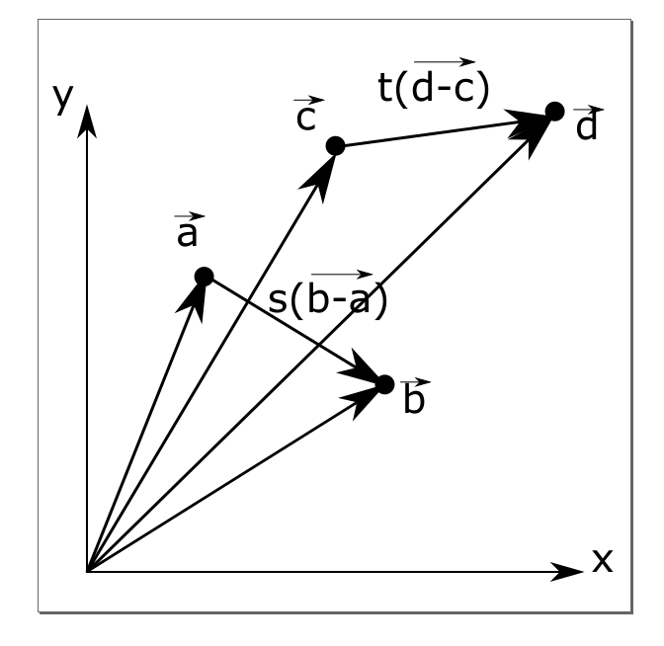
Line Segments
a + s(b-a) = b + t(d-c)
Need
0 <= t <= 1
0 <= s <= 1

Slide 12
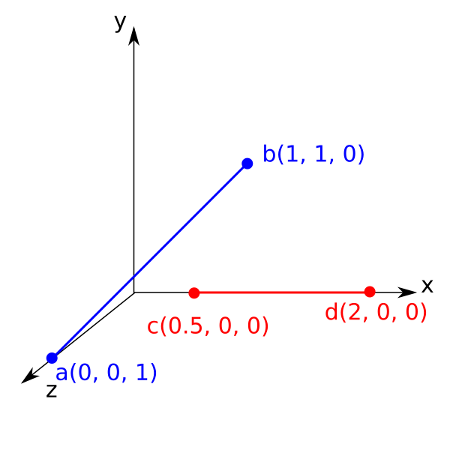
3D Extensions: Skew Lines

Slide 13
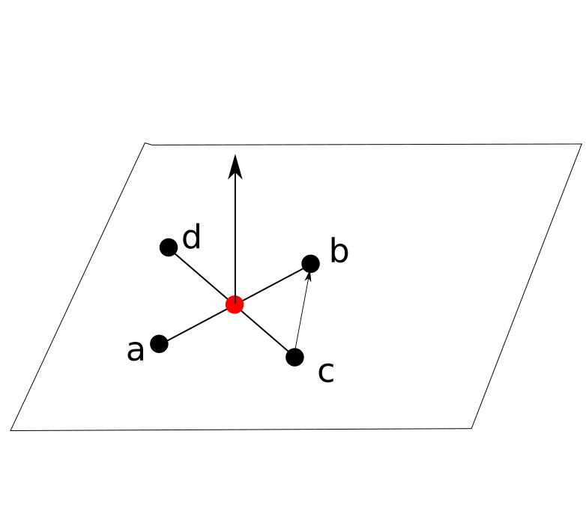
Detecting Skew Lines

Slide 14
y = mx + b??
What if vertical line?
What if very close to vertical line?

Slide 15
Lecture Topics
Line Segment Intersection
Triangle Circumcenter
JSON / Visual Debugging

Slide 16
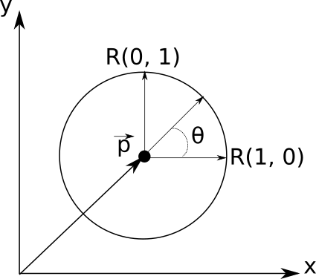
Circles in The Plane
p + R(1, 0)cos(theta) + R(0,1)sin(theta)

Slide 17
Circles in The Plane
How many degrees of freedom?

Slide 18
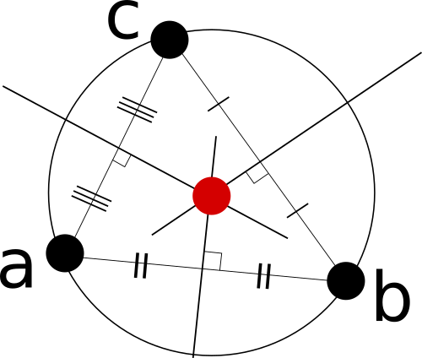
Triangle Circumcenters

Slide 19
Demo: Circumcenter Discovery

Slide 20
Raffle Point Question
Draw a triangle whose circumcenter is outside of the triangle

Slide 21
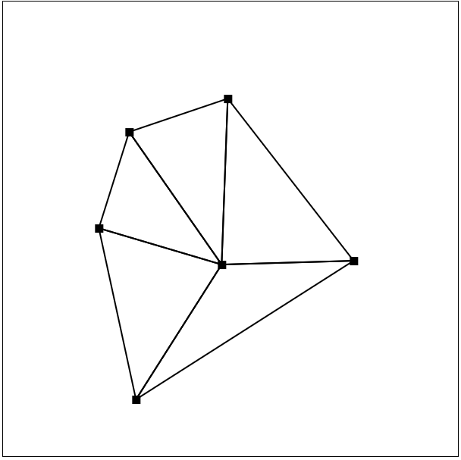
Delaunay Triangulation
Triangulation such that every circumcenter is empty

Slide 22
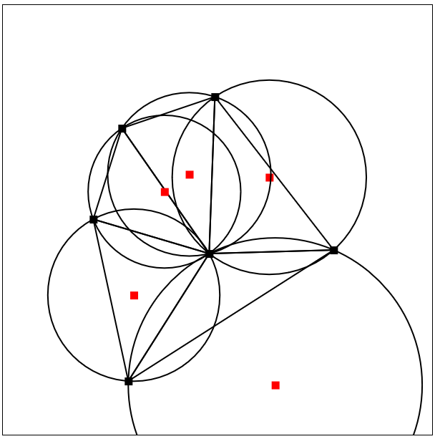
Delaunay Triangulation
Triangulation such that every circumcenter is empty

Slide 23
Delaunay Triangulation
Brute Force Algorithm??

Slide 24
Demo
Brute Force Algorithm??

Slide 25
Lecture Topics
Line Segment Intersection
Triangle Circumcenter
JSON / Visual Debugging

Slide 26
JSON Interactive Demo

