Slide 1
Course and participant introduction
Sonja Aits
“AI for Medicine and Life Science – AI for image and video data”, Lund University
20211018

Slide 2
Welcome!

Slide 3
Recording
Course to be recorded and shared publicly
→ as resource for you (for repetition and for those who miss sessions)
→ as open educational resource
→ to inform patients, health care professionals and other stakeholders

Slide 4
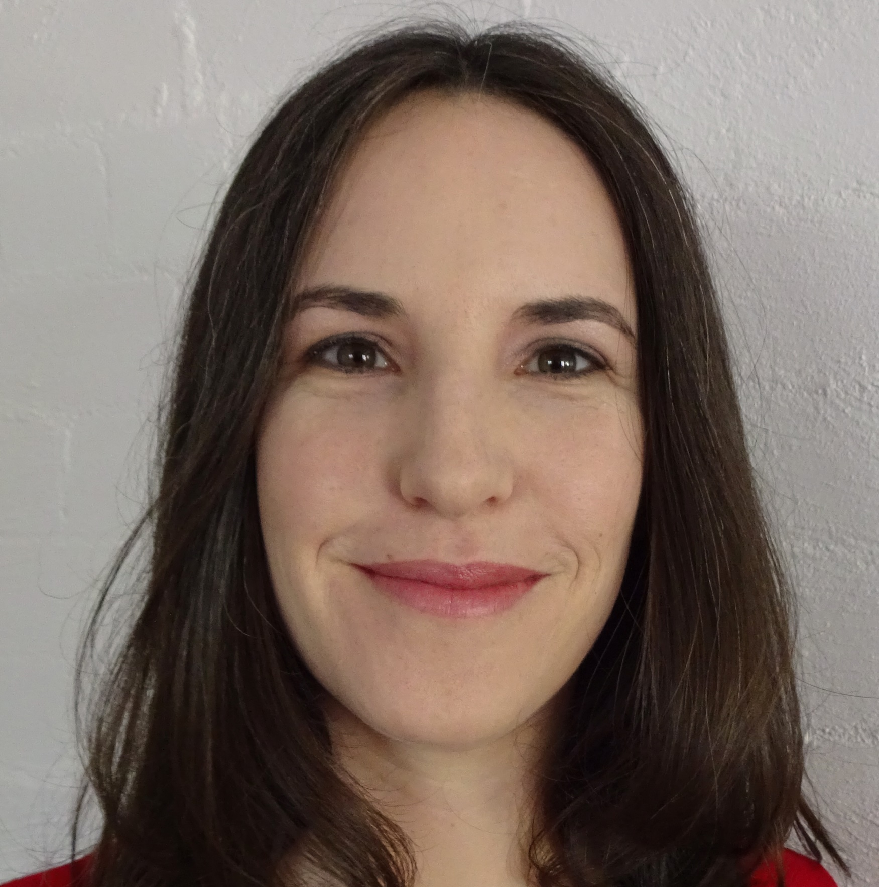
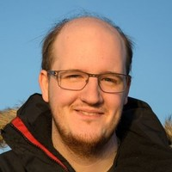
Teachers
Sonja Aits
Faculty of Medicine
Marcus Klang
Faculty of Engineering

Slide 5
Today’s plan
09:00 – 09:45 | Course and participant introduction (including journal club and examination instructions) | Sonja Aits
09:45 – 10:15 | Brief catch-up: what is AI, what is medicine and life sciences? | Sonja Aits
10:15 – 10:30 | Break
10:30 – 12:00 | Computer vision tasks and their applications in medicine and life sciences | Sonja Aits
12:00 – 13:00 | Lunch break
13:00 – 16:00 | Technical concepts in machine learning and computer vision | Marcus Klang

Slide 6
General info
Website
https://github.com/COMPUTE-LU/AI4MedLife_imaging_2021
LU box folder (for examinations)
Invitation via email
Zoom link
Same link entire week (sent via email)
Course variants
Block course, without examination (auditing only, no credits) – only variant available for MSc/BSc students!
Block course, with examination (1.5 ECTS):
Block course + long project, with examination (6 ECTS)
→ Double check you are listed for the correct course variant in the participant list in LU box!

Slide 7
AI in Medicine and Life Sciences Course Package
Introduction
2019, 2022
Python
Every year
Language
2021
Tabular data
2023
Images
2021

Slide 8
Schedule
Oct 18, 9-16
Oct 19, 9-16
Oct 22, 9-14.30
Oct 25, 9-16
Oct 26, 15-16
Oct 28, 9-15: project 1 examination
For 6 ECTS version only:
Nov 17, 9-12: project 2 examination
Full schedule on
course website

Slide 9
Examination for 1.5 ECTS: project 1
Read one or several articles → develop concept for small and feasible computer vision research project
Can be executed by you within a few weeks or months
Dataset exists or could potentially be collected by you in the future

Slide 10
Examination for 1.5 ECTS: project 1
Read one or several articles → develop concept for small and feasible computer vision research project
Document as presentation, using project 1 presentation template
Present for 10 min – Oct 28
Upload presentation slides to LU box – Oct 28
Review two student presentations, using project 1 review template (reviewers are assigned) and upload to LU box – Nov 1
If you are taking the course without credits, you can sign up for “voluntary project 1” in the participant list in LU box if you want (optional)!

Slide 11
Examination for 6 ECTS: project 1 + project 2
Project 1 as for 1.5 ECTS
dataset must be available
at least part of project must be feasible for you to execute within 2 weeks
Project 2: execute (part of) your project 1
Train and evaluate at least two models
Get guidance in weekly meeting and via chat
Write report, using project 2 report template and upload to LU box – Nov 14
Present in 20 min, using project 2 presentation template and upload to LU box – Nov 17
Review one other report, using project 2 review template (reviewers are assigned) and upload to LU box – Nov 24

Slide 12
Things needed for examinations
Presentation and review templates on course website, folder “templates”
Access to LU box (via email)
Folders for uploading slides and reviews
Schedules for examinations (also shows whom you are assigned to as reviewer)

Slide 13
Journal club instructions (Oct 26)
Lugagne 2020, DeLTA: Automated cell segmentation, tracking, and lineage reconstruction using deep learning
https://www.ncbi.nlm.nih.gov/pmc/articles/PMC7153852/
Read the paper before journal club!
Discuss journal club questions 40 min in breakout rooms
Discuss main points 20 min in full group

Slide 14
Questions?

