Slide 1
Brief catch-up: what is AI, what is medicine and life sciences?
Sonja Aits
“AI for Medicine and Life Science – AI for image and video data”, Lund University
20211018

Slide 2
Examples of artificial intelligence?

Slide 3
AI revolution

Slide 4
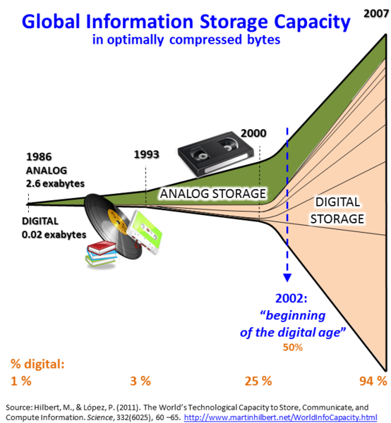
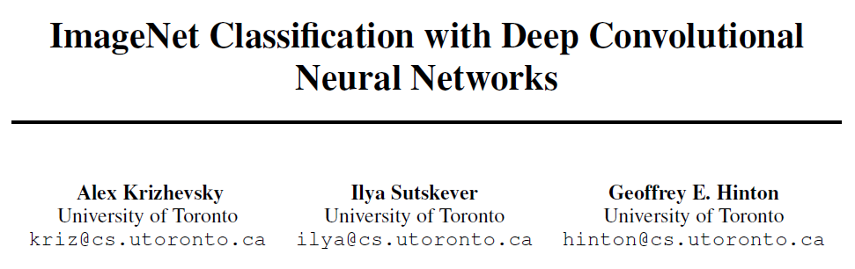

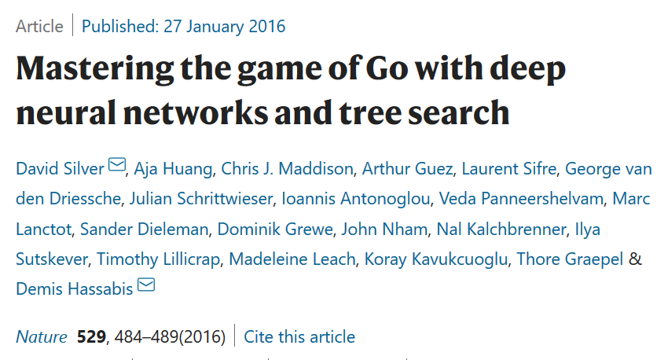
Why now?
Potent hardware
Big data
Methodological advances

Slide 5
How to define artificial intelligence?
imitation of natural intelligence in artificial agents
the science of developing intelligent agents that receive input from the environment and take actions that affect that environment

Slide 6
What is the difference? Artificial intelligence Machine learning Deep learning

Slide 7
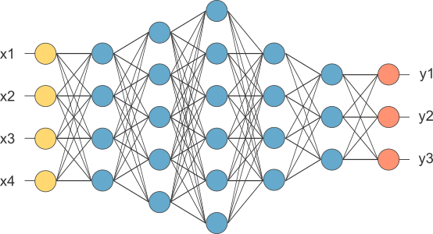
Artificial intelligence
Imitation of natural intelligence in artificial agents
Machine learning
Computers learning from experience (training examples)
Deep learning

Slide 8
What are deep neural networks? How do they learn?

Slide 9
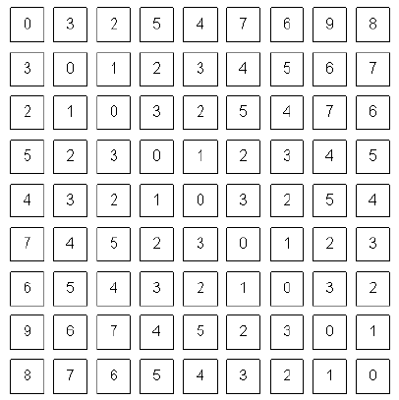
Neural networks are chains of interconnected mathematical operations

Slide 10
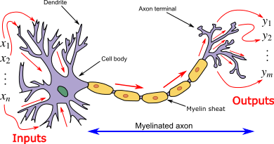
Each network node can have several input and output connections

Slide 11
Network parameters are repeatedly adjusted by feedback to reduce errors

Slide 12
supervised vs unsupervised learning?

Slide 13
Supervised learning
Labeled data (x,y)
Defined target
Aim: mapping function x -> y
Unsupervised learning
Unlabeled data
No defined target
Aim: Learn structure of the data
Semi-supervised learning

Slide 14
Supervised or unsupervised?
Predicting whether patient has COVID-19 from a CT scan of the lung
Determining the severity grade of a tumor from histology images
Clustering cells of similar shape from microscopy images
Tracking bird flightpaths in a video
Outlining areas of deforestation on satellite images
Flagging blurry MRI images
Finding unknown types of image corruption in a large dataset

Slide 15
What fields are included in “medicine and life sciences”?
clinical science, cell biology, ecology, virology, pharmacology, toxicology, marine biology, biochemistry, biotechnology, molecular biology, zoology, botany, neuroscience, genetics, anatomy, bacteriology, astrobiology, bioinformatics, structural biology, embryology, systems biology, epidemiology, paleontology, immunology, developmental biology, ethology, biophysics

Slide 16
Examples of images and videos used in medicine and life sciences?

