Slide 1
Common model architectures and their applications
Sonja Aits
“AI for Medicine and Life Science – AI for image and video data”, Lund University
20211019

Slide 2
Recap from yesterday

Slide 3
Summary: common computer vision tasks
Image classification
Image regression
Object detection
Object tracking
Semantic segmentation
Instance segmentation
Pose estimation
Image registration
Image restoration
Super-resolution
Image captioning
Image clustering
Dimensionality reduction
Image generation

Slide 4
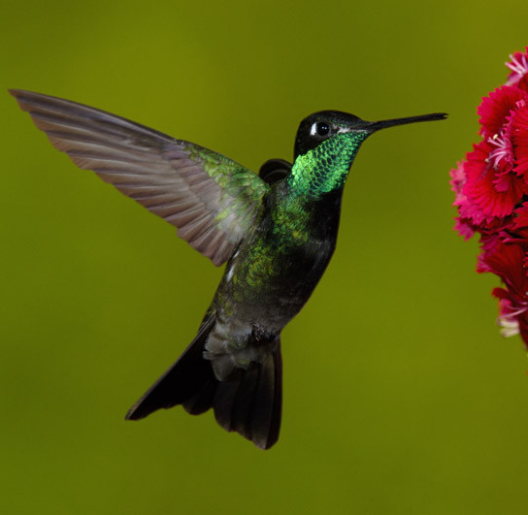
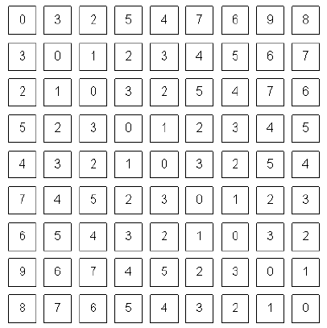
From image to model input
Normalize
Input layer
(tensor) of model
RGB

Slide 5
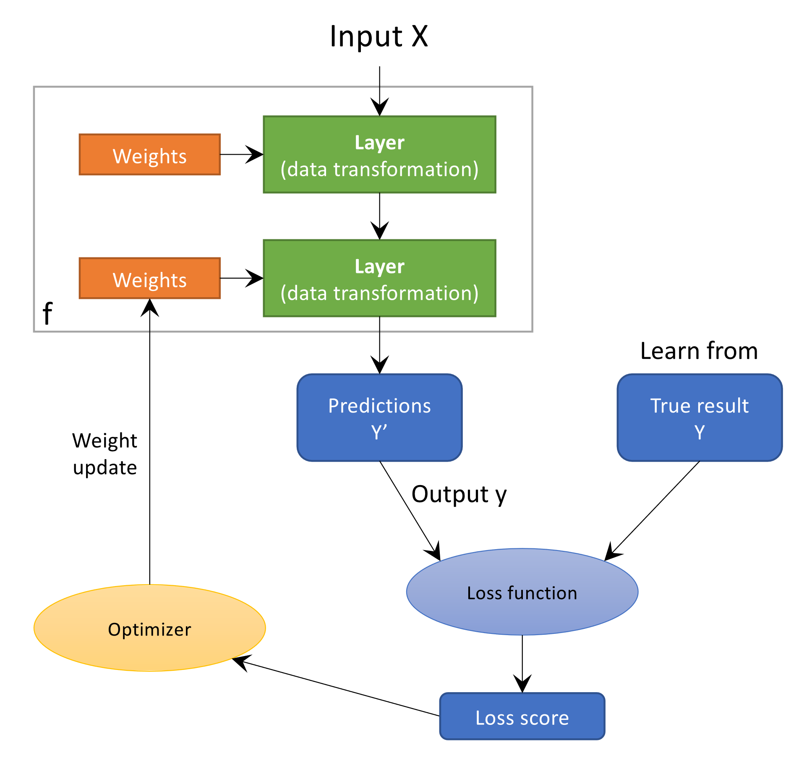
Image by Marcus Klang

Slide 6
Convolutional neural networks (CNNs)
Network type most used for computer vision
Characterized by convolutional layers
Neurons arranged in 3D: width, height, depth
Neurons connected to small area of previous layer
↔ Fully connected network

Slide 7
CNN components
Input layer: holds pixel values of image/video
Convolutional layer: slides filters over input computing dot product
Pooling layer: reduces width and height by pooling (downsampling)
Fully connected layer: every output neuron connected to all input neurons → can recombine all input
Activation layer: applies activation function (element-wise)
Normalization layer: normalizes its input
Dropout layer: randomly sets input units to 0 → prevents overfitting

Slide 8
Simple CNN
Input
layer
Convolution
layer
Activation
layer
Pooling
layer
Fully-connected
layer
0.7
ReLU
pool
FC
0.2
0.1
Filter stack
e.g. 5x5x3x4
Activation
maps
e.g. 28x28x4
e.g. 28x28x4
e.g. 14x14x4
Class scores
e.g. 1x3
height x
width x
depth (channels)
e.g. 32x32x3
Filter depth matches
depth of input
Stack depth
matches number of filters

Slide 9
AlexNet
Output
Softmax
FC
FC
FC
Pool
Conv
Conv
Conv
Pool
Conv
Pool
Alex Krizhevsky, Ilya Sutskever, Geoffrey E. Hinton
NIPS 2012
Conv
Input

Slide 10
VGG networks: repetitive blocks
Convolutions: 3x3, stride 1, pad 1
Max pooling: 2x2, stride 2
Channels doubled after pooling
VGG16: 16 layers
VGG19: 19 layers
→ increase in depth increases performance
Simonyan and Zisserman. 2014. arxiv https://arxiv.org/pdf/1409.1556.pdf

Slide 11
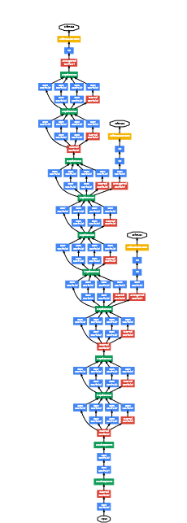
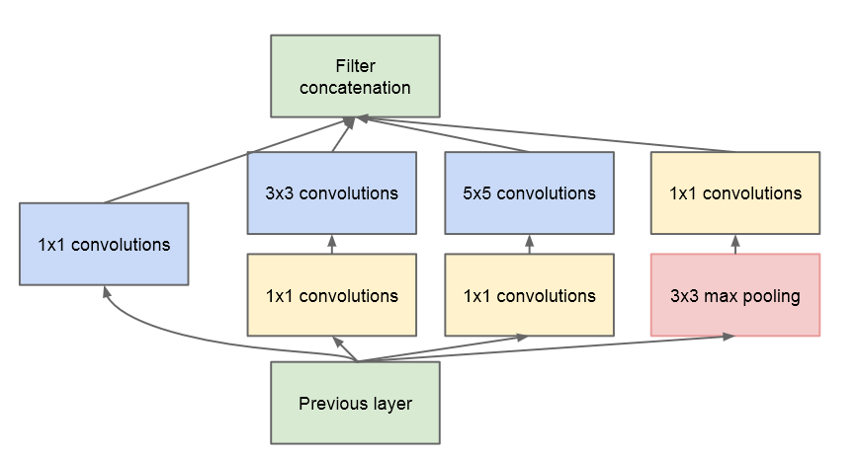
More and more complex networks
GoogLeNet: Inception modules
Szegedy et al. 2014. arxiv. https://arxiv.org/abs/1409.4842

Slide 12
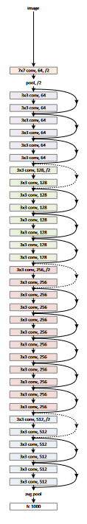
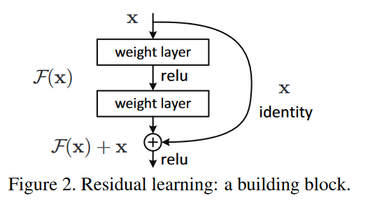
More and more complex networks
ResNets
Up to 152 layers!
He et al. 2015. arxiv. https://arxiv.org/pdf/1512.03385.pdf

Slide 13
Continuous performance gains
https://paperswithcode.com/sota/image-classification-on-imagenet?metric=Top%205%20Accuracy

Slide 14
Transfer learning
Often not beneficial to train neural network from scratch
Largest benefits for small datasets
→ use transfer learning as default
Standard networks pre-trained on ImageNet, e.g. VGG16, ResNet50, EfficientNetB7 (part of deep learning libraries)
Specialist networks trained on data similar to yours (check model zoos)

Slide 15
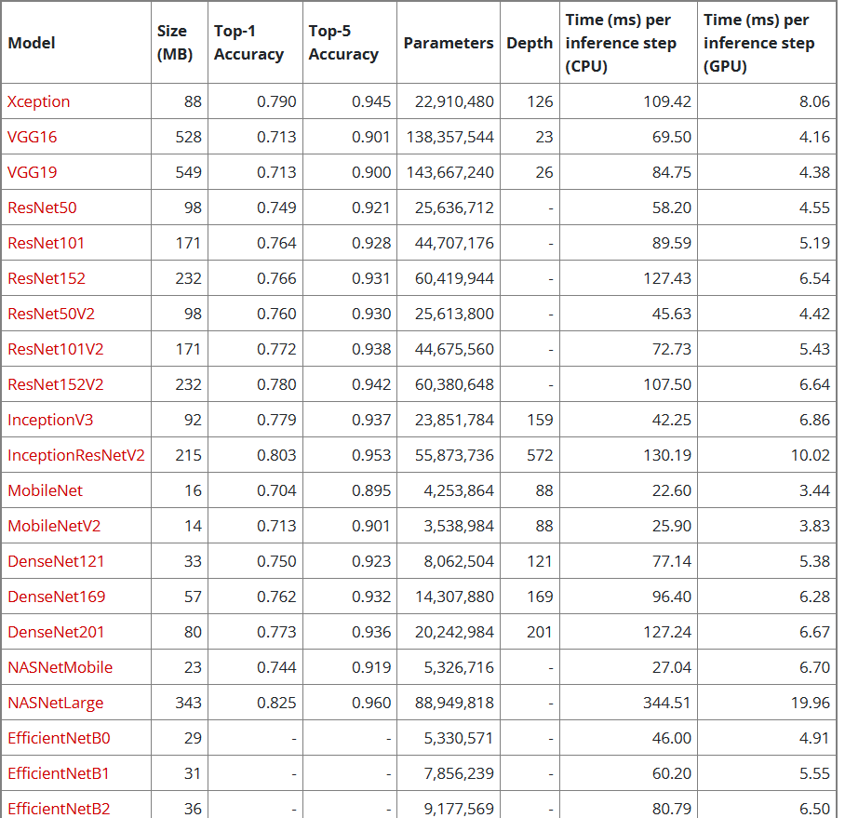
Models in Keras/TensorFlow2 https://keras.io/api/applications/

Slide 16
Transfer learning with “frozen” model as feature extractor
Pre-trained
model
Feature
extraction
FC layer
New FC layer
Train replaced layers
Freeze these layers
Input
Input

Slide 17
Optional fine-tuning possible when larger datasets available
Pre-trained
model
Feature
extraction
Fine-tuning
(optional)
FC layer
New FC layer
Train replaced layers
New FC layer
Unfreeze and train several or all layers with low learning rate
Freeze these layers
Input
Input
Input

Slide 18
CNN applications
Image classification
Image regression
Feature extraction
Reverse image search
As part of more complex networks

Slide 19
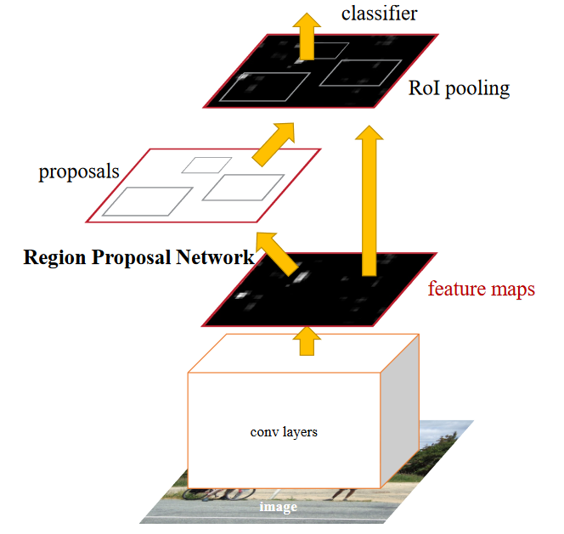
Faster R-CNN for object detection
Two stages:
Region proposal
Object prediction
→ high accuracy
Ren 2015. arxiv. https://arxiv.org/abs/1506.01497

Slide 20
YOLOv3 for real-time object detection
Single-stage object detection:
Network applied to entire image → Image divided into regions and bounding boxes and probabilities predicted for each region
→ very fast but slightly less accurate
Redmon and Farhadi. 2018. arxiv https://arxiv.org/abs/1804.02767

Slide 21
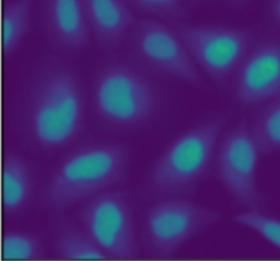
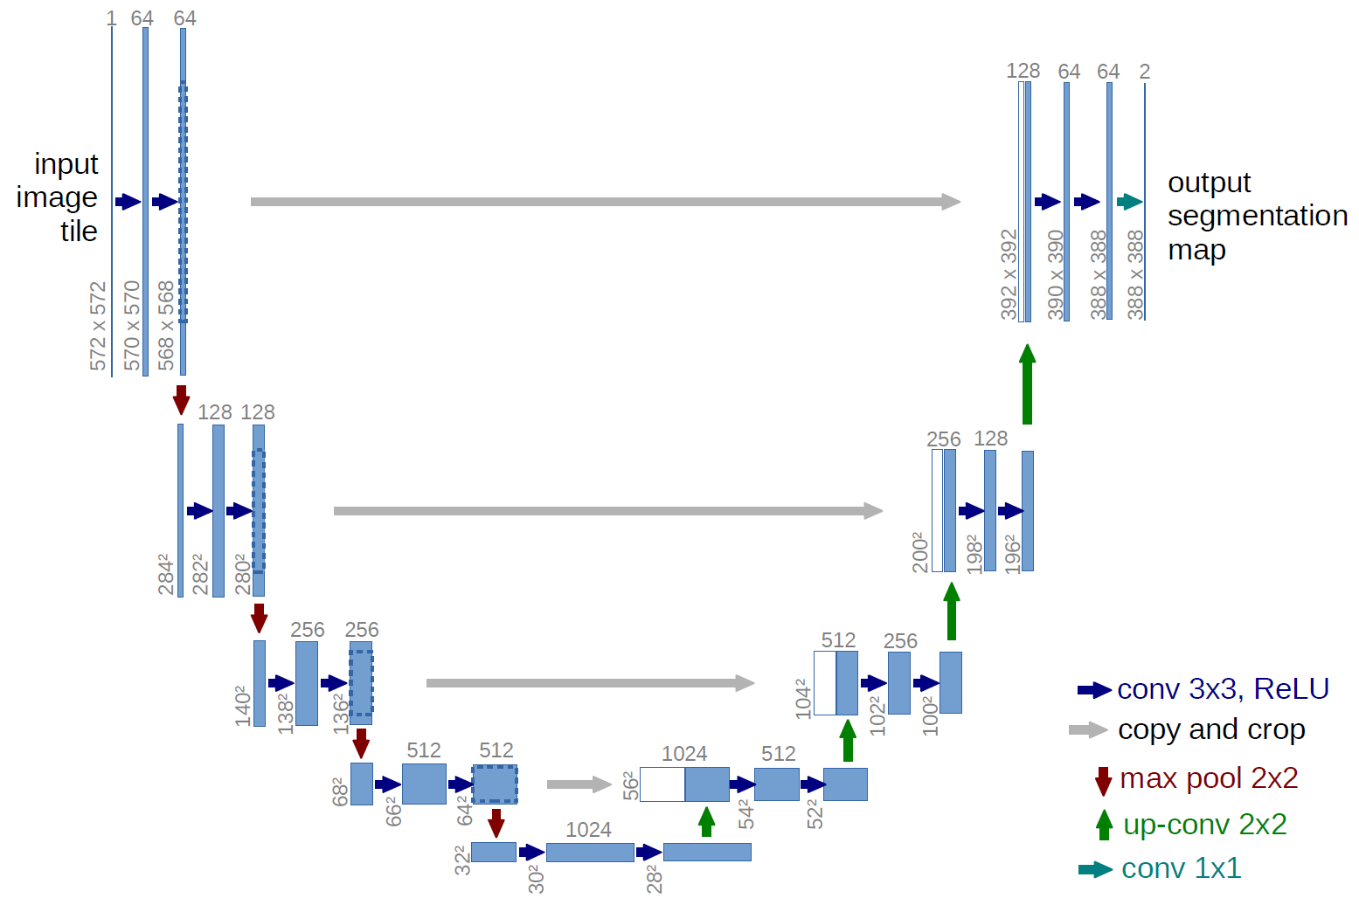
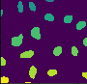
U-nets
Ronneberger et al 2015. arxiv https://arxiv.org/abs/1505.04597

Slide 22
U-nets
Contracting path with repeated blocks (= CNN):
Two 3x3 convolutions (unpadded)
ReLU
2x2 max pooling, stride 2
→ Downsampling
feature channels doubled at each downsampling
→ spatial info decreased, feature info increased
Expanding path with repeated blocks (= CNN):
Up-convolutions
→ Upsampling
Connections between the paths

Slide 23
U-nets: image-to-image applications
Segmentation
Virtual staining
Image restoration
Super-resolution

Slide 24
Autoencoder
Learns to reconstruct input from low-dimensional feature representation
→ feature extraction
No new image generation possible
Output
(reconstructed input)
Input
Encoder
Features
Decoder
Downstream application

Slide 25
Autoencoder applications
Dimensionality reduction
Feature extraction
Denoising

Slide 26
Generative models
Goal: Given a training dataset, create new data from same distribution
Generative adversarial network (GAN)
Variational Autoencoder (VAE)

Slide 27
GANs
Generator
Fake
Generated data
Discriminator
Real data
Real

Slide 28
Applications of GANs
Artificial data generation
Interpolation (e.g. for increasing video frame rate)
Image-to-image translation

Slide 29
Ensembles usually outperform single models
Multiple models with identical hyperparameters and architecture but different random initialization
Selection of best models created during the project (different architectures and hyperparameters)
Same model saved after different epochs
→ predict with each model and combine predictions (e.g. mean or median for regression models, majority vote for classification)

Slide 30
Group exercise
You are working in a small data science consultancy company and are approached by a group of cell biologists who want to “find cool things in their microscopy images” using AI. They tell you that they have 3D-stacks of microscopy images showing two different cell types, each with their outlines and nuclear outlines labeled in different colors. They want to measure the volume of individual nuclei after different treatments in one of the cell types only. Can this be achieved and how? A second challenge is that occasionally one image in a 3D stack has been corrupted resulting in some white patches on the images. Can they be saved somehow? Or can they be found and removed? Try to develop an outline for this project.
What do you need to know about the data?
What different tasks do you have to complete in this multi-step project?
What types of models would you try out for each of the tasks and why did you choose these?

Slide 31
Summary: popular models
Convolutional neural networks
U-nets
Faster R-CNN
YOLOv3
Auto-encoders
GANs

Slide 32
Summary: CNNs and Transfer learning
Convolutional layers as defining characteristic
Large variety of CNN architectures
Can be part of more complex computer vision models
Increases in network depth and complexity increase performance
Transfer learning with networks pre-trained on ImageNet is default choice

